Slide 1
Linked Data in the Library Domain
Focused mainly on traditional library bibliographic data
BIBFRAME
LD4L and LD4P
Different types of resources (Maps, Music, Art works, incunabular…)
Annotation
BIBFLOW
Zpheira
OCLC
Vendor (Ex Libris, Casalini)

Slide 2
Our Project
Experiment with metadata for Special Digital Collections
Use different metadata standards
Use different content standards
Use different controlled vocabularies
Use different manage and discovery systems

Slide 3
Schema.org as a Vehicle for Discovery
Web-friendly data model and vocabulary for all kinds of Web resources
Is under active development with input from the W3C Schema.org Community Group
Supports characteristics of special collections metadata than BIBFRAME
Supported and used by major wen search engines

Slide 4
1. Motley Collection of Theatre and Costume Design (Portraits of Actors, 1720-1920) 2. Kolb-Proust Archive Collection

Slide 5
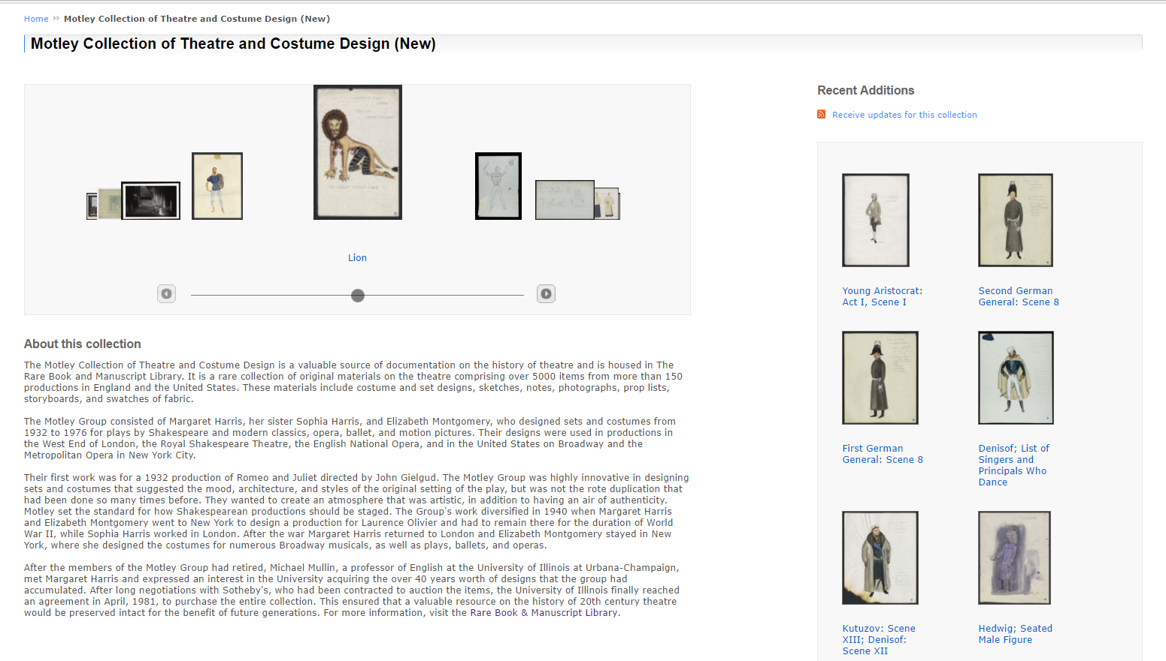
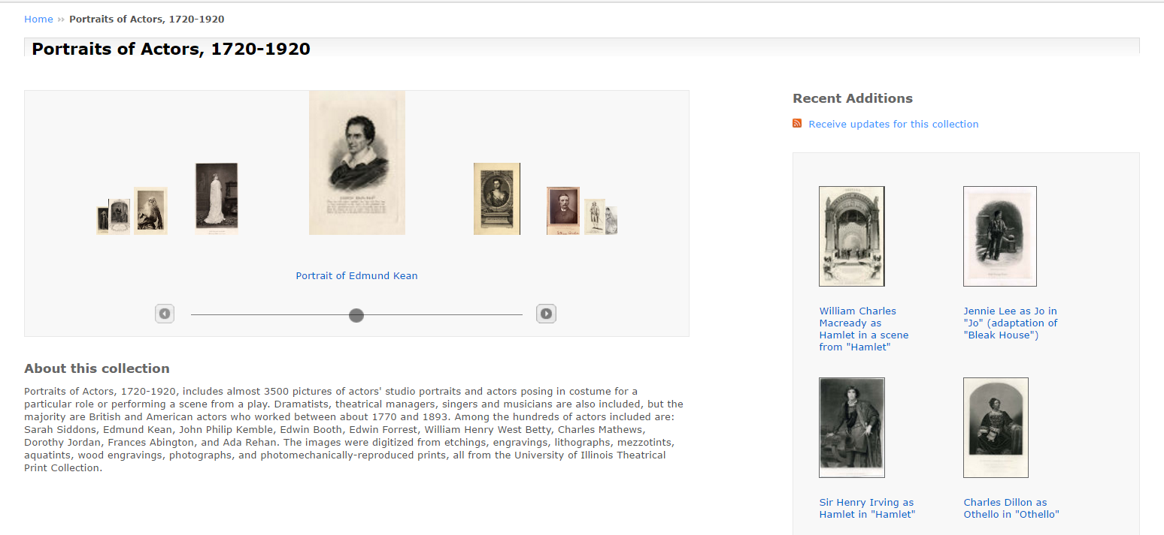

Slide 6
Metadata for Special Collections
Metadata structure is flat
BUT Metadata describes more than one ‘object’
Element name includes contextual information
Multiple values can be included in a single element
Use a specialized/local controlled vocabulary

Slide 7
Original Metadata Describes -
The Original Image
Title of the image
Physical description (size, materials, …)
The Play
Title of the play
The Performance
Theater the play performed
Date of the performance
People
Associated with play (work) - Author or Composer
Associated with performance - Composer, Director, Actor, …
5. The Institution that owns the collection and item

Slide 8
Metadata Workflow
Export metadata
Review
element names and values
Identify and perform metadata enhancement/reconciliation work with linked data sources* and authority data
Mapped local elements to Schema.org and ingested into the system
CONTENTdm
Original data
Add granularity to element names
Enhancement/Reconciliation
HTML+
JSON-LD
*Sources used for the process include Library of Congress (LC) Name Authority Files, Virtual International Authority Files (VIAF), Internet Movie Database (IMDb), Internet Broadway Database (IBDb), Wikipedia, Worldcat Identities, Theatricalia, and many more.

Slide 9
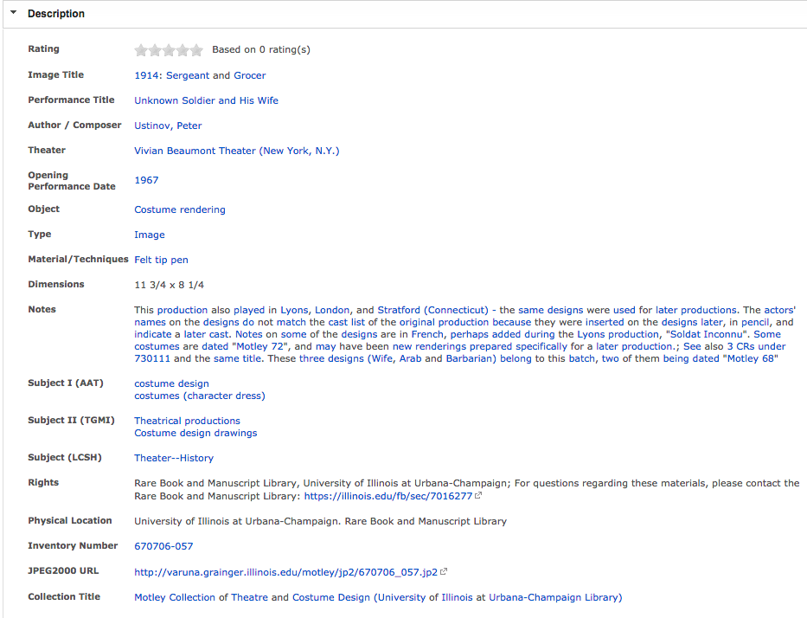

Slide 11
<schema:VisualArtWork>
<schema:name>1914: Sergeant and Grocer
<schema:genre>Costume rendering
<schema:isPartOf>
<schema:CreativeWork> (StageWork)
<schema:locationCreated> http://viaf.org/viaf/140952057
<schema:sameAs>https://...
<schema:dateCreated>1967
<schema:exampleOfWork>
<schema:Book>
<schema:name> Unknown Soldier and …
<schema:author>http://viaf.org/viaf/98273667
<schema:sameAs>http://theatricalia.com/person/r85/ peter-ustinov

Slide 12
<schema:VisualArtWork>
<schema:name>1914: Sergeant and Grocer
<schema:genre>Costume rendering
<schema:isPartOf>
@type: "VisualArtwork",
name: "1914: Sergeant and Grocer",
genre: "Costume rendering",
artform: "Image",
@type: "CreativeWork",
additionalType: "scp:StageWork",
name: "Unknown Soldier and His Wife",
sameAs: [ ],
@id: "https://en.wikipedia.org/wiki/The_Unknown_Soldier_and_His_Wife",
dateCreated: "1967",
locationCreated:
[
{@id: "http://id.loc.gov/authorities/names/n2009004953",
sameAs:
[" https://en.wikipedia.org/wiki/Vivian_Beaumont_Theater "
<schema:CreativeWork> (StageWork)
<schema:locationCreated> http://viaf.org/viaf/140952057
<schema:sameAs>https://...
<schema:dateCreated>1967
<schema:exampleOfWork>
exampleOfWork:
{@type: "Book",
author:
[
{@type: "Person",
@id: "http://viaf.org/viaf/98273667",
sameAs:
["https://en.wikipedia.org/wiki/Peter_Ustinov",
"http://theatricalia.com/person/r85/peter-ustinov"
]
<schema:Book>
<schema:name> Unknown Soldier and …
<schema:author>http://viaf.org/viaf/98273667
<schema:sameAs>http://theatricalia.com/person/r85/ peter-ustinov

Slide 13
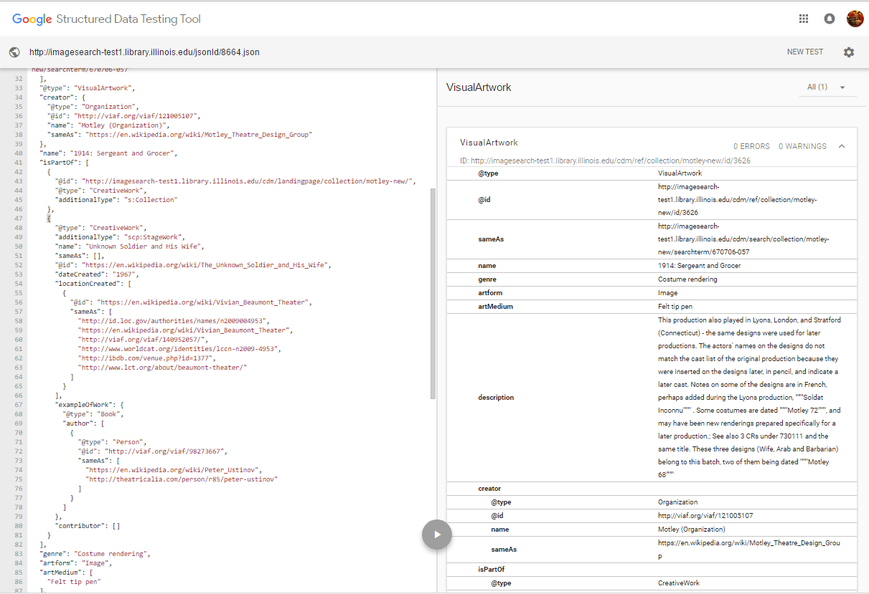

Slide 14
1. Motley Collection of Theatre and Costume Design (Portraits of Actors, 1720-1920) 2. Kolb-Proust Archive Collection

Slide 15
Kolb-Proust Archive – Background (1)
Marcel Proust (1871-1922), French writer, author of Remembrance of Things Past/In Search of Lost Time
Philip Kolb (1907-1992), Professor of French Literature at UIUC 1945-1992, editor of Marcel Proust’s correspondence (Plon, Paris, 1970-1993, 21 volumes)

Slide 16
Kolb-Proust Archive – Background (2)
Proust’s correspondence: 5,000 (out of 20,000?) dispersed, undated, unidentified letters included in 21-volume edition.
Kolb: system of 40,000 notecards organized in cross-referenced card files as tools to edit letters and compile critical apparatus

Slide 17
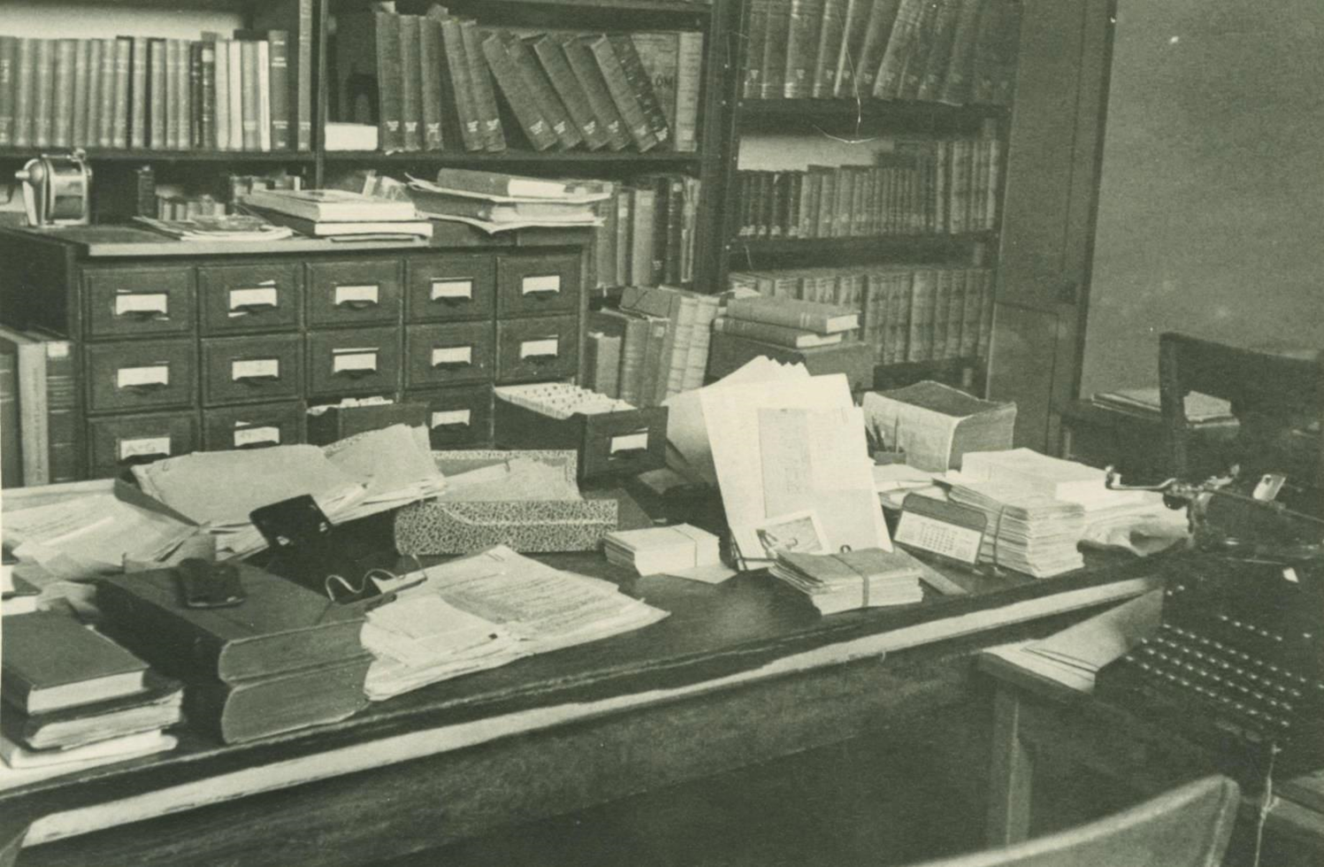
Kolb-Proust Archive – Kolb’s card files
Chronological file
Bibliography of texts by and about Proust
Person file
Correspondence file
Place file
File of literary citations
Periodical file
File of persons not cited in the correspondence

Slide 18
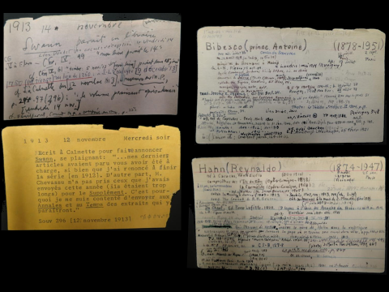

Slide 19
Kolb-Proust Archive Collection’s Metadata
Maintains Name Database
Name
Dates
Family information
Work information
Social circles information
All documents in TEI-XML
Chronology
Bibliography

Slide 20
Encoding Name Database (1)
schema:familyName
schema:givenName
schema:birthDate
schema:deathDate
schema:gender
schema:nationality
schema:knows
schema:spouse
schema:children
schema:parent
schema:sibling
schema:relatedTo
schema:jobTitle

Slide 21
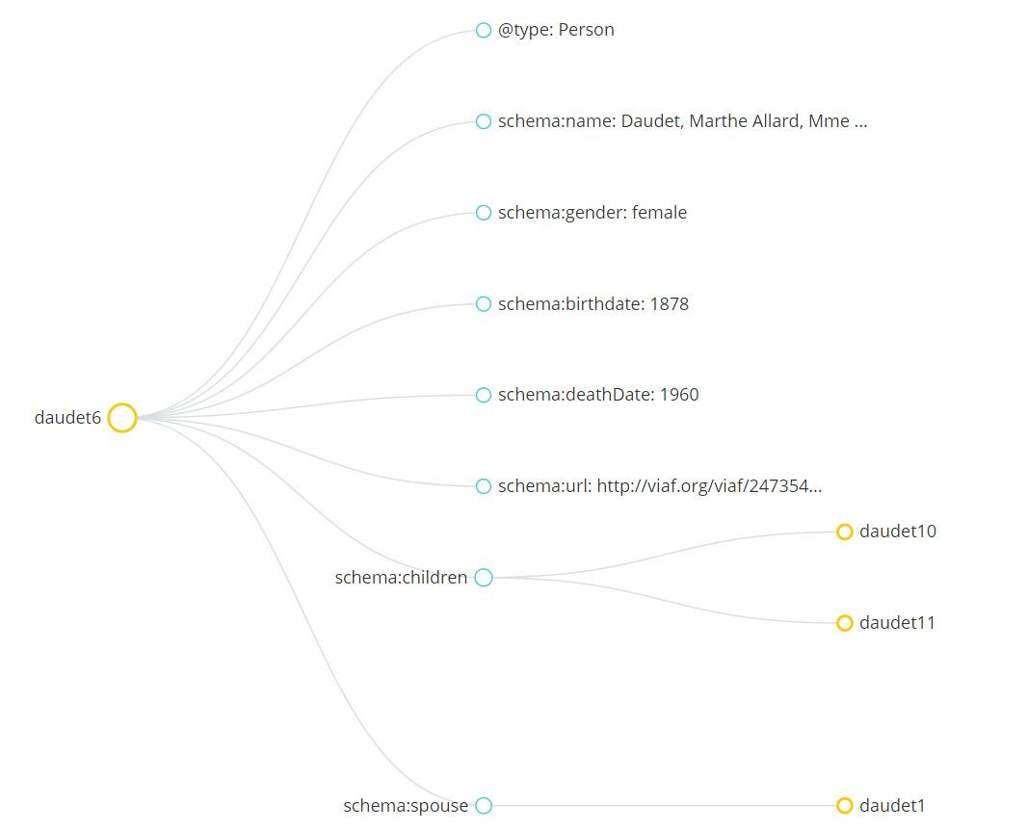
Encoding Name Database (2)
Daudet, Marthe Allard (daudet6) -- 1878-1960, cousine et 2ème femme de Léon”

Slide 22
TEI-Bibliography

Slide 23
Transforming TEI Documents to Schema.org (1)
Book
Article
Field name | Schema.org mapping
TEI | Thing > CreativeWork(s)
TEI@xml:id | scp:standardNumber (text)
div1 > head > date | Not mapped to schema.org
bibl | citation (CreativeWork)
bibl > title | name (Book)
bibl > pubPlace | locationCreated (Book)
bibl > publisher | publisher (Book)
bibl > date | datePublished (Book)
bibl > author | author (Book)
author > name | familyName; givenName (Thing > Person)
p | description (CreativeWork)
Field name | Schema.org mapping
TEI | Thing > CreativeWork(s)
TEI@xml:id | scp:standardNumber (text)
div1 > head > date | Not mapped to schema.org
bibl | citation (CreativeWork)
bibl > title@type=“a” | headline (Article)
bibl > title@type=“j” | name (Periodical)
bibl > date | datePublished (Article)
biblScope@type=“vol” | isPartOf (Article); hasPart (Periodical) volumeNumber (PublicationVolume)
biblScope@type=“issue” | hasPart (PublicationVolume) issueNumber (PublicationIssue)
biblScope@type=“pages” | pagination (Article)
bibl > author | author (CreativeWork)
author > name | familyName; givenName (Thing > Person)
p | description (CreativeWork)

Slide 24
Transforming TEI Documents to Schema.org (2)
<TEI xml:id="DIV4820">
<teiHeader type="TEXT"> ... </teiHeader>
<text>
<body>
<div1 org="uniform" part="N" sample="complete">
<head><date when="19720000">1972</date></head>
<div2 org="uniform" part="N" sample="complete">
<bibl default="false">
<author>, <name>Guiral, Pierre</name>, <name>Temime, Émile</name>, <name>Proust, Marcel</name></author>, <title level="m"><rs>La Société française 1914-1970 à travers la littérature</rs></title>, <pubPlace>Paris</pubPlace>, <publisher>Librairie Armand Colin</publisher>, <date when="19720000">1972</date>.</bibl>
</div2>
<div2 org="uniform" part="N" sample="complete">
<p>Pp. 7-221.</p>
<p>Extrait du <title level="m"><rs>Temps Retrouvé</rs></title>, III, p. 764-766: "La guerre et la mode".</p>
</div2>
</div1>
</body>
</text>
</TEI>
<schema:Book id=“DIV4820”>
<schema:author>
<schema:citation>Guiral, Pierre, Temime, Émile, Proust, Marcel, La Société française 1914-1970 à travers la littérature, Paris, Librairie Armand Colin, 1972.
<schema:name>La Société française 1914-1970 à travers la littérature
<schema:locationCreated>Paris
<schema:publisher>Librairie Armand Colin
<schema:datePublished>1972
<schema:description>Pp. 7-221. Extrait du Temps Retrouvé, III, p. 764-766: 'La guerre et la mode'
<schema:Person>
<schema:familyName>Guiral <schema:givenName>Pierre
…

Slide 25
Transforming TEI Documents to Schema.org (3)
<TEI xml:id="DIV5000">
<teiHeader type="TEXT"> ... </teiHeader>
<text><body> ...
<div2 org="uniform" part="N" sample="complete">
<bibl default="false">
<author>
<name>Bonnet, Henri</name>, <name>Robert, Pierre</name> (<name>Proust, Marcel</name>)</author>,
<title level="a"><rs>Jean de Pierrefeu et Marcel Proust: une correspondance inédite, janvier-décembre 1920</rs></title>,
<title level="j"><rs>Revue d'Histoire litt. F.</rs></title>,
<date when="19790900">septembre</date>- <date when="19791000">octobre 1979</date>,
<biblScope type="vol">79e année, t. 79 </biblScope>, <biblScope type="issue">n. 5</biblScope>,
<biblScope type="pages">p. 800-823</biblScope>.</bibl>
</div2>
<div2 org="uniform" part="N" sample="complete">
<p>4 lettres de Marcel Proust:</p>
...
</TEI>
<schema:Article id=“DIV5000”>
<schema:author>
<schema:headline>Jean de Pierrefeu et Marcel Proust: une correspondance inédite, janvier-décembre 1920
<schema:datePublished>septembre-octobre 1979
<schema:pagenation>p. 800-823
<schema:description>4 lettres de Marcel Proust: …
<schema:isPartOf>
<schema:citation>Bonnet, Henri, Robert, Pierre (Proust, Marcel), Jean de Pierrefeu et Marcel Proust: une correspondance inédite, janvier-décembre 1920, Revue d'Histoire litt. F. septembre-octobre 1979, 79e année, t. 79, n. 5, p. 800-823.
<schema:Periodical>
<schema:name>Revue d'Histoire litt. F.
<schema:hasPart>
<schema:PublicationVolume>
<schema:volumeNumber>79e année, t. 79
<schema:hasPart>
<schema:Person>
<schema:familyName>Bonnet <schema:givenName>Henri
…
<schema:PublicationIssue>
<schema:issueNumber>n. 5

Slide 26
Transforming TEI Documents to Schema.org (4)
<schema:Book id=“DIV4820”>
<schema:author>
<schema:name>La Société française 1914-1970 à travers la littérature
<schema:locationCreated>Paris
<schema:publisher>Librairie Armand Colin
<schema:datePublished>1972
<schema:description>Pp. 7-221. Extrait du Temps Retrouvé, III, p. 764-766: 'La guerre et la mode'
{
"@context": [
"http://schema.org/",
{
"s": "http://schema.org/",
"scp": "http://ns.library.illinois.edu/scp"
}],
"@id": "http://kolbproust.library.illinois.edu/proust/DIV4820",
"@type": "Book",
"url": "http://kolbproust.library.illinois.edu/proust/DIV4820",
"author": [
{ "@type": "Person", "s:familyName": "Guiral", "s:givenName":"Pierre" },
{ "@type": "Person", "s:familyName": "Temime", "s:givenName":"Émile" },
{ "@type": "Person", "s:familyName": "Proust", "s:givenName":"Marcel" }
],
"name": "La Société française 1914-1970 à travers la littérature",
"locationCreated": "Paris",
"publisher": "Librairie Armand Colin",
"datePublished": "1972",
"description": ["Pp. 7-221.","Extrait du Temps Retrouvé, III, p. 764-766: 'La guerre et la mode'"],
"citation": "Guiral, Pierre, Temime, Émile, Proust, Marcel, La Société française 1914-1970 à travers la littérature, Paris, Librairie Armand Colin, 1972. "
}
<schema:Person>
<schema:familyName>Guiral <schema:givenName>Pierre
…

Slide 27
Transforming TEI Documents to Schema.org (5)
<schema:Article id=“DIV5000”>
<schema:author>
<schema:name>Jean de Pierrefeu et Marcel Proust: une correspondance inédite, janvier-décembre 1920
<schema:datePublished>septembre-octobre 1979
<schema:pagenation>p. 800-823
<schema:description>4 lettres de Marcel Proust: …
<schema:isPartOf>
{
"@context": [
"http://schema.org/",
{ "s": "http://schema.org/",
"scp": "http://ns.library.illinois.edu/scp" }],
"@id": "http://kolbproust.library.illinois.edu/proust/DIV5000",
"@type": "Article",
"url": "http://kolbproust.library.illinois.edu/proust/DIV5000",
"author": [
{ "@type":"Person", "s:familyName": "Bonnet", "s:givenName":"Henri"},
... ],
"headline": "Jean de Pierrefeu et Marcel Proust: une correspondance inédite, janvier-décembre 1920",
"isPartOf": [
{"@type": "Periodical",
"s:name": "Revue d'Histoire litt. F.",
"s:hasPart":
[{ "@type": "PublicationVolume",
"s:volumeNumber": "79e année, t. 79",
"s:hasPart": {
"@type": "PublicationIssue",
"s:issueNumber": "n. 5" }}]}],
"pagination":"p. 800-823",
"datePublished": ["1979-09-00", "1979-10-00","septembre","octobre 1979"],
"description": ["4 lettres de Marcel Proust:",...],
"citation": "Bonnet, Henri, Robert, Pierre (Proust, Marcel), ..."
}
<schema:Periodical>
<schema:name>Revue d'Histoire litt. F.
<schema:hasPart>
<schema:Person>
<schema:familyName>Bonnet <schema:givenName>Henri
…
<schema:PublicationVolume>
<schema:volumeNumber>79e année, t. 79
<schema:hasPart>
<schema:PublicationIssue>
<schema:issueNumber>n. 5

Slide 28
TEI-Chronology

Slide 29
Transforming TEI Documents to Schema.org (1)
Field name | Schema.org mapping
div0 | *Thing > Event
div0@id | scp:standardNumber (text or URL)
div0 > head > date | startDate (Event), endDate(Event)
bibl | citation (CreativeWork) recordedIn (Event)
bibl (datePublished) | datePublished (CreativeWork)
bibl (pageStart) | pageStart (CreativeWork)
bibl (pageEnd) | pageEnd (CreativeWork)
title | name (CreativeWork)
title@type | genre (CreativeWork)
name | familyName; givenName (Thing > Person)
*A subcategory of Event can be used, if applicable.

Slide 30
Transforming TEI Documents to Schema.org (2)
<div0 id="c20090" type="card">
<head>
<date value="18990000">1899</date>
</head>
<div1 type="subdiv">
<bibl>Proust. <title type="es">La Peste de Vienne et le danger que peut faire courir à l'Europe la peste du Turkestan.</title> <title>Comptes-rendus des séances de l'Académie des sciences morales et politiques</title>, 59e année, p. 4
</bibl>
<bibl>Cf. 1897: Proust. <title type="es">La conférence sanitaire internationale de Venise de 1897</title>, <title level="j">Revue d'Hygiène</title>, vol. XIX, p. 7
</bibl>
<bibl>Cf. 1897: Proust. <title type="es">La défense de l'Europe contre la peste.</title> <title>Comptes-rendus des séances de l'Académie des sciences morales et politiques</title>, 57e année, p. 4
</bibl>
</div1>
</div0>
<schema:Event id=“c20090”>
<schema:startDate>1899 <schema:endDate>1899
<schema:recordedIn>
<schema:CreativeWork>
<schema:citation>Proust. La Peste de Vienne et le danger que peut faire courir à l'Europe la peste du Turkestan. Comptes-rendus des séances de l'Académie des sciences morales et politiques, 59e année, p. 4
<schema:genre>prose nonfiction

Slide 31
Transforming TEI Documents to Schema.org (3)
{
...
"@id": "http://kolbproust.library.illinois.edu/proust/c20090",
"@type": "Event",
"startDate": "1899",
"endDate": "1899",
"name": "c20090",
"url": "http://kolbproust.library.illinois.edu/proust/c20090",
"location": "na",
"recordedIn": [
{
"@type":"CreativeWork",
"s:url": "http://kolbproust.library.illinois.edu/proust/c20090",
"s:citation": "Proust. La Peste de Vienne et le danger que peut faire courir à l'Europe la peste du Turkestan. Comptes-rendus des séances de l'Académie des sciences morales et politiques, 59e année, p. 4",
"s:genre": "prose nonfiction"
},
...
]
}
<schema:Event id=“c20090”>
<schema:startDate>1899 <schema:endDate>1899
<schema:recordedIn>
<schema:CreativeWork>
<schema:citation>Proust. La Peste de Vienne et le danger que peut faire courir à l'Europe la peste du Turkestan. Comptes-rendus des séances de l'Académie des sciences morales et politiques, 59e année, p. 4
<schema:genre>prose nonfiction

Slide 32
Name Reconciliation Work

Slide 33
Sources Consulted in Manual Process
Sources Supporting Linked Data
Other Web Resources
Library of Congress (LC) Name Authority Files
Virtual International Authority File (VIAF)
Internet Movie Database (IMDb)
Internet Broadway Database (IBDb)
Wikipedia
Worldcat Identities
Canadian Theatre Encyclopedia
Encyclopedia Britannica
Turner Classic Movies
Goodreads
Obituaries in various digital newspapers
Australian Dictionary of Biography
doollee.com
Opera Scotland
Copies of text on Amazon Books
Theatricalia

Slide 34
Automatic vs Manual
(Motley Collection) | Total No. | Sources | Manual | Automatic
Personal Names | 916 | VIAF/LCNAF | 197 | 477
 |  | WorldCat | 93 | n/a
 |  | WikiPedia | 356 | 331
 |  | IMDb | 388 | n/a
 |  | Theatricalia | 533 | n/a
 |  | IBDb | 49 | n/a
 |  | Britannica | 18 | n/a
Theater Names | 11 | VIAF | 10 | 6
 |  | WikiPedia | 8 | 2

Slide 35
Challenges Identified
Original metadata quality
Variant name forms
No specific roles the name played for the play
Not all names have authorized headings
Not all names are well-known outside of theater world
Not all names created ‘WORKS’
Not all sources support linked data structure
But it provides additional contextual information for names that do not have authorized headings!
It requires manual search!

