Slide 1
Advisory Board Meeting 27 March 2017 Chicago, IL USA Exploring the Benefits of LOD for Digitized Special Collections
Timothy W. Cole
University of Illinois at Urbana-Champaign

Slide 2
the project
PI: Tim Cole, co-PIs: MJ Han, Caroline Szylowicz collaboration of the UIUC Library and iSchool / CIRSS
Sponsor: Andrew W. Mellon Foundation; total award: $248,000.
Collections:
Motley Collection of Theater & Costume Design (images, CONTENTdm)
Portraits of Actors, 1720 – 1920 (images, CONTENTdm)
Kolb-Proust Research Archive (text, XTF)
Timeframe:
Planned: 1 November 2015 through 30 June 2017
No cost extension request pending would move end date to 31 December

Slide 3
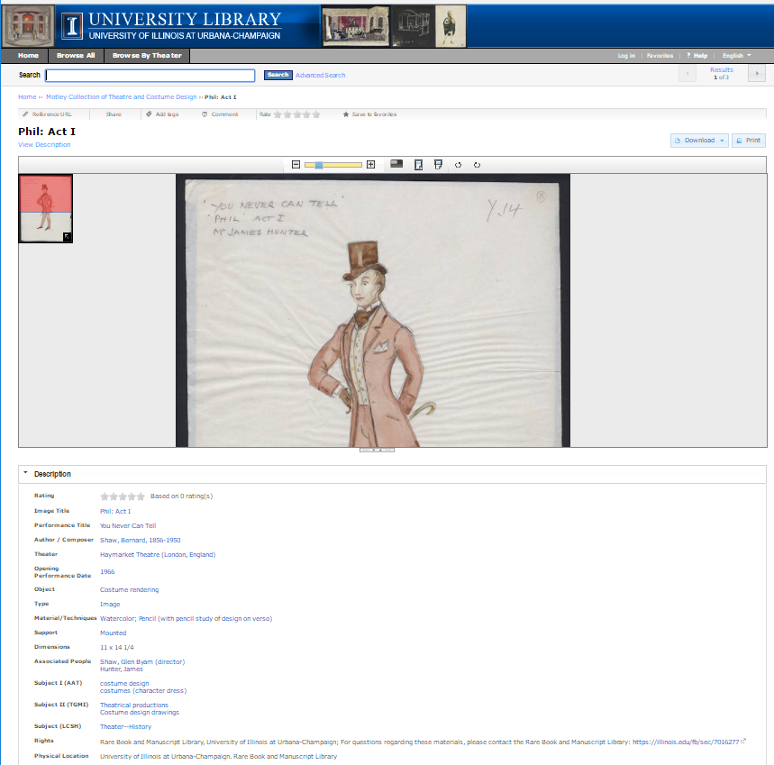
starting point
Siloed collections
no links to related information on the Web
Rich metadata, but…
semantics start with Dublin Core / teiHeader & get worse from there
Indexed by Google, et al., but…
poor rank, discoverability
not in Google images search

Slide 4
research questions
Goal is to incrementally improve understanding, not to definitively answer:
Item-level metadata for digitized special collections more granular, richer, and expressed using custom vocabularies. What unique challenges are encountered when transforming legacy special collections metadata into more LOD friendly semantics?
Often interfaces used to discover and view these collections are disconnected from other library collections & services. Can LOD reconnect library collections?
Often these collections are also disconnected from external, non-library information resources on the Web. Can LOD help connect to these resources? Can these resources enrich special collections metadata in real time?
Often special collection item metadata include extensive references to people and relationships. Can emerging network visualization and annotation technologies add a perspective that complements traditional bibliocentric perspectives?
Doing more than just making RDF metadata; but less than creating reasoning engines

Slide 5
deliverables (& progress to date)
White Paper #1 describing reconciliation & transformation, workflows implemented, resources required and lessons learned;
Scripts & code used in reconciling and transforming legacy metadata (To be released via GitHub with UIUC/NCSA license);
White Paper #2 describing strategies and early user feedback on our use of LOD descriptions of digitized special collections to connect collections to the larger Web;
Extensions to special collection image services to accommodate LOD - initially CONTENTdm, but also for locally-developed system (Released via GitHub, as above).
Extensions to XTF (i.e., XSLTs) to accommodate transformed Kolb-Proust LOD (Released via GitHub, as above.)
Prototype interface for viewing the social network of Proust: Code may not be easily adaptable, but will help demonstrate proof-of-concept. (Released via GitHub, as above.)

Slide 6
where do you come in?
Feedback on overall project progress, and progress on each deliverable.
Feedback on early drafts of first white paper components. Specifically, thoughts on metadata remediation, reconciliation and mappings to schema.org?
Feedback on enrichment methods and workflows. Suggestions for other sources of LOD, or other methods of automating identification of relevant resources? Suggestions for ways to save time or increase accuracy?
Feedback on preliminary interface re-design and user testing. Suggested changes to interface or information generated? Suggested changes with an eye to UX?
Please engage us today in conversation… our rough agenda is only a starting point

Slide 7
today’s agenda
09:15 - Board feedback on work to date (will include a break midway):
Demo of how LOD has been integrated into Motley collection search and browse resource
Mapping Motley and Portraits of Actors Collection metadata to schema.org
Strategies used to identify and add links to existing descriptions
Marking up Proust network of names and mapping Kolb's notes to schema.org
Summary and preliminary observations from baseline Google analytics data and benchmark round of user testing; plans for Motley testing on new interface this spring
12:00 - Lunch & discussion
01:00 - Work in progress
Ideas for axes of interest for visualizing and annotating the social network of Marcel Proust
Ideas for replacing and migrating from CONTENTdm
02:15 - Wrap-up, action items & takeaways
03:00 - Adjourn

Slide 8
possible outcomes, action items, follow-up
Suggestions for developing use cases and approach to Kolb-Proust social network visualization. What potential tools and features could be employed to meet needs of use cases? What are the interesting name / relationship attributes to visualize?
Suggestions for prioritizing and organizing remaining work. Any synergistic projects / groups with which it could be valuable for project team to engage? Other thoughts on work in this realm?
Suggestions for action items and follow-on tasks. Discussion of next steps to recommend to Mellon, or other interested funders, as part of potential new projects for this, or other, groups

Slide 9
an additional overview
Draft paper shared last week was submitted to (and rejected by) JCDL
The paper addresses many relevant aspects for digital library practitioners. The work carried out so far is interesting and the position/vision of the authors is interesting to follow. But the paper does not make any attempt to support its arguments with studies, evaluations, etc.
There is a core of current work related to the use of schema.org for vocabularies and the challenges of mapping to these from the various remarks held in the DC records of the archive collections they were working with. I like their reasoning for using schema.org - basically in looking at how to utilize LOD in the archive to improve discoverability rather than as an inventory mechanism, discoverability across collections - i.e. using the LOD approach (along with the schema.org vocabularies) to improve the interconnections between archive collections. A report of this initial mapping work along with the initial UI work over their ContentDM collection would have made a stronger statement as a short paper.
It seems Sections 4.3 and 4.4 are more like proposes based on other similar implementations as the examples used are not based on the project. Please clarify in writing.
It would be great to have lessons learned like statements for each steps for more general application of the project experience.
One final comment, on a particular point. The abstract and section 3.1 indicate that the metadata in use is Dublin Core based, which we found very misleading. The mapping presented in section 3.2 shows data elements with very detailed semantics, not the general semantics that characterizes Dublin Core.
This work would more suitable for presentation at the JCDL2017's practitioners day, as a poster.

Slide 10
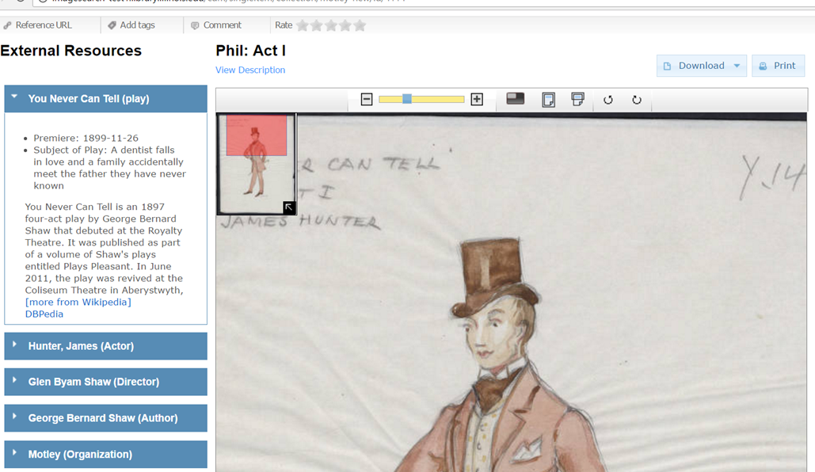
examples - getting a sense of our vision
http://imagesearch-test1.library.illinois.edu/cdm/singleitem/collection/motley-new/id/4114
http://imagesearch-test1.library.illinois.edu/cdm/singleitem/collection/motley-new/id/240
http://imagesearch-test1.library.illinois.edu/cdm/singleitem/collection/motley-new/id/4453
http://imagesearch-test1.library.illinois.edu/cdm/singleitem/collection/motley-new/id/4329
http://imagesearch-test1.library.illinois.edu/cdm/compoundobject/collection/motley-new/id/4820

