Slide 1



Making is For Everyone: Lessons Learned from Library Makerspaces for Youth with Disabilities
Dr. Yong Ju Jung, Moses Munyao, and Dr. June Abbas
School of Library and Information Studies
University of Oklahoma
yongju@ou.edu | jmabbas@ou.edu
2025 Library Makerspace Research Showcase

Slide 2
PROJECT OVERVIEW
“Making is For Everyone: Learning within Library Makerspaces for Youth with Disabilities”
- IMLS funded research (LG-252323-OLS-22)
2022-2023
2023-2024
2024-2025
Nationwide surveys & interviews
On-site visit to 5 exemplary public libraries
Additional visits; Developing design guidelines

Slide 3

2025 Library Makerspace Research Showcase
Rationale of Our Study
Growing attention to patrons with disabilities in makerspaces and maker-based learning (Allen et al., 2023; Anderson & Phillips, 2023; Seo, 2019), but...
Lack of research on libraries' actual practices and library professionals' actual experiences and perceptions
Lack of library makerspaces' attention to youth with disabilities
Contact: Dr. June Abbas jmabbas@ou.edu | Dr. Yong Ju Jung yongju@ou.edu

Slide 4
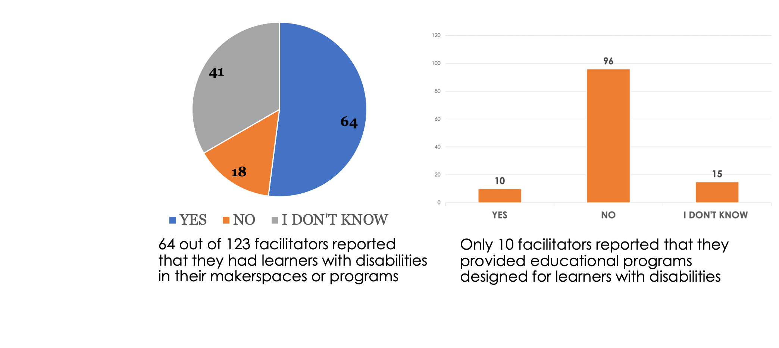
2025 Library Makerspace Research Showcase
Survey Results
Contact: Dr. June Abbas jmabbas@ou.edu | Dr. Yong Ju Jung yongju@ou.edu

Slide 5
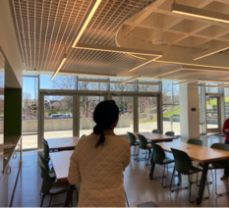
2025 Library Makerspace Research Showcase
Lessons Learned from Interviews and Site Visits
Physical space readiness: ADA... but more!
  Accessibility in the space:
    Outlets; height-adjustable and movable AND safe tables and chairs; noise-dampening headphones; adaptive scissors
  Accessibility to the space:
    Entrance, parking lot, elevators
  Inclusivity in the space:
    Utilizing sensory rooms;
    operation of sensory/low-stimulation hours
Contact: Dr. June Abbas jmabbas@ou.edu | Dr. Yong Ju Jung yongju@ou.edu

Slide 6
2025 Library Makerspace Research Showcase
Lessons Learned from Interviews and Site Visits
Staff mindset:
Believe in everyone's abilities!
  "They [youth with disabilities] engage in everything with everybody else, it’s just accommodations"
  Further, library professionals from exemplary libraries reported that this is not enough; they emphasized more proactive actions.
Contact: Dr. June Abbas jmabbas@ou.edu | Dr. Yong Ju Jung yongju@ou.edu

Slide 7
2025 Library Makerspace Research Showcase
Lessons Learned from Interviews and Site Visits
Reach actively and proactively
Invite learners with disabilities to existing opportunities
  Statement (e.g., on the website) that anyone who needs accommodations can reach out with a specific person in charge and contact information
  Proactively reach out to related community organizations and schools
Contact: Dr. June Abbas jmabbas@ou.edu | Dr. Yong Ju Jung yongju@ou.edu

Slide 8
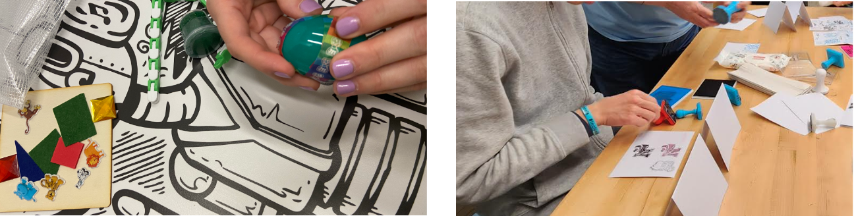
2025 Library Makerspace Research Showcase
Lessons Learned from Interviews and Site Visits
Reach actively and proactively
  Develop exclusive maker-based programs for youth with disabilities
    Specifically for youth with disabilities (but open to anyone)
    Newly design programs in conversations with the organizations and special education teachers; for the needs of youth with disabilities
Contact: Dr. June Abbas jmabbas@ou.edu | Dr. Yong Ju Jung yongju@ou.edu

Slide 9
2025 Library Makerspace Research Showcase
Lessons Learned from Interviews and Site Visits
Flexibility during a session
Provide personalized scaffolding and flexibility by considering different interests and flexibility in their choice-making
  e.g., Having a child draw Mickey Mouse cartoons during a flower-drawing program
  Tinker together with their own abilities
    e.g., helping a customer with a physical disability make a creative hand with a potato masher for sewing activities.
Contact: Dr. June Abbas jmabbas@ou.edu | Dr. Yong Ju Jung yongju@ou.edu

Slide 10
2025 Library Makerspace Research Showcase
Lessons Learned from Interviews and Site Visits
Staffing and resources in library
One library had a dedicated staff member who is in charge of accessibility and actively partner with different departments in the library system (including their STEAM team)
A few libraries offered staff training on patrons with disabilities
Contact: Dr. June Abbas jmabbas@ou.edu | Dr. Yong Ju Jung yongju@ou.edu

Slide 11
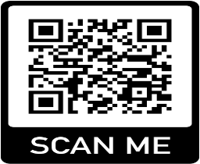
2025 Library Makerspace Research Showcase
Moving Forward
Additional visits
Developing design principles for library makerspaces and maker programming
https://makingforall.oucreate.com/ ​
This project was generously supported by the Institute of Museum and Library Services
(IMLS # LG-252323-OLS-22).​
Thank You!
Contact: Dr. June Abbas jmabbas@ou.edu | Dr. Yong Ju Jung yongju@ou.edu

