Slide 1
Connected Spaces: A Technological Framework for Fostering Collaboration by Linking Novice Makers with Mentors and Peers
Mike Tissenbaum, University of Illinois
Nathan Holbert, Columbia University

Slide 2
Re-envisioning making education in an increasingly distributed landscape
Effective and reliable learning environments are those that help learners connect, collaborate, and build communities in both co-located and distributed systems.

Slide 3
Connected Spaces (C/S)
A technological toolkit and design framework to connect geographically distributed middle and high school learners interested in fabrication and making to like-minded colleagues

Slide 4
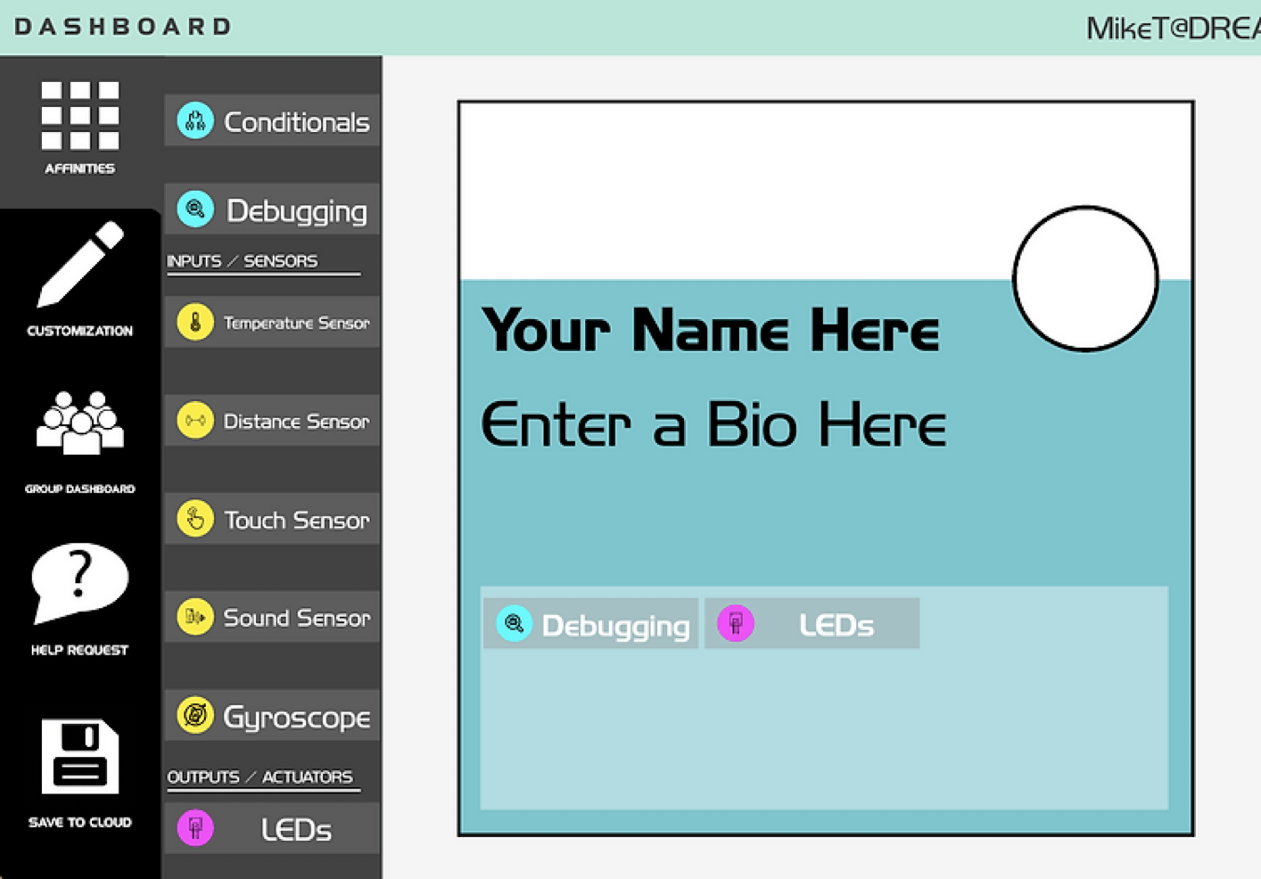
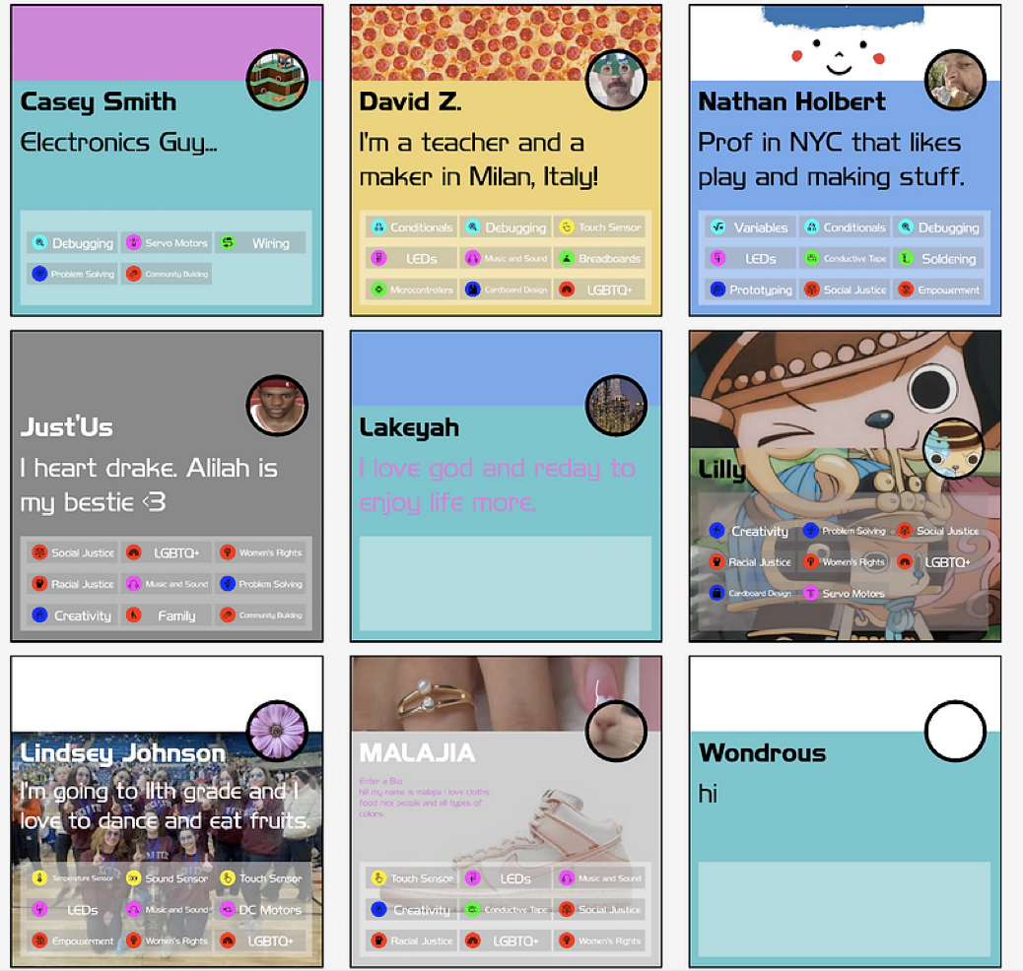
CxS Dashboard

Slide 5
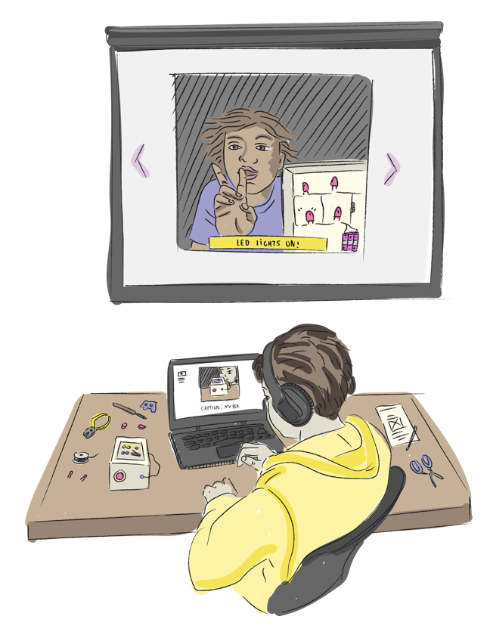
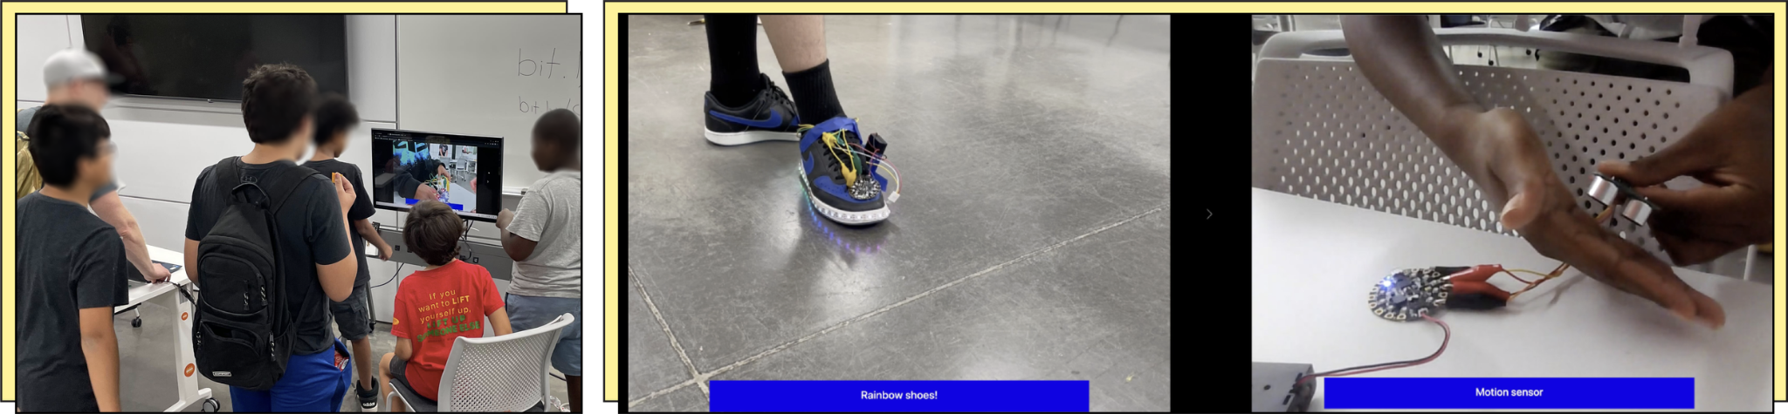
Make-in-Progress
Make-in-Progress is a tool that enables students to quickly and easily capture photos or videos of their work, add a brief caption, and instantly publish them to carousel displays located in geographically distributed makerspaces.
Additional multimodal generative AI supports makers and educators in probing the database towards productive ends. For example, students might ask the system to generate a slideshow of their extended maker project, or a teacher might ask the system to identify new materials or needs a student group might have for their project.

Slide 6
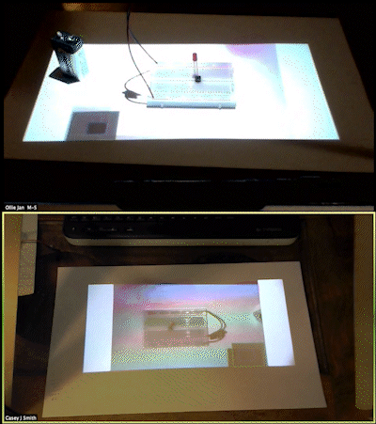
REACH Projector
Allows for real-time embodied collaboration between peers and/or near-peer mentors even when physically distant.

Slide 7
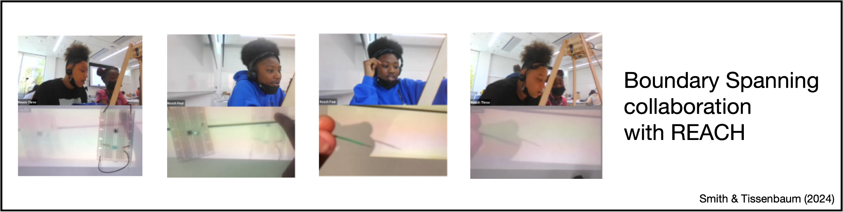
Facilitating new forms of collaborative making

Slide 8
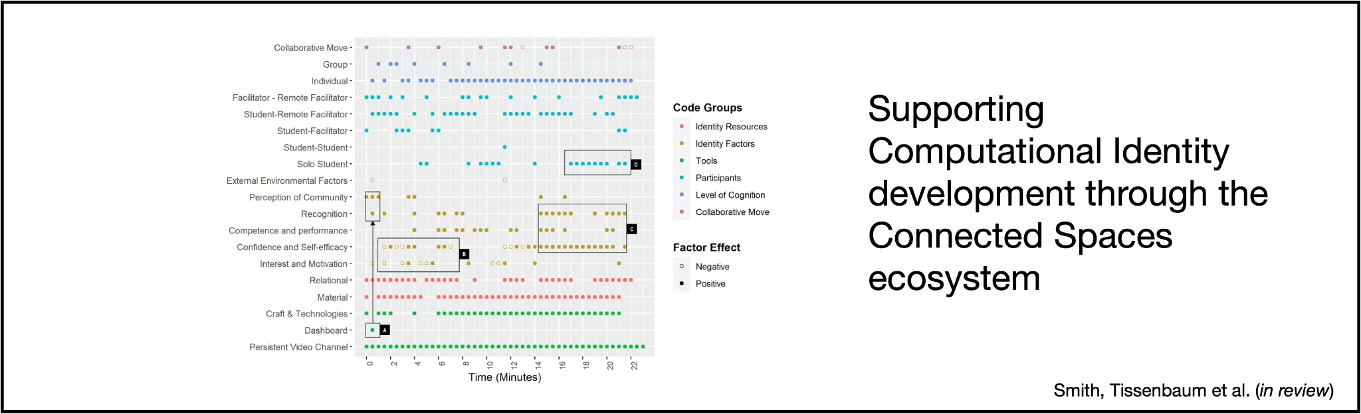

Slide 9
Connected Spaces for library makerspaces
Opportunities to connect makers across library networks
Support small groups of kids to connect to larger communities of makers
More opportunities to share projects, expertise, mentorship, and impact

