Slide 1
Co-teaching and the role of school librarians in facilitating maker learning in schools
Dr. Kyungwon Koh
University of Illinois at Urbana-Champaign

Slide 2


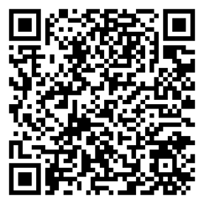
ACKNOWLEDGEMENT
The project was made possible by the Institute of Museum and Library Services National Leadership Grant for Libraries.
The study received a 2022 AASL (American Association of School Libraries) Research Grant for excellence in manuscript.
I would like to acknowledge and express my gratitude for the tremendous work of the project team over the years, including Kathryn Lewis, Dr. Shirley Simmons, Dr. Lee Nelson, Dr. Janessa Doucette, Arian Davis, Dr. Xun Ge, Dr. Leslie Maniotes, Dr. Leanne Bowler, Leslie Preddy, and Dr. Julia Petrella, for their critical contributions to this project. I also extend my sincere thanks to all the teachers, school librarians, and students who participated.
Learning in Libraries:
Guided Inquiry Making and Learning

Slide 3
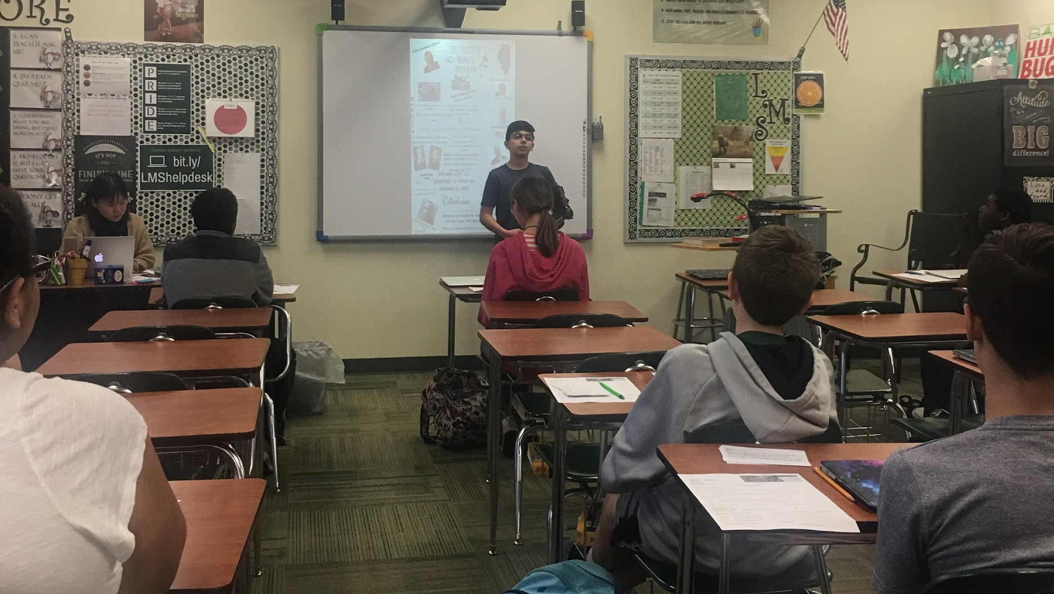
Can we make in schools?

Slide 4
Challenges of Incorporating Making into Schools
Philosophical Challenges
Practical Challenges

Slide 5
Backgrounds
The instructional partnership and leadership of school librarians
Implementing learner-centered instructions in formal schools

Slide 6
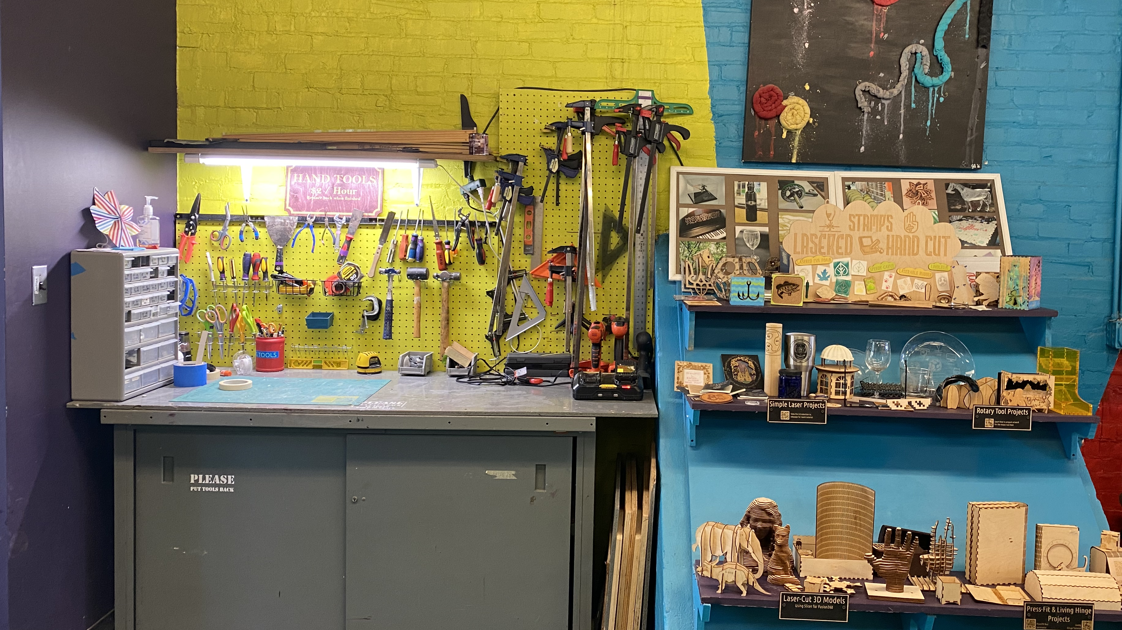
Maker Learning
A hands-on learning approach through which learners create, design, tinker, experiment, and share projects with a range of technologies

Slide 7
Co-Teaching
A specific style of instructional collaboration and partnership
Allows teachers to provide higher-quality instruction in ways that are not possible with only one educator

Slide 8
The Research
Goal: Aims to understand co-teaching practices between school librarians and classroom teachers when facilitating inquiry and maker learning
Research questions:
How did the school librarians and classroom teachers co-teach to facilitate inquiry and maker learning?
What were the roles of school librarians in co-teaching with classroom teachers?
What were the processes and approaches to co-teaching?

Slide 9
The Research (Cont.)
Investigated the ways that educators took part in co-teaching 35 inquiry/making units in a public school system in a mid-sized suburban community over three years (2016-2019)
Data collection: interviews and field observation
Participants: 25 educators (5 librarians, 18 classroom teachers with different disciplines, and 2 gifted-resource coordinators) across 3 schools (1 elementary, 1 middle, and 1 high schools)
Data analysis: multiple iterative cycles of qualitative coding processes.

Slide 10
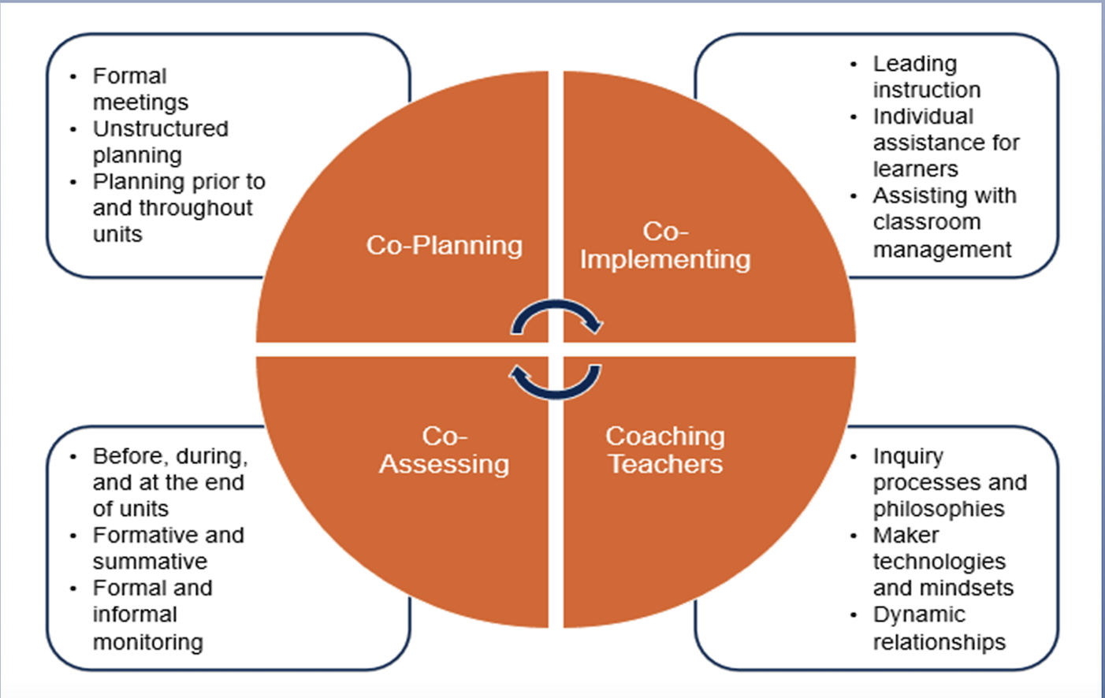
FINDINGS
Co-teaching processes
Co-planning
Co-implementing
Co-assessing
The role of school librarians

Slide 11
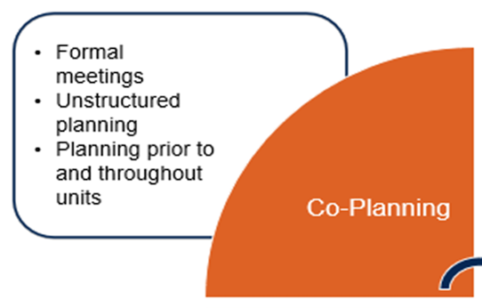
Co-planning

Slide 12
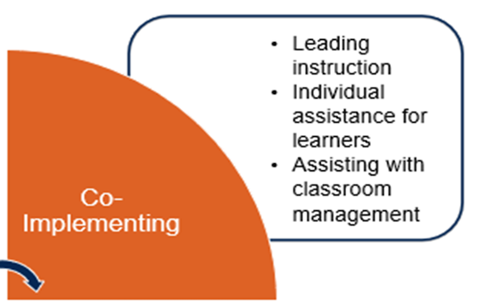
Co-Implementing

Slide 13
Informal, Individual Coaching
“You see the kids that are struggling…You look for who needs you and just kinds of—you gravitate to them.” (elementary school librarian)

Slide 14
Cognitive Apprenticeship
Learning through guided experience, such as scaffolding, modeling, mentoring, and coaching

Slide 15
Cognitive Apprenticeship-- Modeling
“If you’re in the front of the room and your technology is just tanking and you’re having trouble troubleshooting, my preference is to just work through it with kids and use that as a model for a growth mindset and how to deal with the struggle and just be honest and say, ‘My audio is not working. Let’s see, I am going to think through this. What works; what doesn’t.” (SP18 ES Librarian)

Slide 16
Classroom Management
“One teacher to thirty kids, there is no way you can be everywhere and help them all in a one-hour period a day.” (High school math teacher)
“I think the teacher-librarian partners are so helpful in that regard.” (high school language arts teacher)

Slide 17
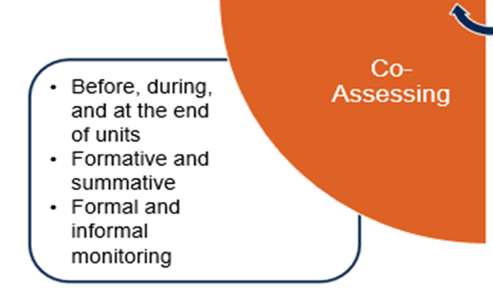
Co-assessing

Slide 18
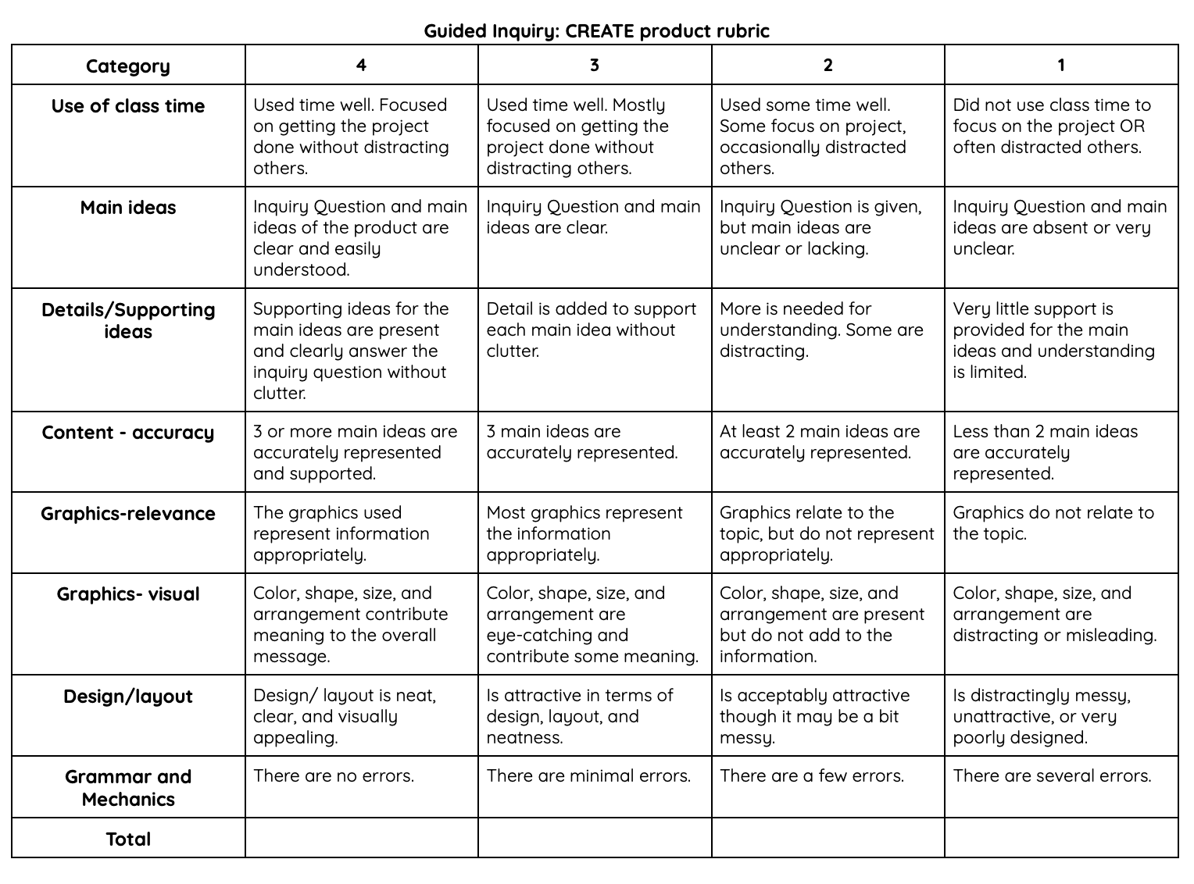

Slide 19

Conclusion and Implications
Co-teaching with school librarians helps overcome challenges in learner-centered instruction, such as maker learning.
Recommendations:
School Librarians: Develop expertise in maker learning, as well as learner-centered instructional methods like co-teaching and cognitive apprenticeship. Be flexible, adapting to teachers’ experience levels and evolving needs.
Classroom Teachers: Seek and embrace co-teaching opportunities with school librarians to enhance learner-centered instruction.
Administrators: Hire qualified school librarians. Foster a culture of instructional collaboration and provide professional development that connects school librarians and teachers.

Slide 20
“There are no silver bullets in education, and
makerspaces—like any innovation in schools—
take planning and hard work if they are to live up
to their potential” (p. 52).
Salsbury, K., & Nichols, T. P. (2020). School Library Makerspaces: Beyond the Hype.
PHI DELTA KAPPAN, 101(8), 49-53

Slide 21
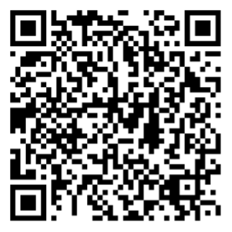
Thank you!
Full Paper available at:
Questions? kkoh@Illinois.edu

