Slide 1

Factors Influencing Intention to Introduce Accessibility in Makerspace Planning and Implementation
Heather Moorefield-Lang
Ana Dubnjakovic

Slide 2
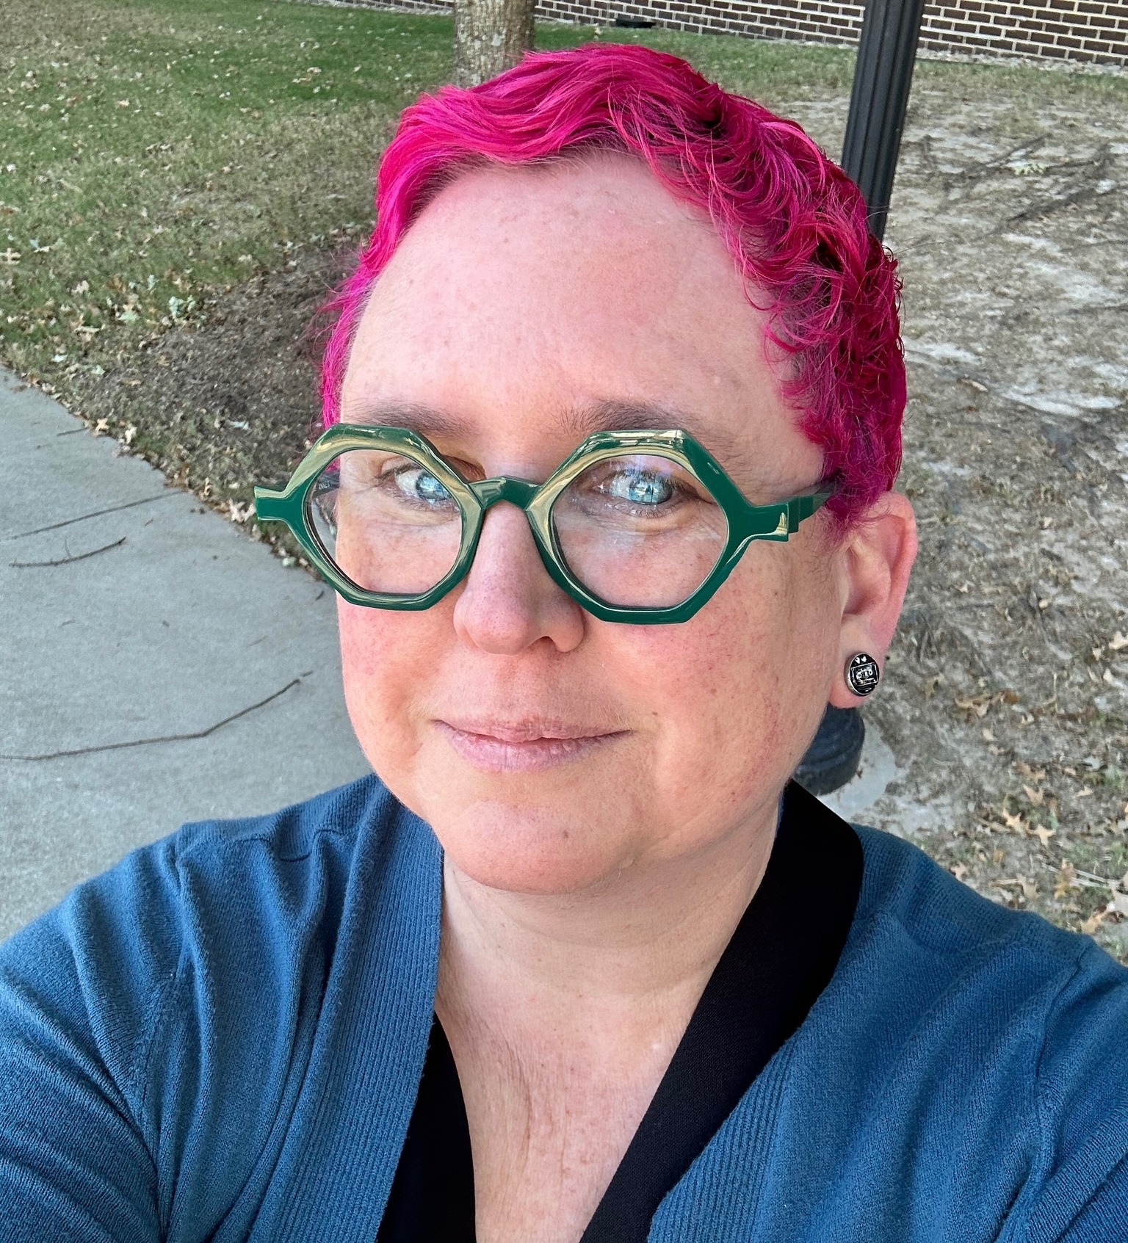
Heather Moorefield-Lang
hmoorefield@gmail.com

Slide 3

Ana Dubnjakovic
University of South Carolina
Music Libraries
ana@mailbox.sc.edu

Slide 4

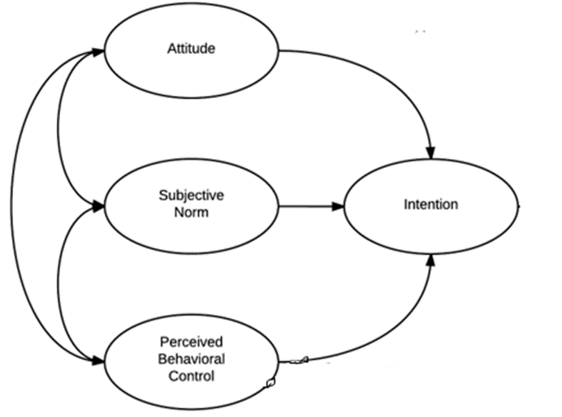
THEORY OF PLANNED BEHAVIOR

Slide 5
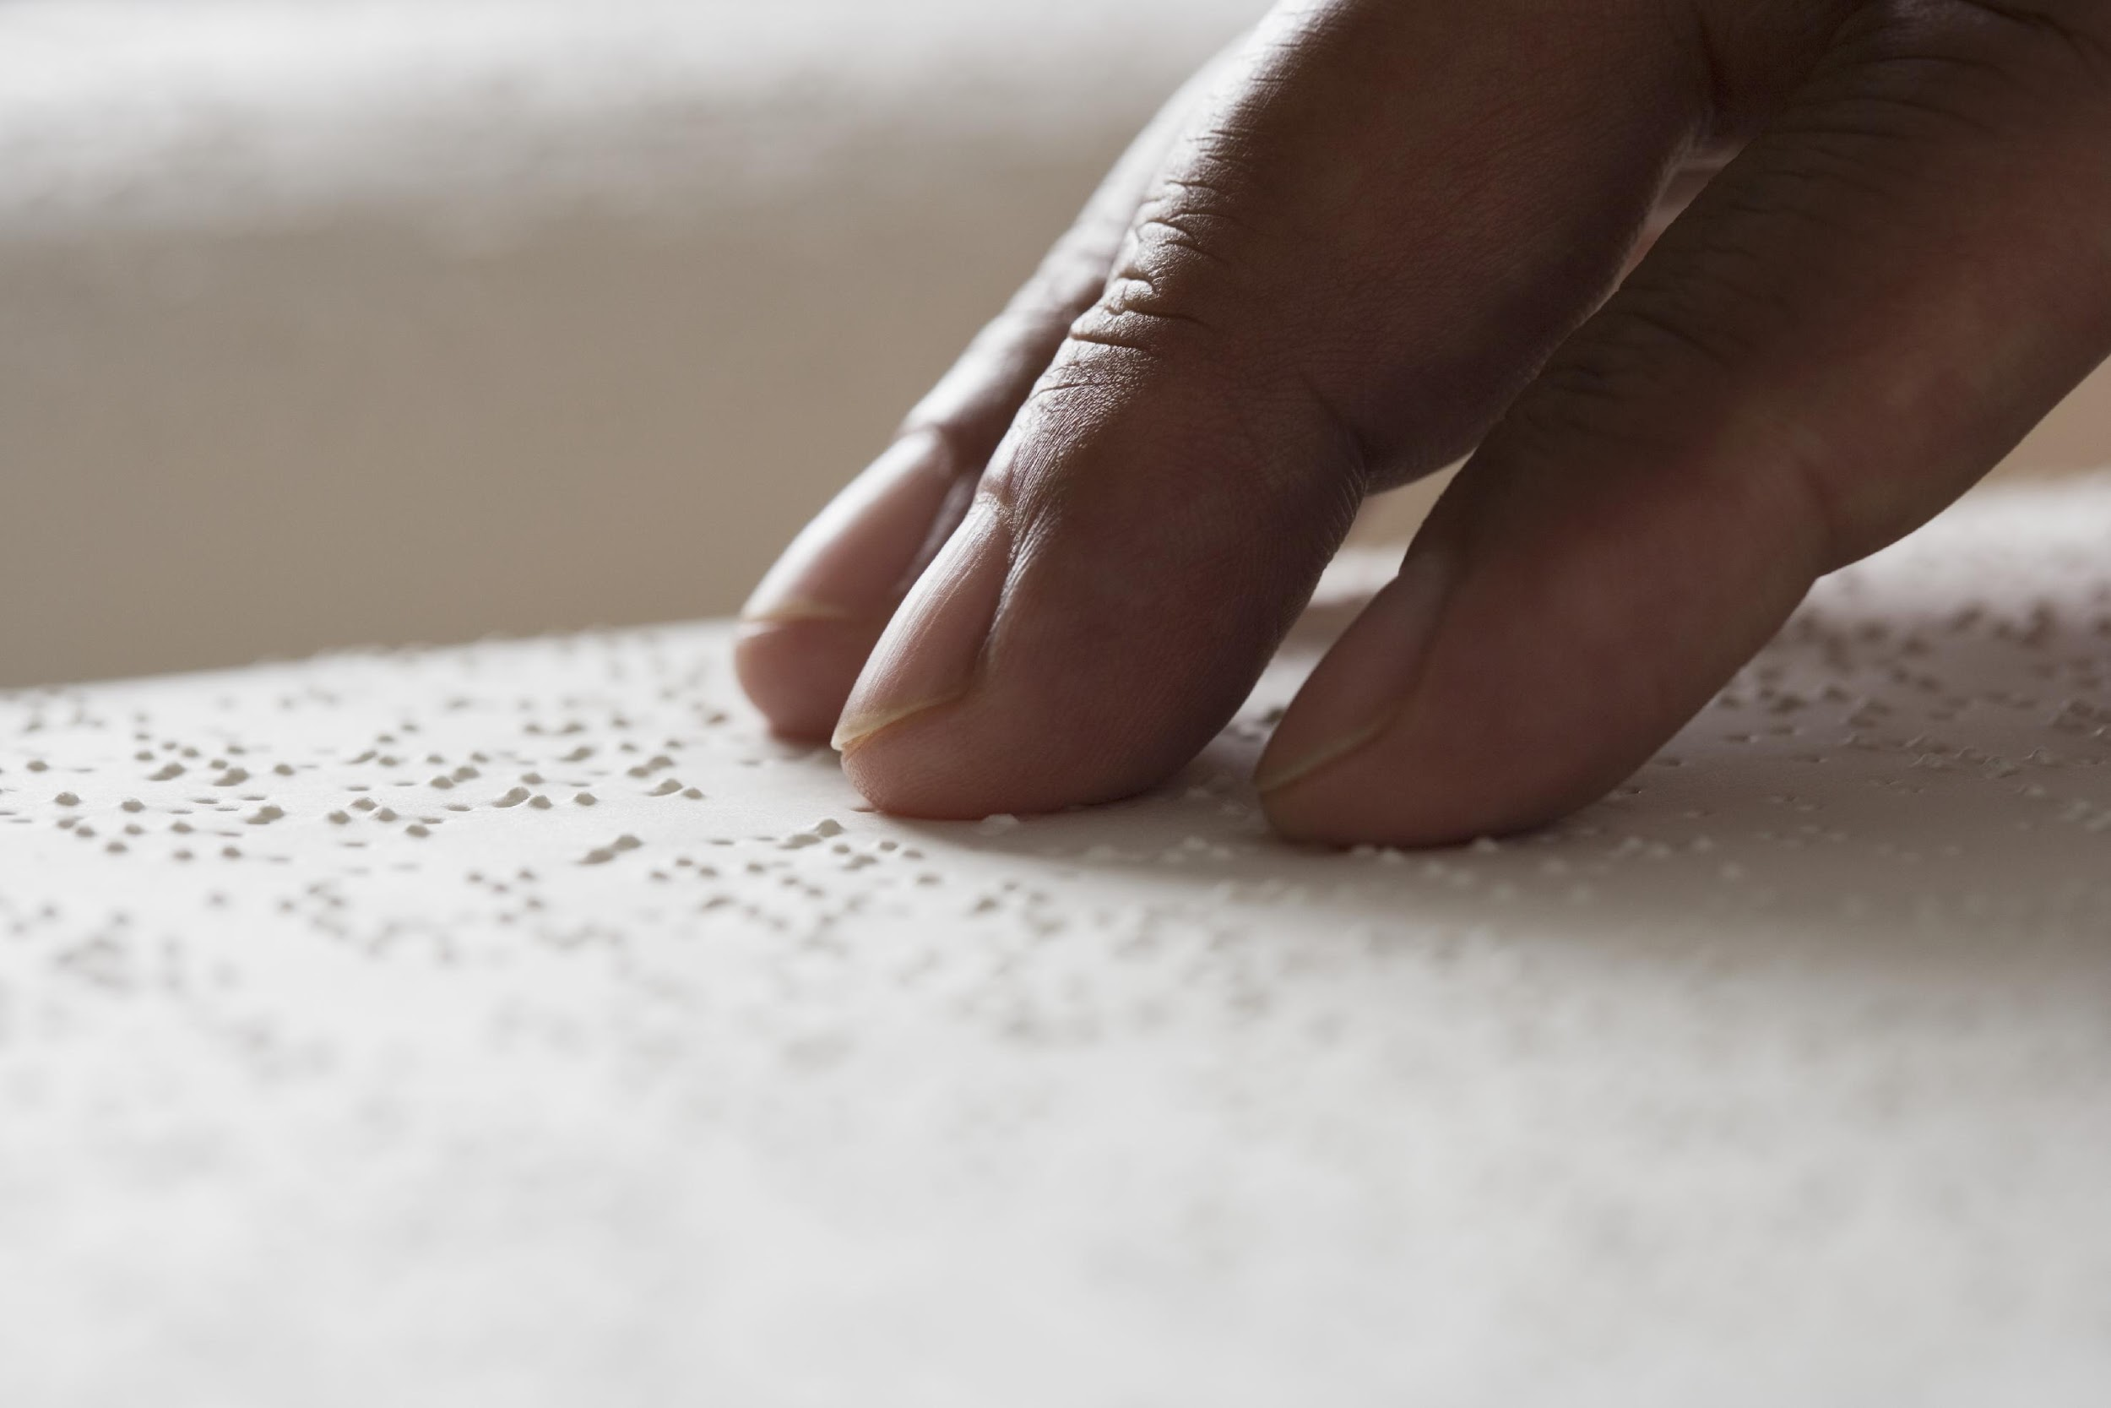
Behavioral Intention
I intend to make my makerspace more accessible
I will work on making my makerspace more accessible
I will improve accessibility of my makerspace

Slide 6
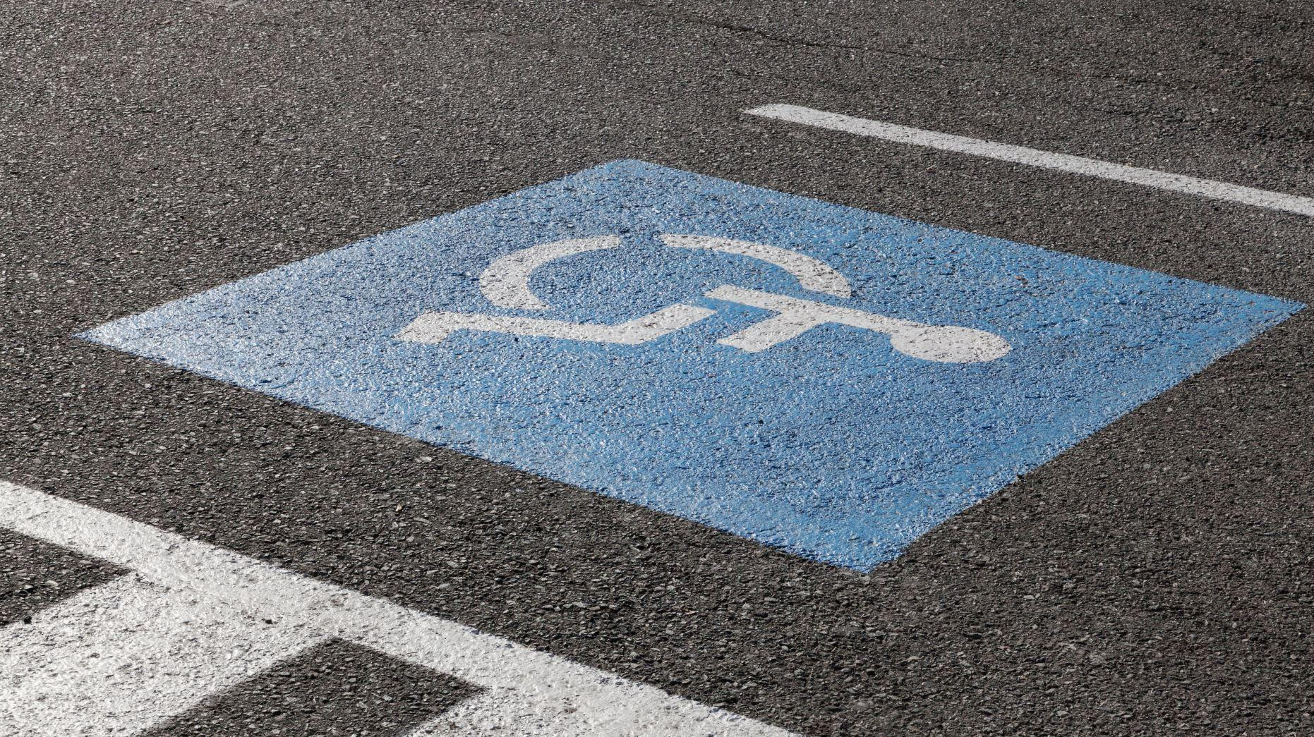
Subjective Norm
My students believe accessibility is important for makerspaces
My faculty believe accessibility is important for makerspaces
Parents believe accessibility is important for makerspaces

Slide 7
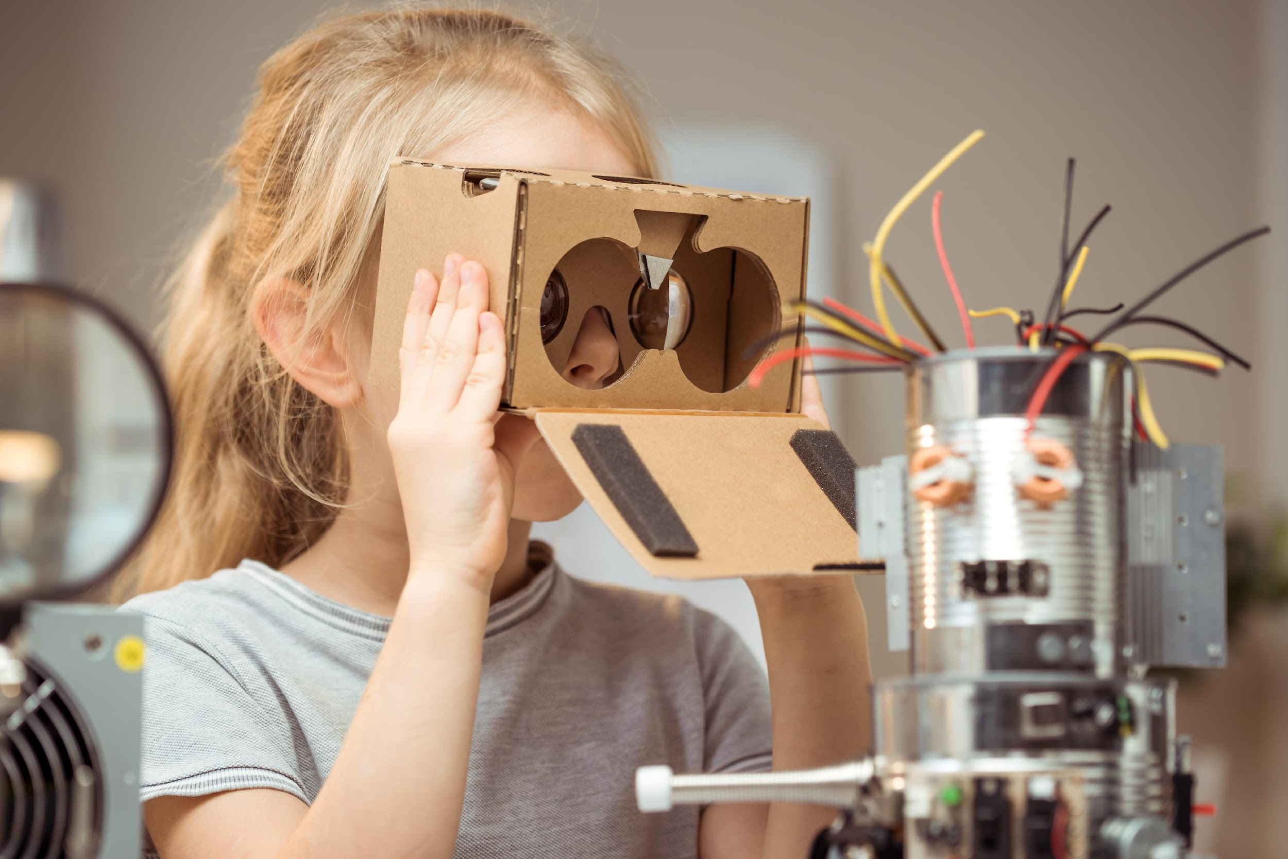
Perceived Behavioral Control
I can secure the resources to make my makerspace more accessible
I can gain enough knowledge/expertise to make my makerspace more accessible
I can secure financial support to make my makerspace more accessible

Slide 8

Attitude Toward Behavior
Accessibility is essential in a successful makerspace
I consider makerspace accessibility a top priority
A well-designed makerspace must be accessible

Slide 9
Methods
Survey Instrument created with Likert scale and open-ended questions
Survey sent to national and state listservs along with a variety of social media
Sample included 116 participants
All participating librarians had makerspaces within a time frame ranging from 8 years to less than a year. (Most participants had their makerspaces for at least two years)
Most participants were in elementary schools, but respondents spanned all school levels.

Slide 10
Results/Discussion
Identifying makerspace accessibility as top priority and agreeing that it should be accessible might be different in the minds of school librarians. Librarians wanted to be in control of the changes that would happen to make the library accessible for their learning communities.
School librarians had the least confidence or at least only somewhat agreed that other important actors (i.e., administration, parents and students) considered accessibility an essential feature in a makerspace.
Perceived behavioral competence was the most influential predictor of behavioral intention to implement accessibility in a makerspace in the current study to the extent that it could for all practical purposes be considered the sole predictor.

Slide 11
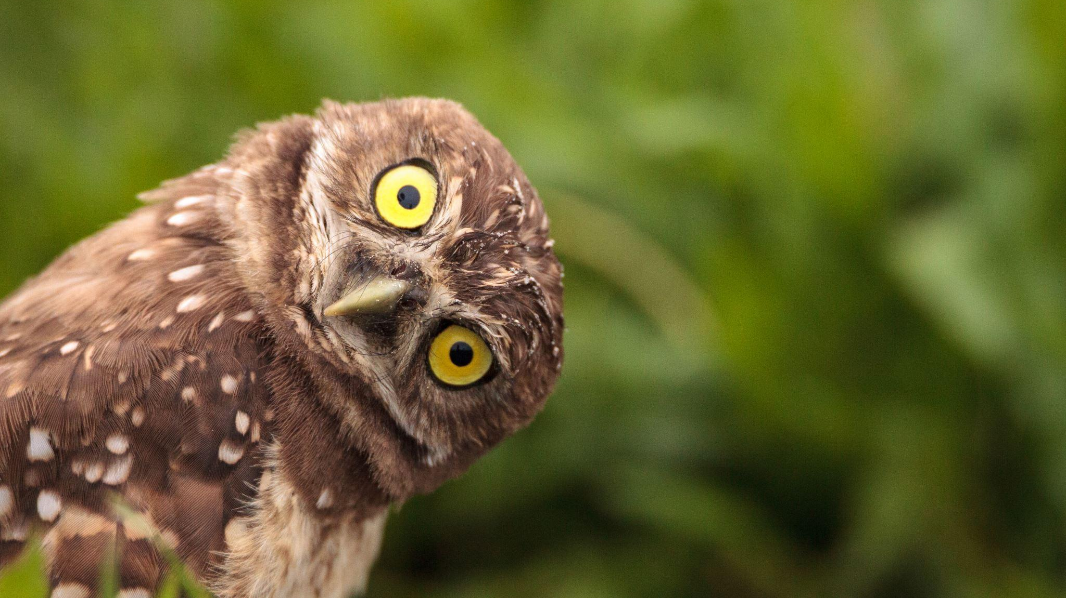
QUESTIONS

Slide 12
Original Paper
Moorefield-Lang, H., & Dubnjakovic, A. (2020). Factors influencing intention to introduce accessibility in makerspace planning and implementation. School Libraries Worldwide, 26(2), 14-26.

