Slide 1

Comparison of Hermetic Wheat Storage with Traditional Storage Methods in India
Pavel Somavat^{a,b}, Haibo Huang^{b}, Sunil Kumarª, Mukesh K. Gargª,
Mary-Grace C. Danao^{b}, Vijay Singh^{b}, Kent D. Rausch^{b} & Marvin Paulsen^{b}
ªCollege of Agricultural Engineering & Technology,
CCS Haryana Agricultural University, Hisar, Haryana, India
^{b}Department of Agricultural and Biological Engineering,
University of Illinois, Urbana, Illinois, USA

Slide 2
Introduction
Higher postharvest losses of wheat (7 to 15%) in India was the impetus for this study.
  Unbiased, objective data were needed
We simulated typical Indian conditions and eight wheat samples (1 tonne each) were stored for a year using three storage techniques.
  Two techniques widely used in India for wheat storage
    Metallic bins
    Gunny bags
  Hermetic Storage technique
CO₂, temperature and RH sensors were used to monitor internal environment
Qualitative tests were performed on wheat each month to ascertain performance of each structure

Slide 3
Experimental Setup
Sr. No. | Method | Experiment Name | Start Date | Sample Weight (Tonne) | Initial Moisture (% w.b.)
1. | Hermetic Storage Bags | H1 | 24.07.13 | 1 | 11.53
2. |  | H2# | 24.07.13 | 1 | 11.80
3. |  | H3 | 29.07.13 | 1 | 13.43
4. |  | H4# | 29.07.13 | 1 | 13.42
5. | Metallic Bins | S1 | 22.07.13 | 1 | 11.76
6. |  | S2 | 22.07.13 | 1 | 11.70
7. | Gunny Bags | B1 | 26.07.13 | 1 | 12.23
8. |  | B2 | 26.07.13 | 1 | 12.26
# Bags infested by 80 adult specimens of Lesser Grain Borer (Rhyzopertha dominica) on 13.08.13.
Notes:
80 adult specimens of Rhyzopertha dominica were introduced on 13.08.2013 in H2 and H4

Slide 4
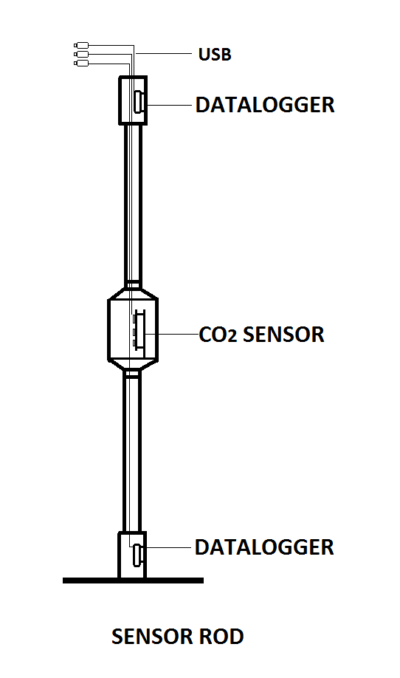

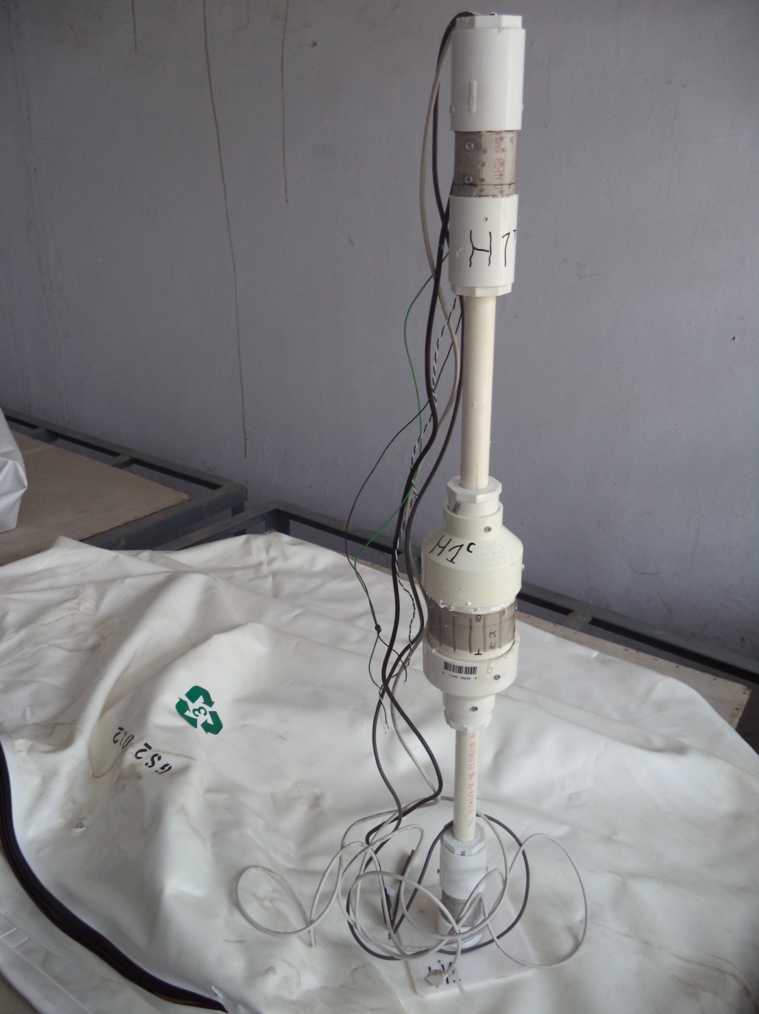

Sensors
Two temp/RH sensors and one CO₂/temp/RH sensor used in each structure at top, middle and bottom.
H 1 T (T & RH)
H 1 C
(T, RH & CO2)
H 1 B (T & RH)
Notes:
Sensors were isolated from each other by using silicone sealant.

Slide 5
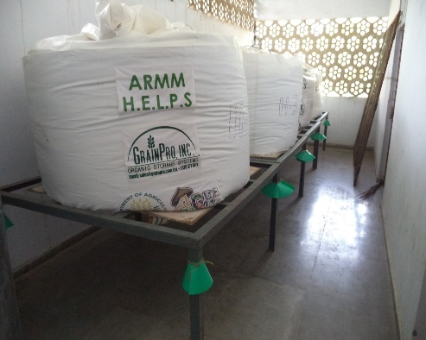
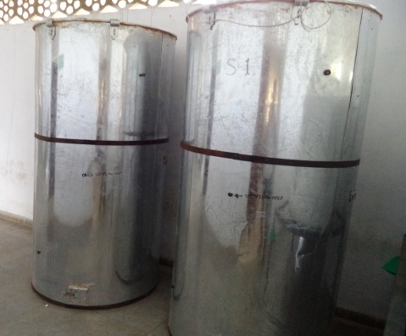
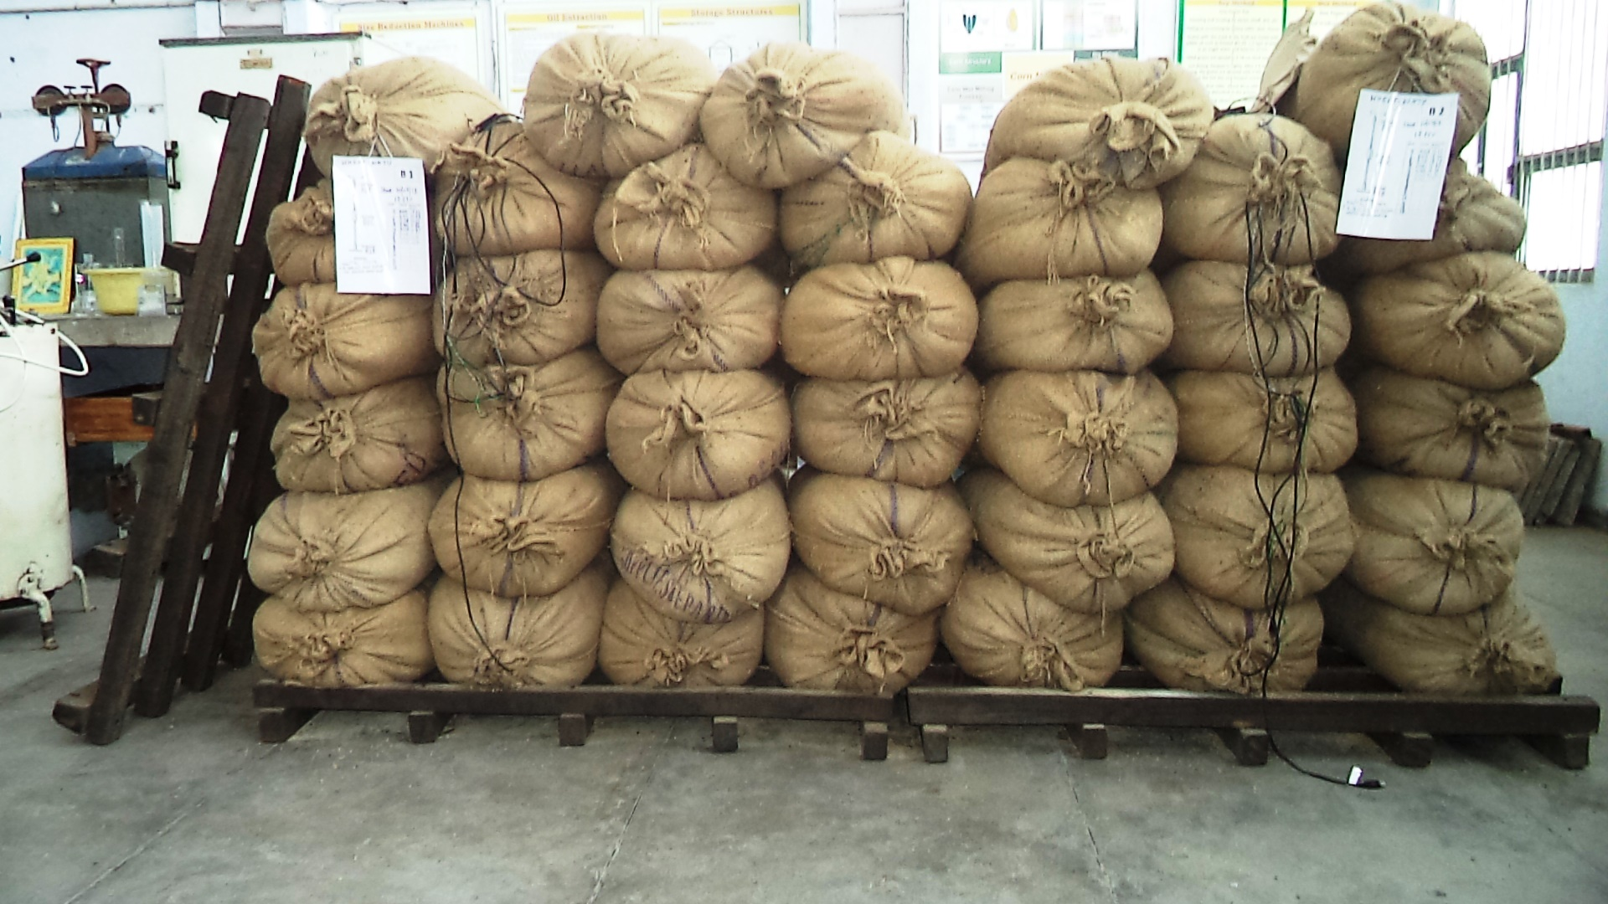
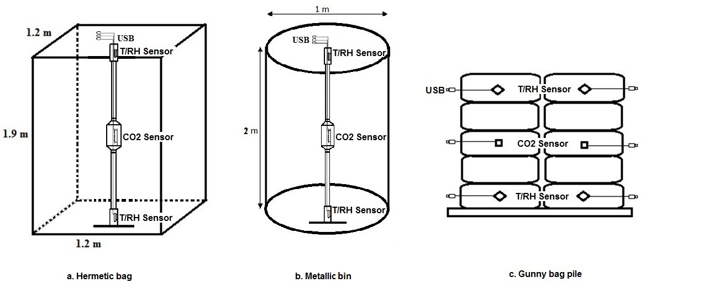
Final Experimental Setup

Slide 6
Ambient Conditions
Notes:
Temperature varied between 38 to 8° C while RH varied from 15 to 95% during this experiment.
6 hour sampling from 26.10.2013 onwards.
Change in scale on the horizontal axis is due to this sampling difference.

Slide 7
CO₂ variation in Hermetic Bags
Notes:
CO2 buildup is faster in bags having wheat with higher moisture content.
Failure to obtain gas tightness. Periodic sampling or improper insulation at the point of wire/cable exit could be the reasons.
This failure of obtaining gas tightness and moisture accumulation in peripheral layers has been reported by Darby & Caddick (2007).

Slide 8
CO₂ variation: Bins & Gunny Bags

Slide 9
Temp./RH in Hermetic Bag H1

Slide 10
Temp./RH in Hermetic Bag H4

Slide 11
Temp./RH in Metallic Bin S1

Slide 12
Temp./RH in Gunny Bag Pile B2

Slide 13
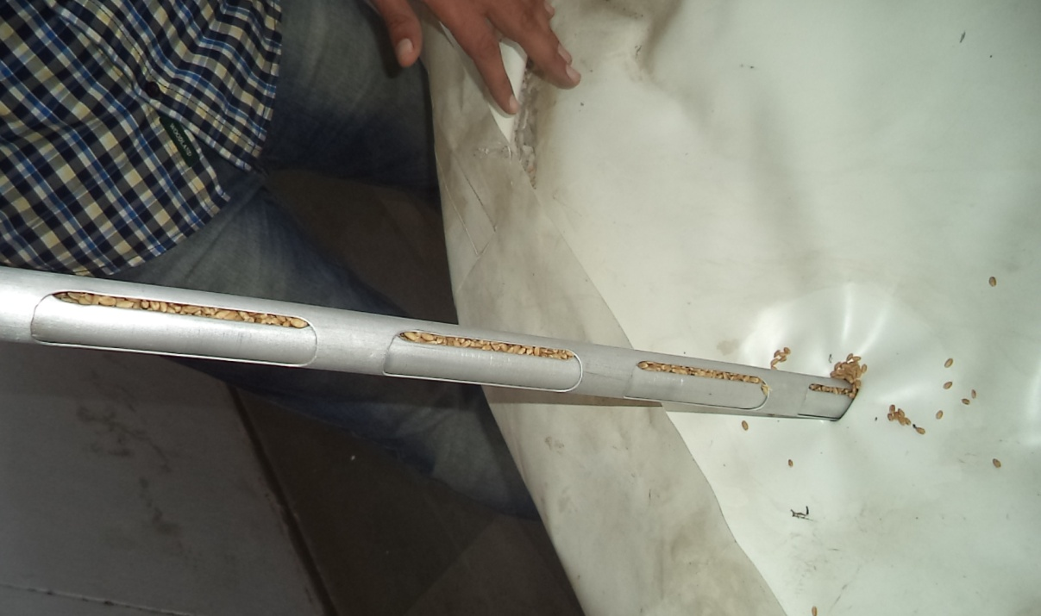
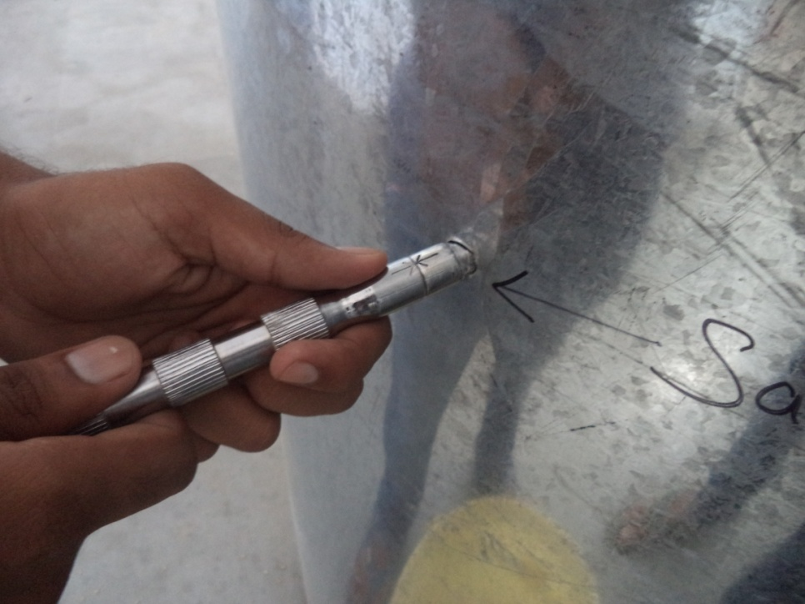
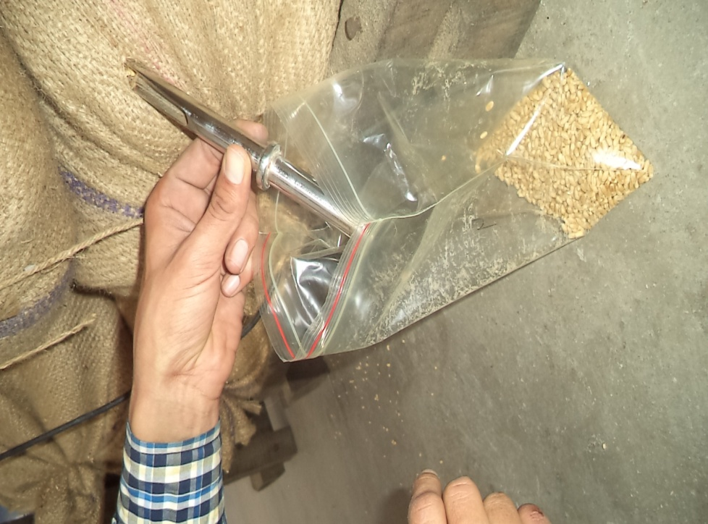
Sampling
Procedure
Notes:
Sampling orifice was made on the top of hermetic bag as it was feared that holes on the sides will be difficult to close. However this restricted us from profiling moisture migration in horizontal plane and may have caused erroneous moisture content readings.

Slide 14
Moisture Content
Notes:
Ambient temperature/RH variations affected all the three storage structures with varying degree. Gunny bags had maximum temperature dependant moisture content variation followed by metallic bins. Hermetic bags showed least effect for all the three. Still 2-4% moisture content variation in the bags indicate temperature dependant moisture migration. Further studies are required for profiling of this moisture migration in HBs.

Slide 15
Thousand Kernel Weight
Notes:
Thousand kernel weight test results for all the structures corresponded nicely with the results of wheat moisture content test for each structure.

Slide 16
Germination Test
Notes:
Wheat stored in Hermetic Bags has maintained above 85% germination after 9 months of storage. Germination percentage is in confirmation with the standards according to the International Rules for Seed Testing (ISTA, 2011).

Slide 17
Insect-bored Grain
Note: Rhyzopertha dominica were introduced to H2 and H4 on 13.08.2013.
Notes:
Hermetic bags have contained infestation for the last nine months even though 80 adult specimens of Rhyzopertha dominica were introduced to H2 and H4 in August, 2013. Gunny bags have been severely affected by spontaneous infestation while the metallic bins have also been affected. Hermetic bags appear to be the most effective of all the three storage techniques.

Slide 18
Milling Yield
Notes:
Milling yield of wheat over the time was almost the same for all the three storage types and corresponded nicely with the earlier studies.

Slide 19
Observations
Maximum CO2 levels were around 9% in hermetic bags (HBs)
  Even though gas tightness was not achieved
After 9 months, HBs maintained 88% seed viability. This number was 85 and 82% for metallic bins and gunny bags.
HBs had no infestation and did not require chemical interference.
  HB treatments H2 and H4 had deliberately introduced infestation
  Gunny bags: 7% bored grains
  Metallic bins: 2%
To safely store wheat in gunny bags, application of chemicals is required.
Notes:
Recommended usage of fumigants for cereal storage at Central Warehousing Corporation (India): Phosphine/Methyl Bromide (every 3 Months); Malathion/DDVP (every 2 weeks)

Slide 20
Observations & Future Directions
HBs can be an attractive, environment friendly storage solution and can empower farmers.
Better profiling of modified environment inside HBs using more CO2/O2 sensors and further understanding of moisture migration is required.
Further field studies at farm level with other crops are needed.

Slide 21
Authors are thankful for funding assistance provided by the
ADM Institute for the Prevention of Postharvest Loss
and Dr. K. S. Khokhar,
CCS Haryana Agricultural University, Hisar for his support.
Thank you!

