Slide 1
Food Dehydration
Reduction of Postharvest Losses
Hao Feng, PhD, Professor
Department of Food Science and Human Nutrition
University of Illinois at Urbana-Champaign (UIUC)
Food Systems for Food Security Symposium
February 10, 2015

Slide 2

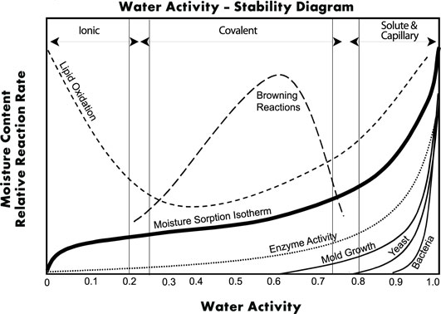
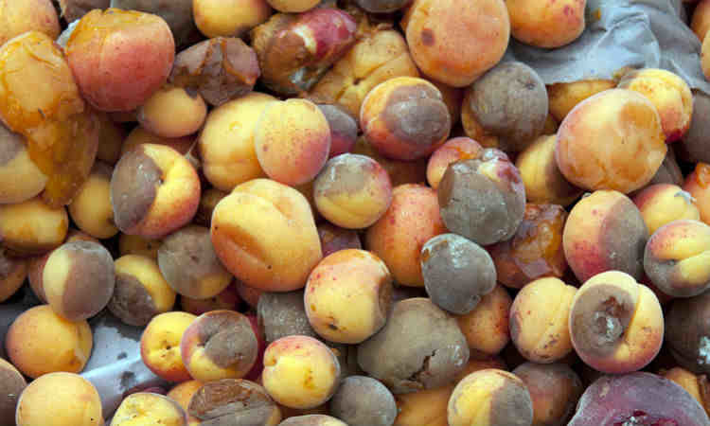
Water Activity and Postharvest Losses
Reduce a_{w}
Reduce m/o

Slide 3
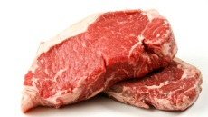
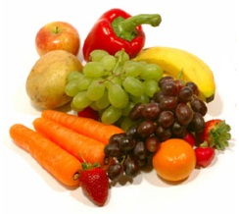
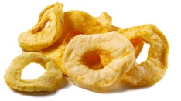
Food Dehydration
Postharvest or
postmortem
storage
Product storage
Dehydration
Q
0
End use
Q
D
Q
C
Q
F
I
Without dehydration
C
II
III
Shelf life
Time

Slide 4
Food Dehydration Technologies
First Generation
Solar Drying
Cabinet and bed type dryers
Second Generation
Spray drying
Drum drying
Third Generation
Freeze dehydration
Osmotic dehydration
Fourth Generation
Microwaves and RF
Refractance window

Slide 5
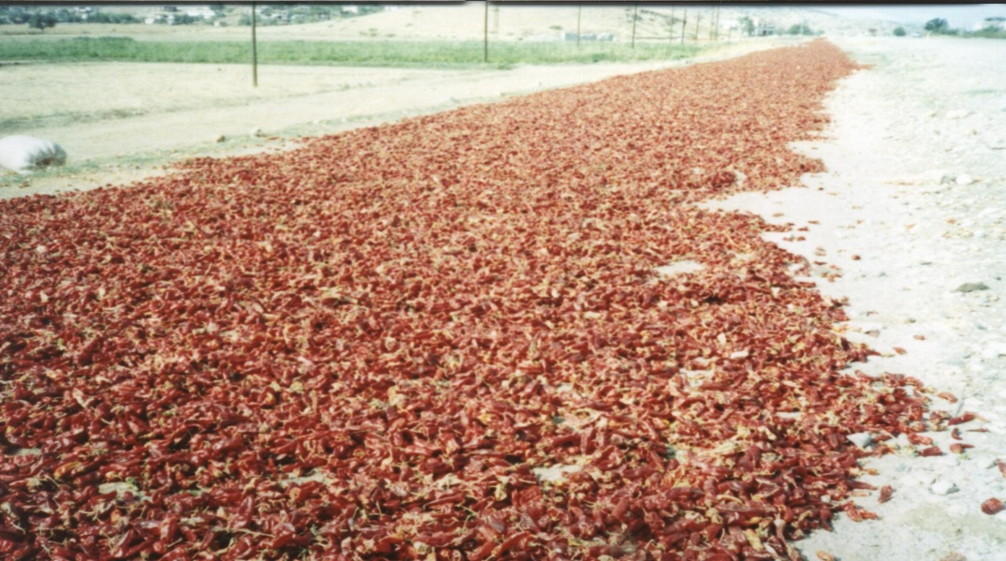

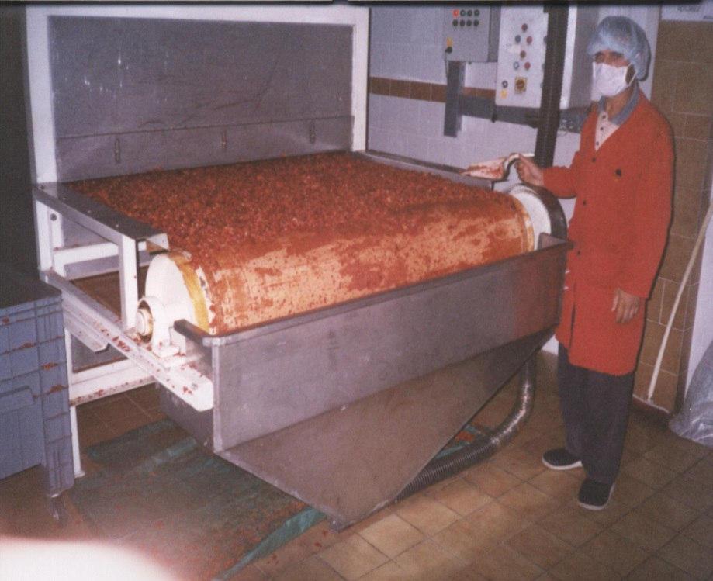
Paprika Drying
Solar Drying
Both drying and milling processes results in a 20–53% loss of carotenoid in paprika
Tunnel Drying

Slide 6
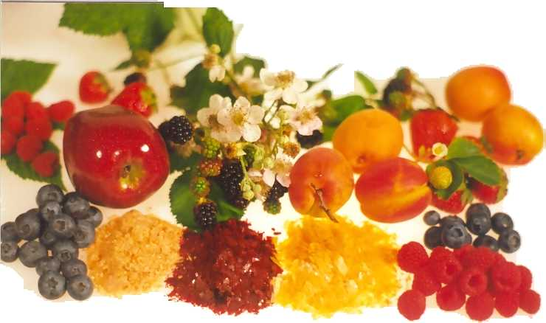
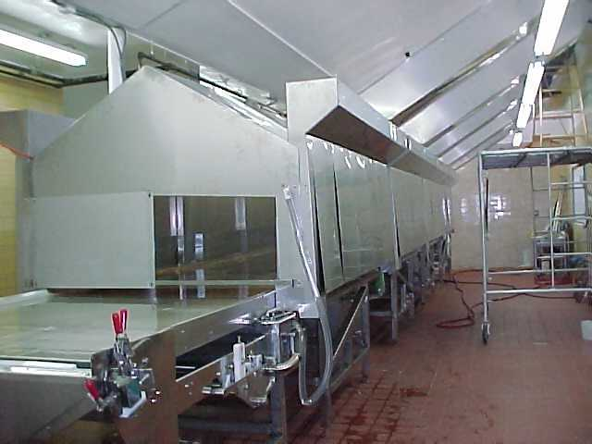
Paprika – Refractance Window Drying

Slide 7
Paprika – Refractance Window Drying
exhaust system
applicator
wet product
dried product
vapor
scraper
hot water
heat
Mylar plastic belt
heater
pump

Slide 8
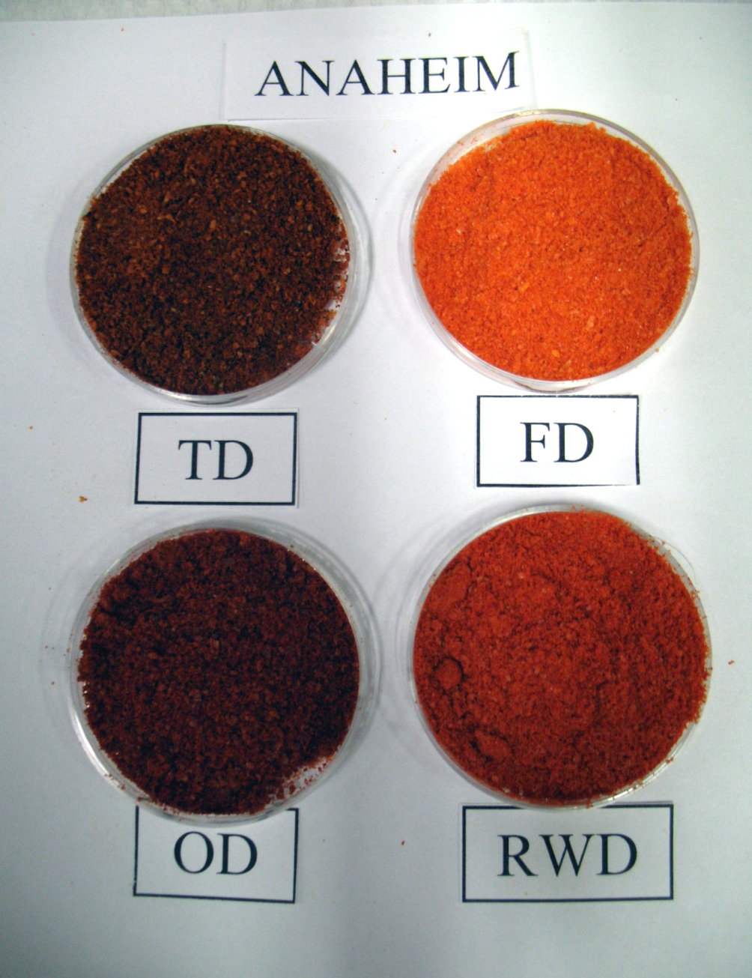
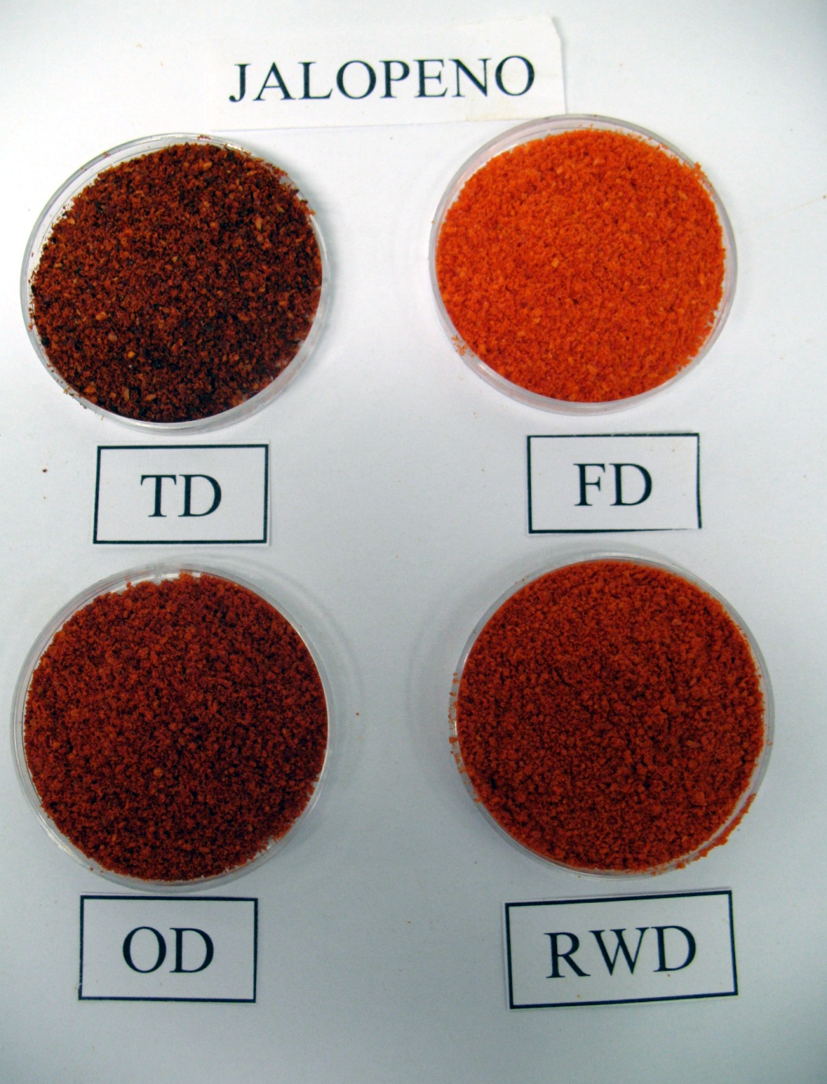
Paprika – Refractance Window Drying
TD = Traditional Drying
FD = Freeze Drying
OD = Oven Drying
RWD = Refractance Window Drying
Notes:
Traditional

Slide 9
Paprika – Refractance Window Drying

Slide 10
Carrots – Refractance Window Drying
Sample
Total carotene
α carotene
β carotene
Loss (%)
Loss (%)
Loss (%)
Air dried
29.0
Drum dried
56.0
55.0
57.1
RW* dried
8.7
7.4
9.9
Freeze dried
4.0
2.4
5.4
*Refractance Window
TM

Slide 11

Solar drying
Solar Dryers
Direct Type
Indirect Type
Mixed Type
Natural Circulation
Forced Circulation
Criteria
Simple
Low Cost
Minimal or no energy consumption
Versatile

Slide 12
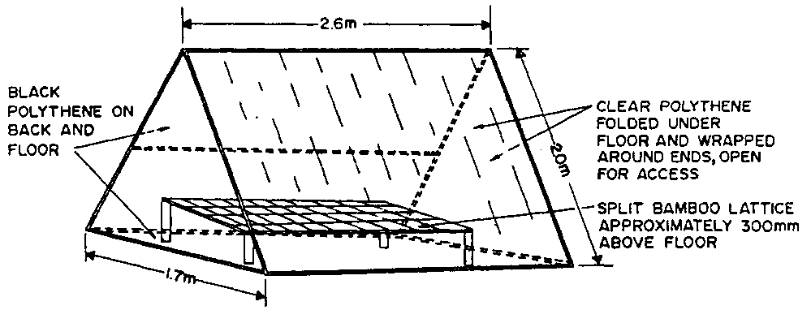
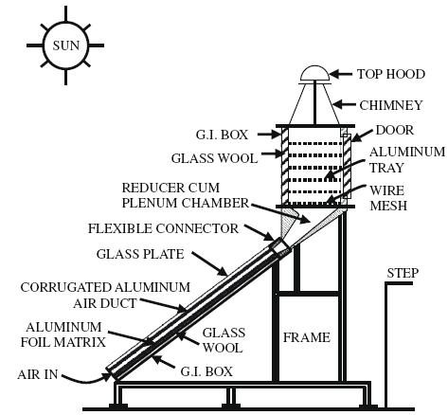
Current solar dryers

Slide 13
All-weather hybrid solar dryers
Limitations of currently used solar dryers
Long drying time
  -not possible in rainy or cloudy days
  -no drying at night
Not suitable for small farms
Possible fungal growth
Solar and solar regenerable desiccant combined drying (S-SRD)

Slide 14
S-SRD dryers
Without SRD
1 → 2: solar heating of air
2 → 3: drying
With SRD
1 → 2’: solar heating of air
2’ →3’: drying
Advantages
Faster drying
Dry at a lower temperature
Less chance for microbial growth
Improved quality
3
3’
ΔH
1
2
2’
ΔT

Slide 15
Desiccants
Class 1
chemical reaction, which forms either a new compound or a hydrate
Class 2
physical absorption - constant relative humidity or vapor pressure
Class 3
physical absorption - variable relative humidity or vapor pressure
Class 4
physical adsorption
Regenerable desiccants
Silica gel - sodium silicate
Bentonite-CaCl₂
Clay
Agricultural residues
…
Equilibrium data
Sorption isotherms
Regeneration temperature

Slide 16
Moisture profile
daytime
night
Without desiccant
Moisture Content
With desiccant
Desiccant
Time of day/hour

Slide 17
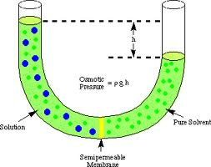
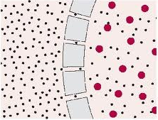
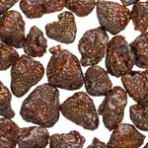


Osmotic dehydration
Osmotic pressure
H₂O
Hot-air
Osmotically dehydrated

Slide 18
Osmotic dehydration
Operational conditions
Temperature: 30 – 50ºC
Food: small pieces (1 to 2 cm³)
Advantages
Intermediate Moisture
Foods (a_{w} = 0.6 – 0.9)
Simple
No phase change (economic)
Minimized quality degradation by heat
Retention of natural quality
Limitations
Longer drying times
Potential microbial development
Final moisture

Slide 19
Implementation
Cost
Yield
Low cost
S-SRD
dryer
Natural
circulation
Low
Low
Osmotic
dehydration
Medium cost S-SRD
dryer
Natural/forced
circulation
Low/
medium
Low/
medium
Combined
S-SRD
dryer
Forced
circulation
Medium/
high
Medium/
high
Dried Foods
Intermediate Moisture Foods

Slide 20

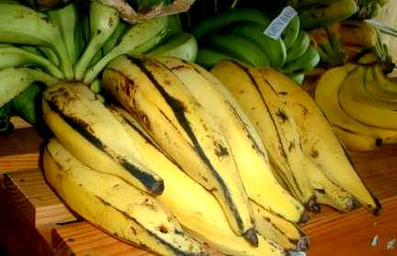
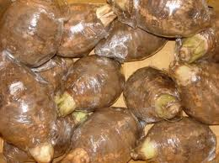
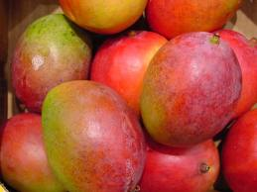
Implementation
S-SRD dried okra chips
S-SRD dried baby okra
S-SRD dried plantain chips
Osmotic + S-SRD dried plantain
Osmotic dried plantain (rings)
S-SRD dried yam chips
Osmotic + S-SRD dried yam
S-SRD dried mango chips
Osmotic + S-SRD dried mango
Osmotic dried mango

Slide 21

