Slide 1

Innovations to achieve nutrition security in low-income countries
Juan E. Andrade, Ph.D.
Assistant Professor
Food Science and Human Nutrition
Division of Nutritional Sciences
Center for Latino American and Caribbean Studies

Slide 2
Acknowledgements
Graduate Students
Dr. Julio Lopez Ross Peterson Pablo Torres Chen Chen | Liz Sloffer Richard Bukenya Shashank Gaur Nawaf Alruwaili Xin Xie Eliana Rosales
Undergraduate Students
Thiago Silva Elise Ellinger Sindi Chang Grace Iberle Suzanni Carvalho Katherine Carrera |  | Fátima Flores Andrea Huerta Emely Lopez ISEL Program (24 graduates)
Collaborators
ECE FSHN DNS KCH SW
Organizations
Honduras Spanish Center (Honduras) Zamorano University (Honduras) World Food Program/P4P (Guatemala) USAID Emergency Relief Office (DC) Dudhsagar Dairy/ MIDFT (India)
Funding
USDA/NIFA ISE DNS Vision 20/20 ACES Equipment Grant ACES OIP Student Sustainability | ACES SAO Albrecht Fellows CLACS Hatch
  My family

Slide 3

85 kids at the end of my 15 minutes of glory!
45%
of all child deaths are associated with poor nutrition

Slide 4
According to current stats…
1 billion insufficient kcals and nutrients (hunger)
2 billion sufficient kcals, but insufficient nutrients
(hidden hunger)
3 billion sufficient kcals and nutrients (healthy)
1.4 billion excess kcals (some with insufficient
nutrients) (overweight/obesity)
Black, R.E., et al,. 2013. Maternal and Child Nutrition Study Group. Maternal and child undernutrition and overweight in low-income and middle-income countries. Lancet 382, 427–451.
FAO. 2013. Food Systems for better Nutrition.
Keats, S., Wiggins, S., 2014. Future Diets: Implications for Agriculture and Food Prices. ODI Report. Overseas Development Institute, London.
United Nations Children’s Fund (UNICEF), 2013. Improving child nutrition: The achievable imperative for global progress. UNICEF, New York, NY
WHO, 2013. Global Nutrition Policy Review: What Does It Take to Scale Up Nutrition Action? WHO, Geneva, Switzerland.

Slide 5
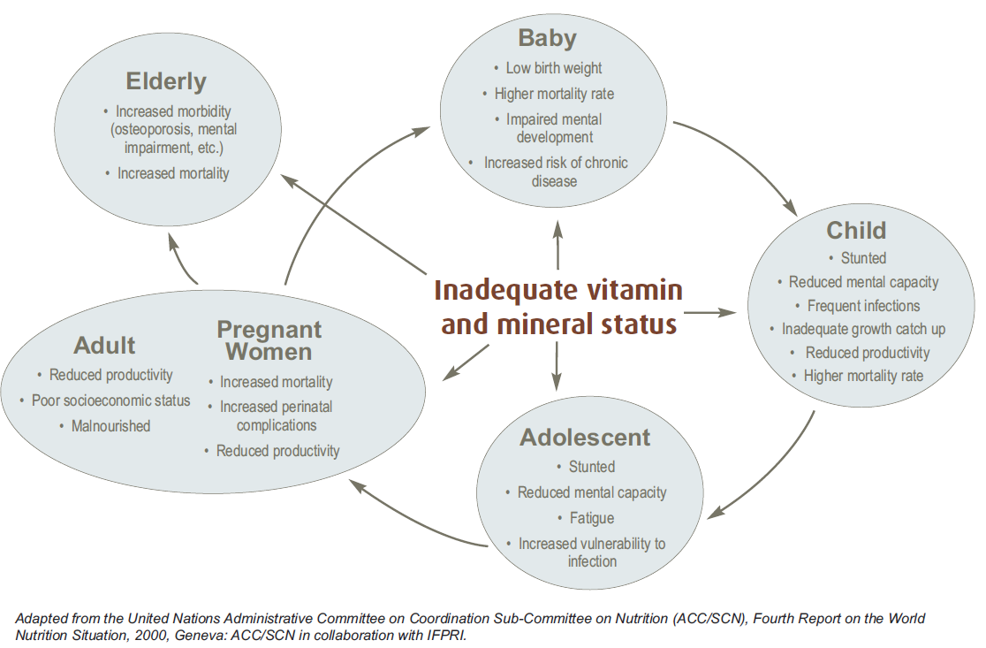
Consequences of Hidden Hunger throughout life cycle
Source: MI Global Report, 2009. Investing in the Future. A united call to action on vitamin and mineral deficiencies

Slide 6

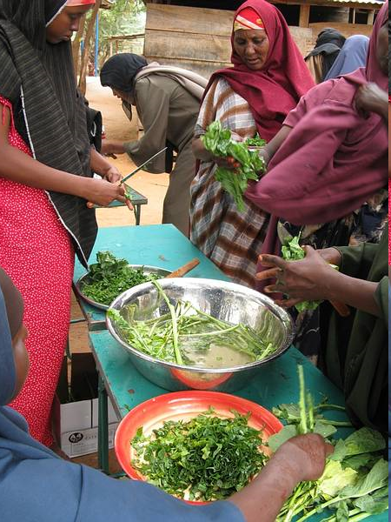
What Works?
Supplementation
Fortification
Biofortification
Dietary diversification

Slide 7
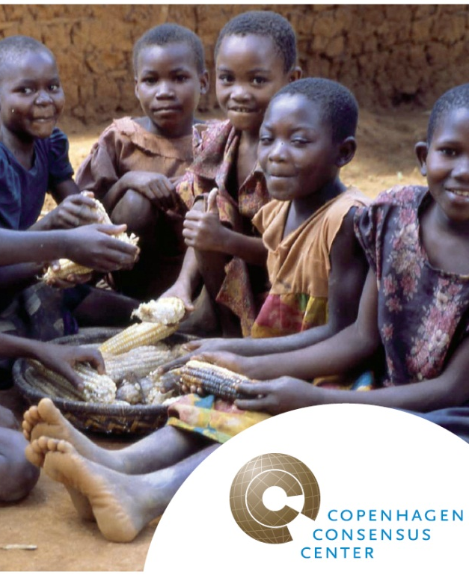
Copenhagen Consensus 2008
If you have $75 Billion…
Nobel laureates in economy
Set priorities to face global challenges
Four solutions associated with nutrition:
  Supplementation (vit.A & Zn)
  Fortification (iron and iodine)
  Biofortification of staples
  Community-based nutrition promotion

Slide 8
So, What is the problem?
Understand the context
  Linkages Ag-Nutrition-Health
  Limited resources
  Limited communication
Nutrition is not part of national agendas
Data on micronutrient status are absent (beyond hemoglobin) and collection is expensive

Slide 9
Our Mission
Surveillance
Diagnostics
Smartphones
Decision/Response
Delivery
Stealth nutrition
In-situ Fortification
LNS
Nanotech
Maximize Adequate Nutrition
Context
Food security/Agriculture
Family dynamics
Gender
Resiliency
Climate change
Education
Smartphones
Training
Renovation
Study Abroad

Slide 10
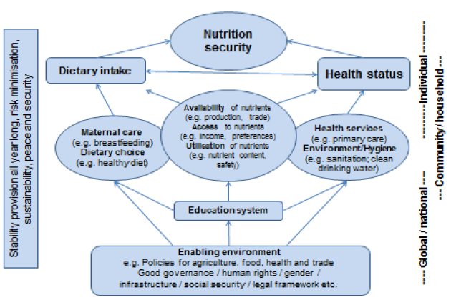
Acharya, T. et al. June 2014. Assessing Sustainable Nutrition Security: The Role of Food Systems. ILSI Research Foundation, Center for Integrated Modeling of Sustainable Agriculture and Nutrition Security. Washington, DC. Accessible at: http://goo.gl/gEyQ1F.

Slide 11
Food Security
“All people, at all times, have physical, economic and social access to sufficient, safe, and nutritious food to meet their dietary needs and food preferences for an active and healthy life”
(The World Food Summit 1996)
Food and Agriculture Organization of the United Nations (FAO), 1996. The State of Food and Agriculture. Available from: http://www.fao.org/docrep/003/w1358e/w1358e14.htm#P36_6144

Slide 12
Nutrition Security
“All people at all times have physical, social and economic access to food, which is safe and consumed in sufficient quantity and quality to meet their dietary needs and food preferences, and is supported by an environment of adequate sanitation, health services and care, allowing for a healthy and active life”
(Committee on World Food Security, 2012)
Committee on World Food Security (CFS), 2012. Coming to Terms with Terminology, Food Security Nutrition Security Food Security and Nutrition Food and Nutrition Security. Report of the 39th Session, 15–20 October 2012. Committee on World Food Security, Food and Agriculture Organization of the United Nations, Rome, Italy

Slide 13
Acharya, T. et al. June 2014. Assessing Sustainable Nutrition Security: The Role of Food Systems. ILSI Research Foundation, Center for Integrated Modeling of Sustainable Agriculture and Nutrition Security. Washington, DC. Accessible at: http://goo.gl/gEyQ1F.

Slide 14
Lack of quality data
To assess progress, Identify actions, Improve accountability

Slide 15
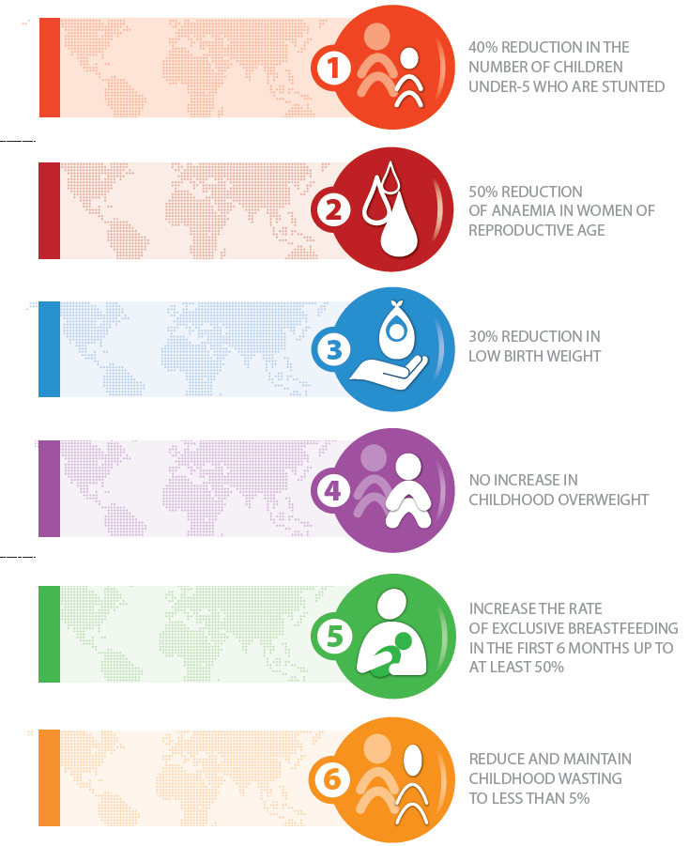
Global Targets 2025
2012 World Health Assembly
Stunting
Anemia
Low birth weight
Childhood obesity
Breastfeeding
Wasting

Slide 16
IT’S HARD TO MEET NUTRITION GOALS IF YOU DON’T HAVE DATA ON NUTRITION
49%
of countries do not have enough data to assess if they are on course/off course of global targets

Slide 17
4 of these indicators require very simple measurements
(height and weight)
We decided to focus on micronutrient status

Slide 18
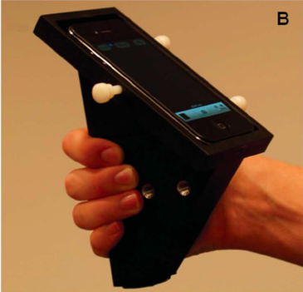
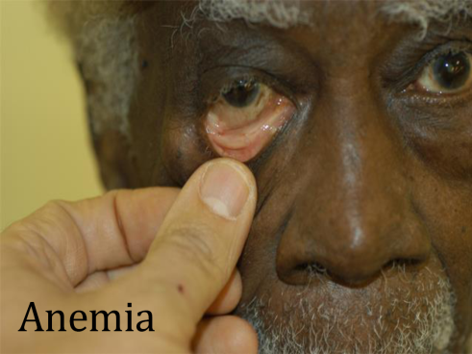


Optical Biosensor for assessment of micronutrient status and Support evidence-based nutrition
  Gallegos et. al., 2013
ACTIONS & IMPACT EVALUATION
  Peterson et. al., 2014

Slide 19
Summary
Food and Nutrition security should be at the top of our agendas
We need solutions that bridge the incredible potential from interdisciplinary research: engineering, nutrition, food science, economics, ag. sci., extension, social work, community development, natural resources, and informatics
Advances in diagnostic technologies should provide the critical data to assess progress, identify actions, improve accountability

Slide 20
Thank you!
Opportunity is missed by most people because it is dressed in overalls and looks like work.
-Thomas A. Edison
So, let’s start to work!

