Slide 2
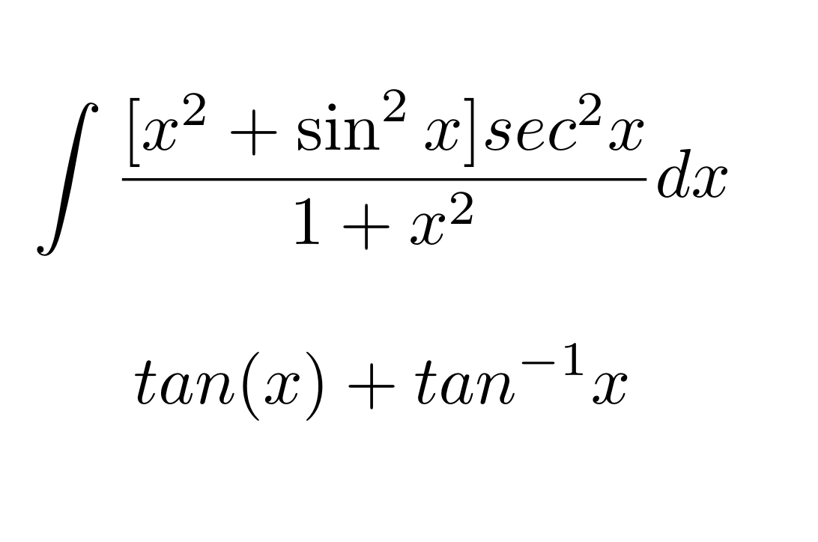

Slide 5
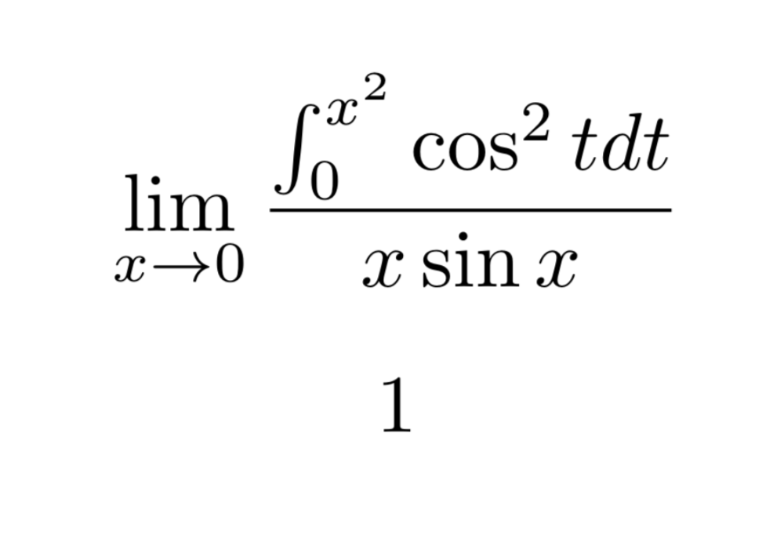

Slide 8
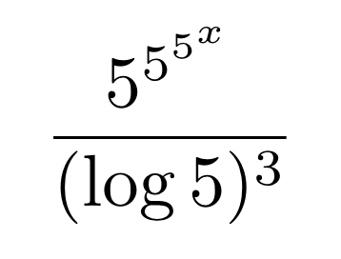

Slide 10
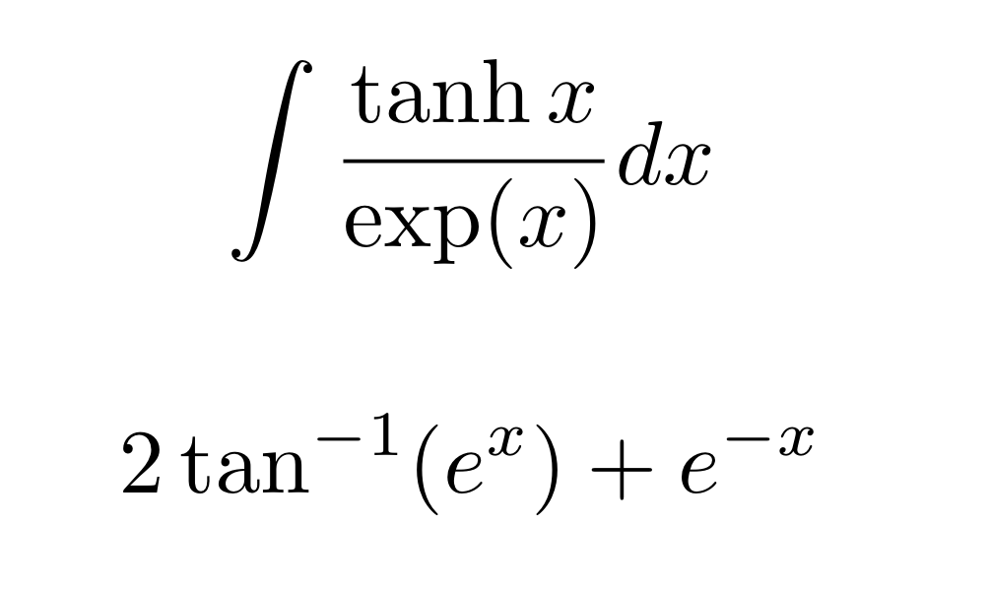

Slide 14
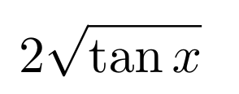

Slide 20
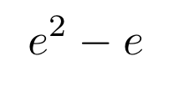

Slide 21
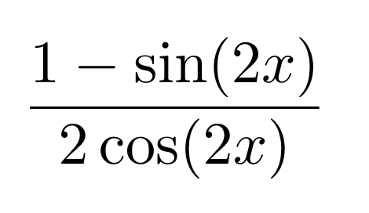

Slide 23
$$\left[\begin{matrix}\int_{1}^{e}{\frac{1}{x}}dx & \int_{\frac{−π}{2}}^{\frac{π}{2}}{cosx dx} \\ \frac{d(x^{x})}{dx}at x=e & \int_{−1}^{−\frac{1}{2}}{\frac{1}{x^{2}}}dx\end{matrix}\right]$$
$Determine \left|B\right|$.
$$1−4e^{e}$$

Slide 25
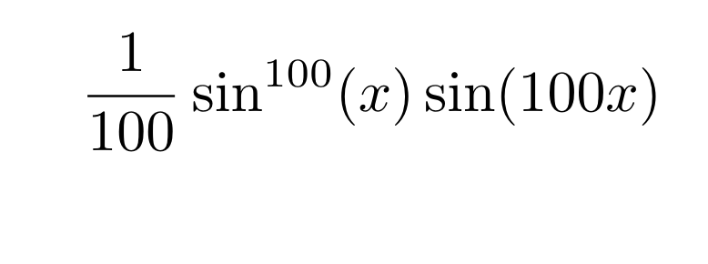

Slide 29
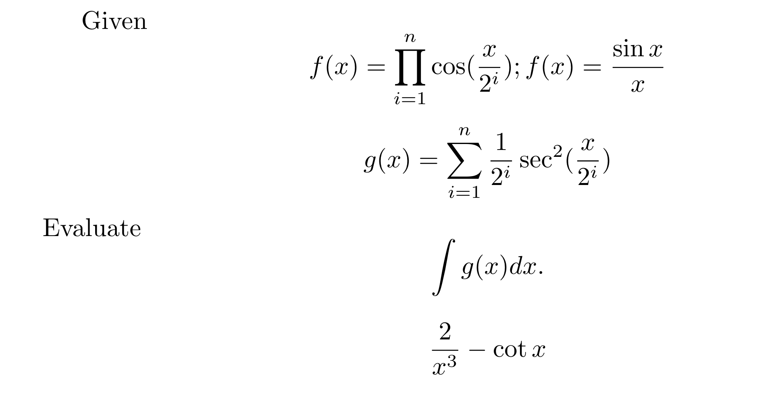

Slide 30
$$128$$
$Given ∇ =\begin{matrix}1 & a & a^{2} \\ a & a^{2} & 1 \\ a^{2} & 1 & a\end{matrix}=−4$
${Compute ∇}^{′}=\begin{matrix}a^{3}−1 & 0 & a−a^{4} \\ 0 & a−a^{4} & a^{3}−1 \\ a−a^{4} & a^{3}−1 & 0\end{matrix}$
$$and hence determine\int_{0}^{∇′}{x dx}.$$

Slide 37
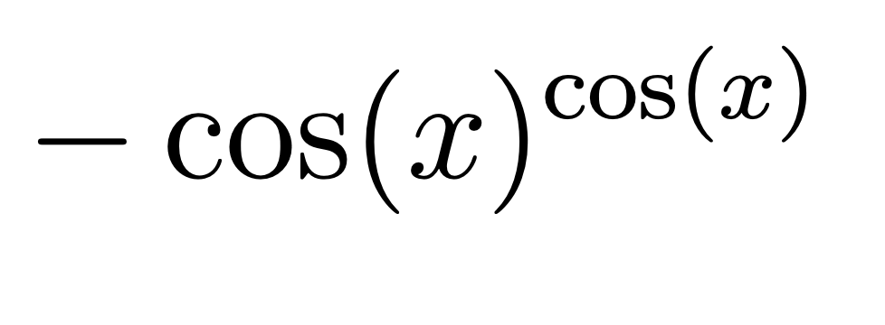

Slide 42
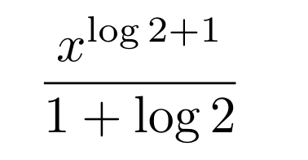

Slide 43
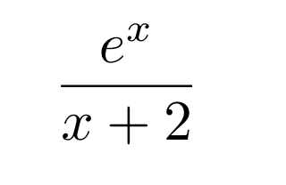

Slide 46
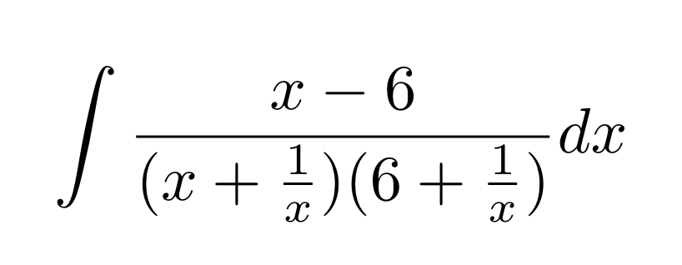

Slide 47
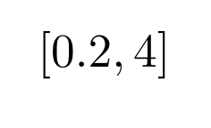

Slide 51
