Slide 1
Chrome River: Good Habits and Helpful Hints
Presented By:
Tammy Ziegler, Sr. Coordinator, University Payables Payment Operations
Rachel Santarelli, Chrome River Senior Specialist, University Payables Payment Operations

Slide 2
Agenda
Chrome River System
OBFS Webpage
Business Purpose
Chrome River Resources
Creating an Expense Report
Avoiding Rejections
Enhancements
Chrome River Invoice
Questions

Slide 3
Chrome River System Information
Currently the University has 30,785 enrolled users in Chrome River
Approximately 250,000 reports (Expense and Invoice) have been approved in FY23
There are 11 Payables staff members reviewing all the submitted Expense and Invoice reports for all campuses, extension units and hospitals

Slide 4
OBFS Website
The OBFS website contains valuable information pertaining to:
–OBFS Policies & Procedures Manual
–Log-in options
–Job aids and Training Materials
–Course and Webinar Registrations
–Additional Resources
https://www.obfs.uillinois.edu/

Slide 6
Chrome River Resource page
https://www.obfs.uillinois.edu/travel-resources
Log into Chrome River
View demo videos
FAQ
Job aids
Service Desk link

Slide 7
Business Purpose
Business Purpose - More information is better
Business purpose requirements are a result of the IRS Accountable Plan rules
Provide the Who, What, When, Where, and Why when entering the business purpose
The business purpose should have enough details to satisfy an auditor’s request for information

Slide 8
IRS Accountable Plan
The University is subject to the IRS Accountable Plan Rules which define the circumstances under which reimbursements are considered non-taxable income.
These are:
The expense must have served a business purpose
The employee has submitted receipts substantiating the date, time, place, and amount within a reasonable amount of time (defined as 60 days)
The employee returns excess advances or reimbursements within a reasonable amount of time (defined as 120 days)

Slide 9
IRS Accountable Plan (additional info)
If all three rules for the accountable plan are met, reimbursements will not be included as income on your W2.
The IRS publication can be found: https://www.irs.gov/publications/p463/ch06.html#en_US_2014_publink100034114

Slide 10
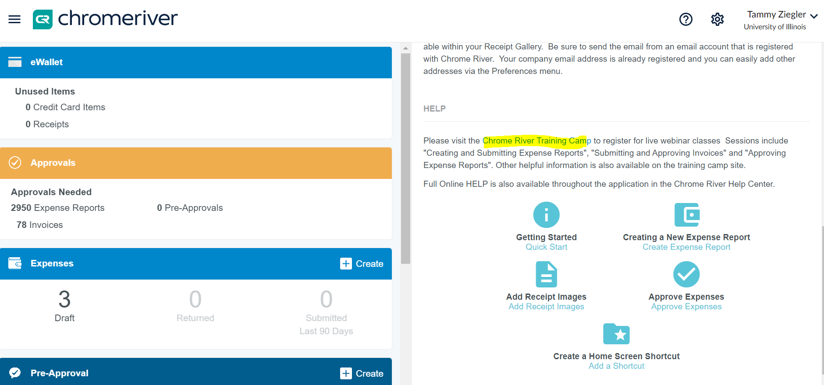
Chrome River Resources

Slide 11
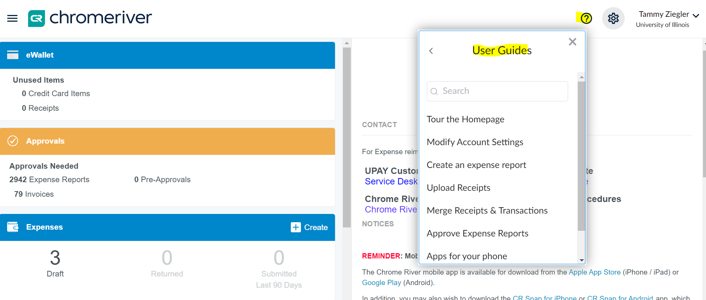
Chrome River Resources

Slide 12
Creating an Expense Report
Which came first the chicken or the egg?
Receipts or the expense report?
5

Slide 13
Creating an Expense Report
Best Practices:
Send receipts to your eWallet
CR Snap
Email to invoices@ca1.chromeriver.com
Upload to your eWallet
Keep your eWallet clean
Merge receipts with the transactions
Correct expense tiles
Use receipts to create your ER
OCR (Optical Character Recognition)
Correct Dates

Slide 14
Creating an Expense Report
The header and why is it important?
Report Type
Determines what expense tiles are displayed
Purchase Type
Choosing Athletics will route the ER to NCAA compliance
Trip Type
Determines the Account Code for the expenses
Fiscal Year
Determines what year to post the transaction to (when more that one fiscal year is open)

Slide 15
Creating an Expense Report
Where do my receipts go?
Header receipts
Email approvals
Conference agenda
Unit specific documents
Proof of payment (if required)
Expense receipts
Only the receipt/folio that pertains to that specific expense should be attached to that expense line

Slide 16
Avoiding Rejections
Enter the correct date
The date field is the date the expense was purchased (it’s almost never “today’s date”)
Start and end dates are dates of travel, start and end of membership, etc.
Enter hotel expenses correctly
All hotel expenses must use the maximum room rate calculation
Start and end date and check in/check out dates should be the same (these reflect the dates covered by the expense/charge)
Itemize by room rate & taxes per night

Slide 17
Avoid Rejections
Use the correct expense tile
Chrome River will assign a tile
Use Non-Employee Travel Expenses
Proof of conference lodging
Cannot use a website link
Enter addresses for mileage
City/state is not specific enough
One mileage line per day
Use “Add Destination”
Use “Return to Start”

Slide 18
Enhancements
Chrome River is committed to the employee experience. Updates/enhancements are rolled out monthly
Business purpose box
Reporting
Accessibility

Slide 19
Chrome River Invoice
Two types of Invoice: Temp Vendor Invoice and Regular Invoice
When to use a Temp Vendor Invoice
Non-Employee Reimbursement
Refund
Human Subjects under $200
Pros/Cons of processing as a temp vendor

Slide 20
Chrome River Invoice
All current student and employees were added to Chrome River invoice
Temp Vendor and Invoice job aids posted on the Chrome River Resource page
Non-Employee job aid coming soon

Slide 21
Questions
Tips for ride-share
There is no maximum for tipping for ride share
How to deal with duplicate charges
How to delete extra receipts

Slide 22
Contact Information
For Chrome River Questions:
Contact: OBFS UPAY Customer Service
E-mail: OBFSUpay@uillinois.edu
Phone: 217-333-6583
Submit a Service Desk Ticket:
https://appserv7.admin.uillinois.edu/FormBuilderSurvey/Survey/OBFS/services/service_desk_request/

Slide 23
Questions?

