Slide 1
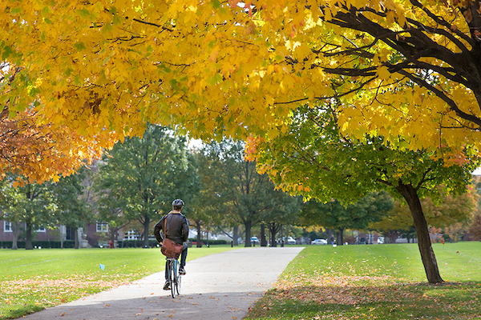
Staying fit…
…in a frantic world
Presented by Michele Guerra
Director, Campus Wellbeing Services

Slide 2
Today’s objectives
Understand how much activity you need
  (not as much as you might think!)
Learn the benefits of lifestyle physical activity
Discover how to fit physical activity into your daily life
Learn how to set yourself up for success
Explore how to overcome barriers to physical activity
Get excited about walking!

Slide 3
Benefits of physical activity
Weight control
Combat chronic disease
Improve your mood
Increased energy
Improved sleep
Increased confidence
Reduced stress
If exercise could be
purchased in a pill,
it would be the single most
widely prescribed and
beneficial medicine
in the nation.”
-Robert H. Butler
Exercise is the pill,
it just takes thirty minutes
to swallow it
-Covert Bailey

Slide 4
How does physical activity reduce stress?
Burns off stress hormones
Triggers release of feel good hormones
Improves physical health → better resilience
Improves your sleep
Enhances self-confidence and elevates mood
Provides the opportunity to “work off” emotions
Can provide an opportunity to “let go”
  grounding and meditative
It’s fun!

Slide 5

2 hours and 30 minutes (150 minutes) each week of moderate-intensity activity
  (30 minutes x 5 days)
OR
1 hour and 15 minutes (75 minutes) each week of vigorous-intensity activity
  (15 minutes x 5 days or 25 minutes x 3 days)
OR
An equivalent mix of moderate and vigorous-intensity activity
AND
8 to 10 strength-training exercises, twice a week (eight to 12 repetitions of each exercise)

Slide 6
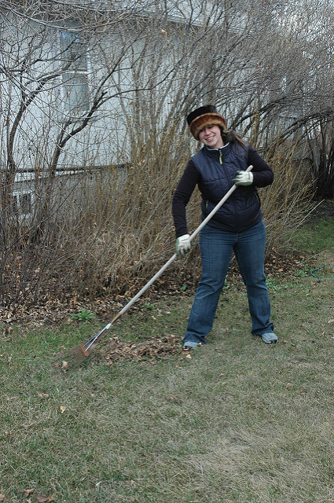
What’s moderate?
Brisk walk
15 to 20-minute mile pace
Walking as if you are late for a meeting
Other activities:
  yard work
  bowling
  bicycling (slow)
  housecleaning
  playing with children

Slide 7
Light, moderate and vigorous
Activity | NO Intensity | Light intensity | Moderate Intensity | Vigorous intensity
Walk/Run | Watching the Boston Marathon | Gentle stroll through the park | Brisk walk | Racewalking, jogging, running
Yard Work | Paying the kid across the street to mow your lawn | Watering the lawn | Mowing the lawn with push (power) mower | Mowing with a hand mower, shoveling
Dance | Watching Dancing with the Stars | Swaying to the music | Doing ballroom dancing | Doing competitive ballroom dancing (or aerobic dance)
House Cleaning | Hiring “Merry Maids” | Dusting, washing dishes | Mopping, vacuuming | Moving furniture

Slide 8

Some is better than none!

Slide 9

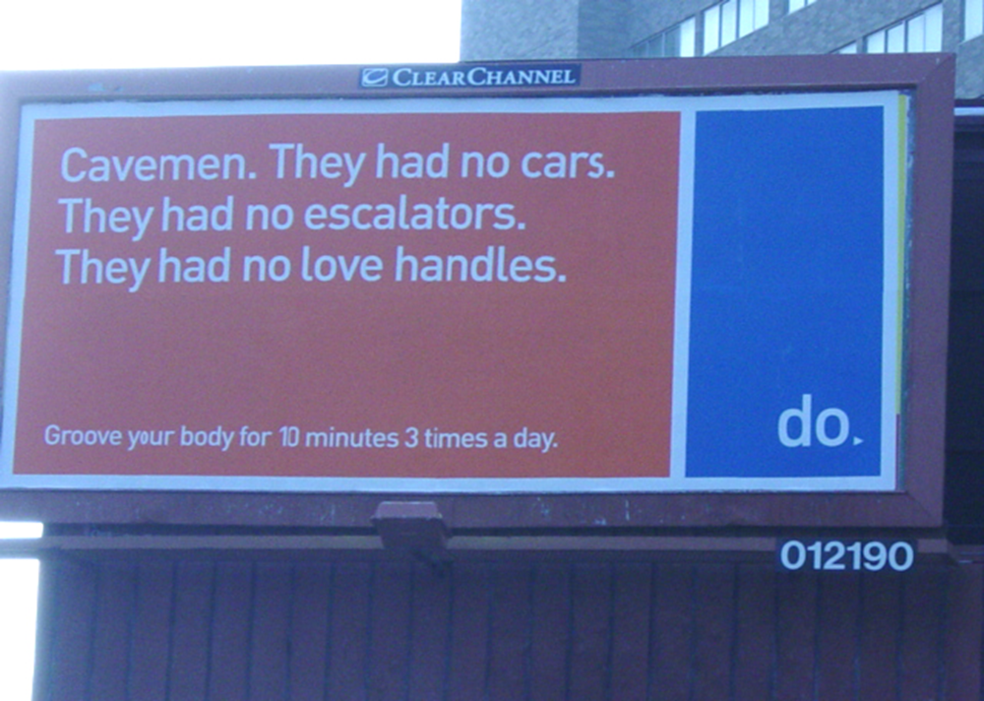
Accumulating short bouts throughout the day is just as effective as continuous 30 minutes
Helps fit physical activity into a busy schedule

Slide 10
How to build up 30 minutes of activity
Two Examples
Morning: Park car ½ mile from office: 10 minutes
Afternoon: Walk back to car: 10 minutes
Evening: Pull some weeds in the garden – 10 minutes
Morning: Walk to meeting (1/2 mile): 10 minutes
Morning: Walk back from meeting: 10 minutes
Lunch: Walk with colleague after lunch: 10 minutes

Slide 11
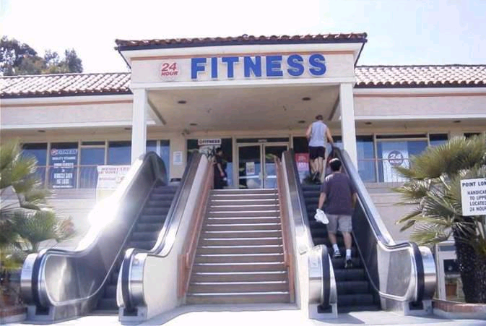
Tip #2: Incorporate
Lifestyle Physical Activity
Making choices to move more in everyday life

Slide 12
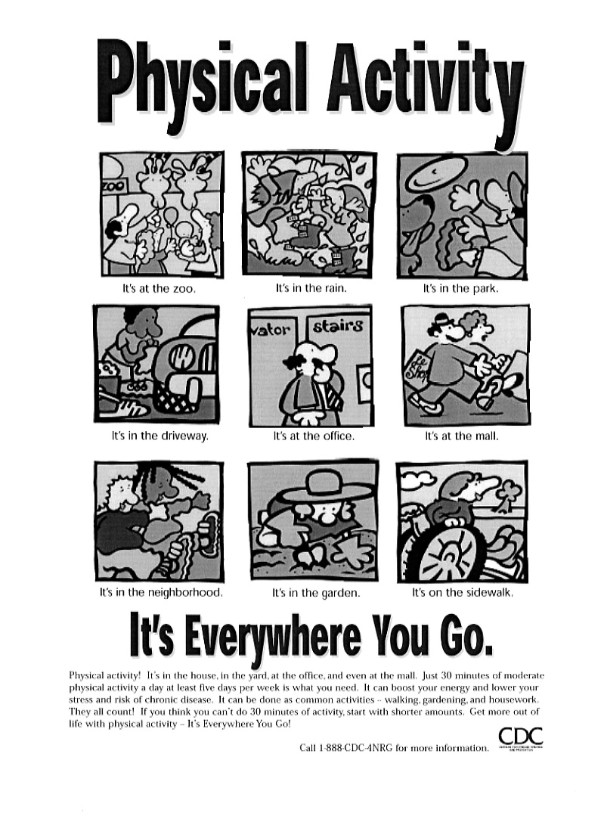
What is Lifestyle PA?
Incorporated into everyday life: household, family, transportation, and leisure-time activities
Examples:
  Gardening
  Playing with children
  Taking the stairs
Can include structured exercise
Use life management skills

Slide 13
Tip #3: Set Yourself up for Success
(with life management skills)
Self-monitor
Seek out Social support
Change self-defeating Self talk
Plan for challenging Situations
Create Solutions to barriers

Slide 14
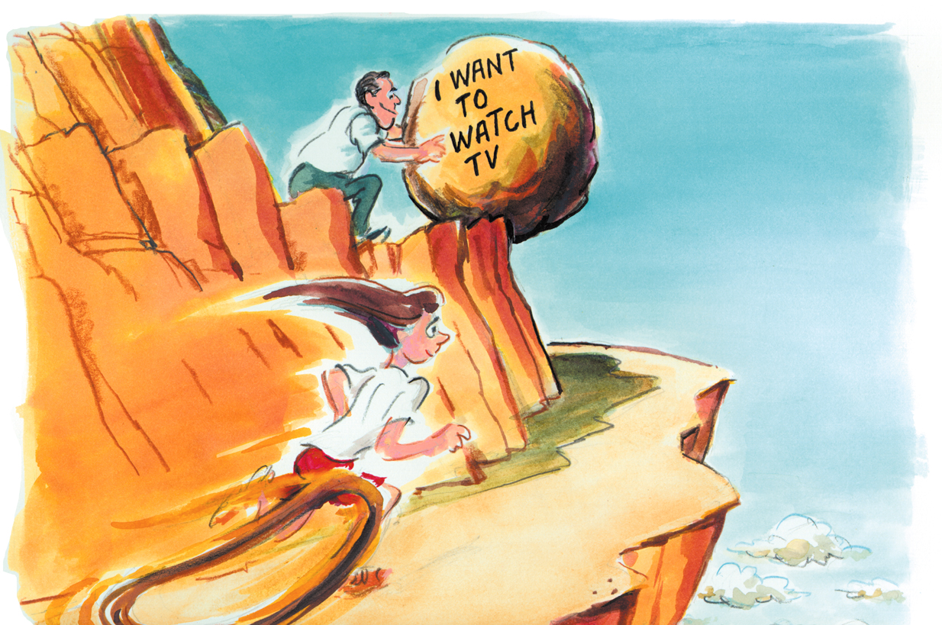
ABCs to Creating
Solutions to Barriers

Slide 15
ABCs to Creating
Solutions to Barriers
Ascertain what gets in your way (barrier)
Brainstorm ways to overcome this barrier
Choose one solution to try
Do it for at least a week
Evaluate and refine your solution

Slide 16
Ascertain what gets in your way
Bad weather keeps me from being active. In particular, I tend to become inactive when the weather is cold and snowy. I don’t like feeling cold and wet. Also, as I’ve gotten older my balance is not as good, and I’m afraid I will fall when it’s snowy or icy outside.

Slide 17
Brainstorm ways to overcome this barrier
Move to Hawaii
Get good outdoor winter clothing and boots
Set-up an indoor garden and tend to it
Buy/ download and do a physical activity video
Walk at the mall

Slide 18
Choose one solution to try
Hawaii – tempting but can’t afford it, also family is here
Winter clothing/boots – Don’t like putting on all those extra clothes.
Garden – I like this idea, but it’s not actually moderate intensity.
Mall walk – I like the mall walking – but I don’t want to have to clean off my car or drive on icy roads.
Video – I like this – saw one I like at my friend’s house, I like to dance, don’t have to scrape the car, drive in snow.
Video – I like this – saw one I like at my friend’s house, I like to dance, don’t have to scrape the car, drive in snow.

Slide 19
Do it for at least a week
Commitment – I will purchase/download the video this weekend, and do it in my home next week on Monday Wednesday and Friday.

Slide 20
Evaluate your solution
My plan worked okay, but could be better. I downloaded the video that weekend, and did it at home on Monday, but skipped on Wednesday and Friday. I think that if I had someone to do the video with me I’d be more successful. I’ll ask my friend in my building (where I first saw the video) if she’ll do it with me next week.

Slide 21
What’s your PA personality?
Social or Solitary?
Competitive or Cooperative?
Meditative?
Musical?
Natural?
Wet, dry, sweat?
Physical ability (pain conditions, coordination)?
What activities do you like?

Slide 22

Take Your Dog for a Walk
-even if you don’t have a dog

Slide 23
Get Excited about Walking!!!!
Most popular physical activity
Easy-to-do – no special skills needed
Can be done just about anywhere
Does not require special equipment
It’s FUN!
I WON’T exercise, but I WILL walk
-Provena USMC Wellness Participant

Slide 24
Physical activity in a pandemic: Safety practices
-
Maintain at least six feet distance
Wear a mask
  even if you are venturing out alone
Wash your hands before and after
Bring your own hand sanitizer and water

Slide 25
Physical activity in a pandemic
More safety tips
Limit groups to 10 or less
Meet at distant locations rather than carpooling
Choose outdoor activities over confined indoor spaces
Select non-contact activities

Slide 26
Physical activity in a pandemic PA
Physically distant options
Hike
Paddle
Bike
Golf or tennis
Dance
Get stuff done
Activate your TV time
Take active breaks
Discover your inner kid

Slide 27
Physical activity on campus
Walk it
Bike it
Campus Recreation
  In-person and virtual options
Krannert Art Museum – virtual yoga
Allerton Park

Slide 28
Resources
Be Active Your Way
http://www.health.gov/paguidelines/adultguide/activeguide.aspx
Campus Wellbeing Services – IWalk toolkit
http://humanresources.illinois.edu/campus-wellbeing-services/resources/online-toolkits/iWalk-Toolkit/index.html
Campus Recreation http://www.campusrec.illinois.edu/
Bike Illinois https://bike.illinois.edu/
VeoRide https://www.veoride.com/uiuc/

Slide 29
Final thoughts
Some is better than none!
Small changes make a BIG difference
Spread out your activity
Discover lifestyle physical activity
Look for opportunities to move everywhere!
Ensure success with life management skills
Problem solve barriers to physical activity
Have FUN!!!!

Slide 30
Michele Guerra
Director, Campus Wellbeing Services
mguerra@illinois.edu
(217) 244-2205
Thanks for attending!
For more info contact

