Slide 1
Rock your personal LinkedIn profile
Blaine Hanson

Slide 2
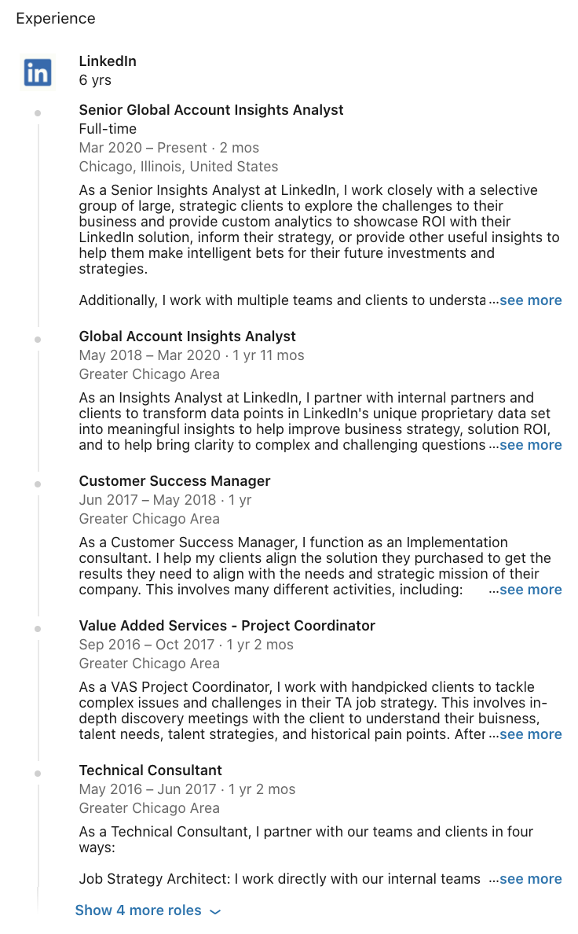
Blaine Hanson
Sr. Insights Analyst at LinkedIn
6 years at LinkedIn
Recent iMBA Grad
Work with World’s Largest Staffing Firms
Full Time Dad
Lover of Whiskey, Books, & Blues Guitar

Slide 3
What is your LinkedIn Profile?
Hiring YOU is a Risk
Good Bet?
Bad Bet?

Slide 4
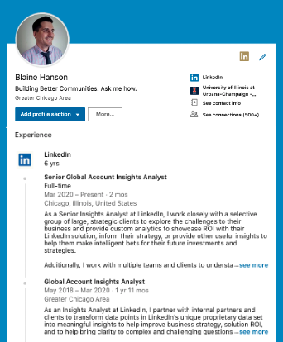
The Bias Behind Your Value Proposition
What I They believe about themselves
What I Believe about Myself
What I Believe about my Career
What I They believe about their career

Slide 5
7 Toxic Career Path Myths:
A successful career path is a straight line.
You need a 10-year plan right now.
Not getting a role indicates I have low value.
You need to work for an amazing brand.
Your degree focus defines your career.
A specific “title” will give job security.
Asking questions about career pathing shows weakness.

Slide 6
Building a great profile

Slide 7
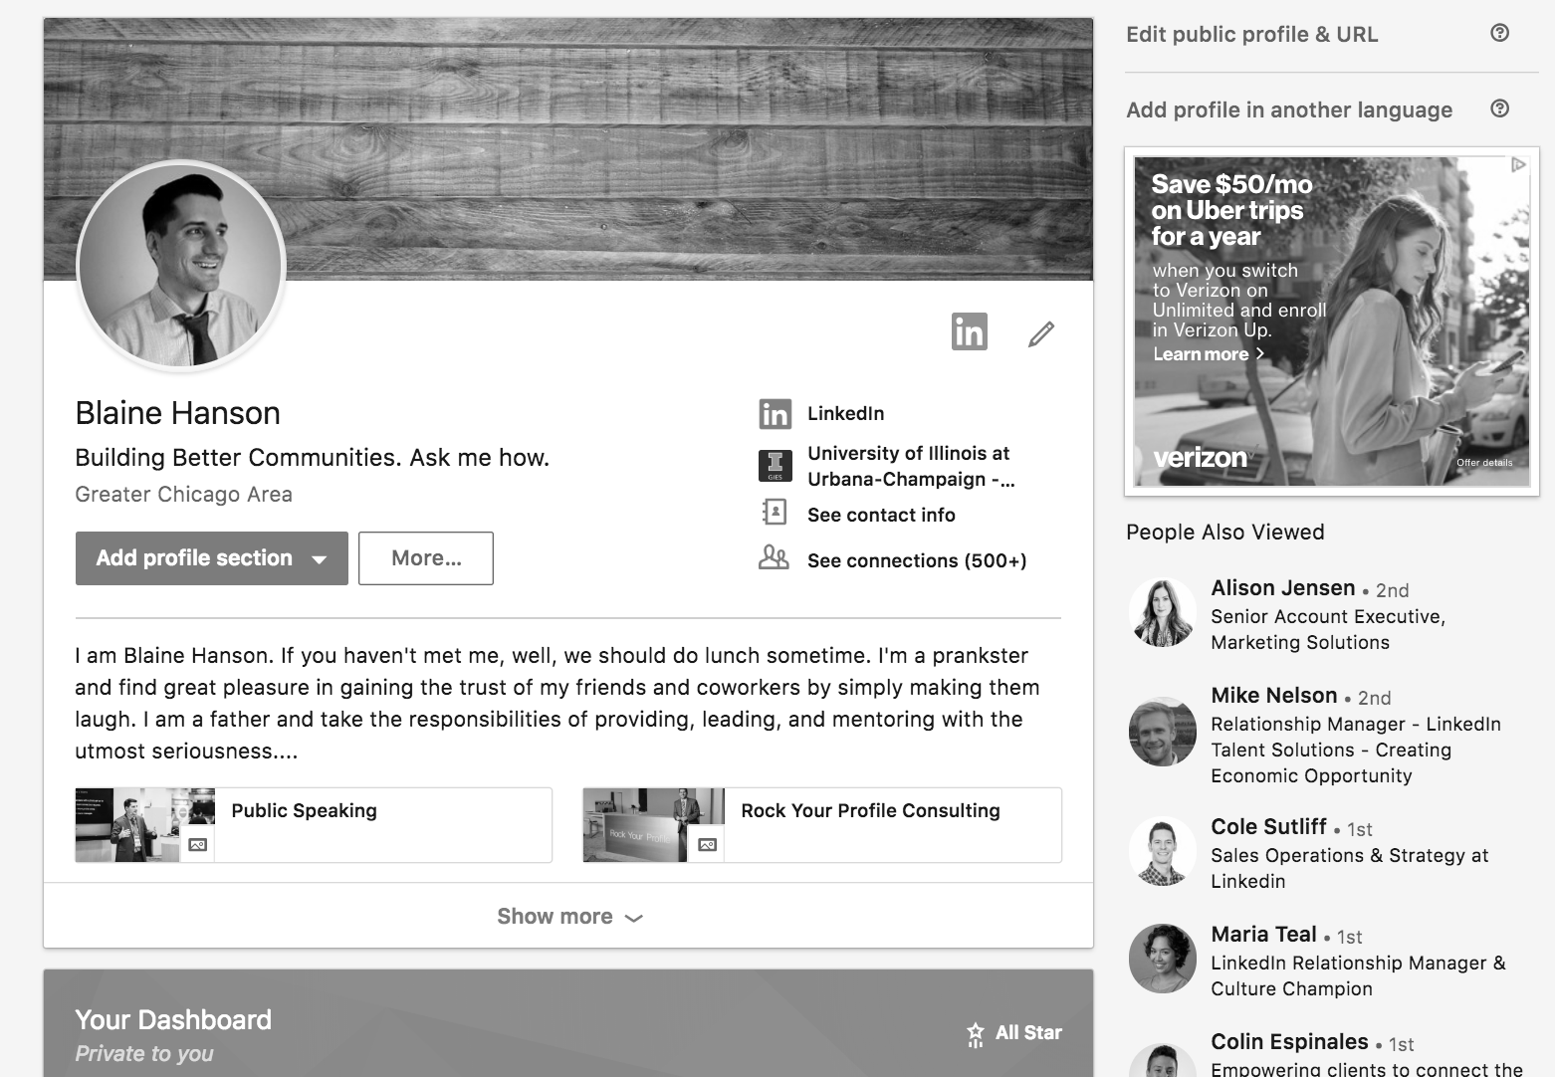
ADD A PHOTO
Members with a photo get up to:
9x more connection requests
21x more Profile views
36x more messages

Slide 8
ADD A BACKGROUND PHOTO
Let Viewers Know:
Your Profile is Up To Date
You Care

Slide 9
CREATE A COMPELLING HEADLINE
Your Headline Should:
Set Perception Bias
Be Your Intro to Your Hero
Define Your Brand

Slide 10
CRAFT THOUGHTFUL SUMMARY
Your Photo & Headline Get Attention…
Your Summary Expands Your Brand
Define Your Strengths, Interests, and Unique Traits or Skills
Emulate a 3 Minute Talk With Your Hero

Slide 11
DETAIL YOUR WORK EXPERIENCE
Members with up-to-date positions receive up to:
5x more connection requests
8x more Profile views
10x more messages

Slide 12
ADD EXAMPLES OF YOUR WORK
Upload photos, presentations, and videos
Give a dynamic, visually appealing representation of your professional story

Slide 13
ADD SKILLS & GET ENDORSED
Add at least 5 skills (soft skills and technical skills)
Members with 5 or more skills are found up to 27x more by recruiters via search

Slide 14
Location
Education
Volunteer experience and causes
Accomplishments: languages, organizations, certifications, publications, etc.
What else?

Slide 15
Sharing updates vs. publishing posts
Helping you grow and engage your network
Updates
Publishing
Share links, articles, images, quotes, or anything else your followers might be interested in
Deeply explore topics that matter to you, then watch the comments to see your impact

Slide 16
REMEMBER:
You Are a CEO.
Personal Brand = Your Company.
Your Profile is Pitching 24/7.
Opportunity is a Goldfish.

