Slide 1
You Can’t Avoid Career Transition
Notes:
How many people in the room are marketers vs. hr practioners?

Slide 2
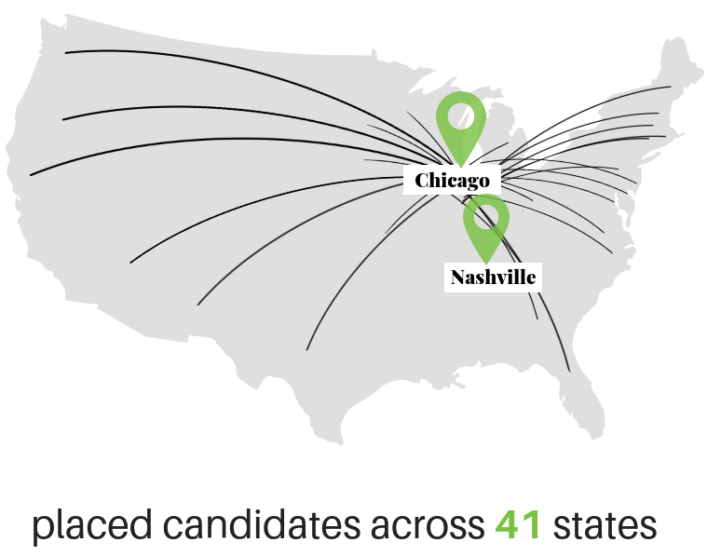
About LaSalle Network
Temporary and Contract | Direct Hire| Culture Consulting
Accounting & Finance ​
Administrative ​
Customer Service ​
Human Resources​
Healthcare Revenue Cycle ​
Marketing ​
Sales ​
Supply Chain ​
Technology

Slide 3
Recognition
@LaSalleNetwork

Slide 4
Laura Bellis Accenture | Leapsource Booz Allen | Notre Dame

Slide 6
Situations
You’ve been fired…or lost a job for another reason
You’re in a Dead-End Job
You’re Faced With an Unplanned Opportunity
You’ve Decided to Take a Leap
@LaSalleNetwork

Slide 7
YOU’RE FIRED!
What should you do?
@LaSalleNetwork

Slide 8
Coffee Chats.
@LaSalleNetwork

Slide 9
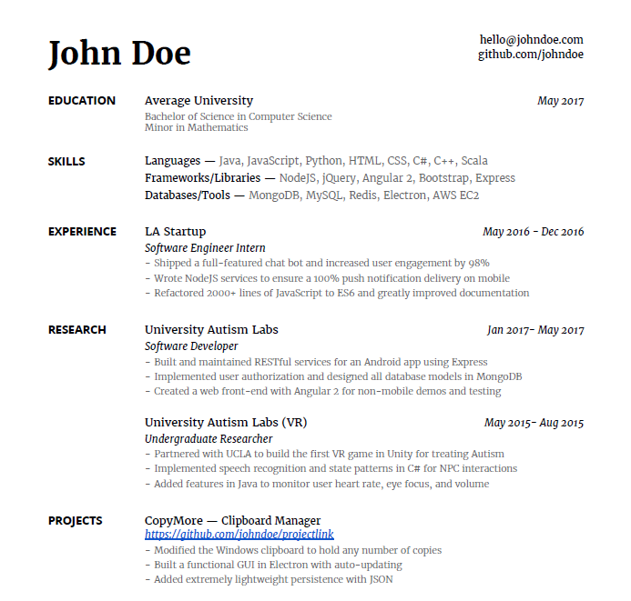
RESUME DUMP
@LaSalleNetwork

Slide 10
UPDATE
@LaSalleNetwork

Slide 11
Keep up with industry trends
@LaSalleNetwork

Slide 12
Daily
Interact With Your Homepage Feed
Weekly
Post Something
Add New Contacts
Monthly
Update Your Profile
Contribute to a Couple of Groups
Reach Out to Old Contacts
@LaSalleNetwork

Slide 13
You’re Stuck in a Dead-End Job
Further advancement isn’t possible
Identify and develop relevant skills that would add value to any prospective employer in the future
Formal or Self-Taught
@LaSalleNetwork

Slide 14
Reassess Priorities
Skills/Competencies/Strengths
What do I enjoy most now? What do I want to develop?
Fields of Interest
What am I interested in learning next? Is there a constant?
Work Culture
What do I need now to be happy?
People & Values
What is most important to me right now?
Rewards
What has become more important to me over time?
@LaSalleNetwork

Slide 15
According to Bill Burnett and David Evans who wrote the book “Designing Your Life”
“
We all contain enough energy and talents and interest to live many different types of lives, all of which could be authentic and interesting and productive.
”
@LaSalleNetwork

Slide 16
Lifeline Exercise by Andy Chan
+
-
@LaSalleNetwork

Slide 17
Where do I start?
@LaSalleNetwork
Notes:
How many people in the room are marketers vs. hr practioners?

Slide 18
Job Search Funnel
Geography
Career
Industry
Company
@LaSalleNetwork

Slide 19
Open an excel spreadsheet
Columns:
Is the company hiring?
Any jobs of interest to me?
Do I know anyone there?
How big of a stretch would this be?
Is this a good geographic location for me?

Slide 20
Unexpected
@LaSalleNetwork

Slide 21
Was Not Expecting This!
A positive situation unexpectedly manifests
In this situation you need to maximize your hustle
Take the opportunity to grow and learn
What Work Hustle Looks Like
Work hustle is all the things you do to rock your career, to get stuff done
And when you do this, you ultimately build a job you love
@LaSalleNetwork

Slide 22
The Leap
Voluntarily leap into a new career, location, or responsibility
Big life-impacting choices
@LaSalleNetwork

Slide 23
Transferable Skills
Transferable skills are the tools you’ll need to adapt to a new job
Everyone has transferable skills, even if you’ve worked in one specific job for many years
Leverage the power of transferable skills acquired in previous jobs to get ahead of the competition
Examples:
Problem Solving
Leadership and Team Management
Communication Skills
Data Analysis
Ability to Learn New Skills
@LaSalleNetwork

Slide 24
Be Prepared To Go The Extra Mile
@LaSalleNetwork

Slide 25
It’s True…
Things are going to happen in your career. Some of them will be good, others not so good
Some transitions will happen because of something your do, while others will be at the hands of someone else
No matter what, if you couple relationships with guts, character with values, skills with foresight, and mix in hustle with time management—nothing can stop you
@LaSalleNetwork

Slide 26
Questions?
Laura Bellis
lbellis@lasallenetwork.com
312-419-1700
@LaSalleNetwork

