Slide 1
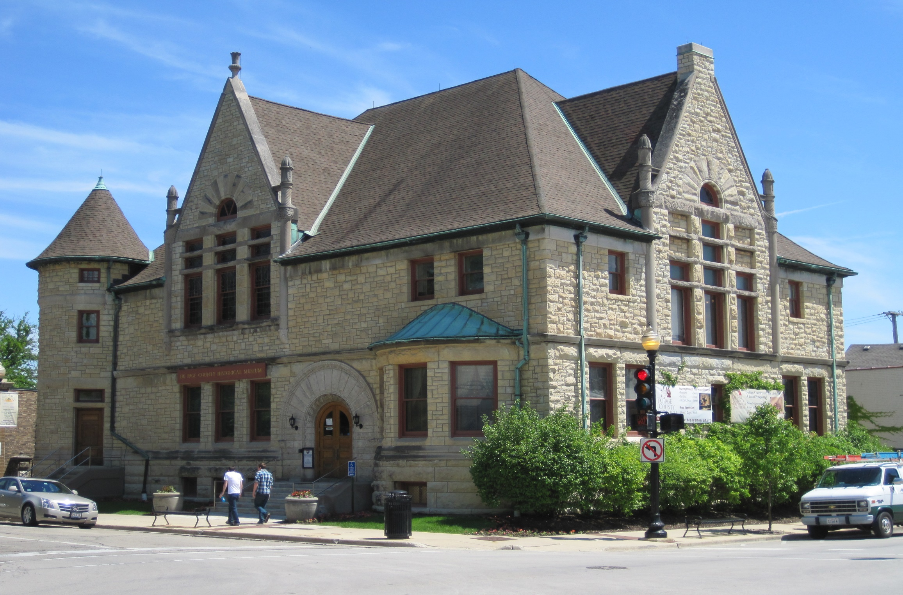

Slide 2
MY FIRST CLUES TO THE UNDERGROUND RR STORY
The curator said, “There is no book on the subject, but you might find something in these two books “
and she handed me THE DUPAGE COUNTY GUIDE and GLEN ELLYN, THE STORY OF AN OLD TOWN.

Slide 3
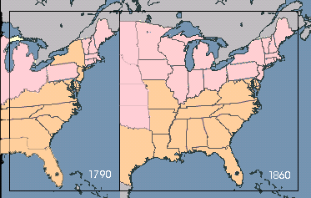


Slave & Free Areas
Slavery Permitted
Slavery Prohibited

Slide 4
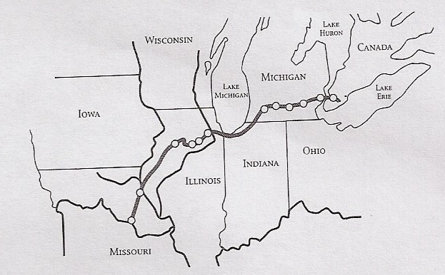
Notes:
4

Slide 5
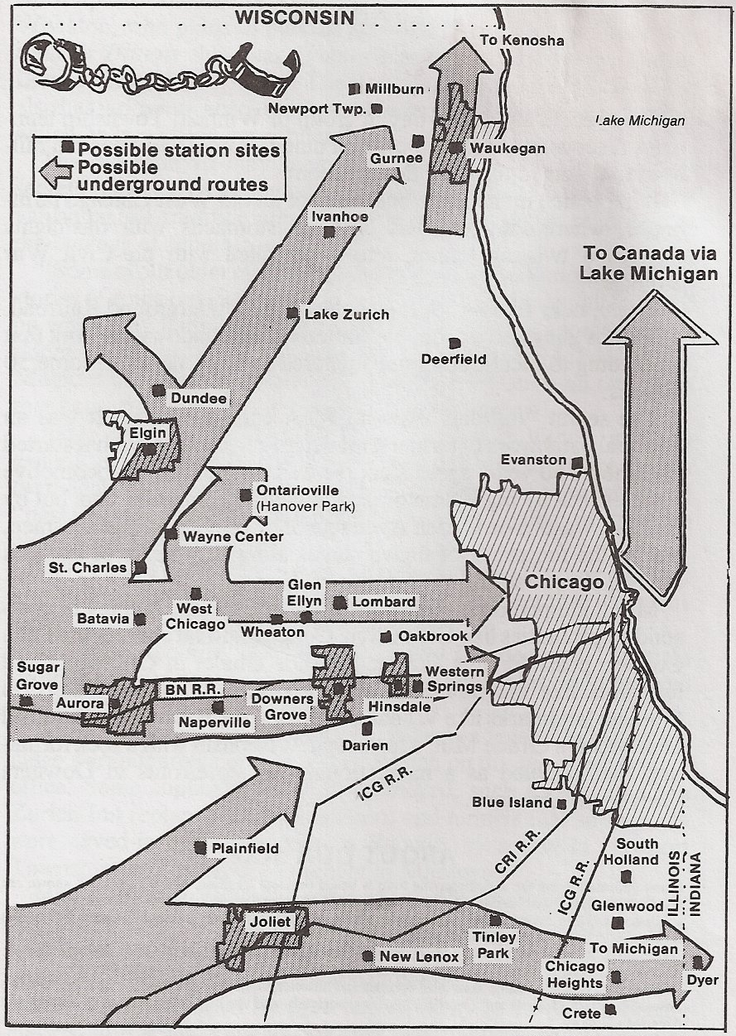
Routes thru
Chicago
Suburbs

Slide 6
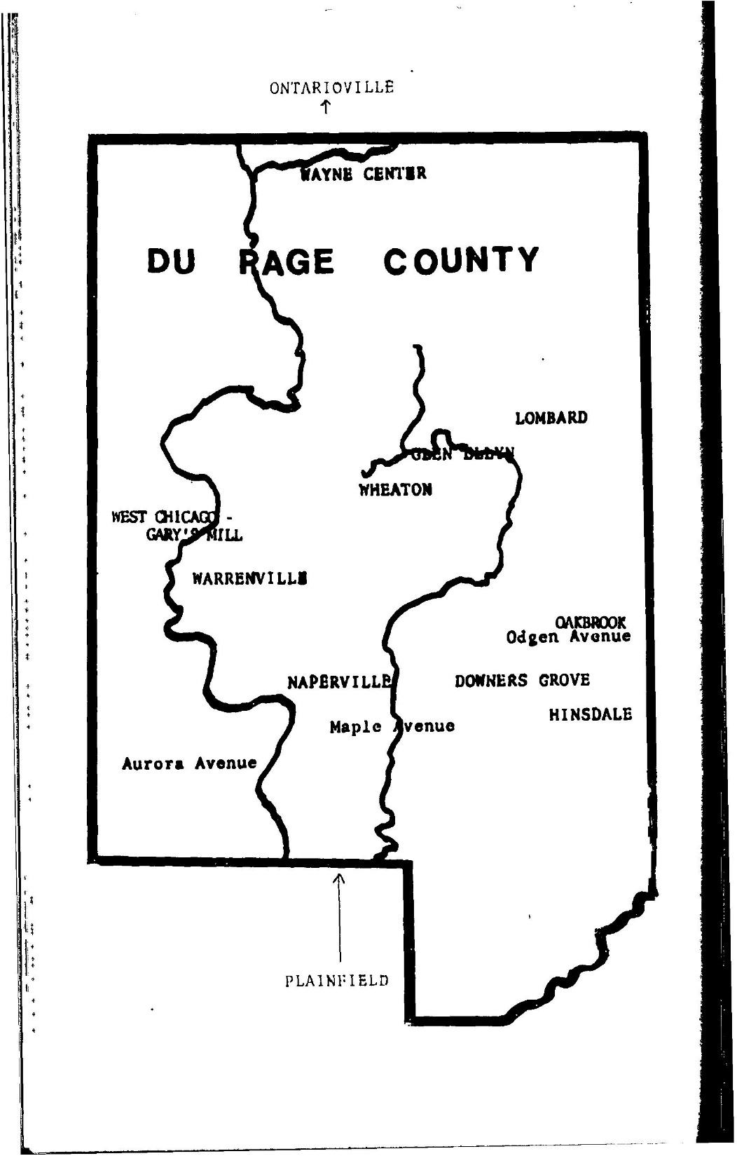
East and west branches of the DuPage River and towns where there was Underground Railroad activity.

Slide 9
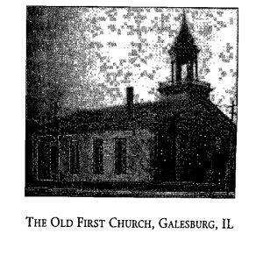
GALESBURG

Slide 10
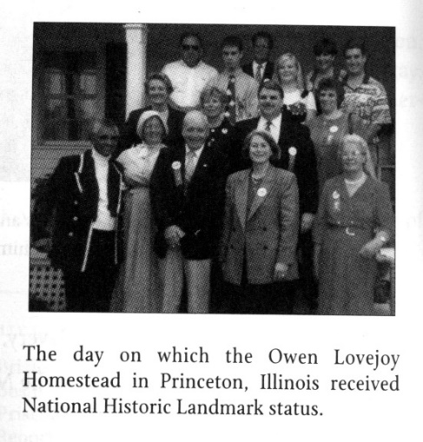
PRINCETON
This picture was taken on the day that the Owen Lovejoy Homestead received National Landmark status.

Slide 11
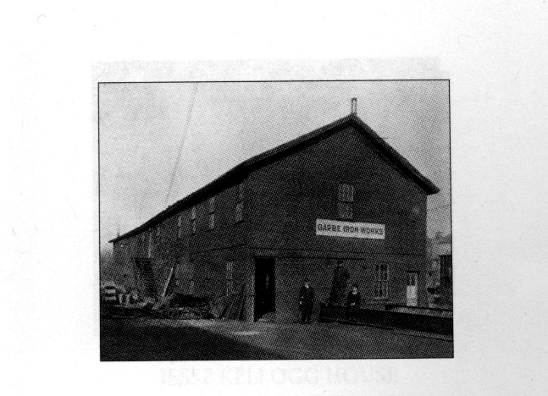
AURORA
The historic Aurora Congregational Church building became an iron works before it was eventually demolished. Within its walls courageous antislavery speakers discussed the issues of the day including such nationally known orators as Frederick Douglass. On one such visit Douglass won General John Farnsworth over to the abolitionist cause.
Courtesy the Aurora Historical Society

Slide 12
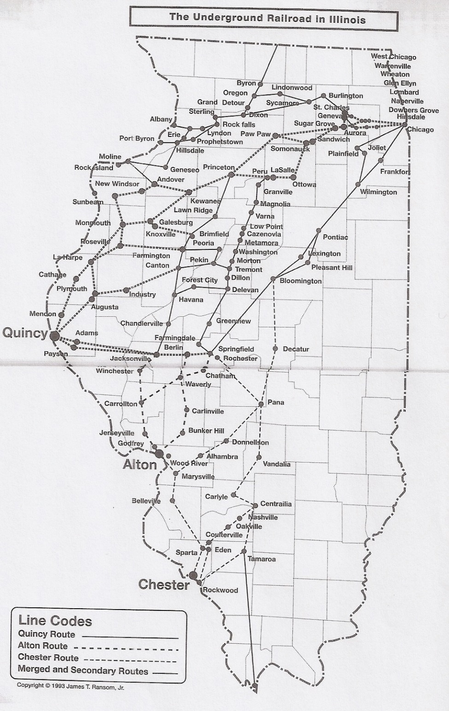

Slide 14
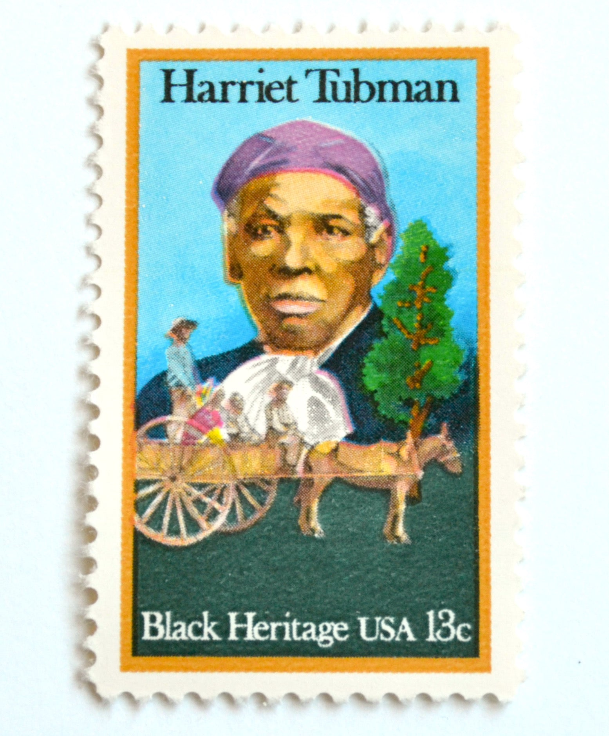

Slide 15
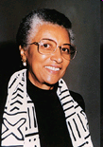
Glennette Tilley Turner
Power Point created by Bianca McKinley

