Slide 1
GPress: a framework for querying genome annotation files in a compressed form
Qingxi Meng
Advisor: Prof. Idoia Ochoa
15th CSL Student Conference

Slide 2
Table of Contents
Motivations
Method Overview
Compression
Random Access
Extension to other files: expression files
Conclusion

Slide 3
1.
Motivations

Slide 4
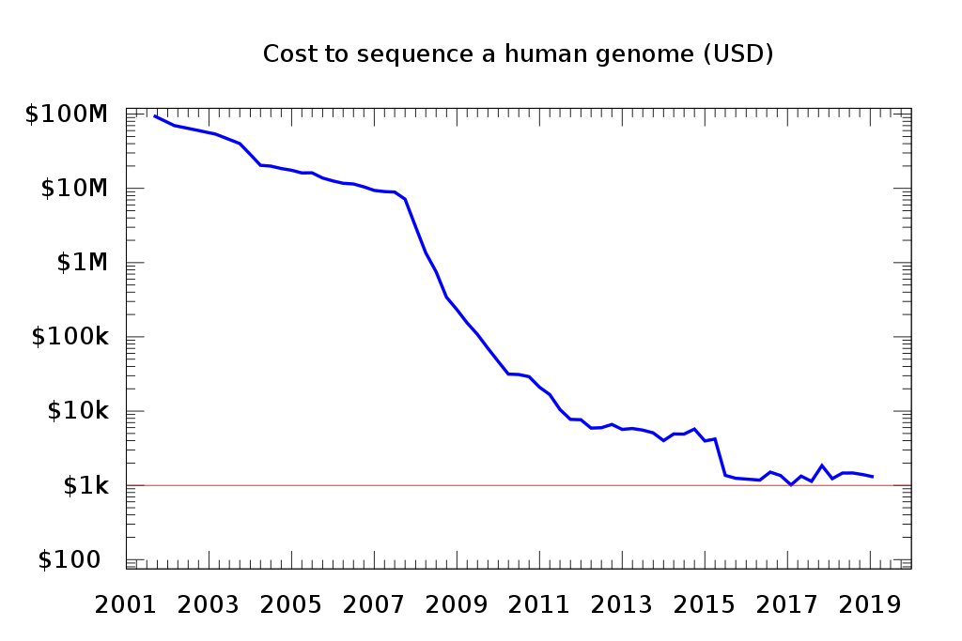

Slide 5
Many large genomic projects use GFF files
5000 Insect Genome Initiative (i5k)
Plant Genome Intiative
Genome 10K (G10K)

Slide 6
Challenges
Storage of GFF files takes more and more space
GFF files are frequently revised, annotated, queried and streamed

Slide 7
Current GFF utilities
tabix: use a general compressor
gffutils by python: don’t compress data
gffread: works directly on original file

Slide 8
Our framework: GPress
Save Space: compression of GFF files
Supports quick searches: random access

Slide 9
2.
Method Overview

Slide 10
seqname
source
feature
start
end
score
strand
frame
attribute
chr1 HAVANA gene 11869 14409 . + . gene_id "ENSG00000223972.5"; gene_type "transcribed_unprocessed_pseudogene"; gene_name "DDX11L1"; level 2; havana_gene "OTTHUMG00000000961.2";

Slide 11
Each GFF file consists of 9 columns of data
Column 1: Seqname (string)
Column 2: Source (string)
Column 3: Feature (string)
Column 4: Start (integer)
Column 5: End (integer)
Column 6: Score (floating point)
Column 7: Strand (char)
Column 8: Frame (integer)
Column 9: Attribute (string)

Slide 12
Idea:
divide the columns into different data streams
seqname
source
feature
start
end
score
strand
frame
attribute
chr1 HAVANA gene 11869 14409 . + . gene_id "ENSG00000223972.5"; gene_type "transcribed_unprocessed_pseudogene"; gene_name "DDX11L1"; level 2; havana_gene "OTTHUMG00000000961.2";

Slide 13
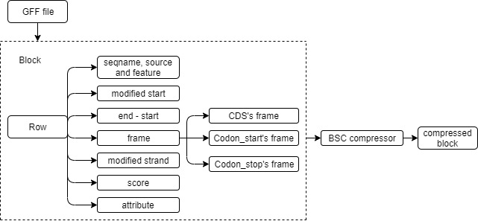
Block Diagram for GPress Encoder

Slide 14
Average a 98% reduction in original file
Results
But we still need to decompress the whole file for searches
Idea: compress in blocks

Slide 15
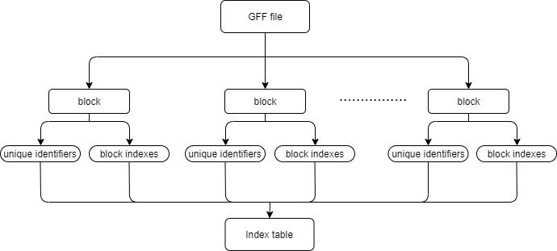
Random Access

Slide 16
ID search
Results
Given an ID (e.g. ENSE00003486434.1), the GPress can print out the item’s information in around 2.5 seconds.
Range search
Given a range of coordinates (e.g. 10000 to 100000), the GPress can print out all items in around 4.5 seconds.

Slide 17
3.
Extention to other files

Slide 18
Expression Files
ENST00000567887.5|ENSG00000004059.10|OTTHUMG00000023246.5|OTTHUMT00000059567.2|ARF5-001|ARF5|1103|protein_coding| 01c9c486-321f-4ebc-ade7-bbe6ea5c4a6e 5060.01331481811 142.006325562341 892.1653 1103
Column 1: target ID
Column 2: sample
Column 3: EST counts
Column 4: tpm value
Column 5: effective length
Column 6: length

Slide 19
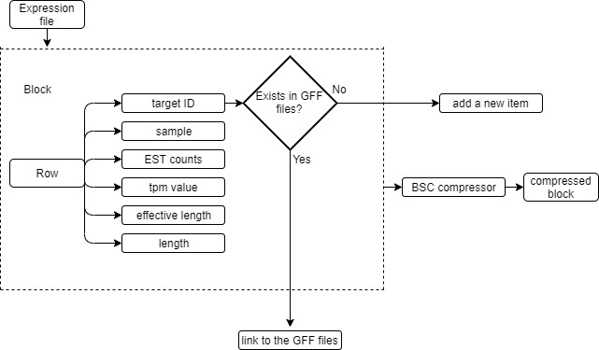
Use Same Idea

Slide 20
Results
Reduce expression file size by more than 68% compared to gzip.
Retrieves the information within seconds.

Slide 21
4.
Conclusion

Slide 22
Conclusion
Average a 98% reduction in original GFF file
Around twice better than gzip
Supports queries in seconds
Can support expression files

Slide 23
Future Work: Other annotation files with similar structure
WIG files
VCF files
BED files
…….

Slide 24
Thanks!
Any questions?

