Slide 1
REGULATORY GENOMICS
Saurabh Sinha, Dept. of Computer Science & Institute of Genomic Biology, University of Illinois.

Slide 2
Introduction …

Slide 3
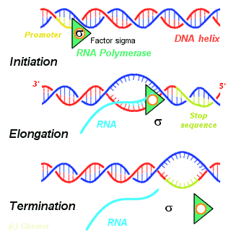
Genes to proteins: “transcription”
RNA Polymerase
http://instruct.westvalley.edu/svensson/CellsandGenes/Transcription%5B1%5D.gif

Slide 4

Regulation of gene expression
More frequent transcription => more mRNA => more protein.

Slide 5
Cell states defined by gene expression
Gene 4
Genes 1&4
Genes 1&2
Genes 1&3

Slide 6
Cell states defined by gene expression
gastrulation
fertilization
posterior
anterior
Progressed disease
Disease onset
Foraging behavior
Nurse behavior

Slide 7
How is the cell state specified ?
In other words, how is a specific set of genes turned on at a precise time and cell ?

Slide 8
Gene regulation by “transcription factors”
TF
GENE

Slide 9
Transcription factors
may activate …
or repress
TF
TF
TF
TF
TF
TF
TF
TF

Slide 10
Gene regulation by transcription factors determines cell state
Bcd (TF)
Kr (TF)
Eve
(TF)
Hairy
Regulatory effects can “cascade”
Gene Eve is “on” in a cell if “Bcd present AND Kr NOT present”.

Slide 11
Gene regulatory networks

Slide 12
Goal: discover the gene regulatory network
Sub-goal: discover the genes regulated by a transcription factor

Slide 13
Genome-wide assays
One experiment per cell type ... tells us where the regulatory signals may lie
One experiment per cell type AND PER TF
... tells us which TF might regulate a gene of interest
Expensive !

Slide 14
Goal: discover the gene regulatory network
Sub-goal: discover the genes regulated by a transcription factor
… by DNA sequence analysis

Slide 15
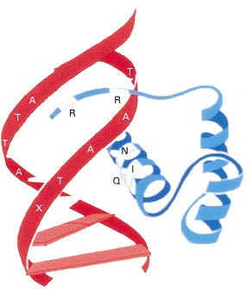
The regulatory network is encoded in the DNA
http://www.ncbi.nlm.nih.gov/bookshelf/br.fcgi?book=mcb&part=A2574
TF
GENE
BINDING
SITE
A TF bound to a “TAAT” site in DNA.
It should be possible to predict where transcription factors bind, by reading the DNA sequence
TCTAATTG

Slide 16
Motifs and DNA sequence analysis

Slide 17
Finding TF targets
Step 1. Determine the binding specificity of a TF
Step 2. Find motif matches in DNA
Step 3. Designate nearby genes as TF targets

Slide 18
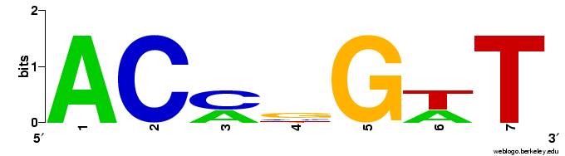
Step 1. Determine the binding specificity of a TF
ACCCGTT
ACCGGTT
ACAGGAT
ACCGGTT
ACATGAT
“MOTIF”
5 | 0 | 2 | 0 | 0 | 2 | 0 | A
0 | 5 | 3 | 1 | 0 | 0 | 0 | C
0 | 0 | 0 | 3 | 5 | 0 | 0 | G
0 | 0 | 0 | 1 | 0 | 3 | 5 | T

Slide 19
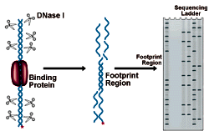
How?
1. DNase I footprinting
TAACCCGTTC
TAACCCGTTC
GTACCGGTTG
GTACCGGTTG
ACACAGGATT
ACACAGGATT
AACCGGTTA
AACCGGTTA
GGACATGAT
GGACATGAT
http://nationaldiagnostics.com/article_info.php/articles_id/31

Slide 20
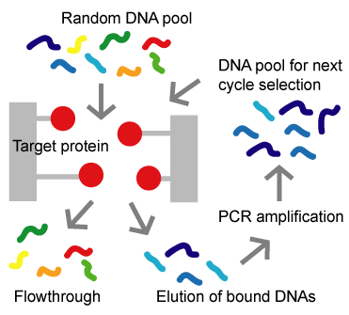
How?
2. SELEX
TAACCCGTTC
TAACCCGTTC
GTACCGGTTG
GTACCGGTTG
ACACAGGATT
ACACAGGATT
AACCGGTTA
AACCGGTTA
GGACATGAT
GGACATGAT
http://altair.sci.hokudai.ac.jp/g6/Projects/Selex-e.html

Slide 21
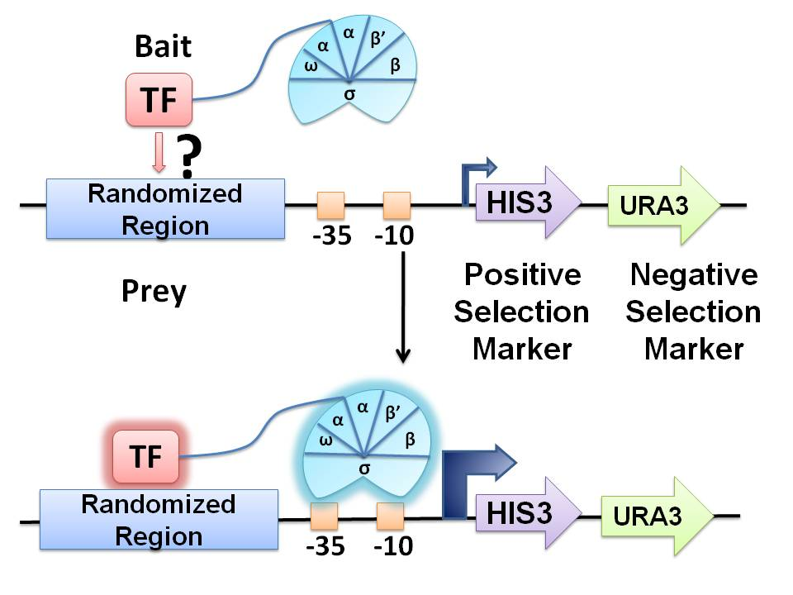
How?
3. Bacterial 1-hybrid
TAACCCGTTC
TAACCCGTTC
GTACCGGTTG
GTACCGGTTG
ACACAGGATT
ACACAGGATT
AACCGGTTA
AACCGGTTA
GGACATGAT
GGACATGAT
http://upload.wikimedia.org/wikipedia/commons/5/56/FigureB1H.JPG

Slide 22
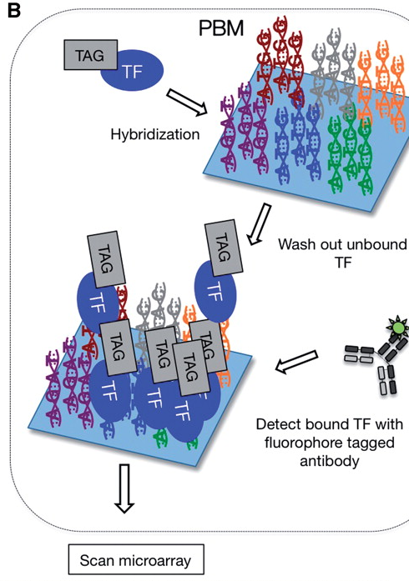
How?
4. Protein binding microarrays
TAACCCGTTC
TAACCCGTTC
GTACCGGTTG
GTACCGGTTG
ACACAGGATT
ACACAGGATT
AACCGGTTA
AACCGGTTA
GGACATGAT
GGACATGAT
http://bfg.oxfordjournals.org/content/9/5-6/362/F2.large.jpg

Slide 23
Motif finding tools
How did this happen?
TAACCCGTTC
TAACCCGTTC
GTACCGGTTG
GTACCGGTTG
ACACAGGATT
ACACAGGATT
AACCGGTTA
AACCGGTTA
GGACATGAT
GGACATGAT
Run a motif finding tool (e.g., “MEME”) on the collection of experimentally determined binding sites, which could be of variable lengths, and in either orientation.
We’ll come back to motif finding tools later.

Slide 24

Motif Databases
JASPAR: http://jaspar.genereg.net/

Slide 25
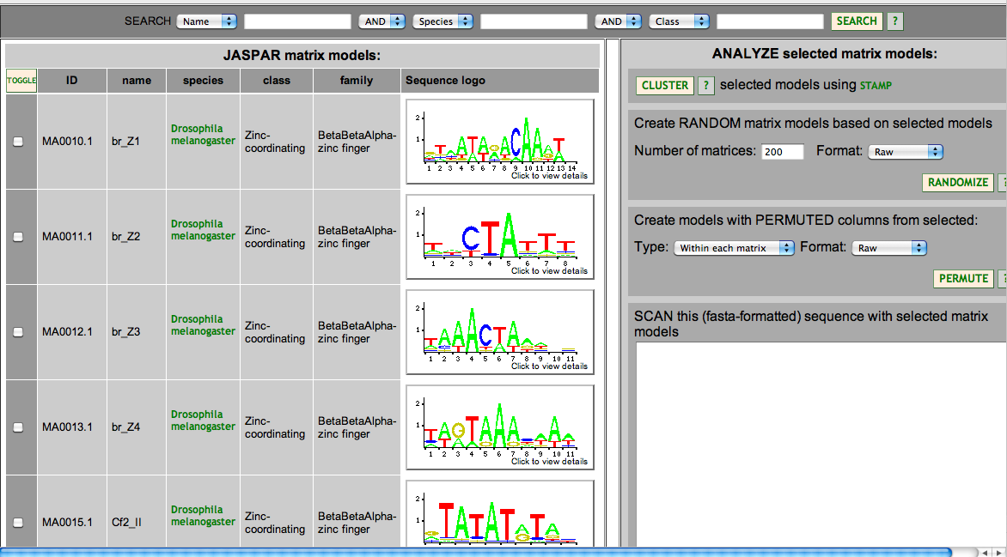
Motif Databases
JASPAR: http://jaspar.genereg.net/

Slide 26
Motif Databases
TRANSFAC
  Public version and License version
Hocomoco: http://hocomoco.autosome.ru/
  Human and mouse motifs
UniProbe: http://the_brain.bwh.harvard.edu/uniprobe/
  variety of organisms, mostly mouse and human

Slide 27
Motif Databases
Fly Factor Survey: http://pgfe.umassmed.edu/TFDBS/
  Drosophila specific
  In analyzing insect genomes, motifs from this database can be used, with some additional checks.

Slide 28
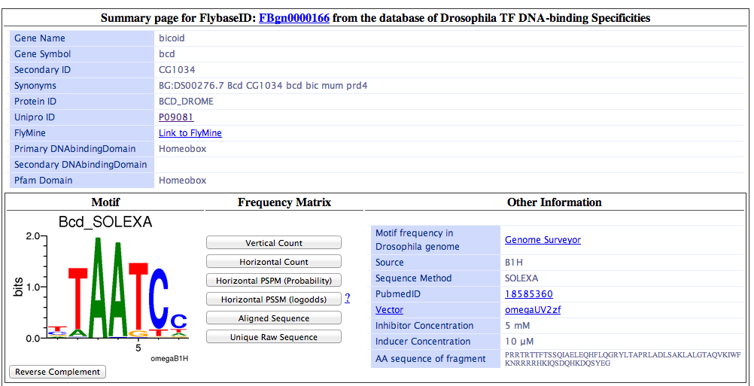
Sample entry in Fly Factor Survey

Slide 29
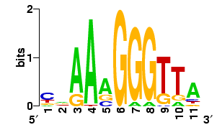
Step 2. Finding motif matches in DNA
Basic idea:
To score a single site s for match to a motif W, we use
Motif:
Match: CAAAAGGGTTA
Apprx. Match: CAAAAGGGGTA

Slide 30
What is Pr (s | W)?
5 | 0 | 2 | 0 | 0 | 2 | 0 | A
0 | 5 | 3 | 1 | 0 | 0 | 0 | C
0 | 0 | 0 | 3 | 5 | 0 | 0 | G
0 | 0 | 0 | 1 | 0 | 3 | 5 | T
1 | 0 | 0.4 | 0 | 0 | 0.4 | 0 | A
0 | 1 | 0.6 | 0.2 | 0 | 0 | 0 | C
0 | 0 | 0 | 0.6 | 1 | 0 | 0 | G
0 | 0 | 0 | 0.2 | 0 | 0.6 | 1 | T
Now, say s =ACCGGTT (consensus)
Pr(s|W) = 1 x 1 x 0.6 x 0.6 x 1 x 0.6 x 1 = 0.216.
Then, say s = ACACGTT (two mismatches from consensus)
Pr(s|W) = 1 x 1 x 0.4 x 0.2 x 1 x 0.6 x 1 = 0.048.

Slide 31
Scoring motif matches with “LLR”
Pr (s | W) is the key idea.
However, some statistical massaging is done on this.
Given a motif W, background nucleotide frequencies W_{b} and a site s,
LLR score of s =
Good scores > 0. Bad scores < 0.

Slide 32
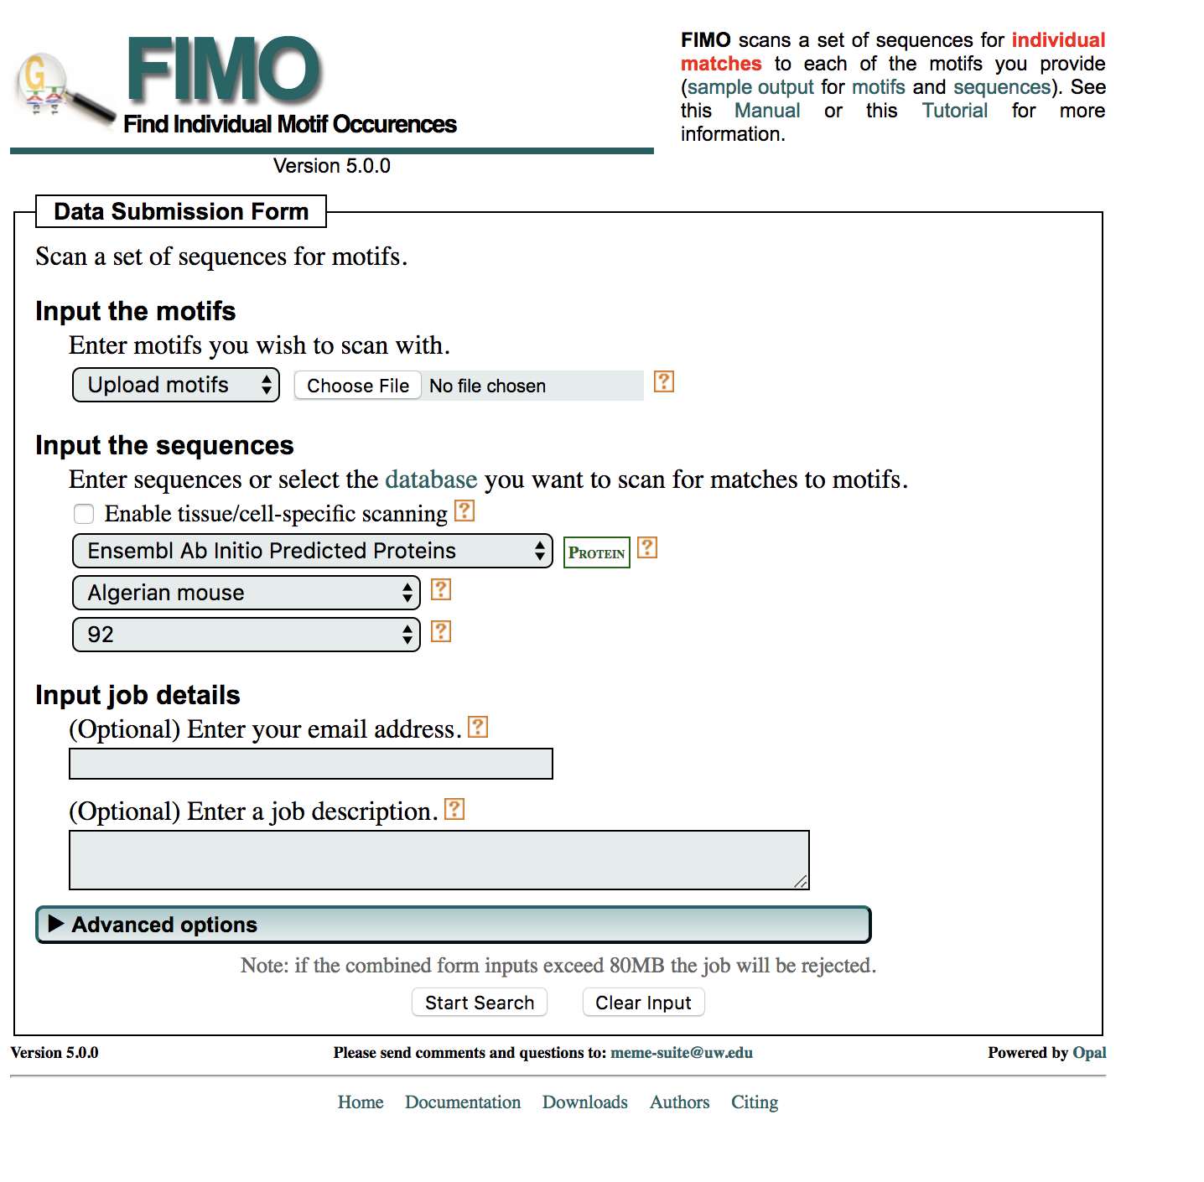
The FIMO program
Grant, Bailey, Noble; Bioinformatics 2011.
Takes motif W, background W_{b} and a sequence S.
Scans every site s in S, and computes its LLR score.
Uses sound statistics to deduce an appropriate (p-value) threshold on the LLR score. All sites above threshold are predicted as binding sites.

Slide 33
Finding TF targets
Step 1. Determine the binding specificity of a TF
Step 2. Find motif matches in DNA
Step 3. Designate nearby genes as TF targets

Slide 34
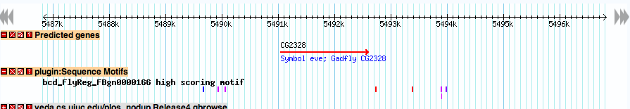

Step 3: Designating genes as targets
Predicted binding sites for motif of TF called “bcd”
Designate this gene as a target of the TF
Sub-goal: discover the genes regulated by a transcription factor … by DNA sequence analysis

Slide 35
Computational motif discovery

Slide 36
Why?
We assumed that we have experimental characterization of a transcription factor’s binding specificity (motif)
What if we don’t?
There’s a couple of options …

Slide 37
Option 1
Suppose a transcription factor (TF) regulates five different genes
Each of the five genes should have binding sites for TF in their promoter region
Gene 1
Gene 2
Gene 3
Gene 4
Gene 5
Binding sites for TF

Slide 38
Option 1
Now suppose we are given the promoter regions of the five genes G1, G2, … G5
Can we find the binding sites of TF, without knowing about them a priori ?
This is the computational motif finding problem
To find a motif that represents binding sites of an unknown TF

Slide 39
Option 2
Suppose we have ChIP-chip or ChIP-Seq data on binding locations of a transcription factor.
Collect sequences at the peaks
Computationally find the motif from these sequences
This is another version of the motif finding problem

Slide 40
Motif finding algorithms
Version 1: Given promoter regions of co-regulated genes, find the motif
Version 2: Given bound sequences (ChIP peaks) of a transcription factor, find the motif
Idea: Find a motif with many (surprisingly many) matches in the given sequences

Slide 41
Motif finding algorithms
Gibbs sampling (MCMC) : Lawrence et al. 1993
MEME (Expectation-Maximization) : Bailey & Elkan 94. (Very popular, visited in today’s lab.)
CONSENSUS (Greedy search) : Stormo lab.
Priority (Gibbs sampling, but allows for additional prior information to be incorporated): Hartemink lab.
Many many others …

Slide 42
Examining one such algorithm

Slide 43
The “CONSENSUS” algorithm
Final goal: Find a set of
substrings, one in each input
sequence
Set of substrings define a motif.
Goal: This motif should have
high “information content”.
High information content means
that the motif “stands out”.

Slide 44
The “CONSENSUS” algorithm
Compute information content of motif:
For each column,
Compute information content of column
Sum over all columns
i=1 ... 8
A | 1 | 1 | 9 | 9 | 0 | 0 | 0 | 1
C | 6 | 0 | 0 | 0 | 0 | 9 | 8 | 7
G | 1 | 0 | 0 | 0 | 1 | 0 | 0 | 1
T | 1 | 8 | 0 | 0 | 8 | 0 | 1 | 0
α
High information content means
that the motif “stands out”.

Slide 45
The “CONSENSUS” algorithm
Start with a substring in one
input sequence
Build the set of substrings
incrementally, adding one
substring at a time
The current set of substrings.

Slide 46
The “CONSENSUS” algorithm
Start with a substring in one
input sequence
Build the set of substrings
incrementally, adding one
substring at a time
The current set of substrings.
The current motif.

Slide 47
The “CONSENSUS” algorithm
Start with a substring in one
input sequence
Build the set of substrings
incrementally, adding one
substring at a time
?
?
?
?
The current set of substrings.
The current motif.
Consider every substring in the next sequence, try adding it to current motif and scoring resulting motif

Slide 48
The “CONSENSUS” algorithm
Start with a substring in one
input sequence
Build the set of substrings
incrementally, adding one
substring at a time
The current set of substrings.
The current motif.
Pick the best one ….

Slide 49
The “CONSENSUS” algorithm
Start with a substring in one
input sequence
Build the set of substrings
incrementally, adding one
substring at a time
The current set of substrings.
The current motif.
Pick the best one ….
… and repeat

Slide 50
Summary so far
To find genes regulated by a TF
  Determine its motif experimentally
  Scan genome for matches (e.g., with Patser & the LLR score)
Motif can also be determined computationally
  From promoters of co-expressed genes
  From TF-bound sequences determined by ChIP assays
  MEME, CONSENSUS, etc.

Slide 51
Further reading
Introduction to theory of motif finding
  Moses & Sinha: http://www.moseslab.csb.utoronto.ca/Moses_Sinha_Bioinf_Tools_apps_2009.pdf
  Das & Dai: http://www.ncbi.nlm.nih.gov/pmc/articles/PMC2099490/pdf/1471-2105-8-S7-S21.pdf

Slide 52
Motif finding tools
MEME: http://meme-suite.org/
Weeder: http://159.149.160.51/modtools/
CisFinder: http://lgsun.grc.nia.nih.gov/CisFinder/
RSAT: http://rsat.sb-roscoff.fr/

Slide 53
Motif scanning

Slide 54
Recap Step 3: Designating genes as targets
Predicted binding sites for motif of TF called “bcd”
Designate this gene as a target of the TF
But there is a problem …

Slide 55
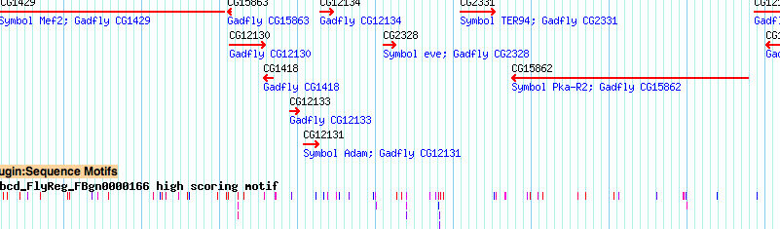
Too many predicted sites !
An idea: look for clusters of sites (motif matches)

Slide 56
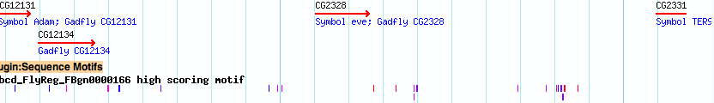
Why clusters of sites?
Because functional sites often do occur in clusters.
Because this makes biophysical sense. Multiple sites increase the chances of the TF binding there.

Slide 57
On looking for “clusters of matches”
To score a single site s for match to a motif W, we use
To score a sequence S for a cluster of matches to motif W, we use
But what is this probability?
A popular approach is to use “Hidden Markov Models” (HMM)
length ~10
length ~1000

Slide 58
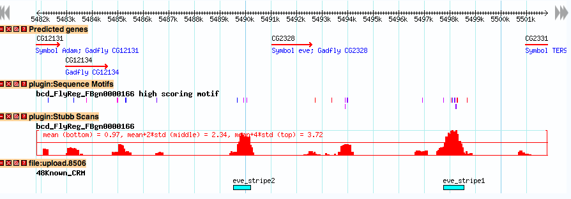
The HMM score profile
This is what we had, using LLR score:
This is what we have, with the HMM score
These are the functional targets of the TF

Slide 59
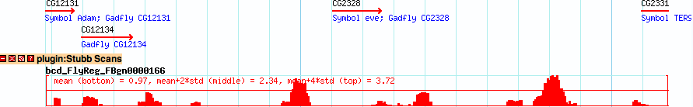
Step 3: Designating genes as targets
HMM Score for binding site presence
In 1000 bp window centered here.
Designate this gene as a target of the TF
Sub-goal: discover the genes regulated by a transcription factor … by DNA sequence analysis

Slide 60
Integrating sequence analysis and expression data

Slide 61
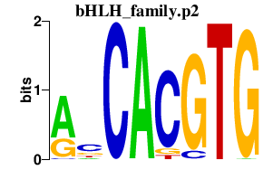
1. Predict regulatory targets of a TF
?
GENE
TF
Motif module: a set of genes predicted to be regulated by a TF (motif)

Slide 62
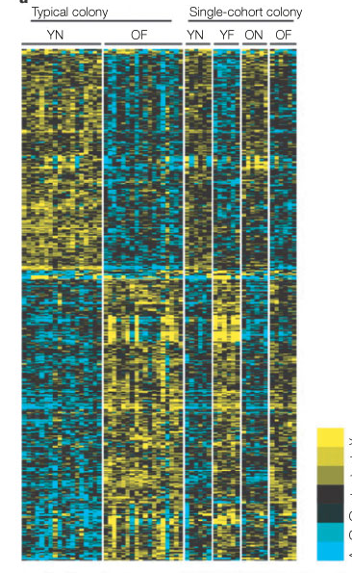
2. Identify dysregulated genes in phenotype of interest
Honeybee whole brain transcriptomic study
Genes up-regulated in nurses vs foragers
Robinson et al 2005

Slide 63
3. Combine motif analysis and gene expression data
All genes (N)
Genes expressed in
Nurse bees
(n)
Genes regulated by TF
(m)
Higher in Nurse bees and regulated by TF(k)
Is the intersection (size “k”) significantly large, given N, m, n?

Slide 64
3. Combine motif analysis and gene expression data
All genes (N)
Genes expressed in
Nurse bees
(n)
Genes regulated by TF
(m)
Infer: TF may be regulating “Nurse” genes.
An “association” between motif and condition

Slide 65

Hypergeometric Distribution
Given that n of N genes are labeled “Nurse high”.
If we picked a random sample of m genes, how likely
is an intersection equal to k ?

Slide 66
Hypergeometric Distribution
Given that n of N genes are labeled “Nurse high”.
If we picked a random sample of m genes, how likely
is an intersection equal to or greater than k ?

Slide 67
Further reading
Motif scanning and its applications
  Kim et al. 2010. PMID: 20126523
    http://www.ploscompbiol.org/article/info%3Adoi%2F10.1371%2Fjournal.pcbi.1000652
  Sinha et al. 2008. PMID: 18256240. http://genome.cshlp.org/content/18/3/477.long

Slide 68
Useful tools
GREAT: http://bejerano.stanford.edu/great/public/html/
  Input a set of genomic segments (e.g., ChIP peaks)
  Obtain what annotations enriched in nearby genes
  only for human, mouse and zebrafish
DAVID: https://david.ncifcrf.gov/
  Input a set of genes
  Obtain what annotations enriched in those genes
  Many different species

Slide 69
Questions ?

