Slide 1
Microbiome Analysis
Nicholas Chia
Center for Individualized Medicine
Mayo Clinic

Slide 2
Where did the microbiome come from?

Slide 3
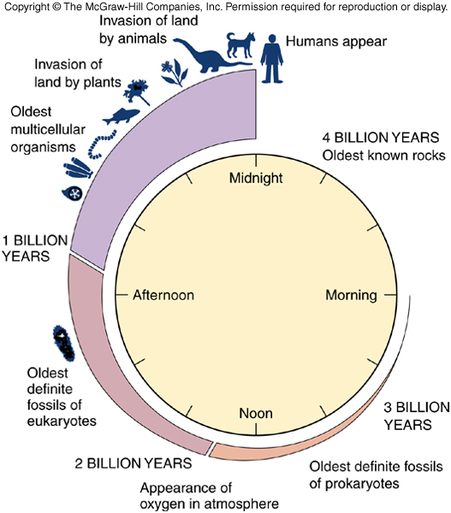
This is our story...

Slide 4
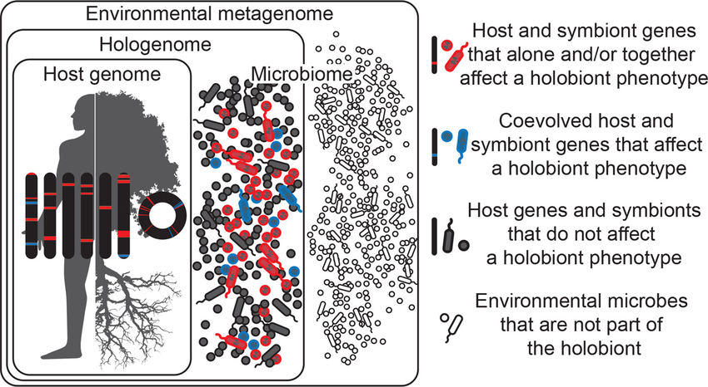
Holobiont
Theis et al.2016. mSystems

Slide 5
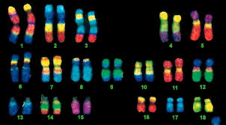
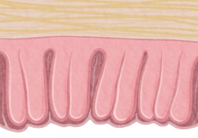
Where does colorectal cancer come from?
Host Genetics ~15%
Stromal “Microenvironment”
Colon Tissue
Environment ~85%
Diet
=Microbiome
Alcohol
Obesity
Smoking
Maybe the microbiome…

Slide 6
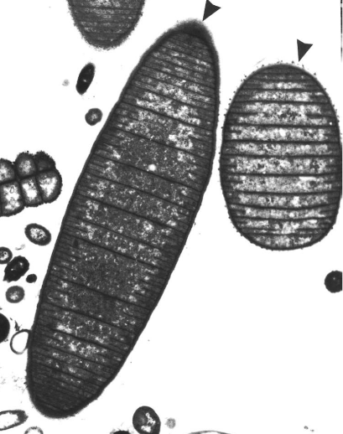
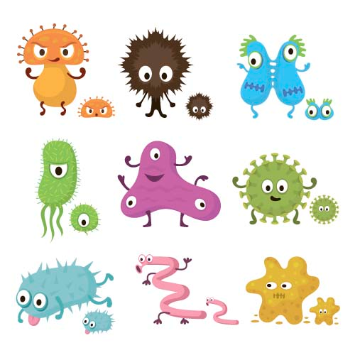
Alpha Diversity – Within Community
A
B
C
Plotted averages with SD
Notes:
So, I’m going to take a moment to explain how we examine diversity within a microbial community. GI health associated with high diversity (Infectious GI disease, Celiacs, Crohns, IBD are all associated with lower microbial diversity) Just like in macro ecology, Alpha diversity is within community diversity, so here is community A, and this represents the microbial community of a single individual human or animal. 4 species, 2, 2, 3, and 3.

Slide 7
Beta-diversity – Between Communities
A
PC2 20%
C
A
B
B
C
PC1 50%

Slide 8
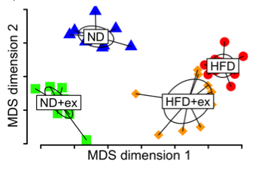
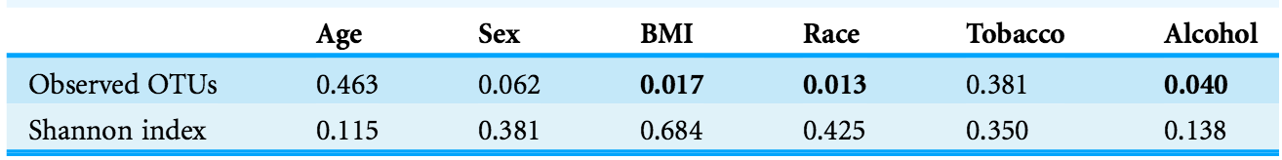
The microbiome as a risk factor for colorectal cancer
  Known Risk Factors
  Diet
  Physical Inactivity
  Race
  Obesity
  Alcohol
  Smoking
S. Kang et al. (2014) Molecular Neurodegeneration
exercise
diet
J. Chen et al. (2015) PEER J

Slide 9
Mini-tutorial #1:
Predicting Community Metabolic Flux

Slide 10
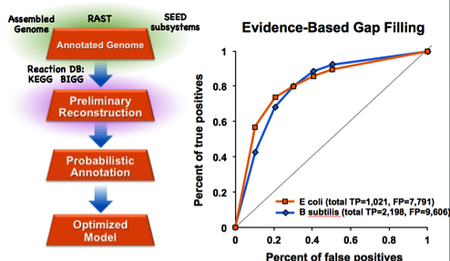
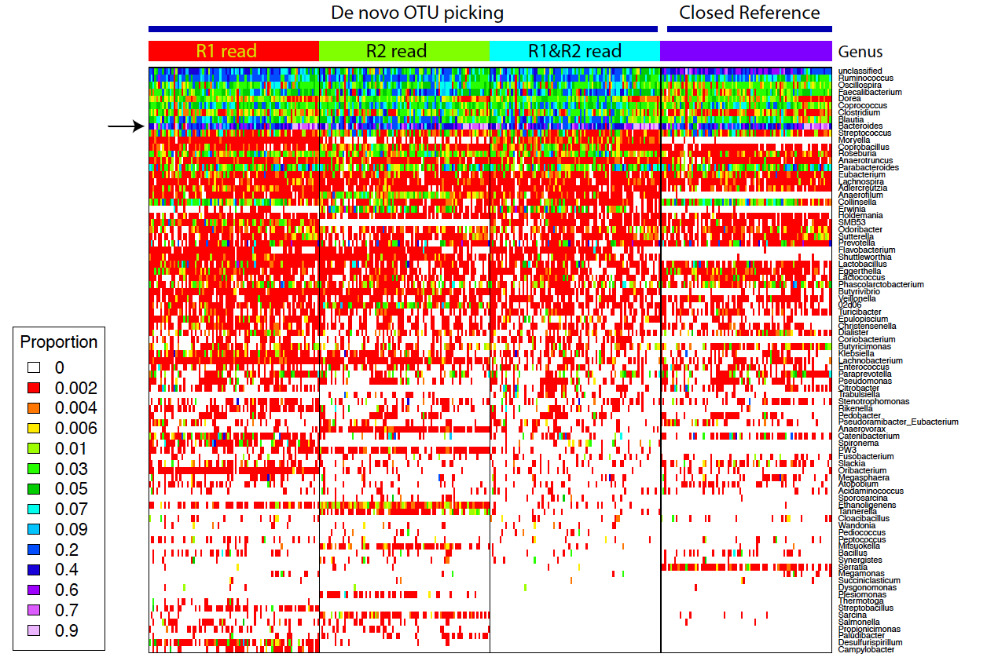
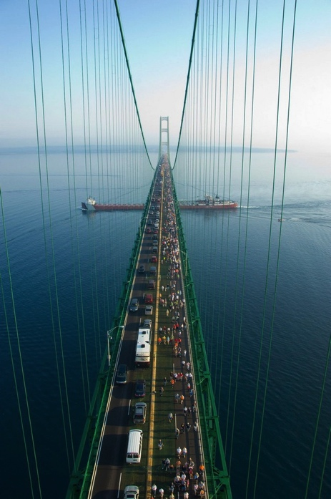


Outline of Community Metabolic Modeling
M. Mundy et all., (2017) Bioinformatics;
M. Benedict et al., (2014) PLOS CompBio
OTU profile
Metabolic Model Building
Makinac
cobraBABEL
Byproducts
Nutrients & cofactors
Toxins
H₂S?
Growth rates
Changes in species abundances

Slide 11
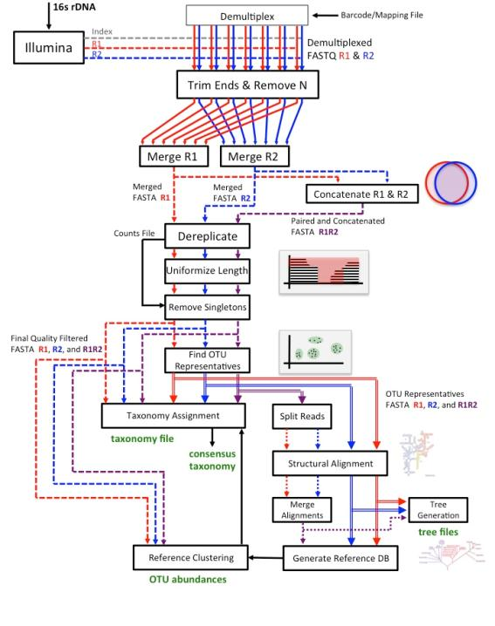
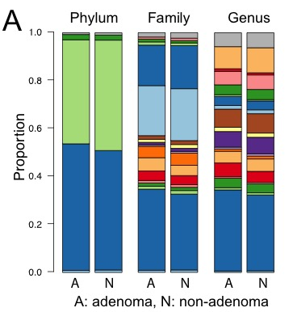
IM-Tornado:
Illinois-
Mayo
-
Taxon
Organization from
R
N
A
Dataset
Operations
Core Service
BIOM output
Jeraldo*, Kalari, et al (2014) PLOS one
Notes:
Our microbiome program elected to commence with Illumina sequencing and decided to develop an analytic pipeline designed to analyze the non overlapping 150 BP reads. In order to do so we had to develop a massive book keeping structure that allowed us to take into account information from both reads (R1 and R2) in order to make better informed decisions about taxonomy, phylogeny, and clustering or OTUs.
Outcomes include closed reference clustering on OTU abundance so you can compare with other references, phylogenetic trees (value is how you tell the communities apart)

Slide 12
Mapping Consensus Reads to Genome IDs
Download PATRIC/AGORA genomes
Make database of 16S region matching V3-V5 primers
For each representative OTU sequence:
  Perform global alignment (VSEARCH, no masking, no match heuristics)
  If <90% identity, discard as an unmatched OTU
  Otherwise, use best match based on alignment score
  If tied, use the most highest quality genome
  If tied, use the type-strain (i.e., best metabolic model)
Download model corresponding to the 16S representative -or- use automated metabolic model reconstruction algorithm
Notes:
Remove if this doesn’t lend to the story.
When then used statistical methods to compare microbial community composition between individuals with and without adenoms. So here, we have different taxonomic levels (phylum, family, genus), the columns with A are the individuals with adenomas, and the columns with n are individuals without adenomas, and each color represents one type of microbe. What you can see is that overall, microbial communities were fairly similar between groups even down to the genus level but because we had a large sample size there were a few significantly predictive taxa

Slide 13
Automated Metabolic Model Building
M. Benedict et al., (2014) PLOS CompBio
Assembled Genome
RAST
SEED subsystems
Evidence-Based Gap Filling
Annotated Genome
Reaction DB:
KEGG BIGG
Preliminary Reconstruction
Accurate gene-reaction
inclusion and annotation!
Percent of false positives remaining
Parsimonious Gapfill
or
Hand-curated
?
Probabilistic Annotation
E coli (total TP=1,021, FP=7,791)
B subtilis (total TP=2,198, FP=9,606)
Optimized Model
Percent of false positives remaining

Slide 14
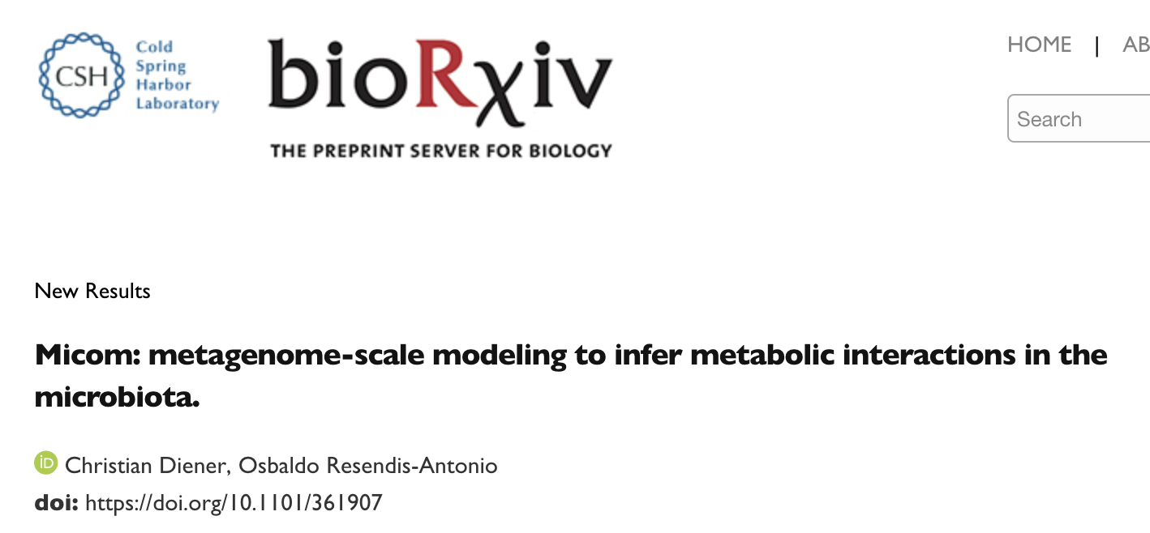
MICOM: Microbial Community Metabolism
Makinac/cobraBABEL
If necessary, convert models to cobrapy format (Makinac)
Install cobrapy and micom
Introduction to micom on bioarXiv
Notes:
Remove if this doesn’t lend to the story.
When then used statistical methods to compare microbial community composition between individuals with and without adenoms. So here, we have different taxonomic levels (phylum, family, genus), the columns with A are the individuals with adenomas, and the columns with n are individuals without adenomas, and each color represents one type of microbe. What you can see is that overall, microbial communities were fairly similar between groups even down to the genus level but because we had a large sample size there were a few significantly predictive taxa

Slide 15
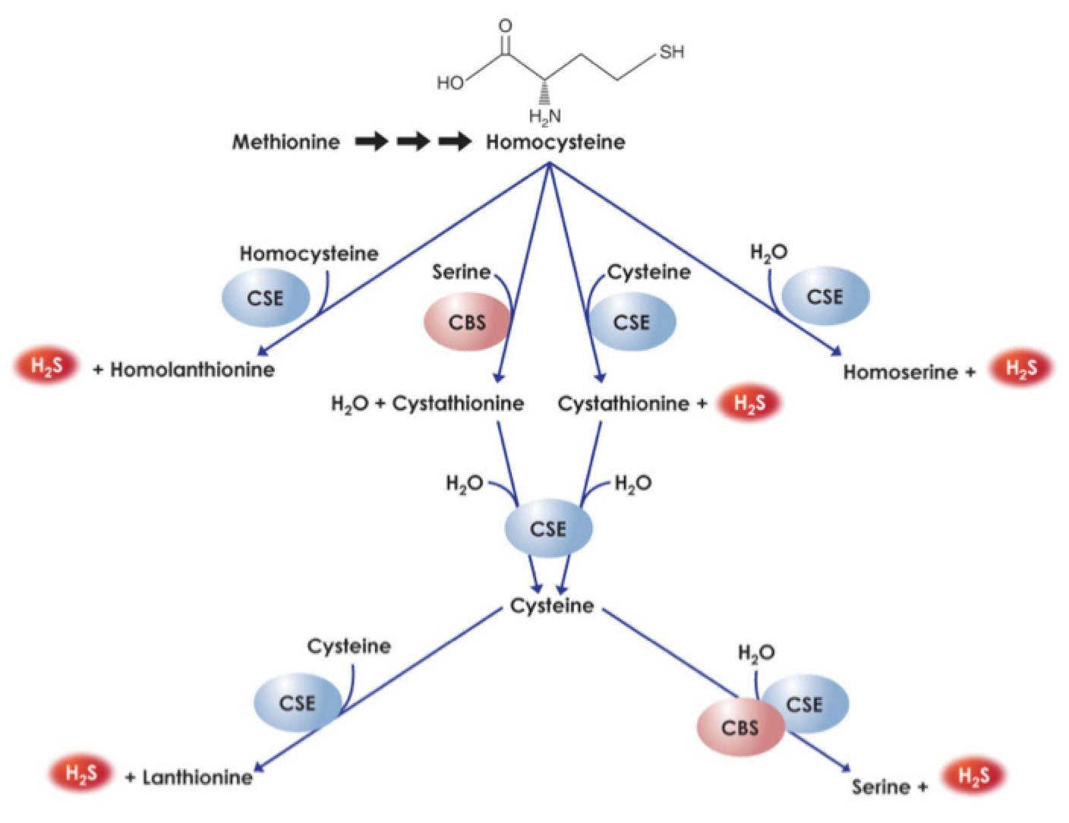
Mini-tutorial #1: Result
Brock, T.G. 2009
Higher H2S production in dMMR tumors!
OTU profile
Representative Genomes/Models

Slide 16
Mini-tutorial #2:
Calculating the Metabolic Influence Network (MIN)

Slide 17
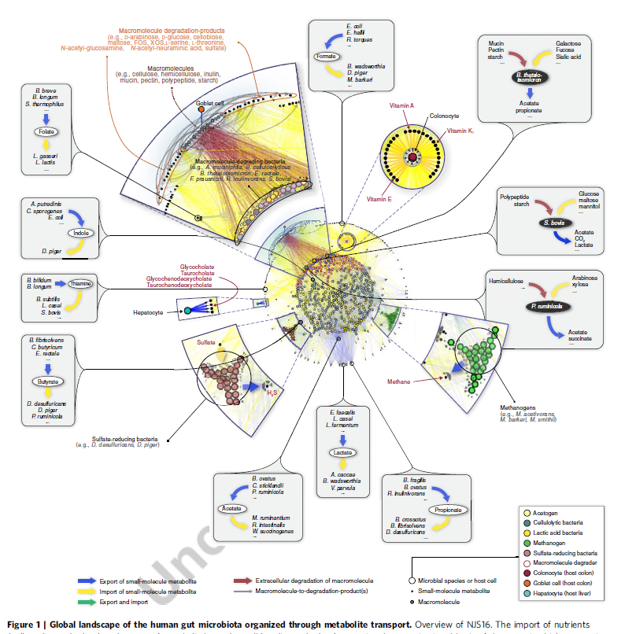
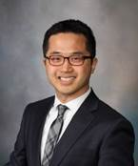
Quick Review: Global Map of Microbial Metabolic Interactions
Jaeyun Sung, et al., Nature Comm. 2017

Slide 18

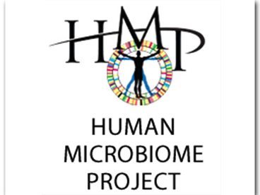

Data Sources
Jaeyun Sung
3 data sources
  HMP Consortium (Nature, 2012)
  MetaHIT (Nature, 2010)
  MetaHIT (Nature, 2012)
4 phenotypes (sample #)
  Healthy (370)
  Obesity (39)
  Inflammatory Bowel Disease (34)
  Type-2 Diabetes (174)
Import & export metabolite identification

Slide 19
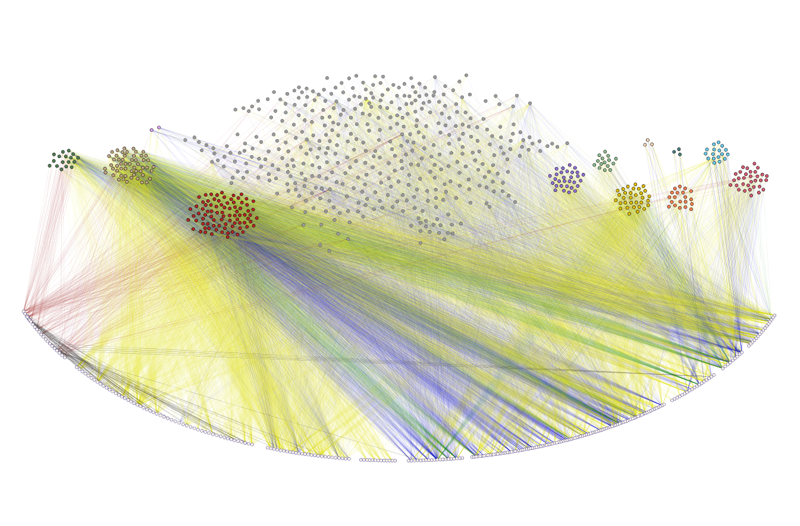


Microbe-Compound bipartite network
Jaeyung Sung
nitrite
oxidizers
propionic acid
bacteria
ammonia
oxidizers
N₂
fixers
methylotrophs
Microbial species (731)
cellulolytic
acetogens
methanogens
denitrifying
bacteria
others
sulfate
reducers
sulfur
oxidizers
lactic acid
bacteria
Metabolic compound (349)
Macromolecules
Gases
Mono-/disaccharides
& derivatives
Inorganic ions
Others
Amino acids, oligopeptides, & derivatives
Nucleic acids & oligonucleotides
Fatty acids & glycerides
Vitamins & co-factors
Notes:
Split into 3 figures (only nodes; nodes + yellow/blue/green; everything) & remove text from figure
Make text bigger in powerpoint (45 min)

Slide 20
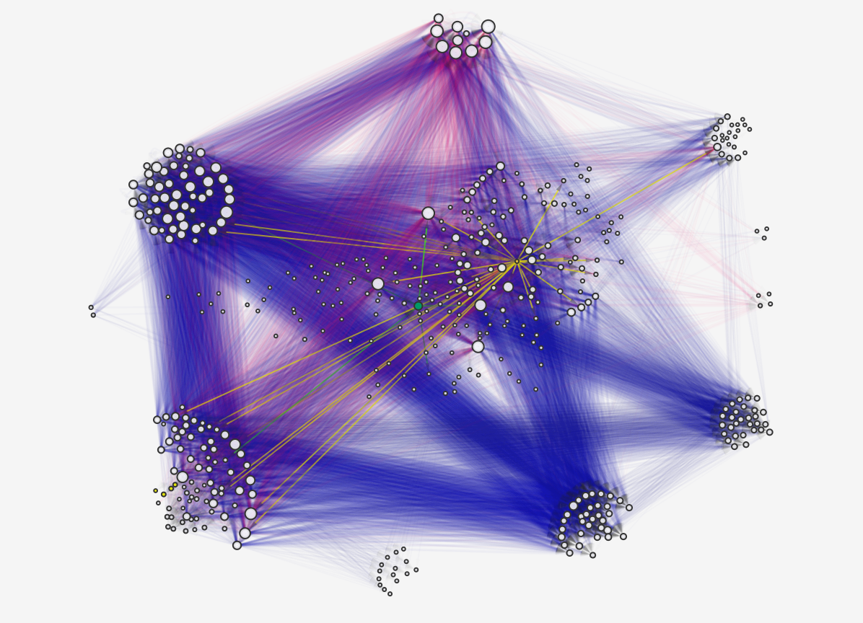
Human gut microbiota interaction network
cellulolytic
denitrifying
bacteria
acetogens
Bacteroides thetaiotamicron
Clostridium perfringens
N₂ fixers
goblet cell
others
Bacteroides fragilis
colonocyte
propionic acid
bacteria
sulfur
oxidizers
Bacteroides vulgatus
methanogens
lactic acid
bacteria
Bifidobacterium longum
Bifidobacterium bifidum
sulfate reducers
methylotrophs
Notes:
Split into several figures (Nodes only; nodes + blue; nodes + red; nodes + green/yellow (host cells); nodes + cellulolytic; nodes + LAB)
Focus on hubs of “others” (1.5 hour)

Slide 21
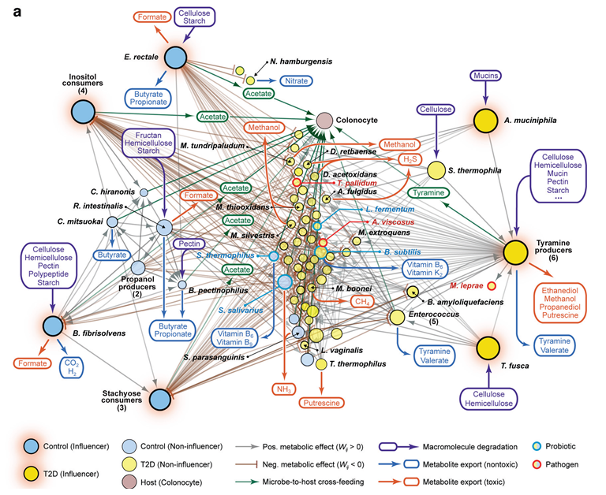
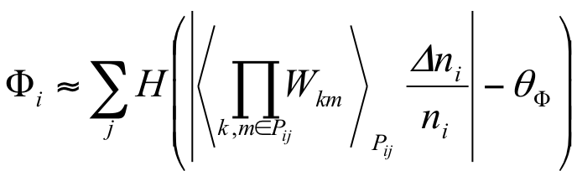
What is a metabolic influence network (MIN)?
Jaeyun Sung, et al., Nature Comm. 2017

Slide 22


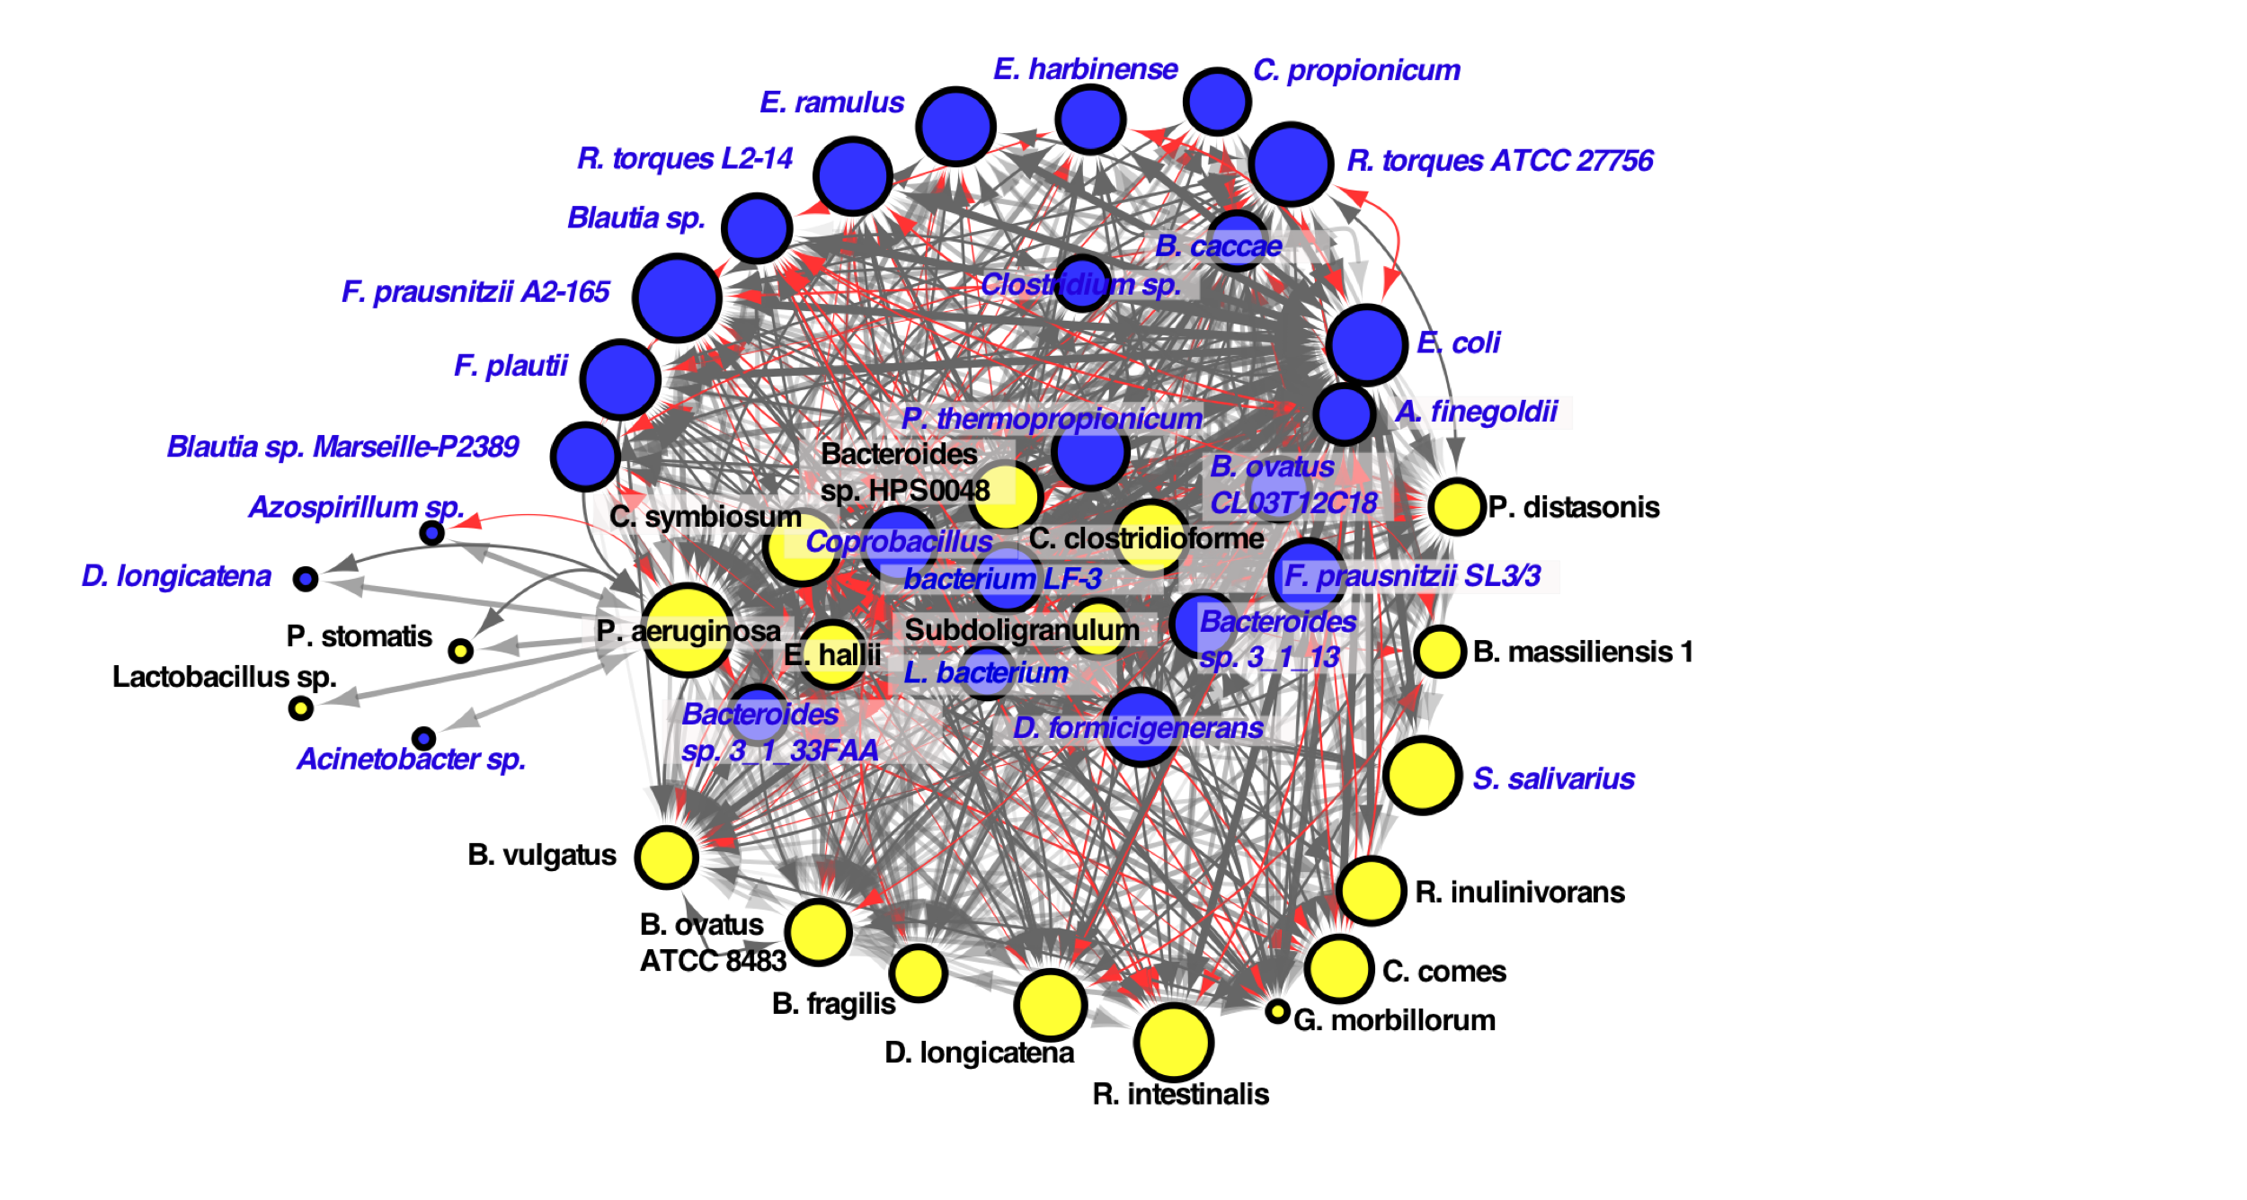
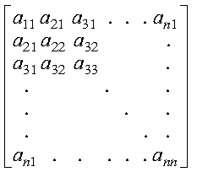
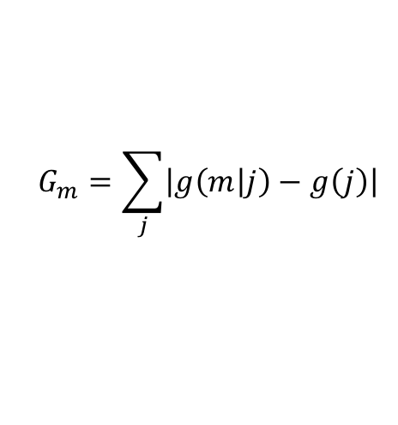
Generating the Metabolic Influence Network
Assess Pair-wise Interactions (FBA)
OTU profile
Metabolic Model Building
$$\begin{aligned}&G_{m}=\sum_{j}{\left|g\left(m | j\right)−g\left(j\right)\right|}\#\end{aligned}$$
Influence Scoring
Visualization
Community Interactions
H. Mendes-Soares et all., (2016) BMC Bioinformatics;

Slide 23
MMINTE

Slide 24
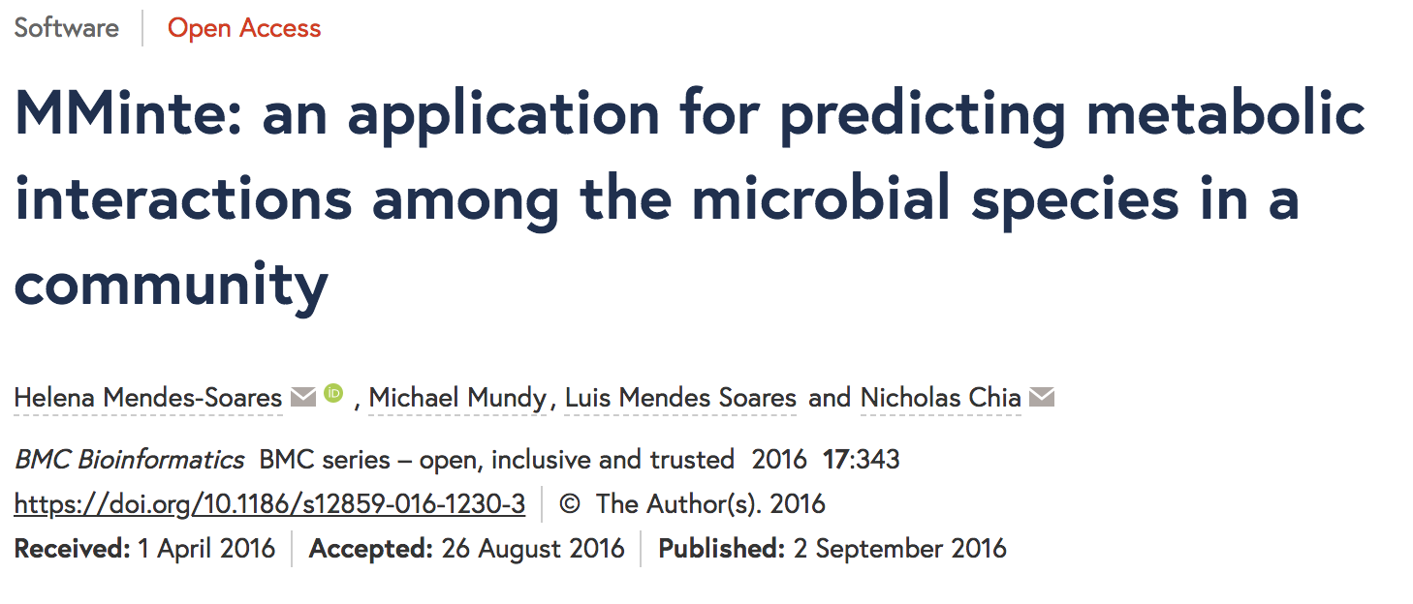
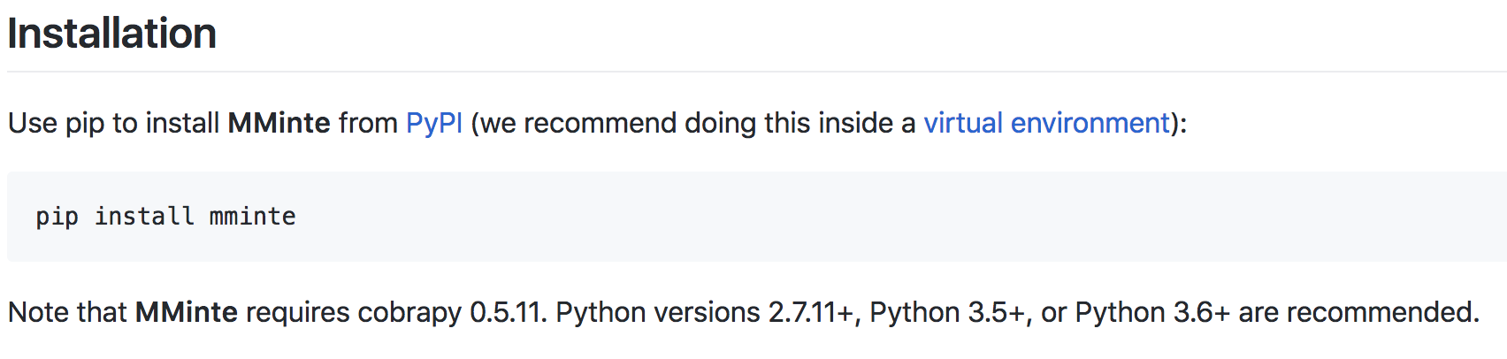
MMINTE
https://github.com/mmundy42/MMinte

Slide 25
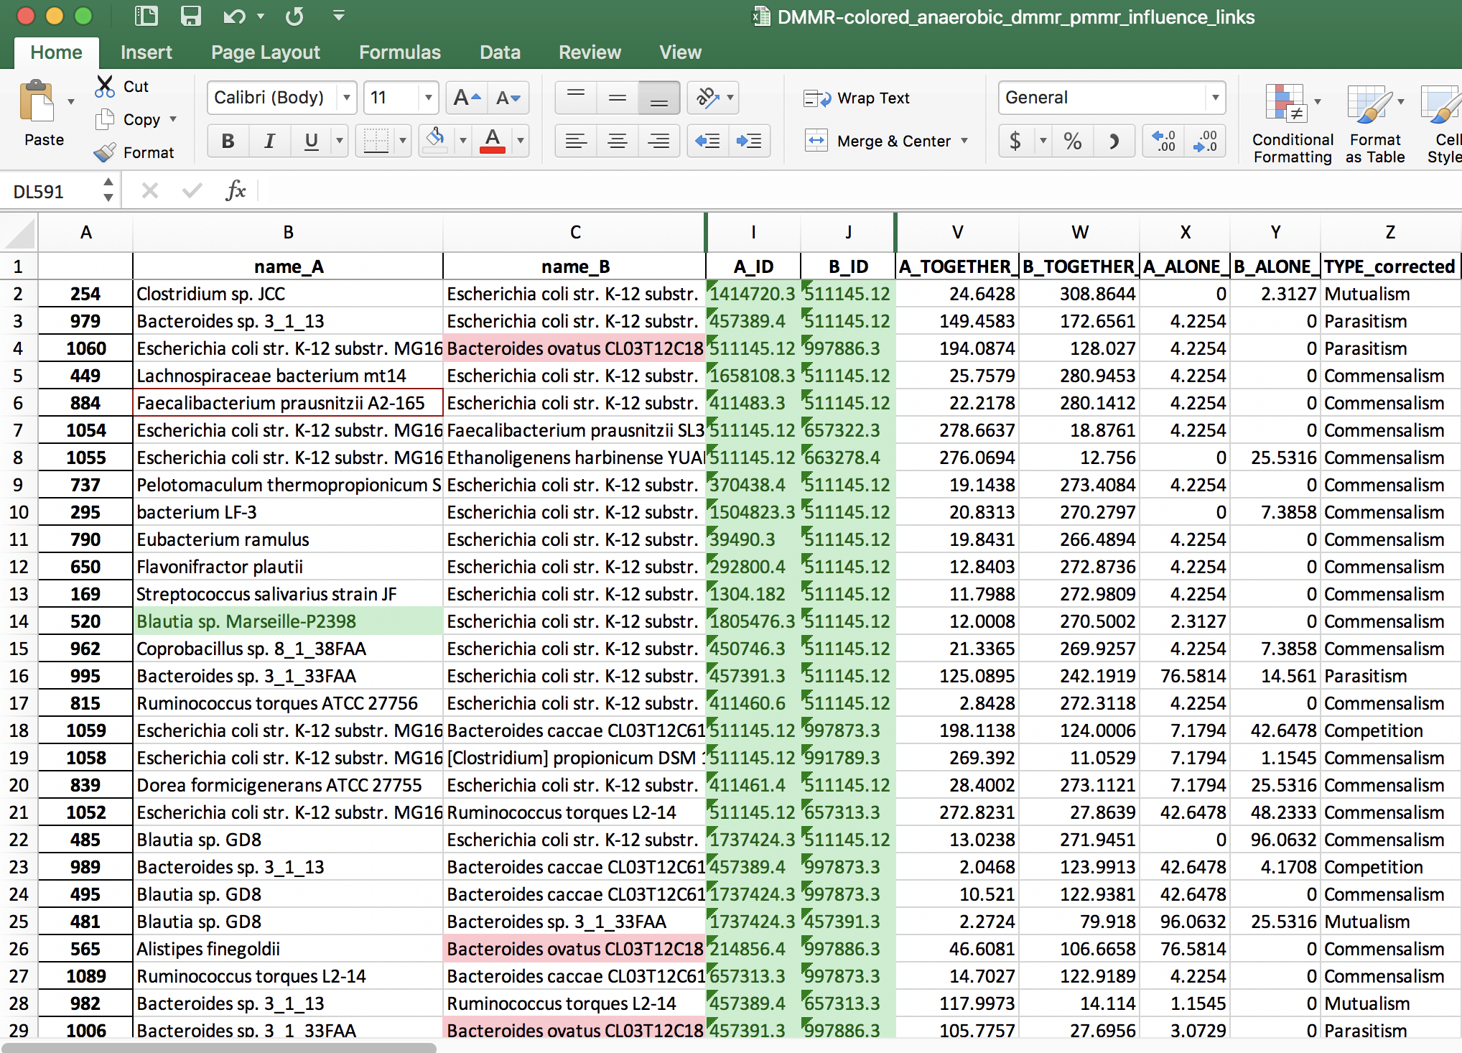
MMINTE

Slide 26
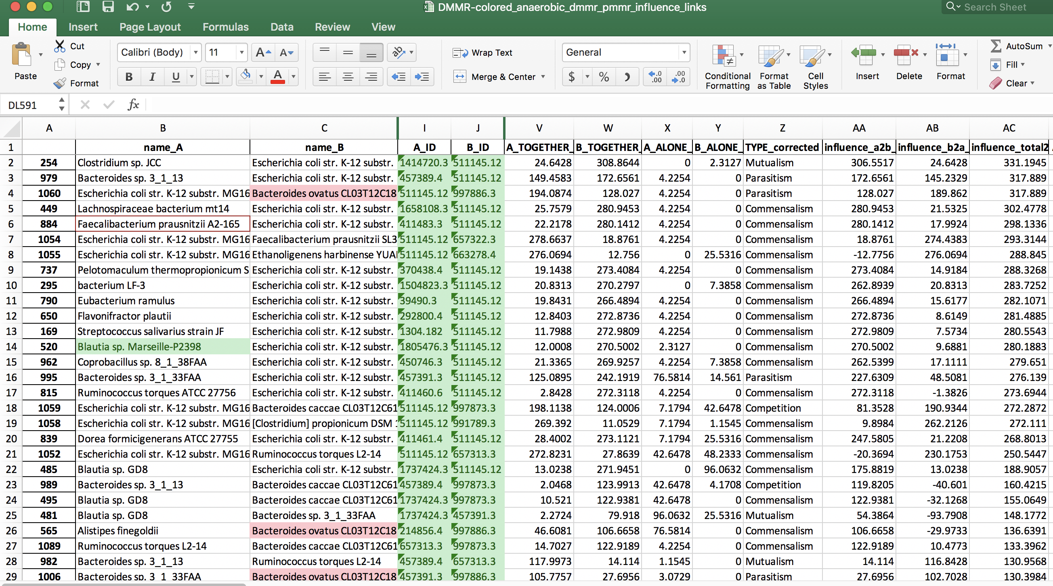
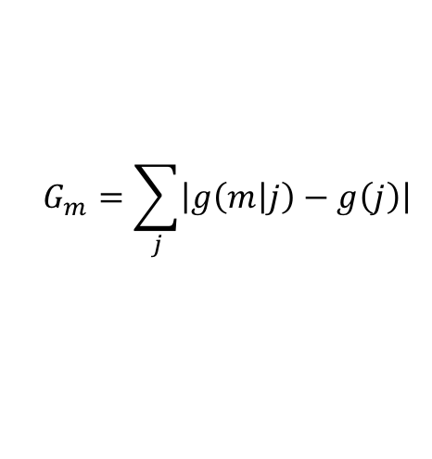
Influence Scores: Edges
$$\begin{aligned}&G_{m}=\sum_{j}{\left|g\left(m | j\right)−g\left(j\right)\right|}\#\end{aligned}$$

Slide 27
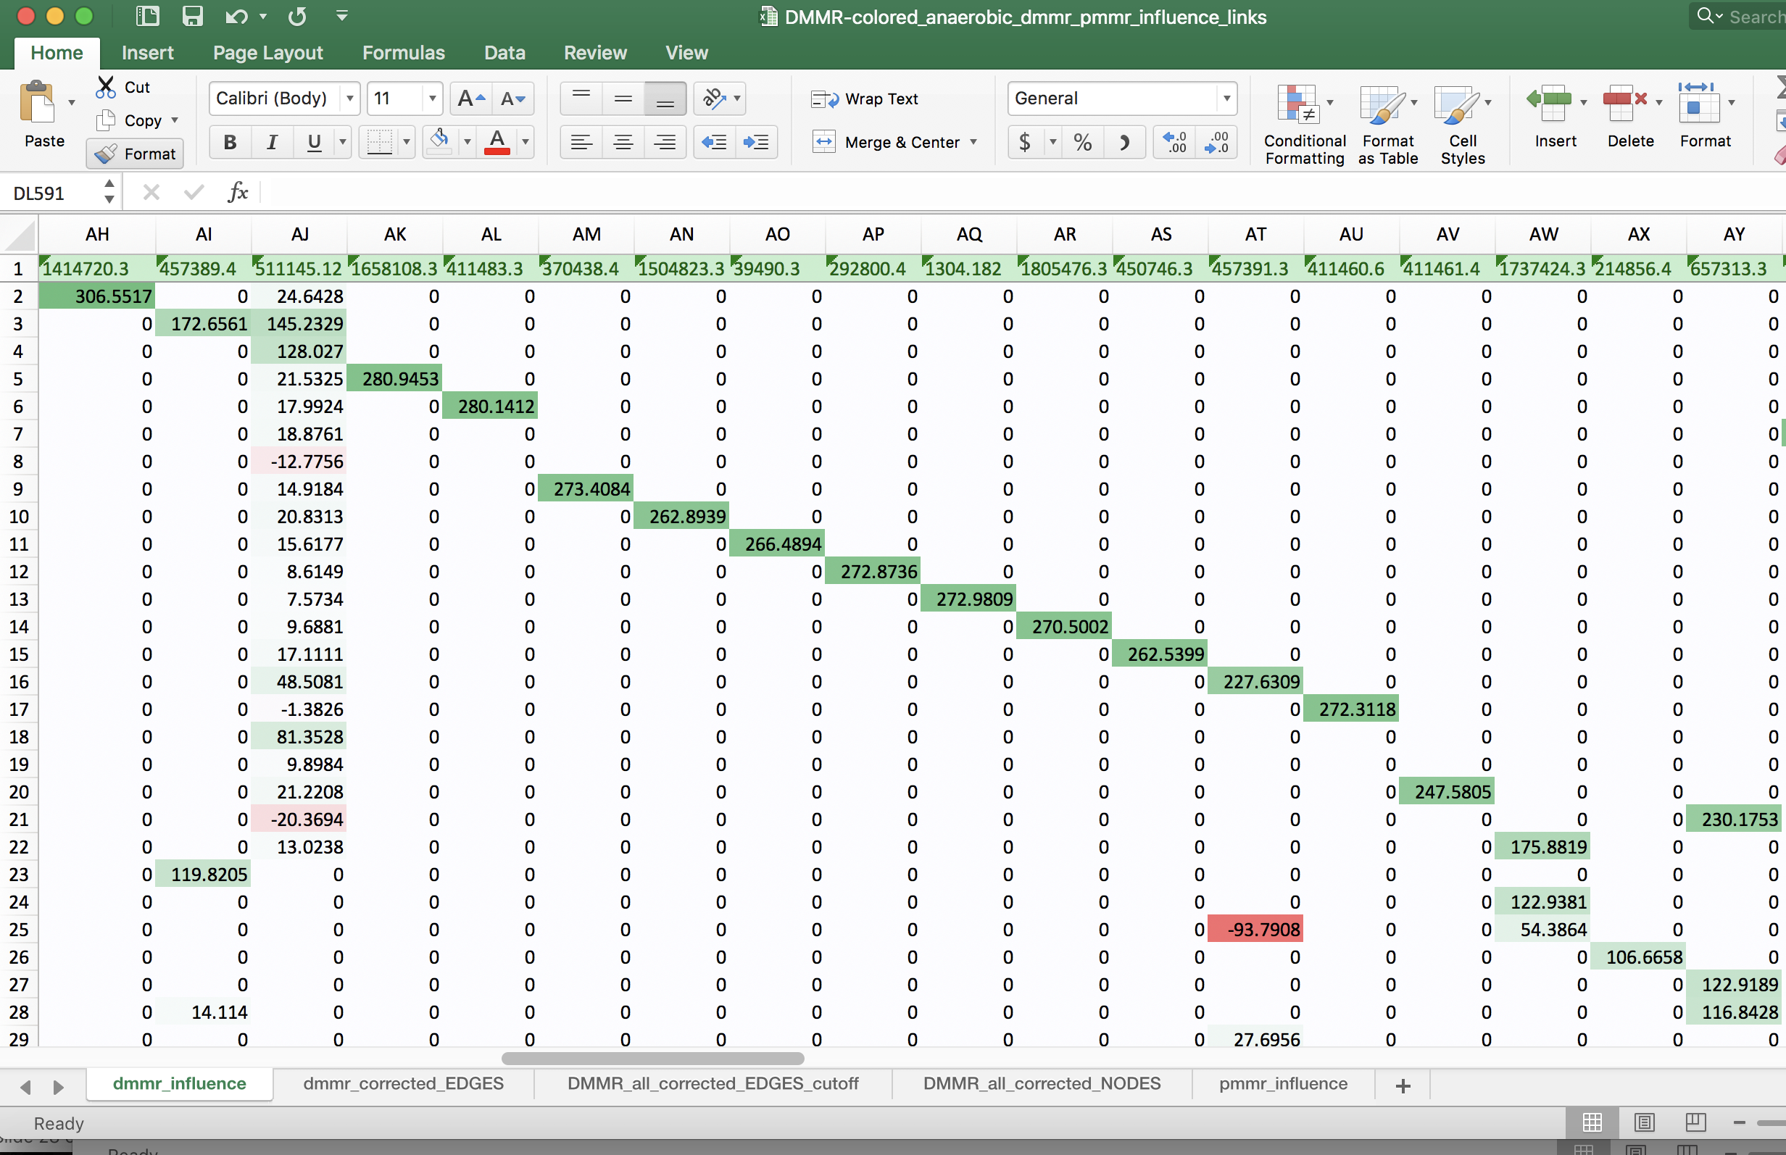
Influence Scores: Nodes

Slide 28
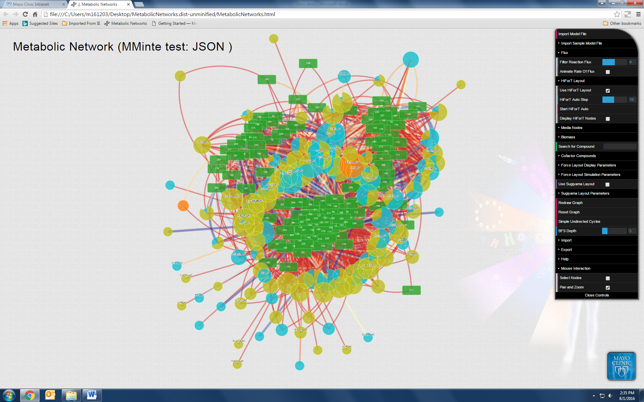
Visualization Tools
HiForT
Hierarchical Force layout Tree

Slide 29
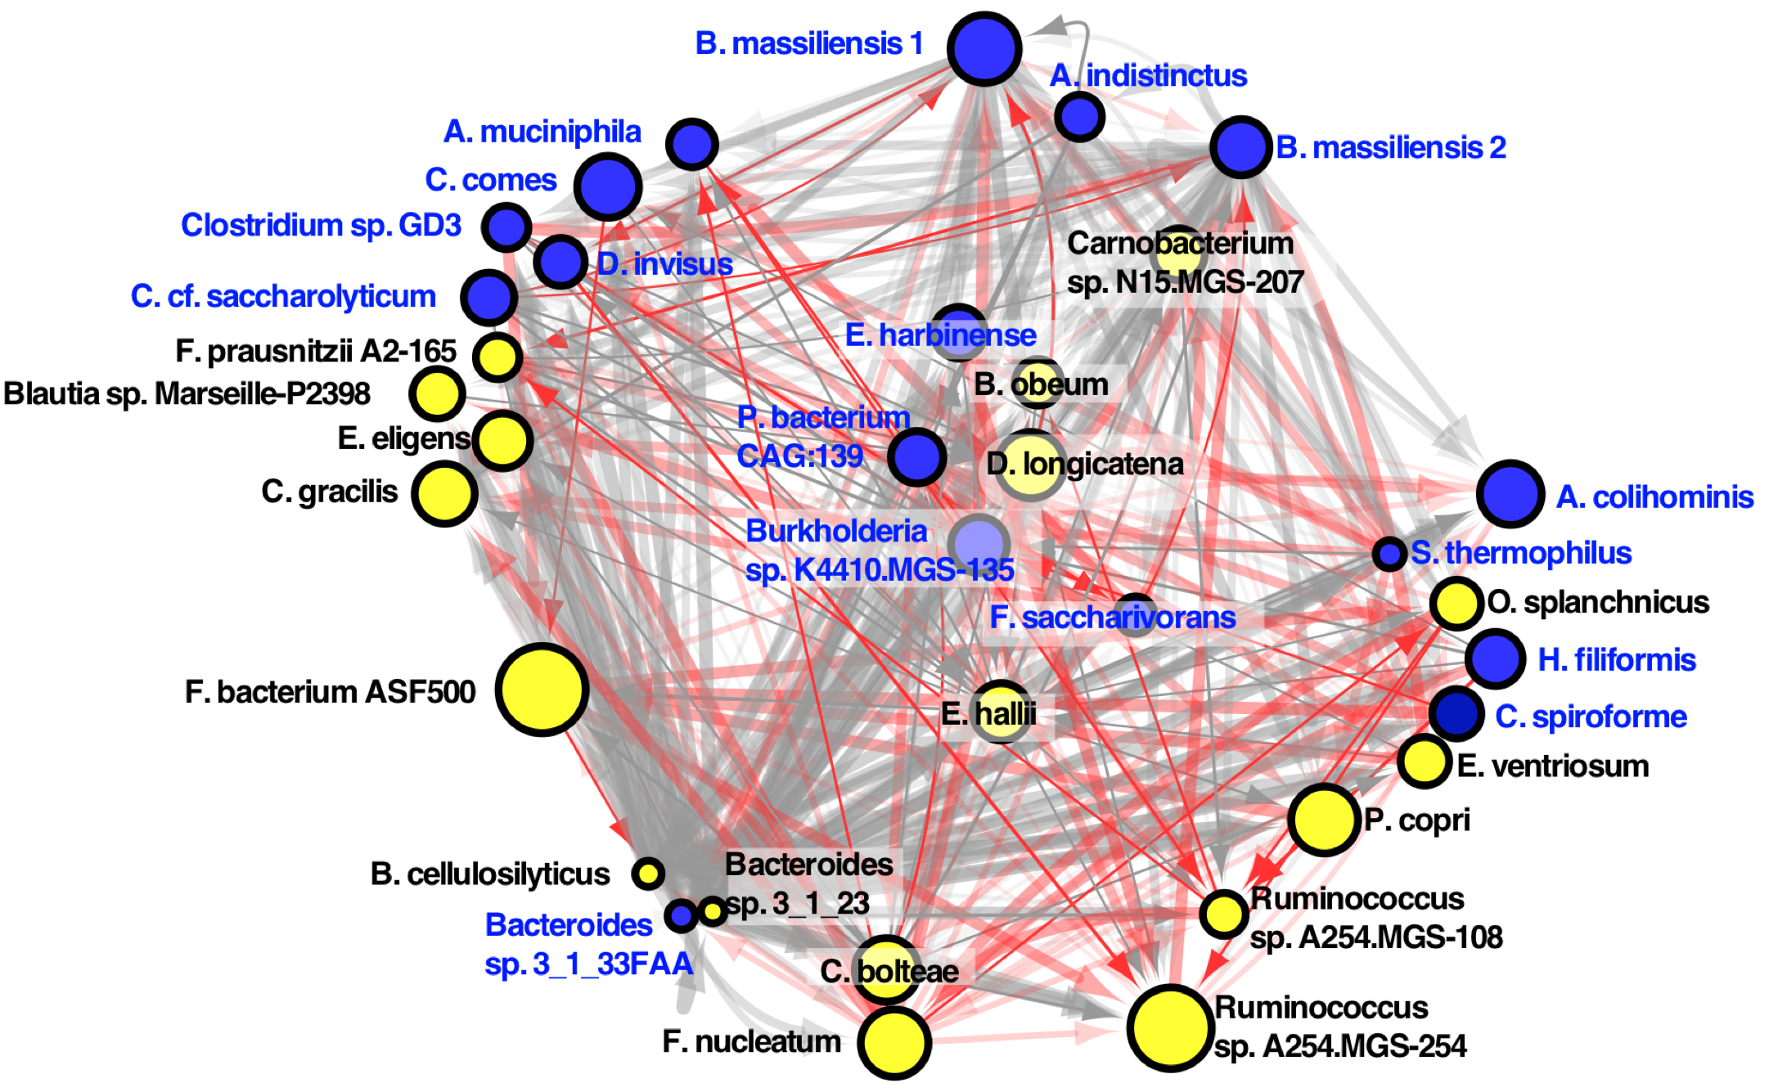
What about the ecology?
Turn to metabolic modeling to predict metabolic cross-feeding: Metabolic Influence Network (MIN)
Which species are ecological drivers?
pMMR CRC MIN
OTU profile
F. nucleatum as a biomarker, but no ecological role—neither an ecological driver or driven by ecology!
dMMR CRC MIN
Representative Genomes/Models
PATRIC
Community Metabolic Modeling
Not Fuso!
Primary Fermenters
Opportunistic Infections
H. Mendes-Soares et all., (2016) BMC Bioinformatics; M. Benedict et al., (2014) PLOS CompBio; Sung et al., (2017) Nat. Comm.

Slide 30
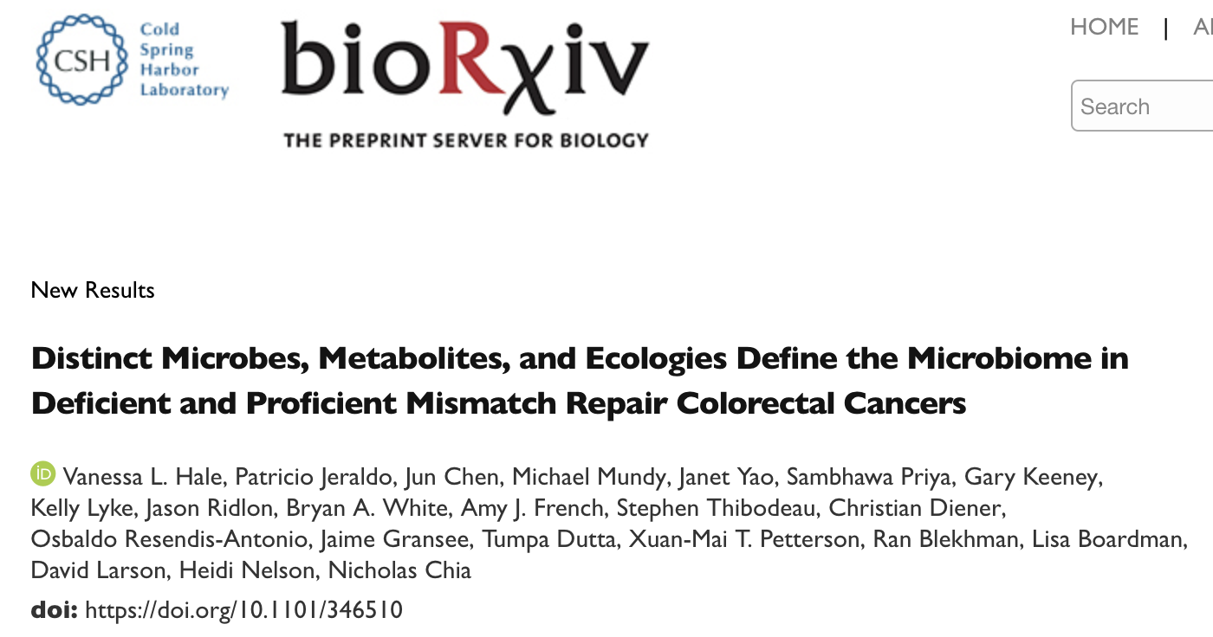
Conclusion
After correcting for BMI, age, sex, and location, dMMR and pMMR CRC have very different microbial associations!
Different microbes means different metabolic and ecological roles in CRC etiology!
F. nucleatum is a dMMR CRC-specific biomarker, but not a driver.

Slide 31
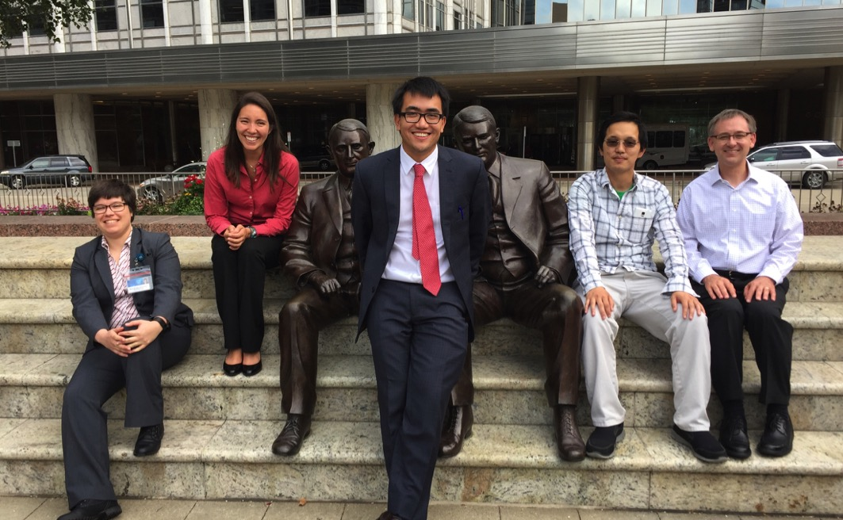
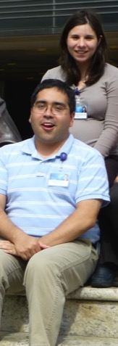
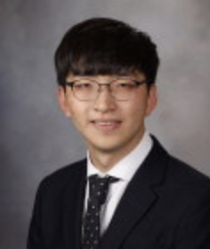

Chia Lab
+Jaeyun Sung
+Heidi Nelson
+Jun Chen
+David Ahlquist
+David Larson
+Mai Petterson
+Kelly Lyke
+Janet Yao
+FSL Pathology
+Tumpa Dutta
+Gary Keeney
Minsuk Kim
Graduating:
Charlie Seto
Vanessa Hale
Patricio
Jeraldo
+Lisa Boardman
+Stephen Thibodeau
Bryan White
Nigel Goldenfeld
Jason Ridlon
Rex Gaskins
Ran Blekman
Sambhawa Priya
Kenneth Beckman
Daryl Gohl
FUNDED BY:
Christian Diener
Osbaldo Resendis-Antonio

