Slide 1
Genome Assembly
Chris Fields
Mayo-Illinois Computational Genomics Workshop, June 10, 2019

Slide 2
Overview
  What is genome assembly?
  Steps in a genome assembly
  Planning an assembly project
  QC assessment of assemblies
  Annotation

Slide 3
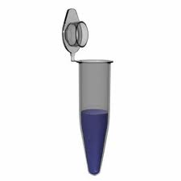
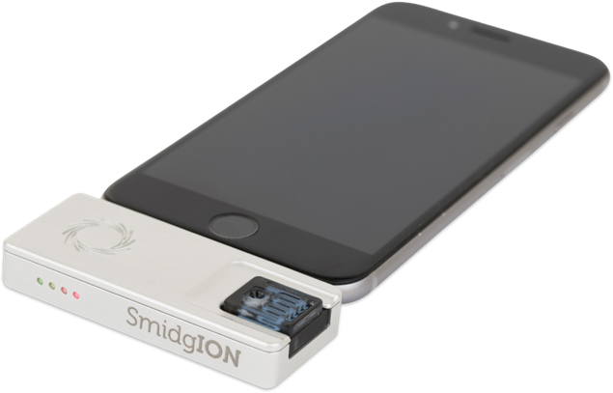
Ideal world
I would not need to give this talk!
AGTCTAGGATTCGCTACAGATTCAGGCTCTGAAGCTAGATCGCTATGCTATGATCTAGATCTCGAGATTCGTATAAGTCTAGGATTCGCTATAGATTCAGGCTCTGATATAT
Human DNA
iSequencer™
46 complete haplotype chromosome sequences
T. Seemann

Slide 4
What is a Genome Assembly?
From scratch:
no prior knowledge

Slide 5
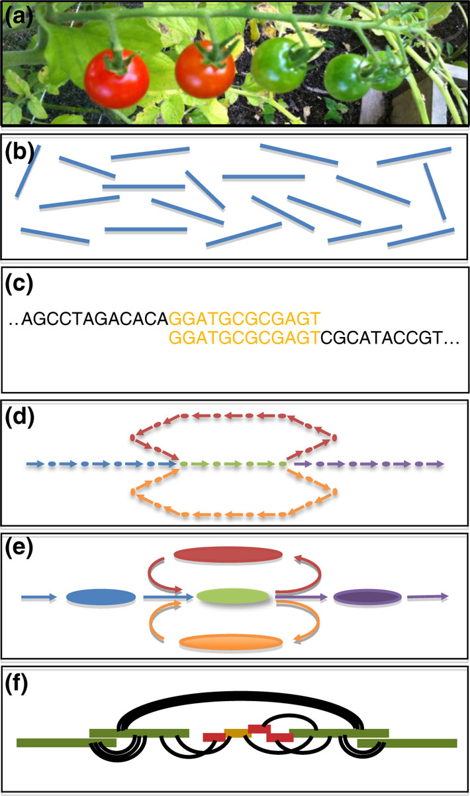
Schematic overview of genome assembly.
DNA is collected from the biological sample, fragmented, and sequenced.
The output from the sequencer consists of many billions of short, unordered DNA fragments from random positions in the genome.
The short fragments are compared with each other in some way to discover how they overlap.
The overlap relationships are captured in a large assembly graph
The graph is refined to correct errors and simplify
Finally, additional information such as mates, markers and other long-range information can be used to order and orient the initial assembly (contigs) into large scaffolds
Schatz et al. Genome Biology 2012 13:243

Slide 6
This Looks Easy, Let’s Do a Genome Assembly!
  It must be easy to get an assembly, right?
  How do you find overlaps between sequences (when you have millions to billions of them)?
    You compare them all (overlapping pieces)
    You find shorter perfectly overlapping segments using some tricks
      Faster but has a lot of assumptions!!!
  How do you store all this information?
  How long does it take?

Slide 8
Results
Now you power up and buy a monster multi-core high-memory server
You assembled your genome with your favorite genome assembly tool that your buddy down the hall recommends
You waited a week to a month and you now have results!
Wait, why do I have a million scaffolds? And why is my server on fire?!?
Biology

Slide 10
Basic Steps for Genome Assembly

Slide 11
Steps
Basic DNA sequence cleanup and evaluation
Contig building
Scaffolding
Post-assembly processing and analyses

Slide 12
Basic cleanup and evaluation
  Is the DNA sequence high quality?
  Does it need to be trimmed?
  Evaluate libraries for read ‘coverage’
  Any additional sequence preparation steps

Slide 13
DNA Quality (FASTQC)
Illumina Data
Bad,
need to
Trim heavily
Good!

Slide 14
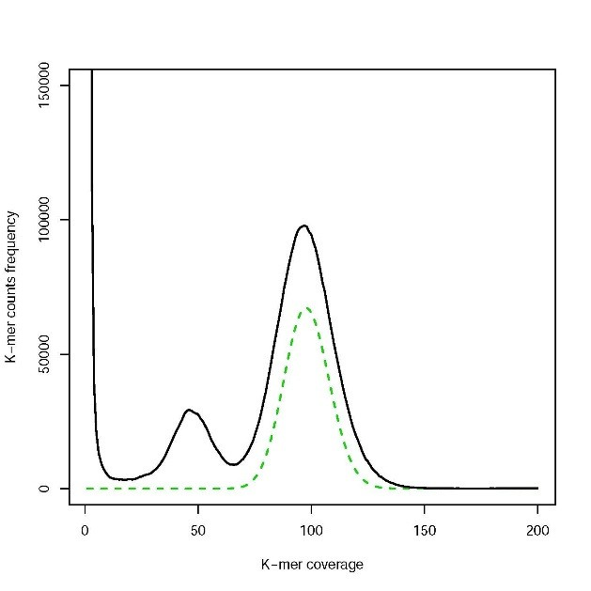
Coverage
Qi Sun, Minghui Wang
Cornell

Slide 15
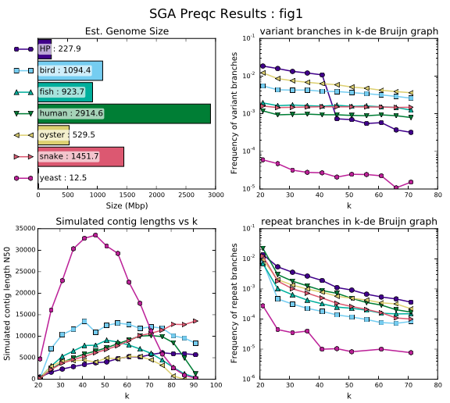
PreQC

Slide 16
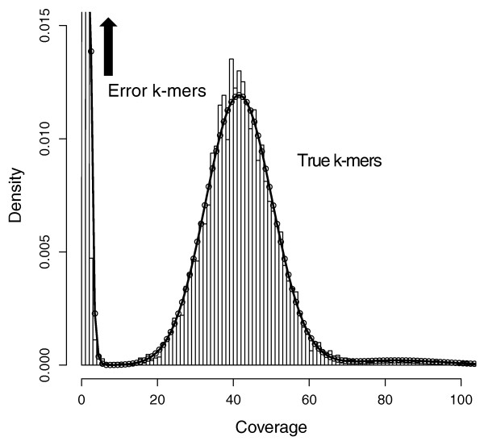
Other pre-assembly steps
Depending on the assembler you use, you may want to:
  Run error correction on the sequence data
  Join paired-end reads
  Assess reads for contaminants

Slide 17
Starting the assembly

Slide 18
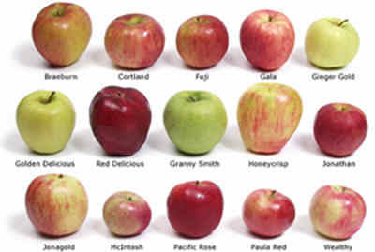
Contig building
Greedy assembly
Seed and extend
Overlap graph
de Bruijn graphs
String graphs
..etc etc
… all essentially doing similar things,
but taking different ‘shortcuts’ based on
needs

Slide 19
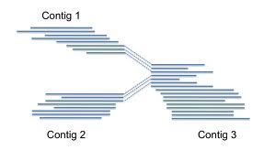
Contigs
Contiguous, unambiguous
stretches of assembled DNA sequence
Contigs ends correspond to
  Real ends (for linear DNA molecules)
  Dead ends (missing sequence)
  Decision points (forks in the road)

Slide 20
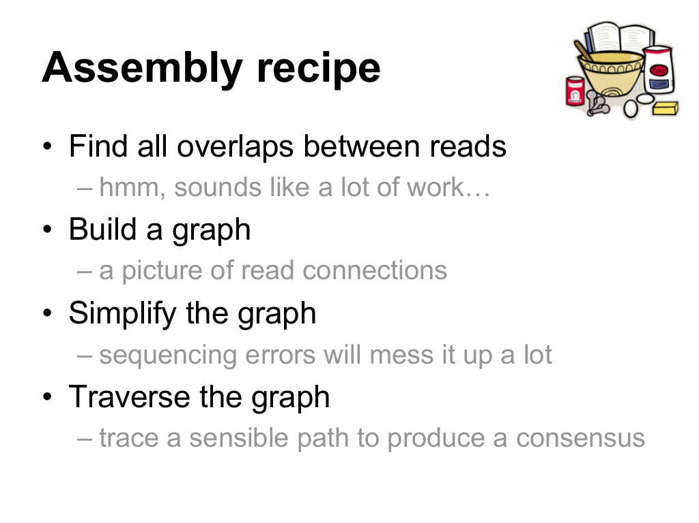

Slide 21
Graph
Review: A structure where object are related to one another somehow
Nodes/Vertices = objects (sequence)
Edges = relationship (overlap)
Compeau et al, Nature Biotech, 29(11), 2011; https://en.wikipedia.org/wiki/Graph_(discrete_mathematics)

Slide 22
Simple?
https://github.com/rrwick/Bandage/wiki/Effect-of-kmer-size

Slide 23
Erm…
http://armbrustlab.ocean.washington.edu/seastar

Slide 24
OLC and de Bruijn overview

Slide 25
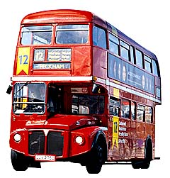
In essence…
  For each unconnected graph, at least one per replicon in original sample
  Find a path which visits each node once
    This is referred to as a Hamiltonian path/cycle
  Form consensus sequences from paths
    use all the overlap alignments
    each of these collapsed paths is a contig

Slide 26
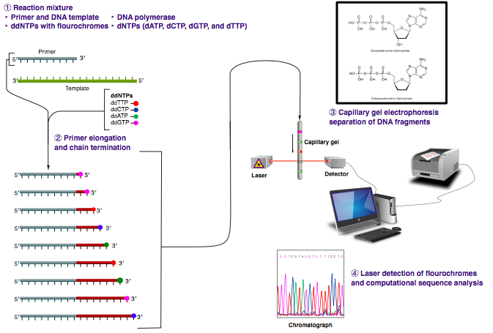
Overlap Layout Consensus
Assembly
Used for longer read data
Sanger
Newer variants for PacBio and Oxford Nanopore
By Estevezj - Own work, CC BY-SA 3.0,
https://commons.wikimedia.org/w/index.php?curid=23264166

Slide 27
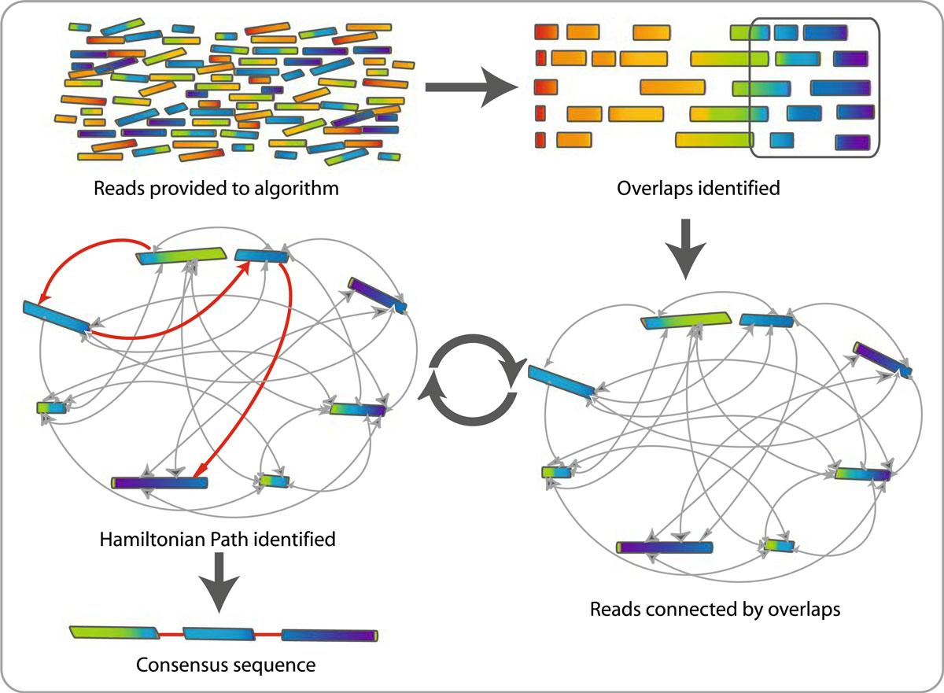
  For each unconnected graph, at least one per replicon in original sample
  Find a path which
  visits each node once
  Form consensus sequences
  from paths
Contig

Slide 28
OLC assembly steps
Calculate overlays
  Can use BLAST-like methods, but finding common strings (k-mers) more efficient
Assemble layout graph, try to simplify graph and remove nodes (reads) – find Hamiltonian path
Generate consensus from the alignments between reads (overlays)

Slide 29
Some OLC-based assemblers
Celera Assembler with the Best Overlap Graph (CABOG)
  Designed for Sanger sequences, but works with other technologies like 454
Canu – is a fork of the Celera Assembler designed for high-noise single-molecule sequencing (PacBio, Oxford Nanopore)
Newbler, a.k.a. GS de novo Assembler - designed for 454 sequences, but works with Sanger reads

Slide 30
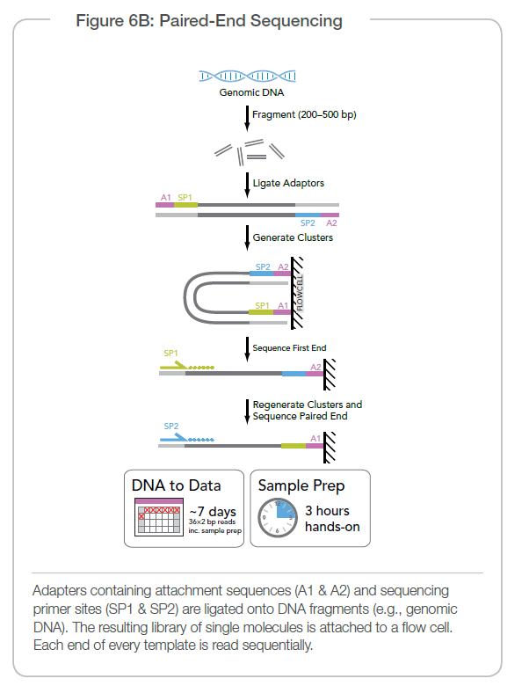
De Bruijn graph assemblers
Developed to deal with high-throughput highly accurate short-read data
Uses shotgun data (generally paired-end fragments of 300-500nt)

Slide 31
M. Schatz, Feb 2015 Course, JHU

Slide 32
M. Schatz, Feb 2015 Course, JHU

Slide 33
M. Schatz, Feb 2015 Course, JHU

Slide 34
M. Schatz, Feb 2015 Course, JHU

Slide 35
M. Schatz, Feb 2015 Course, JHU

Slide 36
M. Schatz, Feb 2015 Course, JHU

Slide 37
De Bruijn graphs - concept

Slide 38
Scaffolding
  Now, you have a huge pile of contigs but you want to make them larger. How?
  Add context!
  Link together contigs using other genomic information
    Infer contigs position on the genome relative to one another

Slide 39
Linking Contigs via DNA Seq
Illumina sequencing (100 to 300 bp reads)
PacBio/ONP long-read (10 – 15+ kb reads)
Paired-end reads
<500bp fragment
10-100 kb+
Mate pair reads
>5kb fragment
Illumina
>250 bp PCR free reads
>50kb fragments
10x Genomics
Linked reads
Modified from Qi Sun, Minghui Wang, Cornell Univ.

Slide 40
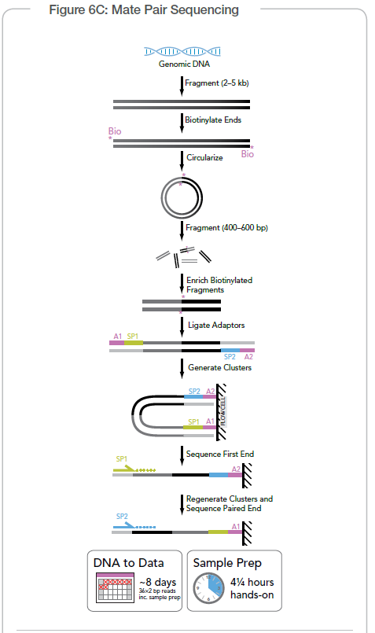
Illumina Sequencing

Slide 41
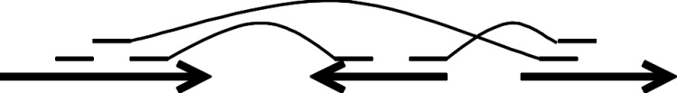
Contigs to scaffolds
Mate-pair read
Paired-end read
Contigs
Scaffold
Gap
Gap

Slide 42
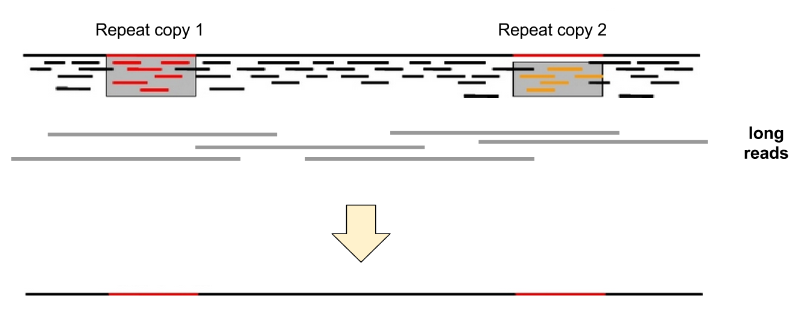
Long reads

Slide 43
Starting a new assembly project

Slide 44
Planning a genome sequencing project?
  How large and/or complex is my genome?
  Ploidy (number of sets of chromosomes) of the genome?
  Are the cells multinucleated?
  How much of the genome is repetitive? What is the repeat size distribution?
  Is my genome heterozygous?
  Is a good quality genome of a related species available?
  Does other useful data exist that could improve my assembly
  BUDGET

Slide 45

What complicates assembly?
Repetitive sequence
  causes nodes to be shared, locality confusion
Variation and Heterozygosity
  Causes lots of branch points in a graph
Sequencing read issues (technical, but very important)
  Sequencing artifacts (adapters, vector sequence, etc)
  Sequence errors
    Generally random, but some technologies have systematic errors
  You remembered to QC, trim, and cleam up the data, right?

Slide 46
Genome size/complexity
By Abizar at English Wikipedia, CC BY-SA 3.0, https://commons.wikimedia.org/w/index.php?curid=19537795

Slide 47
Genome size/complexity
By Estevezj - Own work, CC BY-SA 3.0, https://commons.wikimedia.org/w/index.php?curid=23704739

Slide 48
How large is my genome?
The size and complexity of the genome can be estimated from the ploidy of the organism and the DNA content per cell
This will affect:
  How many reads will be required to attain sufficient coverage (typically 10x to 100x, depending on read length)
  What sequencing technology to use (short vs. long reads)
  What computational resources will be needed (generally amount of memory needed and length of time resources will be used)

Slide 49
Ploidy
Number of sets of chromosomes in a cell (N)
  Bacteria – 1N
  Vertebrates – 2N (human, mouse, rat)
  Amphibians – 2N to 12N
  Plants – 2N to ??? (wheat is 6N)

Slide 50
Repetitive sequences
Most common source of assembly errors
If sequencing technology produces reads > repeat size, impact is much smaller
Most common solution: generate reads or mate pairs with spacing > largest known repeat

Slide 51
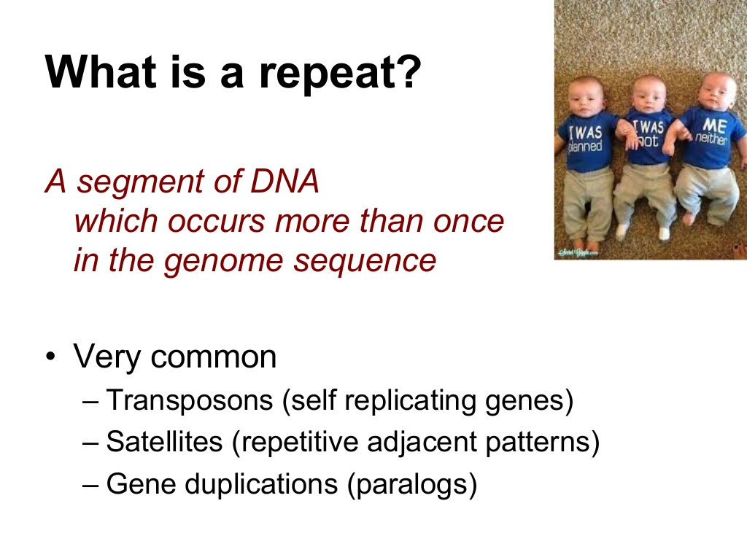

Slide 52
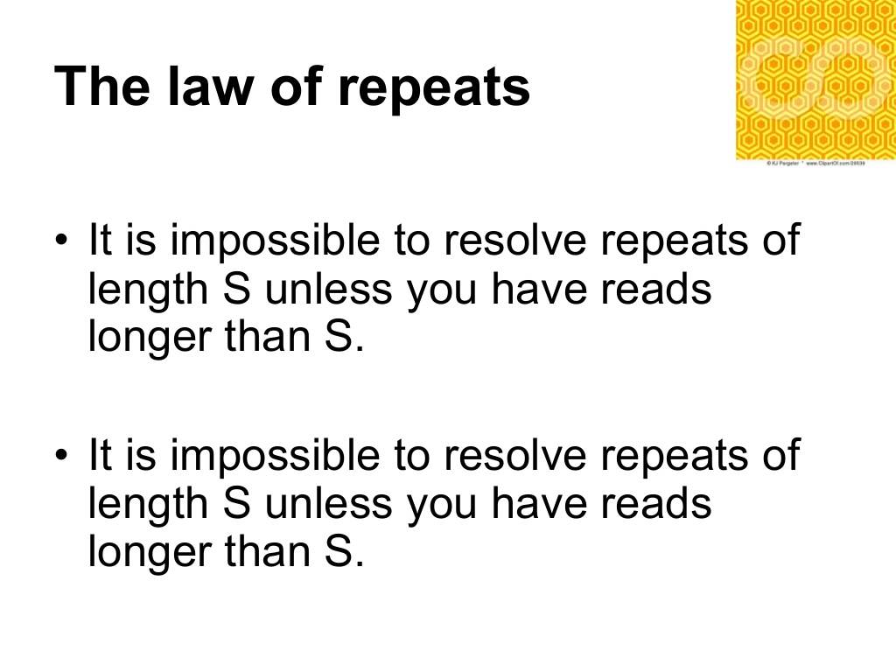

Slide 53
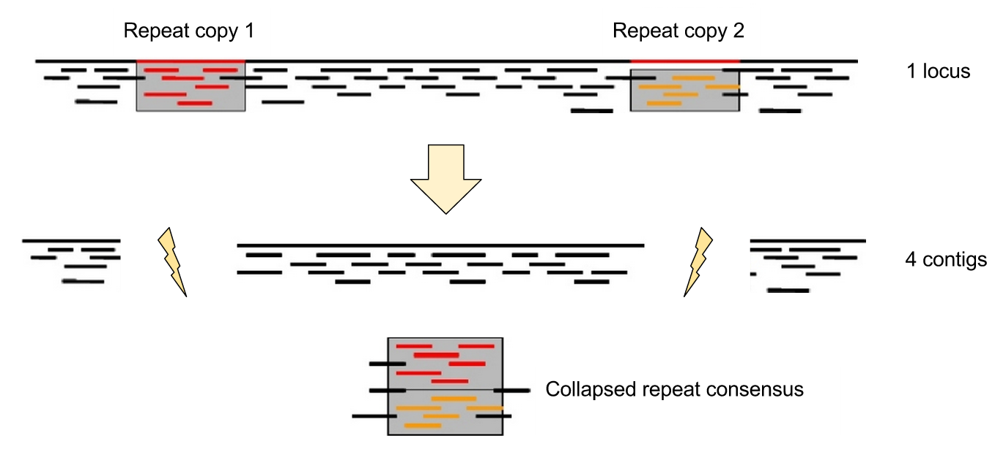
Assembling repeats

Slide 54
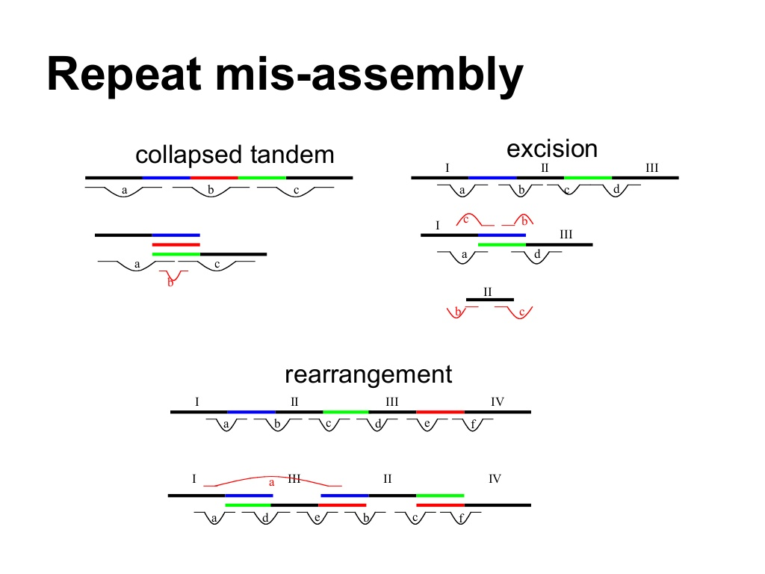

Slide 55
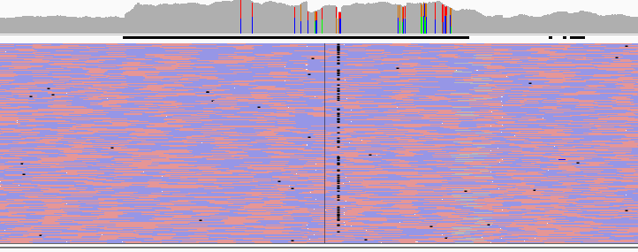

Slide 56
Getting around repeats
Use ‘other information’ to work around the limitation you have with short reads
  Use ‘mate-pairs’ to span repetitive regions and create larger scaffolds
  Use long read data to span repetitive regions
  Cloned libraries – BACS, cosmids, fosmids, etc
  Use ‘linked reads’ via technology like 10x
  Chromosomal interactions (HiC, Dovetail)

Slide 57
Contigs to scaffolds
Mate-pair read
Paired-end read
Contigs
Scaffold
Gap
Gap

Slide 58
Heterozygosity
Heterozygous – Locus-specific; diploid organism has two different alleles at the same locus.
Heterozygosity is a metric used to denote the probability an individual will be heterozygous at a given allele.
Higher heterozygosity == more diverse == harder to assemble
Unfortunately, assemblies are represented (for now) as haploid. So this is a major problem!

Slide 59
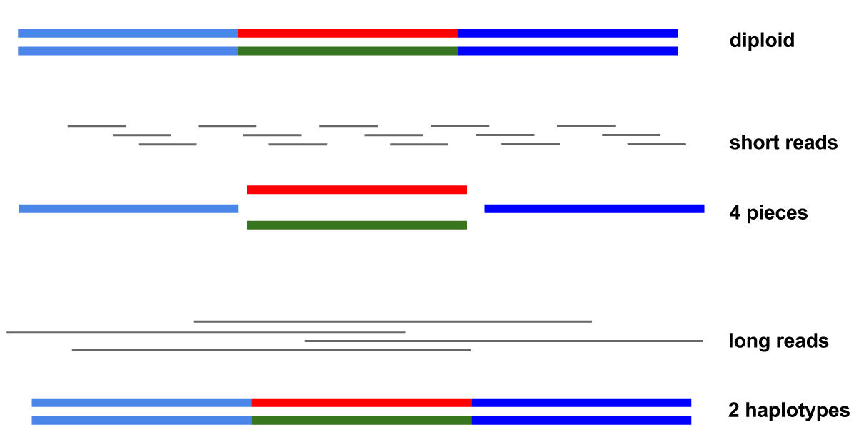
Heterozygosity

Slide 60
Genome(s) from related species
Preferably of good quality, with large reliable scaffolds
Help guiding the assembly of the target species
Help verifying the completeness of the assembly
Can themselves be improved in some cases
But to be used with caution – can cause errors when genome architecture is different!
  Large-scale genomic rearrangement in particular is a problem

Slide 61
Strategies for assembly
Sequencing and assembly strategies are interdependent!
  Example: Bacterial genome assembly
    Generate PacBio or Oxford Nanopore reads, assemble with Flye or Canu
    Generate both PacBio and Illumina, use a hybrid assembler like Unicycler
    Generate Illumina reads and assemble with Velvet or SPAdes
Strategies and technology differ per assembler
    Supernova – only utilizes 10x Chromium linked-read libraries
    SOAPdenovo – allows more flexibility, but optimized for Illumina shotgun libraries generated by BGI (no surprise, since they developed SOAPdenovo)
    ALLPATHS-LG – strict requirement for two library types
    Canu – Long-reads only, PacBio or Oxford
    Falcon – only PacBio

Slide 62
Typical sequencing strategies
Bacterial genome
  PacBio or Oxford Nanopore sequences at 40-50x coverage, self-correction and/or hybrid correction (using Illumina data) and assembly using Canu, Flye
  2 x 300bp overlapping paired-end reads from Illumina MiSeq
Larger genomes
  Paired-end (2x250 nt overlapping fragments) 50-100x
  Mate-pair (1, 3 and 10 kb libraries) 150-250 nt reads – 25-50x
  10x Genomics run, assembly using Supernova
  Long-reads if $$$ is available

Slide 63
Additional useful data
Fosmid libraries
  End sequencing adds long-range contiguity information
  Pooled fosmids (~5000) can often be assembled more efficiently
Genetic or physical maps
  Location of alleles or physical markers in reference to one another
  May be hard to produce (years to decades, $$$$)
RNA-Seq (transcripts)
  Assembled transcripts from genes, which can be used to order scaffolds
  Require their own independent assembly

Slide 64
Assembly strategies and algorithms
In most cases, start with cleanup and error correction of raw reads
For long reads (>500 nt), Overlap/Layout/Consensus (OLC) algorithms work best. Modern example: Canu, wtdbg2
For short reads, De Bruijn graph-based assemblers are most widely used. Modern example: MEGAHIT, SPAdes
Key points:
  There is no simple solution, best to try different assemblers and strategies
  Use simple metrics to gauge quality of assembly
  The field is rapidly evolving, like the sequencing technology

Slide 65
Long-read assembly

Slide 67
Sequel II
(owned by Illumina)

Slide 68
2016-2017

Slide 69
2017
Whale watching: E. coli
Total bases: 5,014,576,373 (5Gb) Number of reads: 150,604
N50: 63,747
Mean: 33,296.44
Accuracy: 80-85%
N. Loman, ASM Microbe 2017
http://lab.loman.net/2017/03/09/ultrareads-for-nanopore/

Slide 70

2017
E. coli: genome assembly in 8 reads
Read | Length | Ref start | Ref end | Time (m)
1 | 876991 | 4398844 | 634183 | 32.48
2 | 696402 | 470003 | 1166405 | 25.79
3 | 799047 | 1137438 | 1936485 | 29.59
4 | 642071 | 1759431 | 2401502 | 23.78
5 | 826662 | 2106227 | 2932889 | 30.61
6 | 883962 | 2699626 | 3583588 | 32.73
7 | 825191 | 3285196 | 4110387 | 30.56
8 | 463341 | 3995967 | 4459308 | 17.16
miniasm
N50 4Mb
Time: 1.5s (1 CPU)
1x coverage!
N. Loman, ASM Microbe 2017
http://lab.loman.net/2017/03/09/ultrareads-for-nanopore/

Slide 71
Long read assembly
Lots of errors in reads, but (very) gradually improving
Can perform a long-read only assembly with very high coverage data (50-100x)
  Requires very high coverage, minimum 50x, with 80x preferred
  Expensive for large genomes (but getting competitive)
  Issues with homopolymers
  …or hybrid assembly, with shorter Illumina reads used to error-correct the long-read assembly (Canu)

Slide 72
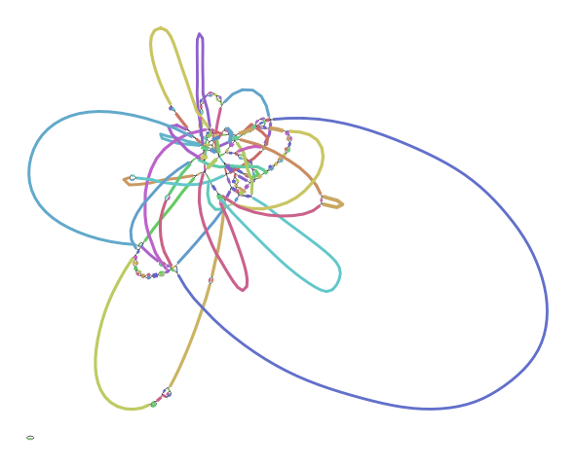

Slide 73
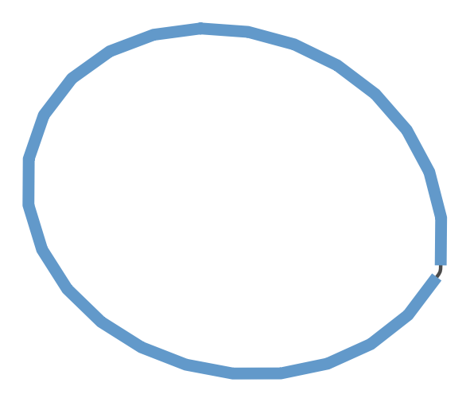

Slide 74
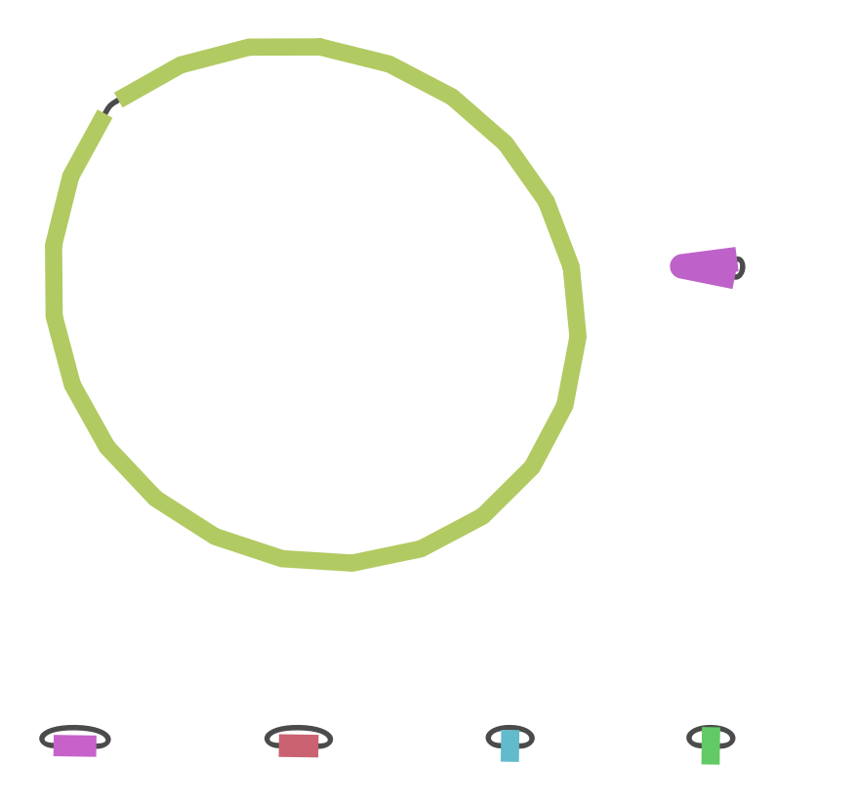
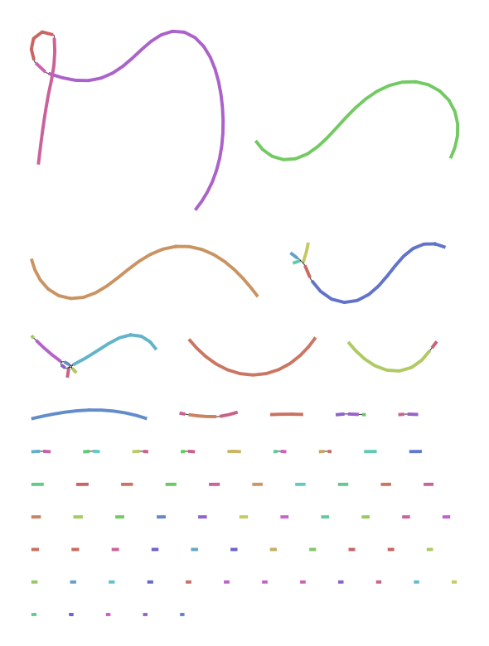

Slide 75
2019

Slide 76
Assessing your assembly

Slide 77
How good is my assembly?
How much total sequence is in the assembly relative to estimated genome size?
How many pieces, and what is their size distribution?
Are the contigs assembled correctly?
Are the scaffolds connected in the right order / orientation?
How were the repeats handled?
Are all the genes I expected in the assembly?

Slide 78
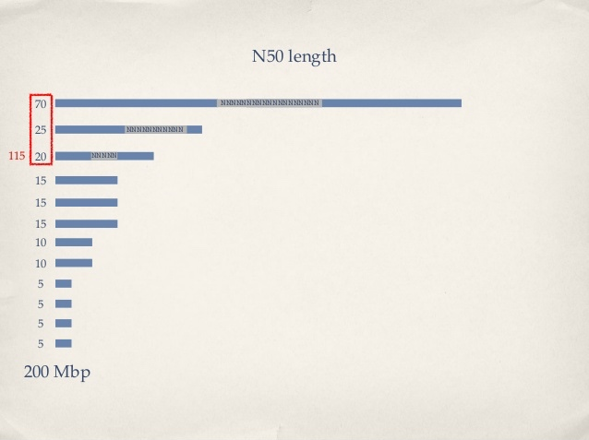
N50: the most common measure of assembly quality
N50 = length of the shortest contig in a set making up 50% of the total assembly length (Larger is better)
NG50 = length of the shortest contig in a set making up 50% of the estimated genome size
NG50 is generally better

Slide 79

N50 concerns
Optimizing for N50
  Encourages mis-assemblies!
  Encourages ‘gaming’ the stats
An aggressive assembler may over-join:
  1,1,3,5,8,12,20 (previous)
  1,1,3,5,20,20 (now)
  1+1+3+5+20+20 = 50 (unchanged)
N50 is the “halfway sum” (still 25)
  1+1+3+5+20= 30 (≥ 25) so N50 is 20 (was 12)
You can also filter contigs below a certain (arbitrary) size, which lowers overall assembly size (and increases N50)

Slide 80
Comparative analysis
Compare against
  A close reference genome
  Results from another assembler
  Self-comparison
  Versions of the same assembly
Whole genome alignment
  MUMmer
  Lastz
Generates an alignment and a dot plot

Slide 81
Dot Plot
How can we visualize whole genome alignments?
With an alignment dot plot
  N x M matrix
    Let i = position in genome A
    Let j = position in genome B
    Fill cell (i,j) if A_{i} shows similarity to B_{j}
T
G
C
A
A C C T
– A perfect alignment between A and B would completely fill the positive diagonal
From M. Schatz and A. Phillipy : Alignment and Assembly Lecture

Slide 82
B
Translocation
Inversion
Insertion
A
B
A
http://mummer.sourceforge.net/manual/AlignmentTypes.pdf
From M. Schatz and A. Phillipy : Alignment and Assembly Lecture

Slide 83
Assembly
Reference

Slide 84
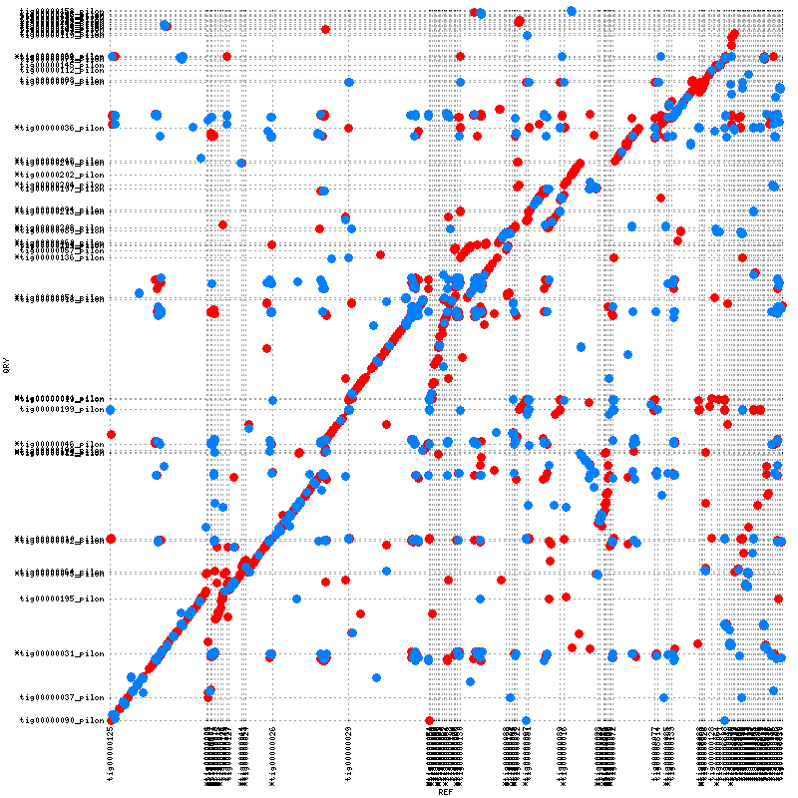
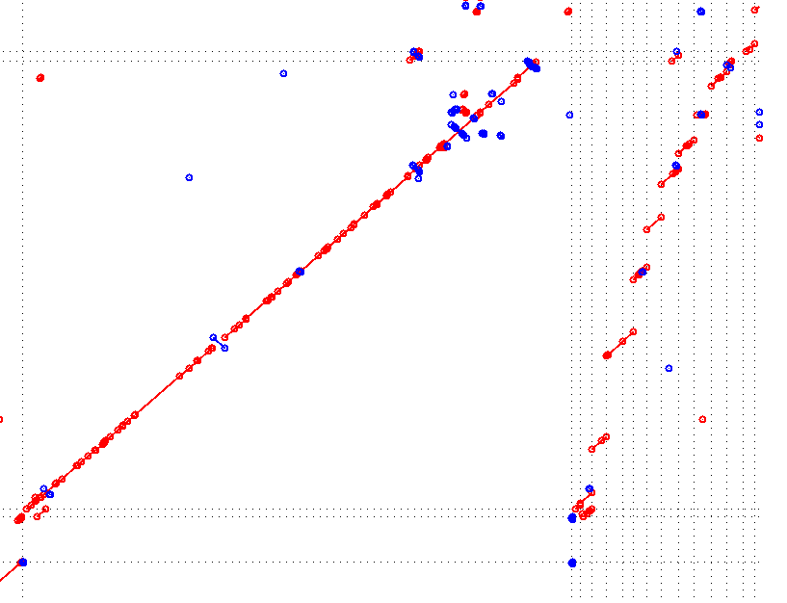

Slide 85
Order and orientation of contigs – more errors in one assembly than in another

Slide 86
REAPR
Toolkit that assesses the quality of a genome assembly independently of the assembler, and without needing a “gold” reference assembly
REAPR output can be visualized in many ways, and helps genome finishing projects
Every genome assembly project should use REAPR or a similar toolkit to perform quality checks on the assemblies being produced

Slide 87
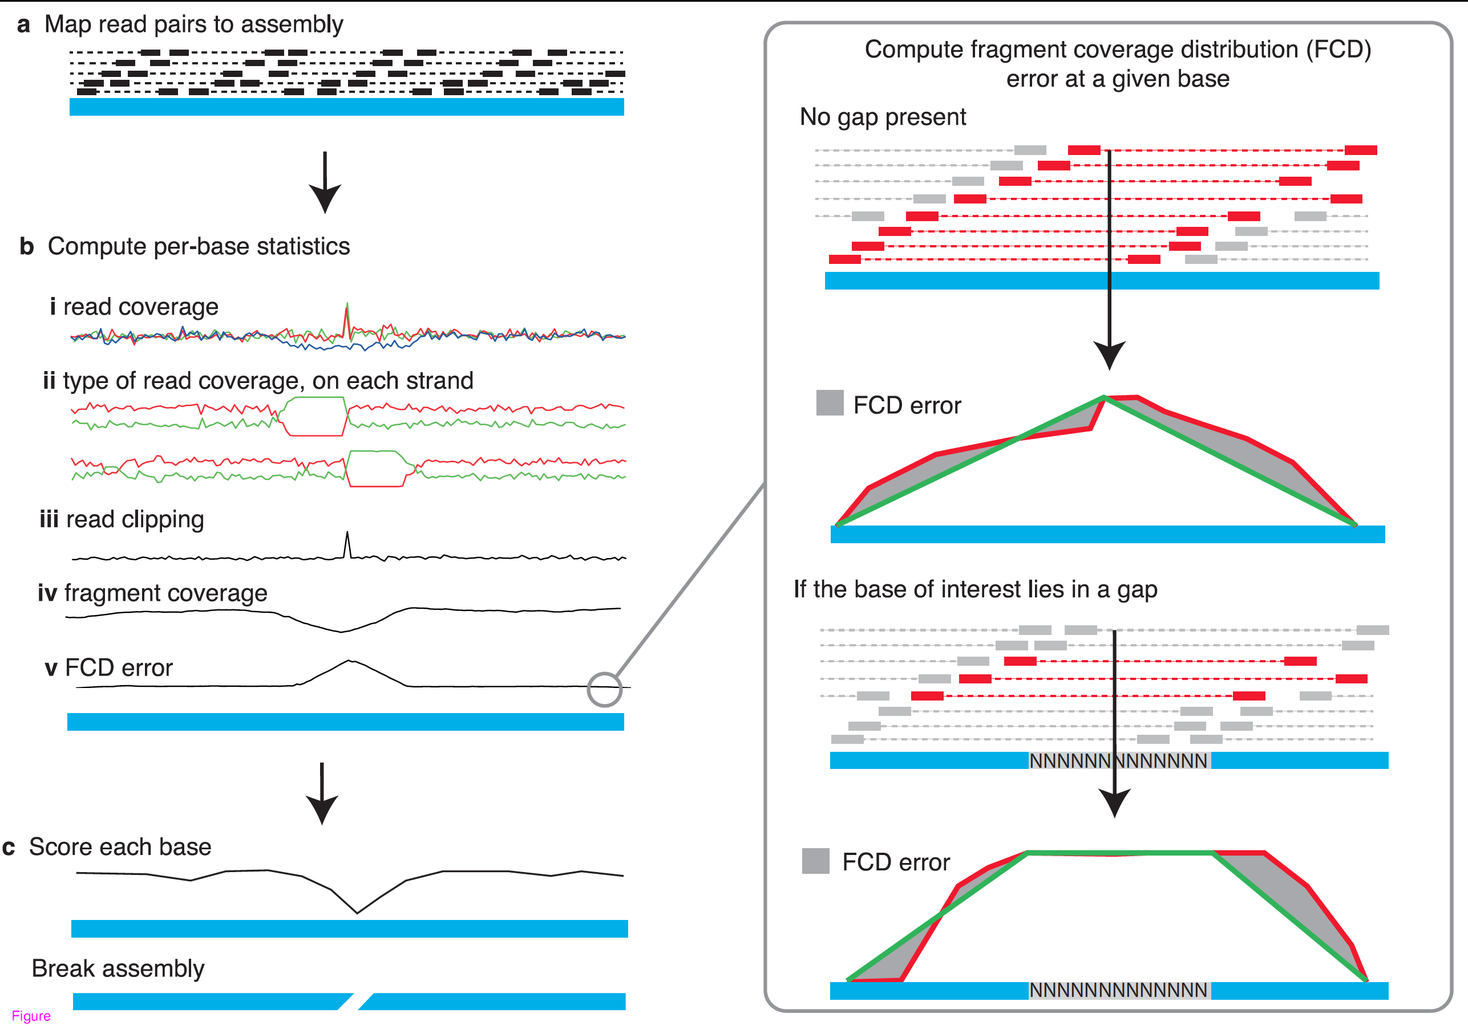
REAPR overview

Slide 88
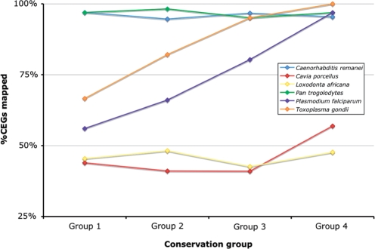
BUSCO and CEGMA: conserved gene sets
BUSCO: From Evgeny Zdobnov’s group,
University of Geneva
CEGMA : From Ian Korf’s group, UC Davis
Mapping Core Eukaryotic Genes
Coverage is indicative of quality
and completeness of assembly

Slide 89
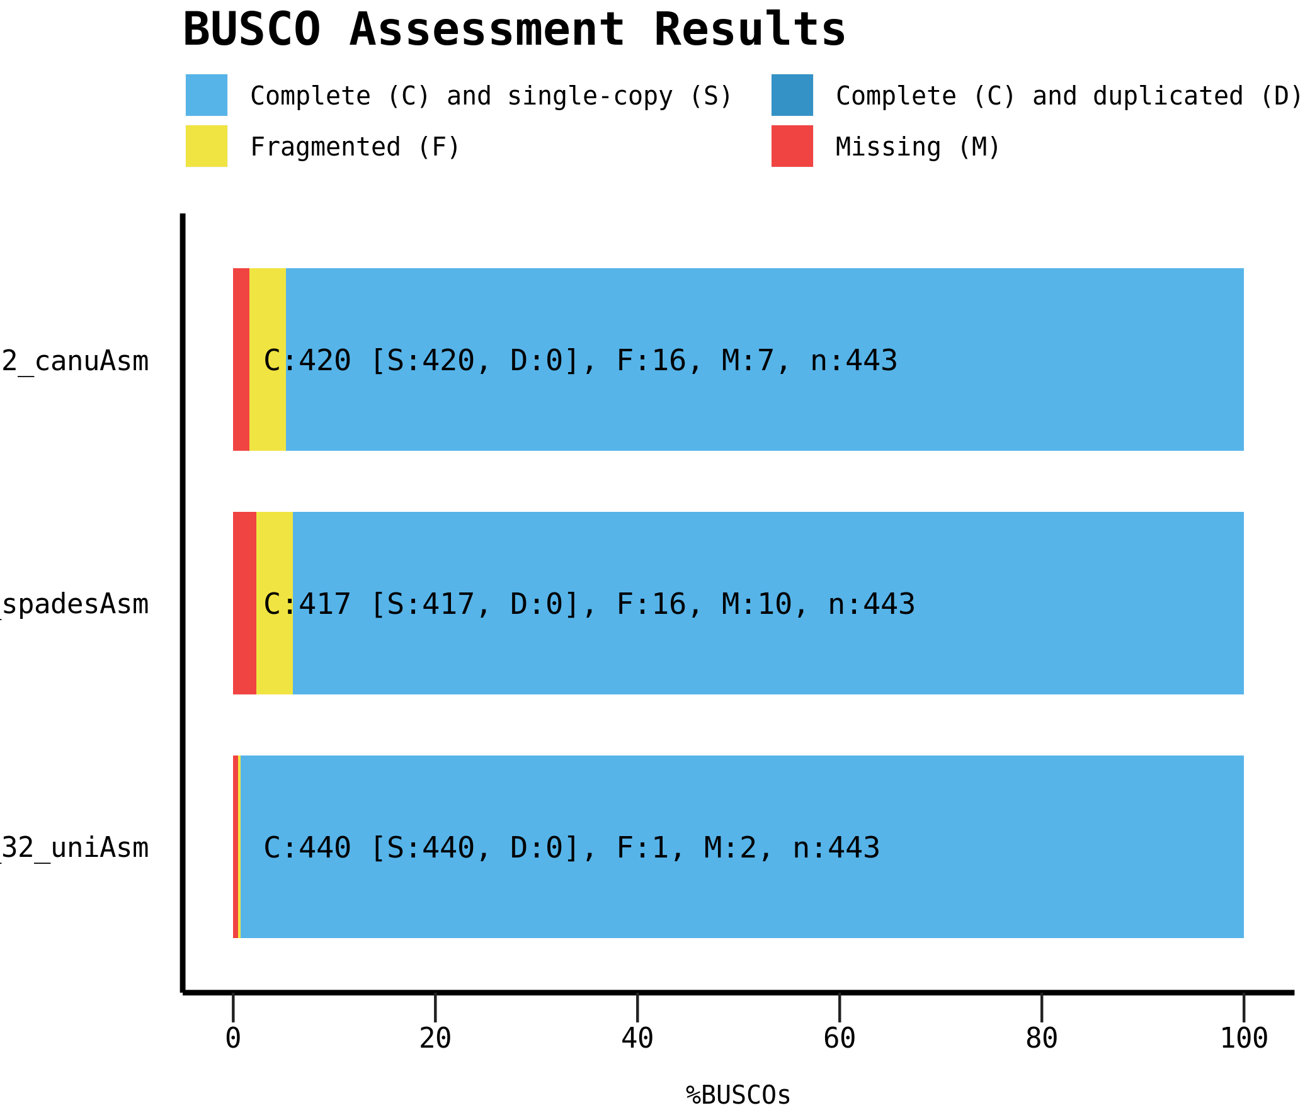

Slide 90
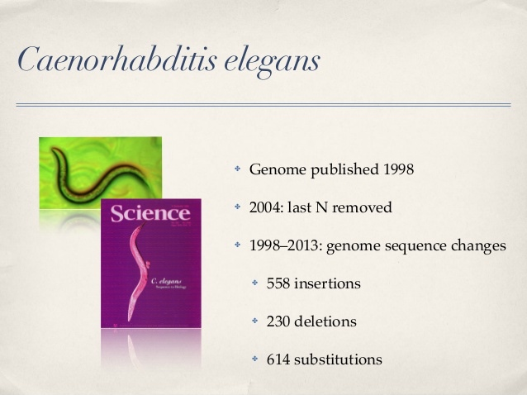
Even the best genomes are not perfect

Slide 91
Assembler comparisons

Slide 92
Assessing assembly strategies
Assemblathon (UC Davis and UC Santa Cruz)
  Provide challenging datasets to assemble in open competition (synthetic for edition 1, real for edition 2)
  Assess competitor assemblies by many different metrics
  Publish extensive reports
GAGE (U. of Maryland and Johns Hopkins)
  Select datasets associated with known high-quality genomes
  Run a set of open source assemblers with parameter sweeps on these datasets
  Compare the results, publish in scholarly Journals with complete documentation of parameters

Slide 93
There is no such thing as a “perfect” assembler
(results from GAGE competition)

Slide 94
The computational demands and effectiveness
of assemblers are very different

Slide 95
Some advice on running assemblies
Perform parameter sweeps
  Use many different values of key parameters, especially k-mer size for DBG assemblers, and evaluate the output (some assemblers can do this automatically)
Try different subsets of the data
  Sometimes libraries are of poor quality and degrade the quality of the assembly
  Artefacts in the data (e.g. PCR duplicates, homopolymer runs, …) can also badly affect output quality
Try more than one assembler
  There is no such thing as “the best” assembler

Slide 96
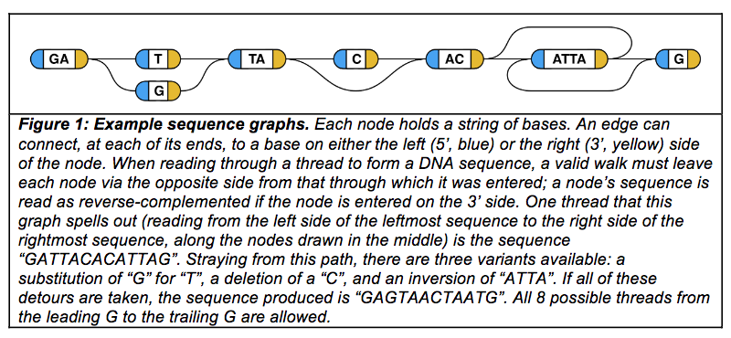
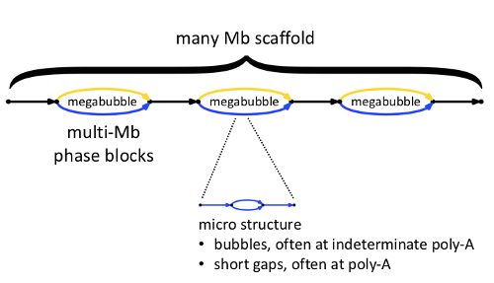
Genome graphs
With the release of the latest human genome reference, there is more pressure to represent more data with a genome.
Current representations are haploid (one copy)
Newer representations are genome graphs, where variant information is retained (e.g. heterozygosity)
Tools are still catching up
Novak et al, bioRxiv: https://doi.org/10.1101/101378
10x Genomics

Slide 97
Genome Annotation

Slide 98
Methods for genome annotation
Ab initio, i.e. based on sequence alone
  INFERNAL/rFAM (RNA genes), miRBase (miRNAs), RepeatMasker (repeat families), many gene prediction algorithms (e.g. AUGUSTUS, Glimmer, GeneMark, …)
Evidence-based
  Require transcriptome data for the target organism (the more the better)
  Align cDNA sequences to assembled genome and generate gene models: TopHat/Cufflinks, Scripture

Slide 99
Methods for biological annotation
BLAST of gene models against protein databases
  Sequence similarity to known proteins
InterProScan of predicted proteins against databases of protein domains (Pfam, Prosite, HAMAP, PANTHER, …)
Mapping against Gene Ontology terms (BLAST2GO)

Slide 100
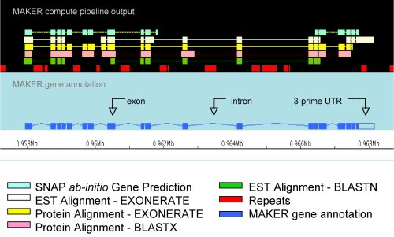
MAKER, integration framework for genome annotation
MAKER runs many software tools on the assembled genome and collates the outputs
See http://gmod.org/wiki/MAKER

Slide 101
Others?
Prokka (bacterial/archaeal/viral)
Joint Genome Institute – IMG/ER (Integrated Microbial Genome Expert Review)
NCBI – RefSeq pipeline

Slide 102
Acknowledgements
Materials from this slide deck include figures and slides from many publications, Web pages and presentations by:
  M. Schatz, A. Phillipy, T. Seemann, S. Salzberg, K. Bradnam, D. Zerbino, M. Pop, G. Sutton, Nick Loman, Carson Holt, Ryan Wick.
  I highly recommend Ben Langmead’s teaching materials; he has a ton fabulous (and much more in-depth) notes on his lab page: http://www.langmead-lab.org/teaching-materials/
  Thank you!

