Slide 1
Galaxy Server Interface
.
Learning Galaxy Interface through an interactive tour.

Slide 2
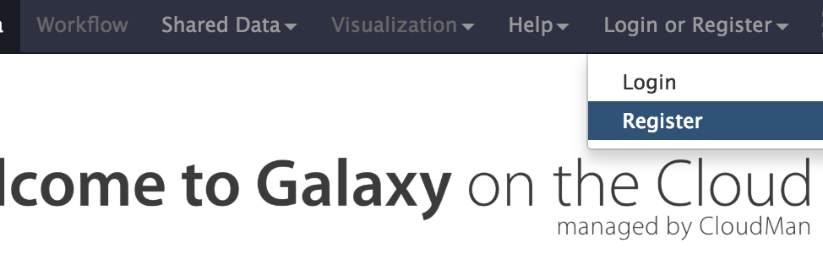
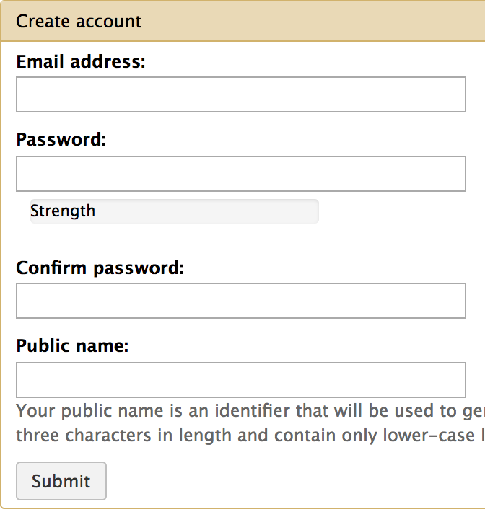
Step 1: Create a Galaxy account
Go to:http://compgen.knoweng.org/galaxy
Click Login or Register
Click Register
Input your account information.
(Note: This website is not encrypted.
You may use a dummy password)
Click Submit.

Slide 3
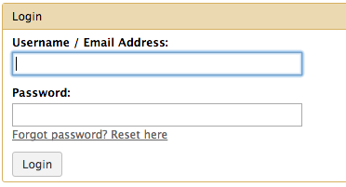
Step 2: Logging into Galaxy
Click Login or Register
Click Login
Input your login credentials.
Click Login.

Slide 4
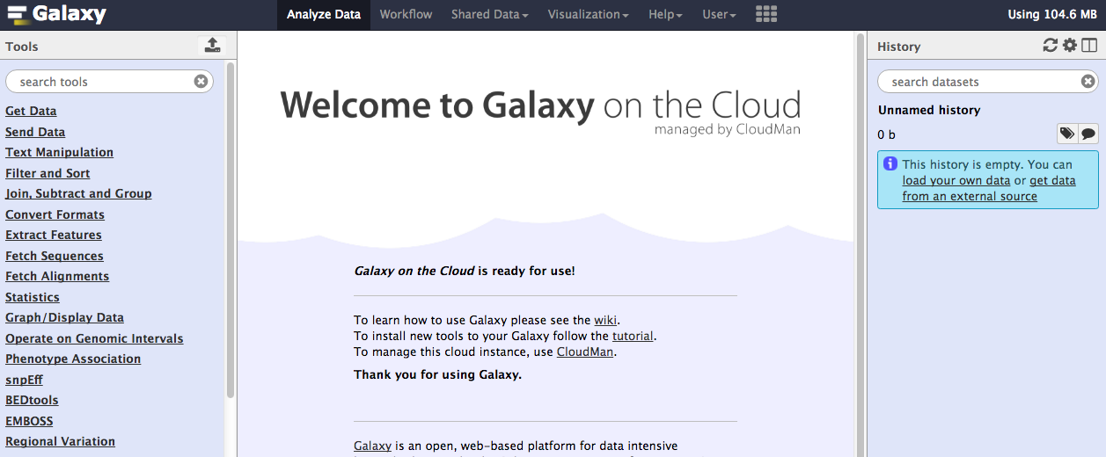
Step 2B: Galaxy Start Screen
The resulting screen should look like the figure below:

Slide 5
Step 2C: Galaxy interface tutorial
Go to
https://usegalaxy.org/tours/core.galaxy_ui

