Slide 1
Regulatory Genomics Lab
Saurabh Sinha
PowerPoint by Saba Ghaffari
Edited by Shayan Tabe Bordbar

Slide 2
In this lab, we will do the following:.
Use command line tools to manipulate a ChIP track for BIN TF in D. Mel.
Subject peak sets to MEME suite.
Compare MEME motifs with Fly Factor Survey motifs for BIN TF.
Subject peak set to a gene set enrichment test.

Slide 3
1
2
3
CHIP-seq peaks (Binding sites of a TF)
Selected ChIP peaks (100 strong binding sites of the TF)
DNA sequences of selected ChIP peaks
TF Motif inferred from selected ChIP peaks
MEME
5
Genes near ChIP peaks
Genes near ChIP peaks (converted IDs)
Gene Ontology terms enriched in genes near ChIP peaks
DAVID
6
7

Slide 4
Step 0A: Start the VM
Follow instructions for starting VM. (This is the Remote Desktop software.)
The instructions are different for UIUC and Mayo participants.
Instructions for UIUC users are here: http://publish.illinois.edu/compgenomicscourse/files/2020/06/SetupVM_UIUC.pdf
Instructions for Mayo users are here:
http://publish.illinois.edu/compgenomicscourse/files/2020/06/VM_Setup_Mayo.pdf

Slide 5
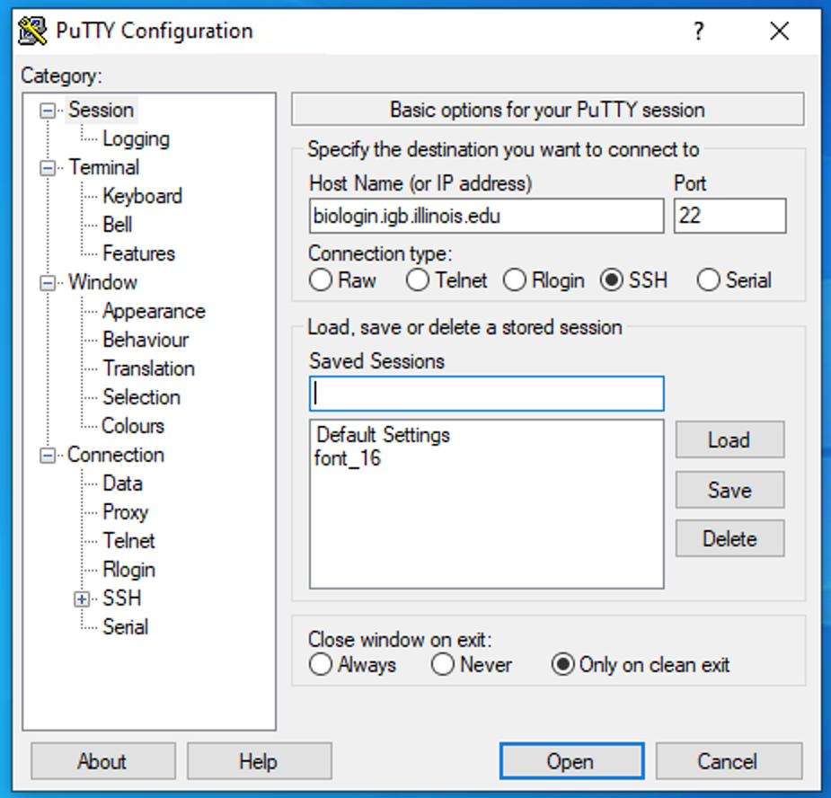
Step 0B: Accessing the IGB Biocluster
Open Putty.exe
In the hostname textbox type:
biologin.igb.illinois.edu
Click Open
If popup appears, Click Yes
Enter login credentials assigned to you; example, user class00.
Now you are all set!

Slide 6
Step 0C: Lab Setup
In PuTTY
The lab is located in the following directory:
/home/classroom/mayo/2020/06_Regulatory_Genomics/
Following commands will copy a shell script -designed to prepare the working directory- to your home directory. Follow these steps to copy and then submit the script as a job to biocluster:
$ cd ~/
# Note ~ is a symbol in Unix paths referring to your home directory
$ cp /home/classroom/mayo/2020/06_Regulatory_Genomics/src/prep-directory.sh ./
# Copies prep-directory.sh script to your working directory.
$ sbatch prep-directory.sh
# submits a job to biocluster to populate your home directory with necessary files
$ squeue –u <userID> # to check the status of the submitted job
Notes:
This directory contains the data and results from the finished version of the lab (i.e. the version of the lab after the tutorial). Consult it if you unsure about your runs. You don’t have write permissions to the lab directory.

Slide 7
Step 0D: Working directory: data
Navigate to the created directory for this exercise and look what data folder contains.
$ cd 06_Regulatory_Genomics
$ ls
# output should be:
# data results src
$ ls data/
# BIN_Fchip_s11_1000.gff
# dm3.fasta
# flygenes_vm.bed
Name | Description
BIN_Fchip_s11_1000.gff | ChIP peaks for BIN transcription factor in GFF format
dm3.fasta | Drosophila Melanogaster genome
flygenes_vm.bed | Coordinates of all Drosophila genes in BED format

Slide 8
Step 0E: Working directory: scripts
Navigate to the directory containing the scripts and look what’s inside.
$ cd src
$ ls *.sh
# lists the scripts to be used in this lab:
# get_closest_genes.sh get_sequence.sh get_top100.sh

Slide 9
Computational Prediction of Motifs
In this exercise, after performing various file manipulations, we will use the MEME suite to identify a motif from the top 100 ChIP regions.
Subsequently, we will compare our predicted motif with the experimentally validated motif for BIN at Fly Factor Survey.

Slide 10
1
2
3
CHIP-seq peaks (Binding sites of a TF)
Selected ChIP peaks (100 strong binding sites of the TF)
DNA sequences of selected ChIP peaks
TF Motif inferred from selected ChIP peaks
MEME
5
Genes near ChIP peaks
Genes near ChIP peaks (converted IDs)
Gene Ontology terms enriched in genes near ChIP peaks
DAVID
6
7

Slide 11
Step 1: Obtain the top 100 strongest ChIP peaks
We will use “sort” command, to sort the peaks based on their score and then take the top 100 peaks.
Use the following line to get get the top 100 chip peaks from the original ChIP gff file.
$ cd ~/06_Regulatory_Genomics/src/
$ head ~/06_Regulatory_Genomics/data/BIN_Fchip_s11_1000.gff
$ sbatch get_top100.sh
# OUTPUT in ~/06_Regulatory_Genomics/results/Top_100_peaks.gff

Slide 12
Please do not try to Run the commands in this slide. This is just to explain what the script that we just ran (get_top100.sh) is supposed to do in more detail.
What’s inside the get_top100.sh script?
#!/bin/bash
#SBATCH -c 1
#SBATCH --mem 8000
#SBATCH -A Mayo_Workshop
#SBATCH -J getTop100
#SBATCH -o getTop100.%j.out
#SBATCH -e getTop100.%j.err
#SBATCH -p classroom
# this is our input (gff)
export TOBESORTED=../data/BIN_Fchip_s11_1000.gff
sort -k 6,6nr $TOBESORTED | head -100 > ../results/Top_100_peaks.gff
Tells the cluster ‘job manager’ what resources you want (1 CPU, 8GB memory), run on the ‘classroom’ nodes, and name the job ‘getTop100’
Create shortcut name for input ChIP peak file in GFF format.
Use Linux sort command to sort the file based on the numeric score stored in the 6th column of the gff file (ChIP score). [–k flag introduces the column to be sorted by. ‘nr’ notes that we desire a numeric sort in reverse order.]
Output is directed to (>) Top_100_peaks.gff file.

Slide 13
1
2
3
CHIP-seq peaks (Binding sites of a TF)
Selected ChIP peaks (100 strong binding sites of the TF)
DNA sequences of selected ChIP peaks
TF Motif inferred from selected ChIP peaks
MEME
5
Genes near ChIP peaks
Genes near ChIP peaks (converted IDs)
Gene Ontology terms enriched in genes near ChIP peaks
DAVID
6
7

Slide 14
Step 2: Extract DNA sequence of Top 100 ChIP Regions
We will use a “getfasta” tool from “bedtools” toolkit to get the DNA sequence for the top 100 ChIP peaks.
Usage:
Please do not try to Run the commands in the first box. This is just to explain the arguments to bedtools getfasta
$ bedtools getfasta [options] –fi <genome_file_name> > \
# specifies the path to the genome sequence in FASTA format
-bed <file_name.bed>
# specifies the path to coordinates of input regions in (BED/GFF/VCF) # formats
Script get_sequence.sh uses Bedtools getfasta to get the sequence corresponding to peaks stored in Top_100_peaks.gff. Run the following command:
$ cd ~/06_Regulatory_Genomics/src/
$ sbatch get_sequence.sh
# OUTPUT in ~/06_Regulatory_Genomics/results/BIN_top_100.fasta
$ squeue –u <userID>

Slide 15
Please do not try to Run the commands in this slide. This is just to explain what the script that we just ran (get_sequence.sh) is supposed to do in more detail.
What’s inside the get_sequence.sh script?
#!/bin/bash
#SBATCH -c 1
#SBATCH --mem 8000
#SBATCH -A Mayo_Workshop
#SBATCH -J get_sequence
#SBATCH -o get_sequence.%j.out
#SBATCH -e get_sequence.%j.err
#SBATCH -p classroom
# load the tool environment
module load BEDTools
# this is our input (dm genome in fasta format)
export GENOME_DM3_FASTA=../data/dm3.fasta
export INPUT_CHIP=../results/Top_100_peaks.gff
export OUTPUT_NAME=../results/BIN_top_100.fasta
# use bedtools
bedtools getfasta -fi $GENOME_DM3_FASTA -bed $INPUT_CHIP | fold -w 60 > $OUTPUT_NAME
Tells the cluster ‘job manager’ what resources you want (1 CPU, 8GB memory, run on the ‘classroom’ nodes, and name the job ‘get_sequence’
Load the software. We use a tool called ‘BEDTools’ to work with peak files.
Create shortcut names for input genome, input ChIP peak file and output FASTA file.
run ‘bedtools getfasta’ to get the DNA sequence in dm3.fasta genome corresponding to coordinates contained in Top_100_peaks.gff
fold –w 60 ensures that the width of lines in the output file does not exceed 60 characters.
results are directed to (>) BIN_top_100.fasta

Slide 16
Note that output of get_sequence.sh (BIN_top_100.fasta) has already been copied to the VM to be used in the next step.

Slide 17
1
2
3
CHIP-seq peaks (Binding sites of a TF)
Selected ChIP peaks (100 strong binding sites of the TF)
DNA sequences of selected ChIP peaks
TF Motif inferred from selected ChIP peaks
MEME
5
Genes near ChIP peaks
Genes near ChIP peaks (converted IDs)
Gene Ontology terms enriched in genes near ChIP peaks
DAVID
6
7

Slide 18
Local Files (for UIUC users)
For viewing and manipulating the files needed for this laboratory exercise, denote the path C:\Users\IGB\Desktop\VM on the VM as the following:
[course_directory]
We will use the files found in:
[course_directory]\06_Regulatory_Genomics\

Slide 19
Local Files (for mayo clinic users)
For viewing and manipulating the files needed for this laboratory exercise, denote the path C:\Users\Public\Desktop\datafiles on the VM as the following:
[course_directory]
We will use the files found in:
[course_directory]\06_Regulatory_Genomics\

Slide 20
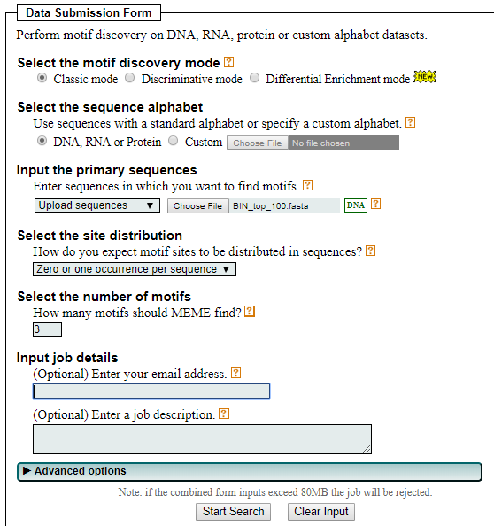
Step 3: Submit to MEME
On Desktop
DO NOT RUN THIS NOW. MEME TAKES A VERY LONG TIME.
In this step, we will submit the sequences to MEME
Go to the following address on your VM internet browser:
http://meme-suite.org/tools/meme
You can find BIN_top_100.fasta in the following directory on the VM:
[course_directory]\06_Regulatory_Genomics\BIN_top_100.fasta
Upload your sequences file here
Enter your email address here.
Leave other parameters as default.
Click “Start Search”.

Slide 21
Step 3A: Analyzing MEME Results
Go to the following web address: (You will receive notification email from MEME.
The webpage contains a summary of MEME’s findings.
It is also available in the following directory:
[course_directory]\06_Regulatory_Genomics\MEME.html
Let’s investigate the top hit.

Slide 22
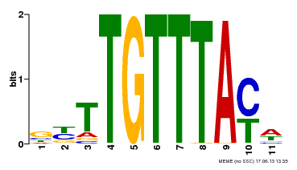
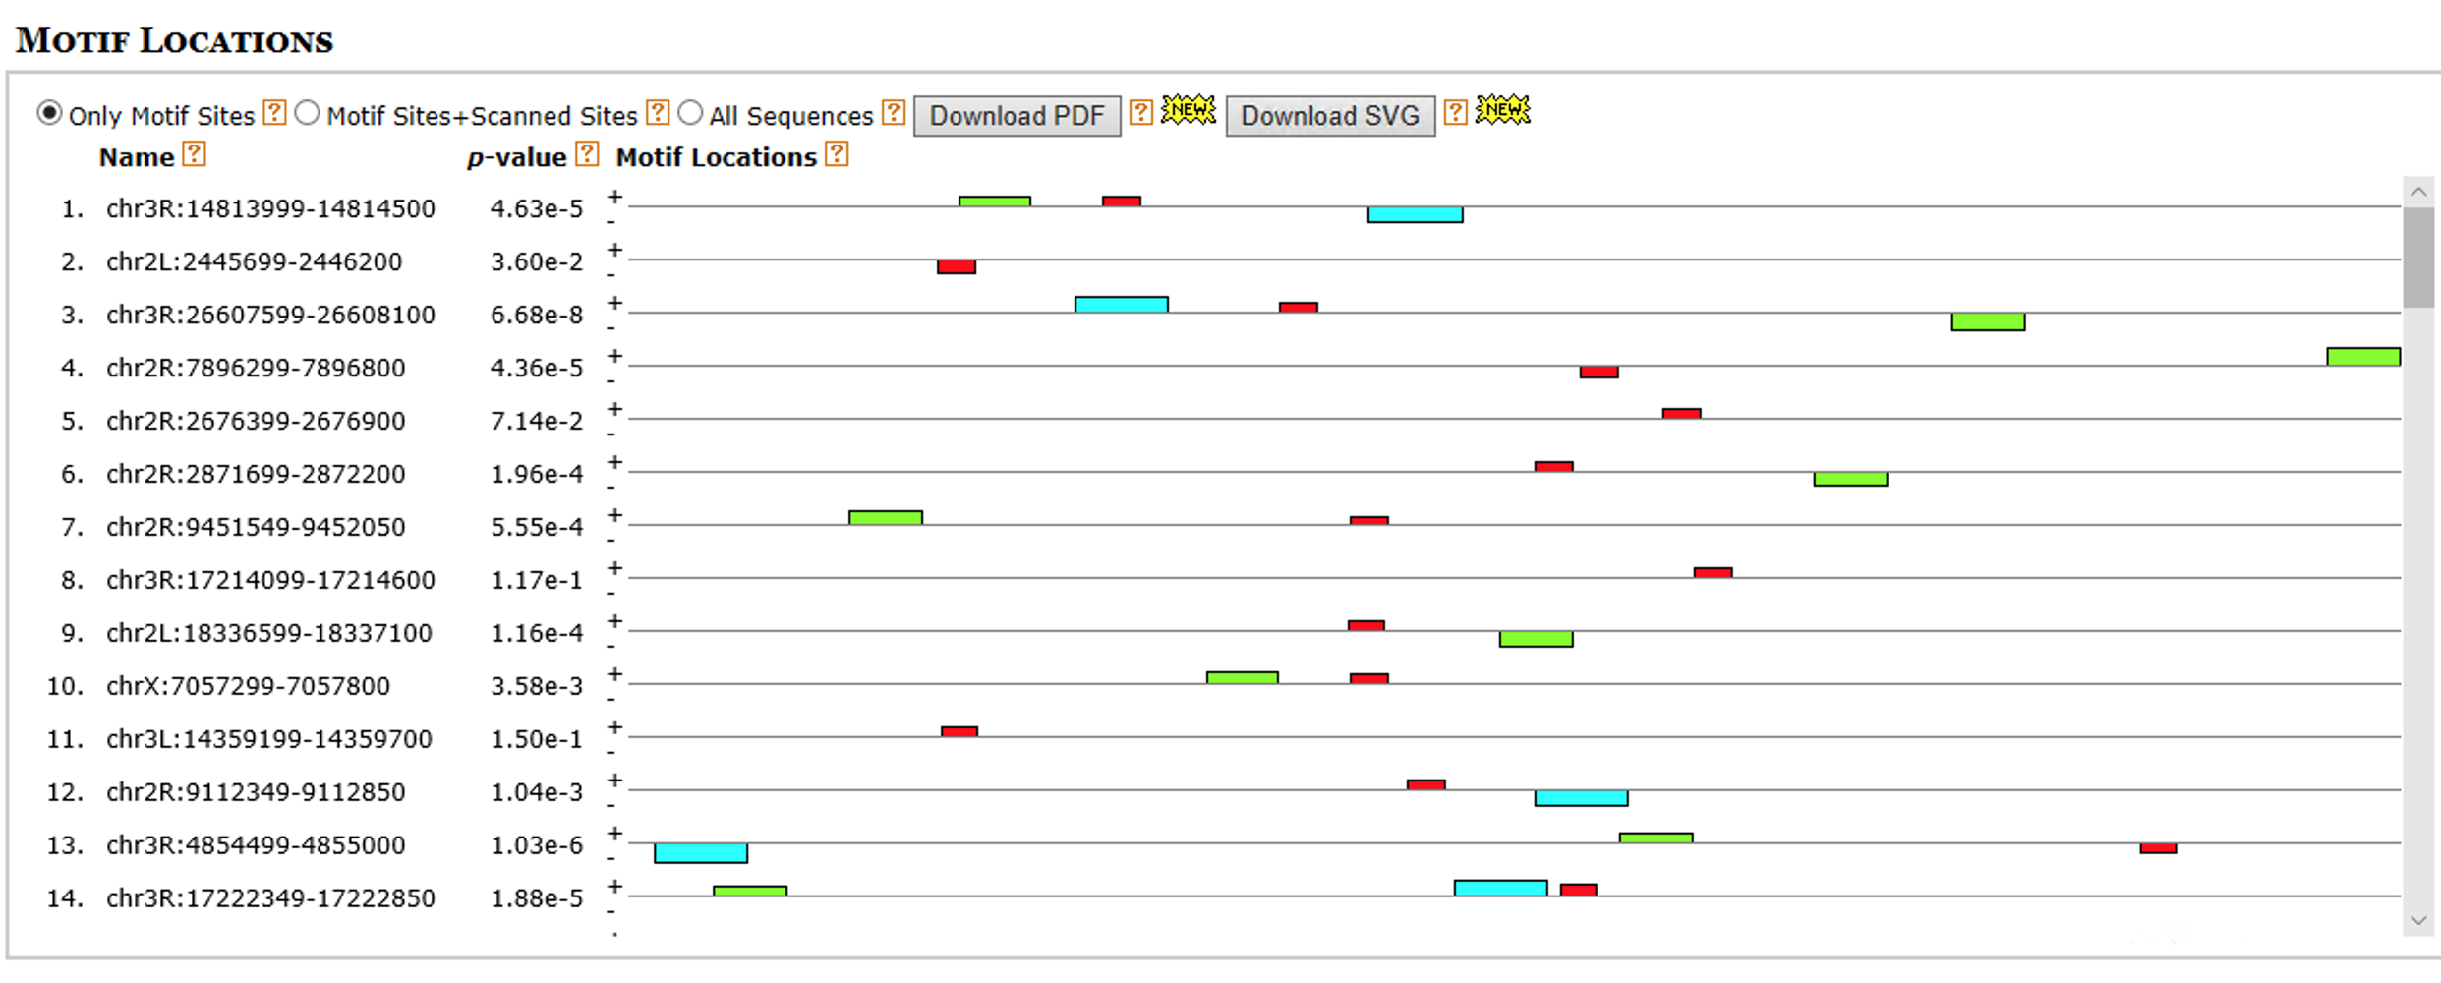
Step 3B: Analyzing MEME Results
To the right is a LOGO of our predicted motif, showing the per position relative abundance of each nucleotide
At the bottom are the aligned regions in each of our sequences that helped produce this motif. As the p-value increases (becomes less significant) matches show greater divergence from our LOGO.

Slide 23
Step 3C: Analyzing MEME Results
Other predicted motifs do not seem as plausible.

Slide 24
Step 4A: Comparison with Experimentally Validated Motif for BIN
FlyFactorSurvey is a database of TF motifs in Drosophila Melanogaster.
Use the internet browser on your VM to go to the following link to view the motif for BIN:
http://pgfe.umassmed.edu/ffs/TFdetails.php?FlybaseID=FBgn0045759

Slide 25
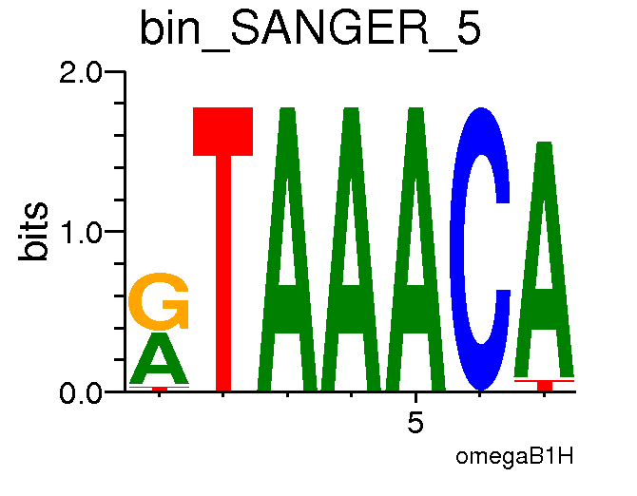
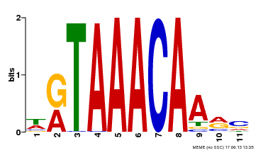
Step 4B: Comparison with Experimentally Validated Motif for BIN
Best MEME Motif
Reverse
Complemented
Actual BIN Motif
Best MEME Motif
There is strong agreement between the actual motif and the reverse complement of MEME’s best motif. This indicates MEME identified the BIN motif from the top 100 ChIP regions for this TF.

Slide 26
Gene Set Enrichment Analysis
In this exercise, we will extract the nearby genes for each one of the ChIP peaks for BIN.
We will then subject the nearby genes to enrichment analysis tests on various Gene Ontology gene sets utilizing DAVID.

Slide 27
1
2
3
CHIP-seq peaks (Binding sites of a TF)
Selected ChIP peaks (100 strong binding sites of the TF)
DNA sequences of selected ChIP peaks
TF Motif inferred from selected ChIP peaks
MEME
5
Genes near ChIP peaks
Genes near ChIP peaks (converted IDs)
Gene Ontology terms enriched in genes near ChIP peaks
DAVID
6
7

Slide 28
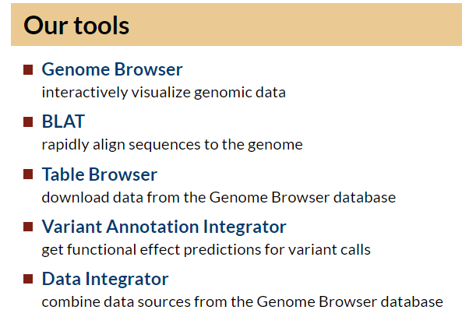
Step 5A: Acquire Nearby Genes
On Desktop
In this step, we will acquire all genes in Drosophila Melanogaster using UCSC Main Table Browser. Go to the following address using your VM internet browser:
https://genome.ucsc.edu/

Slide 29
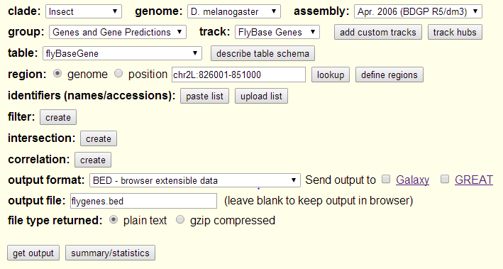
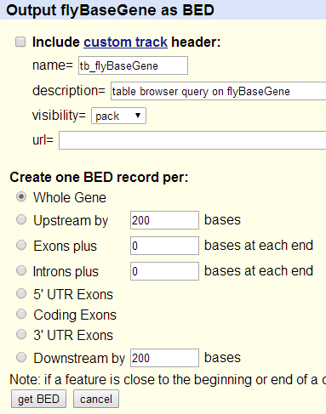
Step 5B: Acquire Nearby Genes
Ensure the following settings are configured.
Click get output and then get BED.
flygenes_vm.bed
Output of this exercise will be stored in VM Downloads directory.
Note that the output of this exercise (flygenes_vm.bed) has already been copied to the following directory on biocluster for convenience:
~/06_Regulatory_Genomics/data/flygenes_vm.bed

Slide 30
Step 5C: Acquire Nearby Genes
In PuTTY
We will use a “closest” tool from “bedtools” toolkit to get the closest non-overlapping genes to the BIN ChIP peaks.
Usage:
Please do not try to Run the commands in the following box. This is just to explain the arguments to bedtools closest
$ bedtools closest [options] –a <file_name> > \
# specifies the path to chip peak file in BED format
-b <file_name>
# specifies path to the BED file containing the coordinates for the
# feature of interest (i.e. genes in this case).

Slide 31
Step 5C: Acquire Nearby Genes
Script get_closest_genes.sh uses Bedtools closest to get name of the genes closest to ChIP peaks stored in BIN_Fchip_s11_1000.gff
All gene names and their corresponding coordinates are stored in flygenes_vm.bed which has been copied here from the output of exercise 5B.
Run the following command:
$ cd ~/06_Regulatory_Genomics/src/
$ sbatch get_closest_genes.sh
# OUTPUT in ~/06_Regulatory_Genomics/results/cg_transcript.txt
$ squeue –u <userID> # to check the status of the submitted job
Note that output of get_closest_genes.sh (cg_transcript.txt) has already been copied to the following directory on your VM for convenience.
[course_directory]\06_Regulatory_Genomics\cg_transcript.txt

Slide 32
Please do not try to Run the commands in this slide. This is just to explain what the script that we just ran (get_closest_genes.sh) is supposed to do in more detail.
What’s inside the get_closest_genes.sh script?
#!/bin/bash
#SBATCH -c 1
#SBATCH --mem 8000
#SBATCH -A Mayo_Workshop
#SBATCH -J get_closest_genes
#SBATCH -o get_closest_genes.%j.out
#SBATCH -e get_closest_genes.%j.err
#SBATCH -p classroom
# load the tool environment
module load BEDTools
module load bedops
# this is our input (dm genome in fasta format)
export INPUT_CHIP_GFF=../data/BIN_Fchip_s11_1000.gff
export INPUT_CHIP_BED=../results/BIN_Fchip_s11_1000_sorted.bed
export FLYGENE_BED=../data/flygenes_vm.bed
export FLYGENE_BED_SORTED=../results/flygenes_vm_sorted.bed
export OUTPUT_NAME=../results/cg_transcript.txt
gff2bed < $INPUT_CHIP_GFF > $INPUT_CHIP_BED
sortBed -i $FLYGENE_BED > $FLYGENE_BED_SORTED
bedtools closest -io -t first -a $INPUT_CHIP_BED -b $FLYGENE_BED_SORTED | cut -f 14 > $OUTPUT_NAME
Tells the cluster ‘job manager’ what resources you want (1 CPU, 8GB memory, run on the ‘classroom’ nodes, and name the job ‘get_closest_genes’
Load toolkits ‘BEDTools’ and ‘bedops’
Create shortcut names for input ChIP peak files, input gene files, and output file.
convert gff to bed format. Using ‘gff2bed’ tool from BEDOPS toolkit
inputs bed files to "bedtools closest" should be sorted based on genomic coordinates. ‘sortBed’ from bedtools does this.
‘bedtools closest’ finds the closest feature in -b to each line in -a
-io flag can be used in order to avoid overlapping features.
-t flag can be used to determine the action when there are ties. Can be one of 'first', 'all', or 'last’
‘cut’ is a Linux command used to extract the 14th column (-f 14) of the output, which contains gene names.

Slide 33
Exit putty by either closing the window or typing ‘exit’ in the command prompt.

Slide 34
1
2
3
CHIP-seq peaks (Binding sites of a TF)
Selected ChIP peaks (100 strong binding sites of the TF)
DNA sequences of selected ChIP peaks
TF Motif inferred from selected ChIP peaks
MEME
5
Genes near ChIP peaks
Genes near ChIP peaks (converted IDs)
Gene Ontology terms enriched in genes near ChIP peaks
DAVID
6
7

Slide 35
Step 6A: Convert IDs
On Desktop
The enrichment tool we will use doesn’t accept genes in this format.
We will use the FlyBase ID converter to convert these transcript ids into FlyBase transcript ids.

Slide 36
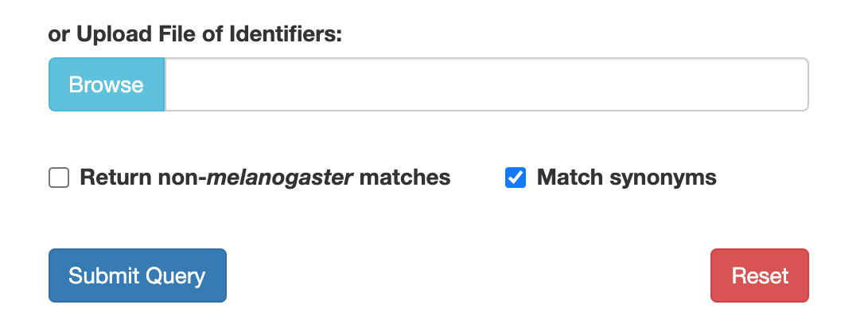
Step 6A: Convert IDs
On Desktop
You can find a copy of cg_transcript.txt in the following location on the VM:
[course_directory]\06_Regulatory_Genomics\cg_transcript.txt
Go to the following link on your VM internet browser:
https://flybase.org/convert/id
Click Browse
Navigate to the location of cg_transcript.txt and click Open
Click Submit Query
On the next page, click all unique validated IDs to download the file of converted IDs.
Note that the downloaded file is named “FlyBase_IDs.txt” and will be in the Downloads folder.

Slide 37
1
2
3
CHIP-seq peaks (Binding sites of a TF)
Selected ChIP peaks (100 strong binding sites of the TF)
DNA sequences of selected ChIP peaks
TF Motif inferred from selected ChIP peaks
MEME
5
Genes near ChIP peaks
Genes near ChIP peaks (converted IDs)
Gene Ontology terms enriched in genes near ChIP peaks
DAVID
6
7

Slide 38
Step 7A: Gene Set Enrichment - DAVID
With our correct ids of transcripts of genes near ChIP peaks, we now wish to perform a gene set enrichment analysis on various gene sets.
A tool that allows us to do this from a web interface is DAVID located at the following address (use your VM internet browser to go to this link):
https://david-d.ncifcrf.gov/summary.jsp

Slide 39
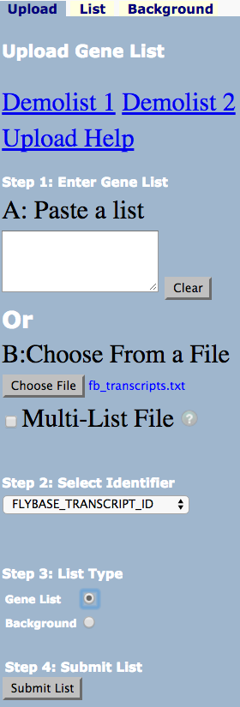
Step 7B: Gene Set Enrichment - DAVID
We will perform a Gene Set Enrichment Analysis on our transcript list (gene list) and see what GO categories are enriched in this set.
Analyze the gene list with Functional Annotation Tool
Click Choose File and select “FlyBase_IDs.txt” from Downloads folder.
If you were not able to download FlyBase_IDs.txt in the previous step:
Note that a copy of “FlyBase_IDs.txt” has already been copied to the following directory, you can instead use that file in this step: [course_directory]\06_Regulatory_Genomics\
Under Select Identifier select FLYBASE_TRANSCRIPT_ID.
Under Step 3: List Type check Gene List.
Click Submit List.

Slide 40
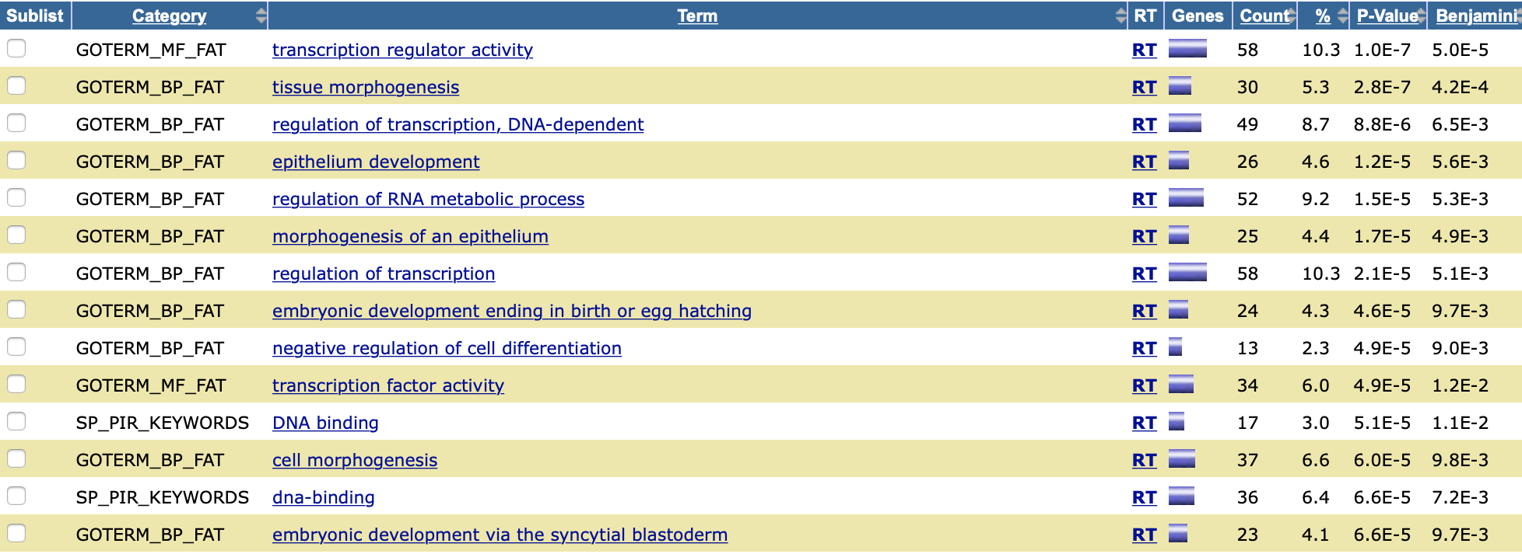
Step 7C: Gene Set Enrichment - DAVID
On the next page, select Functional Annotation Chart.
Our gene set seems to be enriched in the transcription regulator activity Go term
This is consistent with the activity of BIN transcription factor in the literature:
https://flybase.org/reports/FBgn0045759#gene_ontology_section_sub

