Slide 1
Introduction to RNA-Seq & Transcriptome Analysis
Jessica Holmes
PowerPoint by Shayan Tabe Bordbar
RNA-Seq Lab | 2020

Slide 2
Introduction
In this lab, we will do the following:
On the IGB Biocluster:
Use STAR to align RNA-Seq reads to mouse genome.
Use featureCounts to count the reads.
Use multiqc to assess the quality of alignment.
Use edgeR to find differentially expressed genes.
On the Virtual Machine:
View and inspect the results of differential expression analysis.
Visualize our results on the desktop using the Integrative Genomics Viewer (IGV) tool.

Slide 3
Step 0A: Start the VM
Follow instructions for starting VM. (This is the Remote Desktop software.)
The instructions are different for UIUC and Mayo participants.
Instructions for UIUC users are here: http://publish.illinois.edu/compgenomicscourse/files/2020/06/SetupVM_UIUC.pdf
Instructions for Mayo users are here:
http://publish.illinois.edu/compgenomicscourse/files/2020/06/VM_Setup_Mayo.pdf

Slide 4
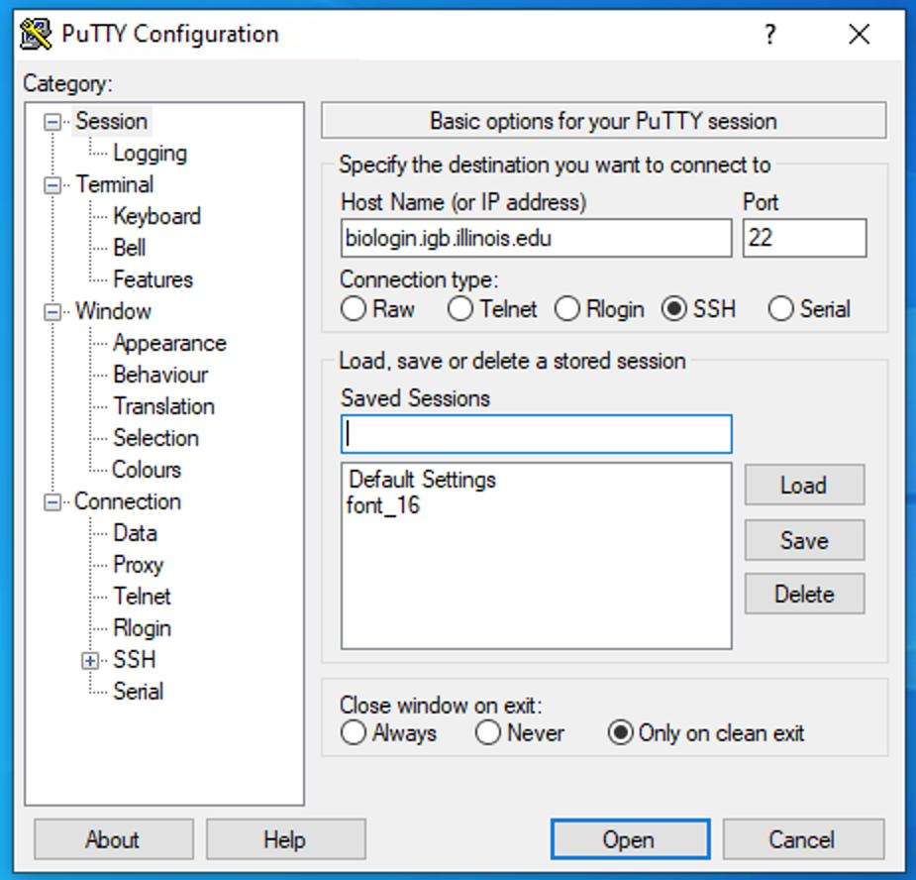
Step 0B: Accessing the IGB Biocluster
Open Putty.exe
In the hostname textbox type:
biologin.igb.illinois.edu
Click Open
If popup appears, Click Yes
Enter login credentials assigned to you; example, user class00.
Now you are all set!

Slide 5
Step 0C: Lab Setup
In PuTTY
The lab is located in the following directory:
/home/classroom/mayo/2020/mouse-rnaseq-2020/
Following commands will copy a shell script -designed to prepare the working directory- to your home directory. Follow these steps to copy and then submit the script as a job to biocluster:
$ cd ~/
# Note ~ is a symbol in Unix paths referring to your home directory
$ cp /home/classroom/hpcbio/mayo-rnaseq/mouse-rnaseq-2020/src/Mayo-RNASeq/prep-directory.sh ./
# Copies prep-directory.sh script to your working directory.
$ sbatch prep-directory.sh
# submits a job to biocluster to populate your home directory with necessary files
$ squeue -u <userID> # to check the status of the submitted job
Notes:
This directory contains the data and results from the finished version of the lab (i.e. the version of the lab after the tutorial). Consult it if you unsure about your runs. You don’t have write permissions to the lab directory.

Slide 6
Step 0D: Working directory: data
Navigate to the created directory for this exercise and look what data folder contains.
$ cd mouse-rnaseq-2020
$ ls
# output should be:
# data results src
$ ls data/
# genome rawseq
$ ls data/rawseq
$ ls data/genome
File name | Time points | Replicate # | # Reads
a_0.fastq b_0.fastq | TP0 | 1 2 | ~ 1 million
a_8.fastq b_8.fastq | TP8 | 1 2 | ~ 1.1 million
Name | Description
mouse_chr12.fna | Fasta file with the sequence of chromosome 12 from the mouse genome
mouse_chr12.gtf | GTF file with gene annotation, known genes

Slide 7
Step 0E: Working directory: scripts
Navigate to the directory containing the scripts and look what’s inside.
$ cd ~/mouse-rnaseq-2020/src
$ ls *.sh *.R
# lists the scripts to be used in this lab:
# edgeR.sh multiqc_summary.sh STAR-index-mouse-genome.sh featureCounts.sh
# prep-directory.sh stats_edgeR.R makeTargetsFinal.R STAR-alignment.sh

Slide 8
Pipeline Overview
v

Slide 9
Step 1: Alignment using STAR
.
In this exercise, we will be aligning RNA-Seq reads to a reference genome.

Slide 10
Step 1A: Create a STAR index of the mouse genome (chromosome 12 only)
In this step, we will start a genome index generation job using the sbatch command.
Additionally, we will gather statistics about our job using the squeue command.
Run the following command (colored black):
$ sbatch STAR-index-mouse-genome.sh
# This will execute STAR-index-mouse-genome.sh on the biocluster.
# OUTPUT in ~/mouse-rnaseq-2020/data/genome/
# STAR-2.7.3a_mouse-chr12_Index/
$ squeue –u <userID>
# Get statistics on your submitted job
# This job takes 3-5 mins to complete.

Slide 11
Please do not try to Run the commands in this slide. This is just to explain what the script that we just ran (STAR-index-mouse-genome.sh ) is supposed to do in more detail.
What’s inside the STAR-index-mouse-genome.sh script?
#!/bin/bash
#SBATCH -N 1
#SBATCH -n 2
#SBATCH --mem 32G
#SBATCH -J make.index
#SBATCH -p classroom
# load the tool environment
module load STAR/2.7.3a-IGB-gcc-8.2.0
cd ~/mouse-rnaseq-2020/
mkdir -p data/genome/STAR-2.7.3a_mouse-chr12_Index/
STAR --runThreadN $SLURM_NTASKS \
--runMode genomeGenerate \
--genomeDir data/genome/STAR-2.7.3a_mouse-chr12_Index \
--genomeFastaFiles data/genome/mouse_chr12.fna \
--limitGenomeGenerateRAM 32000000000 \
--genomeSAindexNbases 12 \
--outTmpDir /scratch/$SLURM_JOB_ID
Tells the cluster ‘job manager’ what resources you want (1 Core, 32GB memory, run on the ‘classroom’ nodes, and name the job ‘make.index’
Load the software. We are using a tool called ‘STAR’ to create an index for chr12 of mm9 mouse genome.
Change and make directory to store the index.
Run STAR tool in ‘genomeGenerate’ mode.

Slide 12
Step 1B: Align sequences using the created index
In this step, we will align sequences from fastq files to the mouse genome using STAR.
Run the following command (colored black):
$ sbatch STAR-alignment.sh
# This will execute STAR-alignment.sh on the biocluster.
# OUTPUT in ~/mouse-rnaseq-2020/results/star/
$ squeue –u <userID> # to check the status of the submitted job
# This job takes 2-4 mins.
$ more STAR-alignment.sh
# Take a look at the script
# press “space” to go to the next page when using more

Slide 13
Please do not try to Run the commands in this slide. This is just to explain what the script that we just ran (STAR-alignment.sh ) is supposed to do in more detail.
What’s inside the STAR-alignment.sh script?
#!/bin/bash
#SBATCH -N 1
#SBATCH -n 2
#SBATCH --mem 16G
#SBATCH --job-name=align_star
#SBATCH -p classroom
#SBATCH --array=1-4%2
# load the tool environment
module load STAR/2.7.3a-IGB-gcc-8.2.0
cd ~/mouse-rnaseq-2020/
mkdir -p results/star
STAR --runThreadN $SLURM_NTASKS \
--genomeDir data/genome/STAR-2.7.3a_mouse-chr12_Index \
--readFilesIn data/rawseq/${line}.fastq \
--sjdbGTFfile data/genome/mouse_chr12.gtf \
--outFileNamePrefix results/star/${line}_ \
--limitGenomeGenerateRAM 32000000000 \
--outSAMtype BAM SortedByCoordinate \
--outTmpDir /scratch/${SLURM_JOB_ID}_${SLURM_ARRAY_TASK_ID}
module load SAMtools/1.10-IGB-gcc-8.2.0
samtools index results/star/${line}_Aligned.sortedByCoord.out.bam
Tells the cluster ‘job manager’ what resources you want (1 Core, 16GB memory, run on the ‘classroom’ nodes, and name the job ‘align_star’. Runs two samples at a time.
Load the software. We are using a tool called ‘STAR’ to align fastq reads to mouse chr12 genome.
Change and make directory to store the alignment results.
Run STAR tool in ‘alignReads’ (default) mode. Options are described in the next slide.
Load SAMtools software to generate index bam files for visualization with IGV
Run ‘samtools index’ for all created alignment files.

Slide 14
Step 1B: Align sequences using the created index
Please do not try to Run the commands in this slide. This is just to explain what are the arguments for running STAR.
Here we go over the essential arguments to use with STAR for aligning sequences in fastq files.
STAR --runThreadN $SLURM_NTASKS \# number of threads
--genomeDir data/genome/STAR-2.7.3a_mouse-chr12_Index \
# path to the indexed genome folder
--readFilesIn data/rawseq/${line}.fastq \
# path to the input fastq file
--sjdbGTFfile data/genome/mouse_chr12.gtf \ # path to the gtf file
--outFileNamePrefix results/star/${line}_ \
# prefix to be used in the names of outputs
--outSAMtype BAM SortedByCoordinate # TYPE OF OUTPUT

Slide 15
Step 1C: Output of STAR alignment Job
You should have 6 outputs per input fastq file when the job is completed.
Discussion
What did we just do?
Using STAR, we created an index for chr12 of mouse genome and aligned input fastq files.
Files
*.Aligned.sortedByCoord.out.bam
*_Log.final.out
*_Log.out
*_Log.progress.out
*_SJ.out.tab
*_STARgenome/
Where are these files located? type the following command to see them:
ls ~/mouse-rnaseq-2020/results/star
Notes:
Periodically, call squeue to see if your job has finished.

Slide 16
Step 2: Read aligned counts
Use featureCounts to generate the aligned counts for each of the bam files generated in step 1.

Slide 17
Step 2A: Counting reads
featureCounts is a part of Subread module.
It takes alignment files (BAM, SAM), along with an annotation file (GTF file here) and counts the number of reads in the alignment that are associated to specified features in the annotation file.
$ sbatch featureCounts.sh
# OUTPUT in ~/mouse-rnaseq-2020/results/featureCounts/
$ squeue –u <userID> # to check the status of the submitted job
# This job takes 1-4 mins.
$ more featureCounts.sh
# Take a look at the script

Slide 18
Please do not try to Run the commands in this slide. This is just to explain what the script that we just ran (featureCounts.sh) is supposed to do in more detail.
What’s inside the featureCounts.sh script?
#!/bin/bash
#SBATCH -N 1
#SBATCH -n 1
#SBATCH --mem 8G
#SBATCH --job-name=counts
#SBATCH --array=1-4
#SBATCH -p classroom
# load the tool environment
module load Subread/2.0.0-IGB-gcc-8.2.0
cd ~/mouse-rnaseq-2020/
mkdir -p results/featureCounts
featureCounts -T 1 -s 2 -g gene_id -t exon \
-o results/featureCounts/${line}_featCounts.txt \
-a data/genome/mouse_chr12.gtf \
results/star/${line}_Aligned.sortedByCoord.out.bam
Tells the cluster ‘job manager’ what resources you want (1 Core, 8GB memory, run on the ‘classroom’ nodes, and name the job ‘counts’. Runs 4 samples at a time.
Load the software. We are using ‘featureCounts’ tool from ‘Subread’ toolkit to count the reads assigned to genomic regions.
Change and make directory to store the count results.
Run featureCounts tool. Options are described in the next slide.

Slide 19
Step 2A: Counting reads
Please do not try to run the commands in this slide. This is just to explain what are the arguments for running featureCounts.
Here we go over the essential arguments to featureCounts.
featureCounts -T 1 \ # number of threads
-s 2 \ # use reverse strand (use -s 1 for forward strand)
-t exon \ # -t option describes the "feature" that this #software will look for in our GTF file
-g gene_id \ # The -g option describes the "meta-feature" #that should also be present in our GTF.
-o results/featureCounts/${line}_featCounts.txt \
-a data/genome/mouse_chr12.gtf \# path to the gtf file
results/star/${line}_Aligned.sortedByCoord.out.bam # path to the #alignment file
Notes:
Once, featureCounts counts all the reads aligning to exons, it will group those counts by "gene_id" (i.e. by gene). "gene_id" is often chosen as a meta-feature# for the -g option because it usually describes an ID that is unique for every gene in GTF files

Slide 20
Step 2B: Output of featureCounts
You should have 2 outputs per input fastq file when the job is completed.
Files
1. *.txt
2. *.txt.summary
Where are these files located? type the following command to see them:
ls ~/mouse-rnaseq-2020/results/featureCounts
Run the following command to take a look at one of the output files:
$ more ~/mouse-rnaseq-2020/results/featureCounts/a_0_featCounts.txt.summary
# take a look at one of the summary output files
Notes:
Periodically, call squeue to see if your job has finished.
results/featureCounts/${

Slide 21
Step 3: Using MultiQC to generate quality report
Now we will use MultiQC to assess the quality of alignments and to collate STAR and featureCounts numbers.
We will also use a R script to generate plots on read mappings.

Slide 22
Step 3A: MultiQC
We will use multiqc tool to summarize the results from STAR and featureCounts.
$ sbatch multiqc_summary.sh
$ squeue –u <userID> # to check the status of the submitted job
# This job takes ~ 1 minute.
# OUTPUT in ~/mouse-rnaseq-2020/results/
# multiqc_report.html ReadFatePlot.jpeg Targets_Final.txt
# we will analyze the results on VM
Note that the files generated by multiqc_summary.sh script have already been copied to [course_directory]\04_Transcriptomics\
on the VM for visualization.

Slide 23
Please do not try to Run the commands in this slide. This is just to explain what the script that we just ran (the multiqc_summary.sh) is supposed to do in more detail.
What’s inside the multiqc_summary.sh script?
#!/bin/bash
#SBATCH -N 1
#SBATCH -n 1
#SBATCH --mem 8G
#SBATCH --job-name=multiqc
#SBATCH -p classroom
# load the tool environment
module load MultiQC/1.7-IGB-gcc-8.2.0-Python-3.7.2
cd ~/mouse-rnaseq-2020/results
multiqc ./
# load the tool environment
module purge
module load R/3.6.0-IGB-gcc-8.2.0
Rscript ../src/makeTargetsFinal.R
Tells the cluster ‘job manager’ what resources you want (1 Core, 8GB memory), run on the ‘classroom’ nodes, and name the job ‘multiqc’.
Load the MultiQC module.
Change directory to results.
Run multiqc on the results directory.
Unload all modules. Then load R module.
Run makeTargetsFinal.R script. This R script creates visualizations on the fate of sequencing reads. can use Linux ‘more’ command to view the script.

Slide 24
Local Files (for UIUC users)
For viewing and manipulating the files needed for this laboratory exercise, denote the path C:\Users\IGB\Desktop\VM on the VM as the following:
[course_directory]
We will use the files found in:
[course_directory]\04_Transcriptomics\

Slide 25
Local Files (for mayo clinic users)
For viewing and manipulating the files needed for this laboratory exercise, denote the path C:\Users\Public\Desktop\datafiles on the VM as the following:
[course_directory]
We will use the files found in:
[course_directory]\04_Transcriptomics\

Slide 26
Step 3A: MultiQC
On Desktop
Navigate to the following directory on your VM:
[course_directory]\04_Transcriptomics\
Note that the files generated by multiqc_summary.sh script have already been copied to this directory for convenience.
Open multiqc_report.html

Slide 27
Step 3A: MultiQC

Slide 28
Step 3A: MultiQC

Slide 29
Step 3A: MultiQC

Slide 30
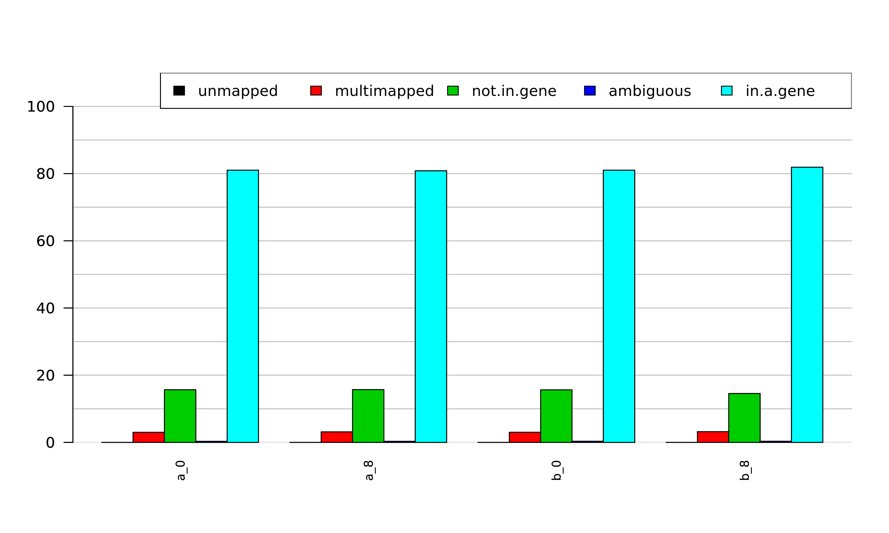
Open ReadFatePlot.jpeg
This file is in the same directory as the previous one:
[course_directory]\04_Transcriptomics\

Slide 31
Step 4: Finding differentially expressed genes
Now we will use edgeR to analyze the count files generated in step 2 to find differentially expressed genes between two time points.

Slide 32
Step 4: Statistical analysis with edgeR
In PuTTY
We run edgeR.sh, that uses an R script “stats_edgeR.R” to perform the statistical analysis and find differentially expressed genes.
We use FDR 0.05 to call differential expression.
$ sbatch edgeR.sh
$ squeue –u <userID> # to check the status of the submitted job
# This job takes ~ 30 seconds.
# OUTPUT in ~/mouse-rnaseq2020/results/edgeR/
# MDSclustering.jpeg NumSigGenes_FDR0.05.csv RawCounts.txt
# t8_vs_t0_AllResults.txt t8_vs_t0_MeanDifferencePlot.jpeg
Note that the files generated by edgeR.sh script have already been copied to [course_directory]\04_Transcriptomics\
on the VM for convenience.

Slide 33
Please do not try to Run the commands form the first grey box. This is just to explain what the script that we just ran (the edgeR.sh) is supposed to do in more detail.
What’s inside the edgeR.sh script?
#!/bin/bash
#SBATCH -N 1
#SBATCH -n 1
#SBATCH --mem 8G
#SBATCH --job-name=edgeR
#SBATCH -p classroom
# load the tool environment
module load R/3.6.0-IGB-gcc-8.2.0
cd ~/mouse-rnaseq-2020/
mkdir -p results/edgeR
Rscript src/stats_edgeR.R
Tells the cluster ‘job manager’ what resources you want (1 Core, 8GB memory), run on the ‘classroom’ nodes, and name the job ‘edgeR’.
Load the R module.
Change and create directory to store results.
Run stats_edgeR.R script. This script performs the differential expression analysis.
$ more stats_edgeR.R
# to view stats_edgeR.R

Slide 34
Exit putty by either closing the window or typing ‘exit’ in the command prompt.

Slide 35
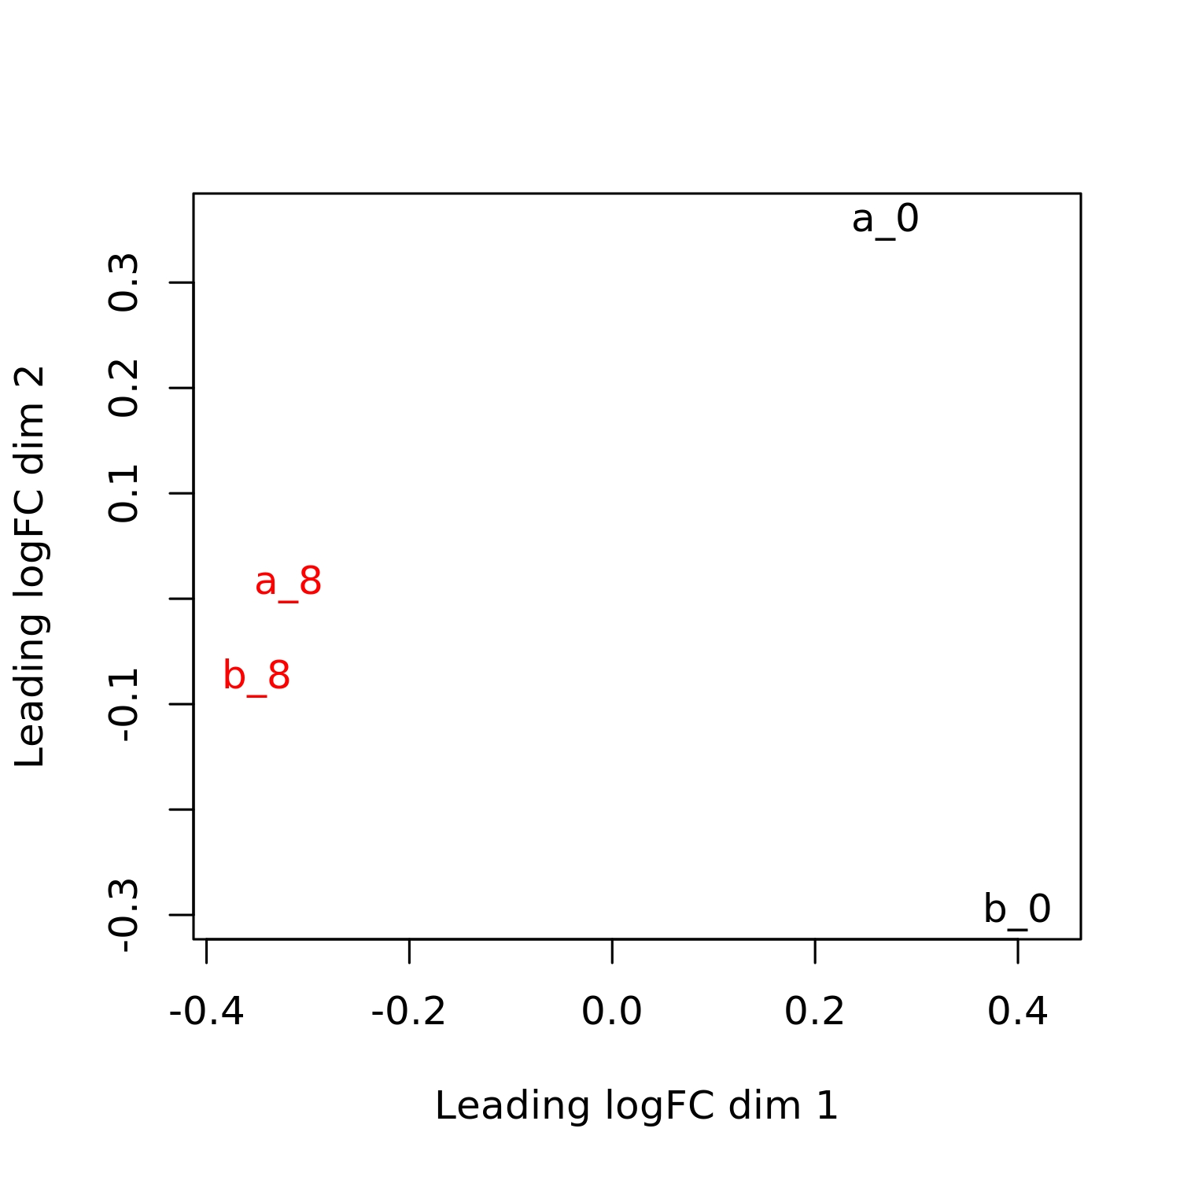
Examining the results
On Desktop
Navigate to the following directory on your VM:
[course_directory]\04_Transcriptomics\
Open MDSclustering.jpeg
Multi Dimensional Scaling is used to identify outliers and batch effects on large number of samples.
We used the top 500 most highly variable genes to construct this plot
Notes:
similar to PCA

Slide 36
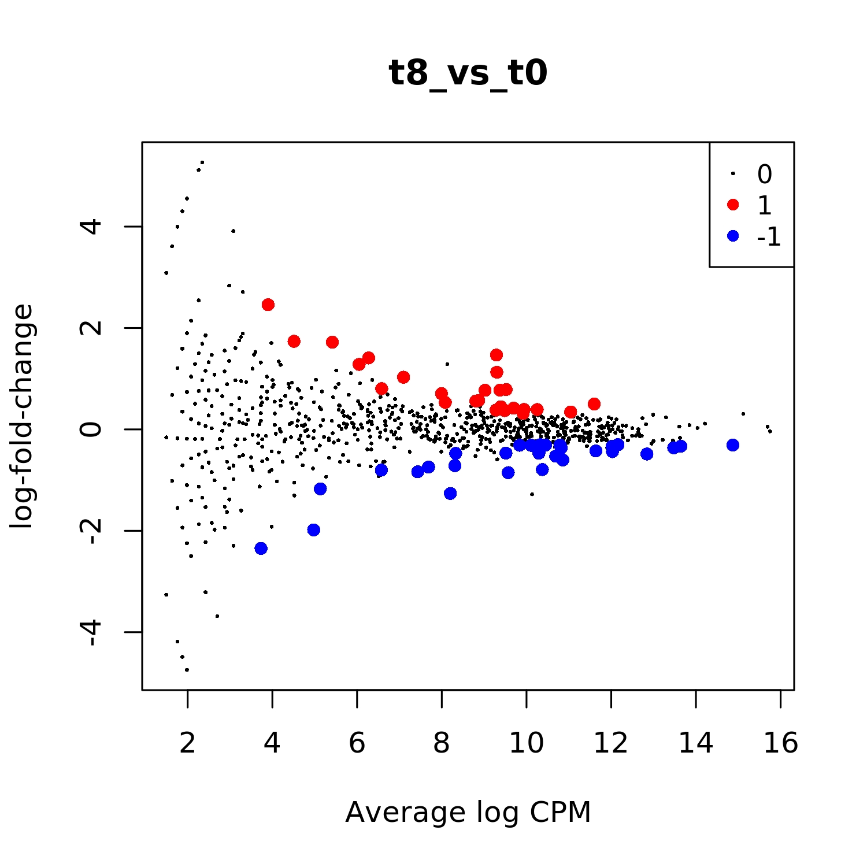
Examining the results
open t8_vs_t0_MeanDifferencePlot.jpeg
Each point in the plot represents a gene.
Upregulated genes are marked with red and down-regulated genes are marked with blue.

Slide 37
Visualization Using IGV
.
The Integrative Genomics Viewer (IGV) is a tool that supports the visualization of mapped reads to a reference genome, among other functionalities. We will use it to observe where hits were called for the alignment for the two samples (TP0 and TP8), and the differentially expressed genes.

Slide 38
Start IGV on Desktop
On Desktop
In this step, we will start IGV to visualize the differential expression for a selected gene.
If IGV is already open from a previous session, just close it and open again by double clicking on the IGV icon on your Desktop.
Graphical Instruction: Load Genome
1. Within IGV, click the ‘Genomes’ tab on the menu bar.
2. Click the the ‘Load Genome from File’ option.
3. In the browser window, Navigate to: [course_directory]\04_Transcriptomics\
4. Select mouse_chr12.fna

Slide 39
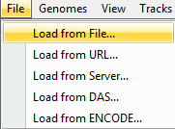
Loading bam and GTF Files
On the menu bar, click File
Click Load from File…
Navigate to: [course_directory]\04_Transcriptomics\
Hold the Ctrl key down.
Click on these files
Click Open.
Files to Load
mouse_chr12.gtf a_0_Aligned.sortedByCoord.out.bam
b_0_Aligned.sortedByCoord.out.bam
a_8_Aligned.sortedByCoord.out.bam
b_8_Aligned.sortedByCoord.out.bam

Slide 40
Resulting window should look like this

Slide 41
Fbln5 is the most significant differentially expressed gene.
You can check this later in:
[course_directory]\04_Transcriptomics\t8_vs_t0_AllResults.txt
Paste Fbln5 here in the IGV window
Press Enter or click Go.

Slide 42
Click on the + sign to zoom in.

Slide 43
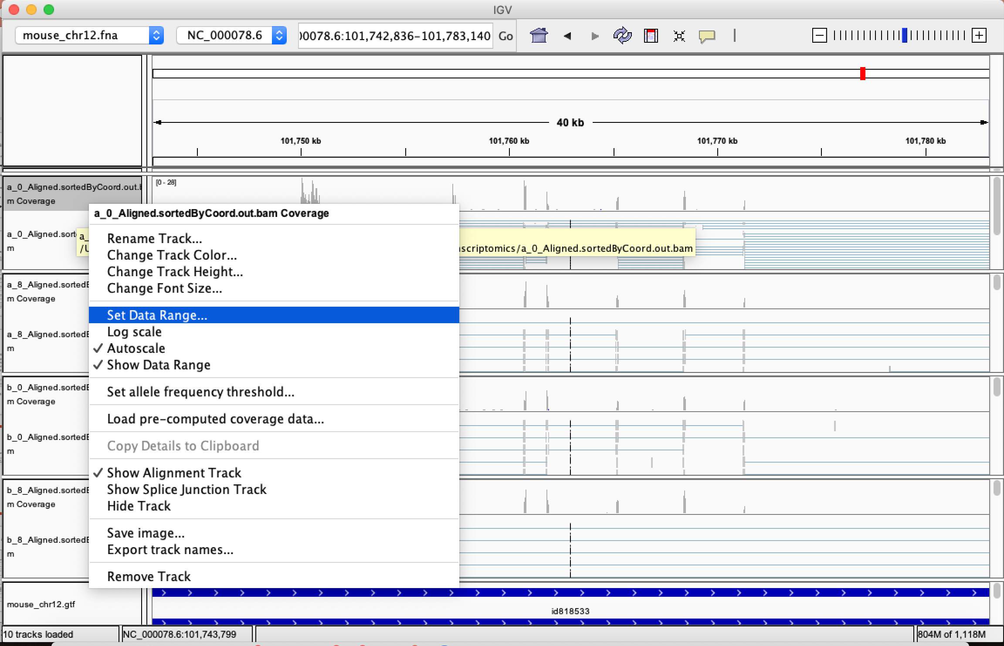
Right click on each coverage panel and click on set Data Range
Set the Max to 100

Slide 44
Look at a differentially expressed gene
The gene appears to be more highly expressed in the TP8 time point in both replicates

