Slide 1
Time & Stress Management
Animal Sciences Graduate Student Association
Mark Layng, LCPC
Embedded Clinical Counselor for the College of ACES
mlayng@illinois.edu

Slide 2
Personal Relationships
Tests, Research, Homework
Authority figures
If you had to pick 1 area of your life…..
where is your stress most invasive?
Pubic speaking/presentations
Future Success

Slide 3
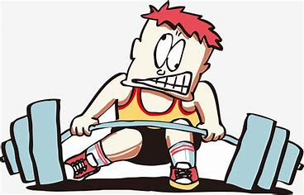
Pressure to Stress… and back again
Too much weight
(classes, homework, social events)
Poor form
(Study/social skills, motivation)

Slide 4
Managing your Emotions
Utilizing your Mind
Developing your Behaviors

Slide 5
The Duality of Thinking and Feeling

Slide 6
Developing your Behaviors
Repetition – Muscle memory
Clear pattern
Determination

Slide 7
The Reluctant Relationship
Limited involvement
Only when it is in our best interest
Limited Power
Just enough to motivate our behavior toward the goal.

Slide 8
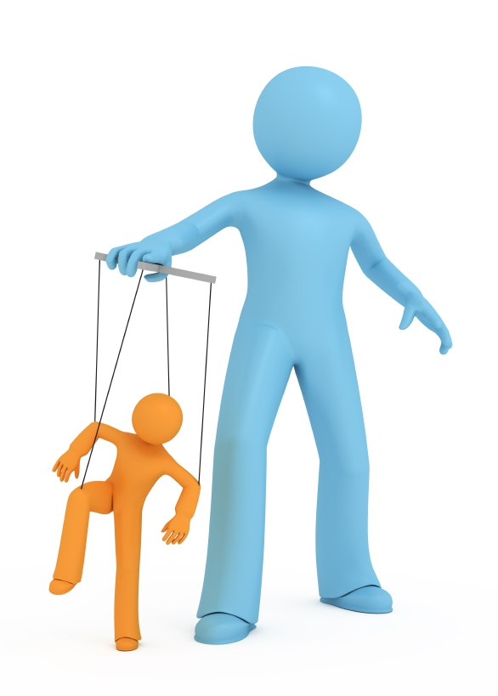
The Regretful Relationship
Invasive
Overpowering
Resulting in feelings of helplessness and being out of control.
FEAR
me

Slide 9
Changing my internal state
Share it OUT LOUD (breathing: exhale to inhale)
Run/Walk/Dance/Aerobic workout
(Burn off anxious energy)
5 – 4 – 3 Things you see, hear and feel
(mindfulness)
Music Soothing, Motivating
(elevating other emotions)
Meditation (Calming body, heart and mind
Hugs (Physical connection)
Journaling Joy (Countering fear)
Assess To Do Lists (Limits/boundaries)

Slide 10
Skill Development Resources
Daily Mindfulness: COVID-19 and the need to isolate has added another layer of stress to our lives. Every weekday, we offer a brief, guided mindfulness exercise online to help you learn strategies to focus and calm anxiety.
In Focus: Assists students who have ADHD or ADHD-like symptoms.
Perfectionism: Focuses on recognizing when perfectionistic tendencies can be harmful and how to implement coping strategies to better manage.
RIO: Offers students a chance to develop skills to recognize and understand their emotions and use mindfulness principles to regulate emotions and determine what changes they'd like to make in their lives. RIO stands for recognition, insight, and openness.
Test Anxiety: This workshop discusses effective ways to manage test anxiety and perform better on exams.
Time Management: This workshop will help you reflect on how you prioritize, learn task-management and motivation strategies, and understand the importance of self-care and allowing yourself breaks.
Tuesday@7: Presented by Counseling Center Paraprofessionals. These peer-facilitated workshops focus on "Students Helping Students" by enhancing mental health, well-being, and success.

Slide 11
Questions?.....and feedback.
mlayng@illinois.edu

Slide 12
www.counselingcenter.illinois.edu/outreach-and-prevention/outreach-series/daily-mindfulness-drop-ins
www.counselingcenter.illinois.edu/InFocus
www.counselingcenter.illinois.edu/outreach-and-prevention/outreach-series/perfectionism-series
www.counselingcenter.illinois.edu/RIO
www.counselingcenter.illinois.edu/TestAnxiety
www.counselingcenter.illinois.edu/TimeManagement
www.counselingcenter.illinois.edu/node/190
https://surveys.illinois.edu/sec/1052643612

